Slide 1
RICSA-StockMarketInsight

Slide 2
To build a Visual Analytics Platform that helps the users to easily get information about any Selected company ,
How they are performing and their Historical Stock Price?
How Users are reacting to company at that time?
News Headlines of the Company.
Get All Related News Articles on selected Ticker and Summarized News using NLP in one table.
Corelate News Headlines and User tweets to see users are tweeting more about some news and their Sentiments.

Slide 3





Tools Used
GitHub: Version Control
Language: Python
Flask: Web framework
Pycharm
IDE
Dash: User interface

Slide 4




STOCKMARKETINSIGHT
Summarized News
Historical Stock Price
Stock News Headlines
News Articles
Stock Twits Sentiment

Slide 5

Real Time Stock Price Data from Yahoo Finance API

Slide 6
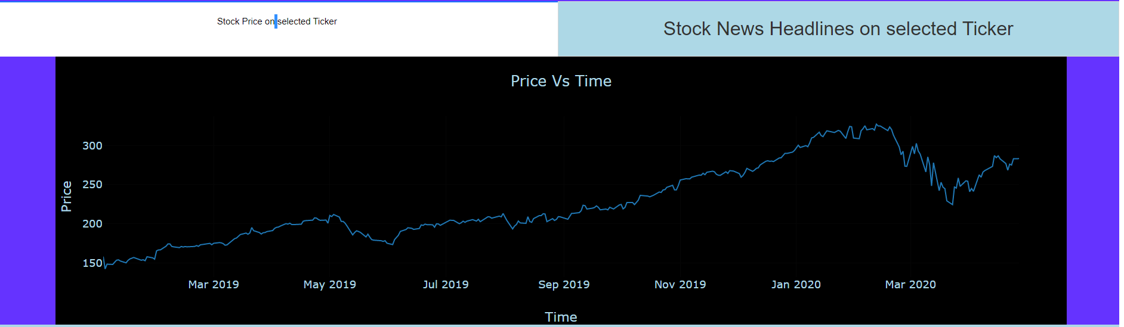
Interactive Historical Stock Price Visualization

Slide 7
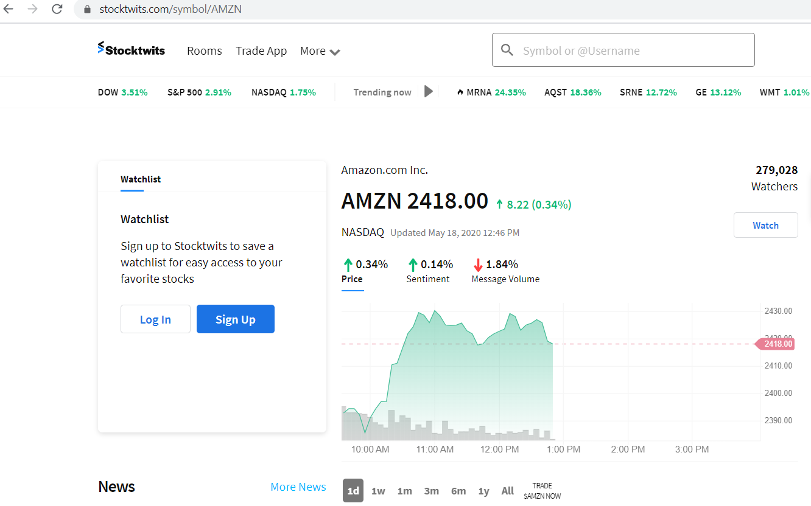
STOCK TWITS
Stock Twits is a platform where actual investors and traders tweet in real time about the stocks.

Slide 8
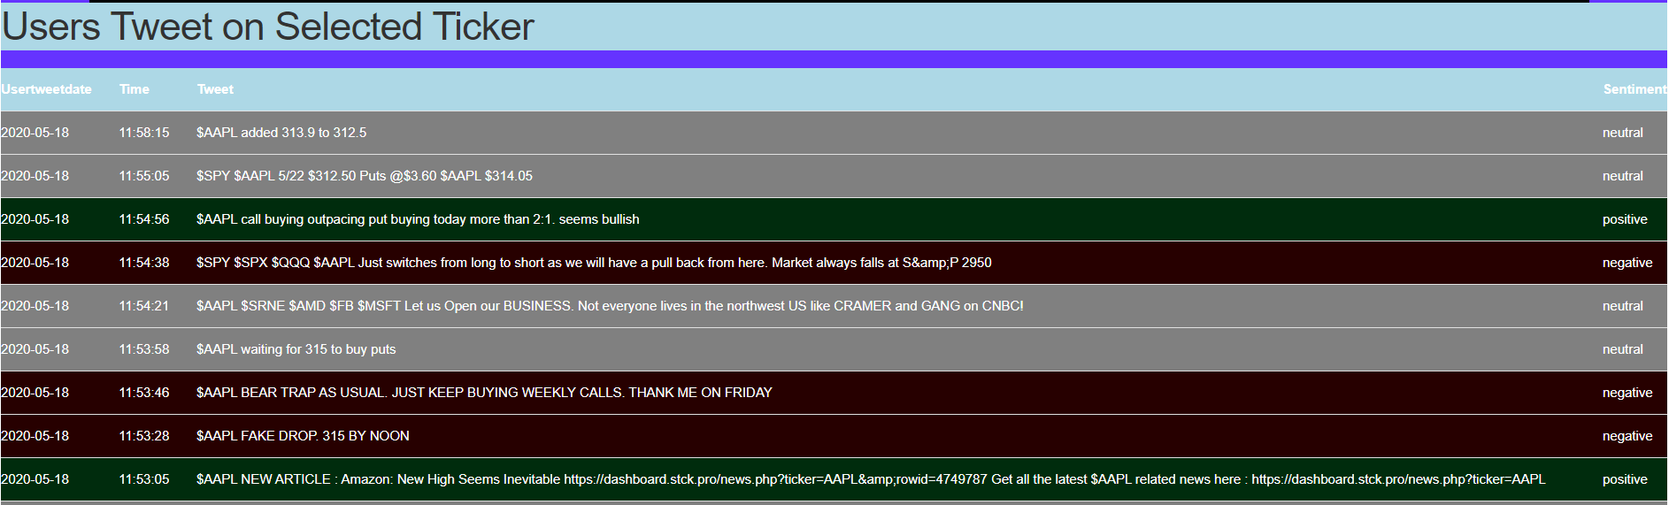
Sentiment Using TextBlob Module

Slide 9
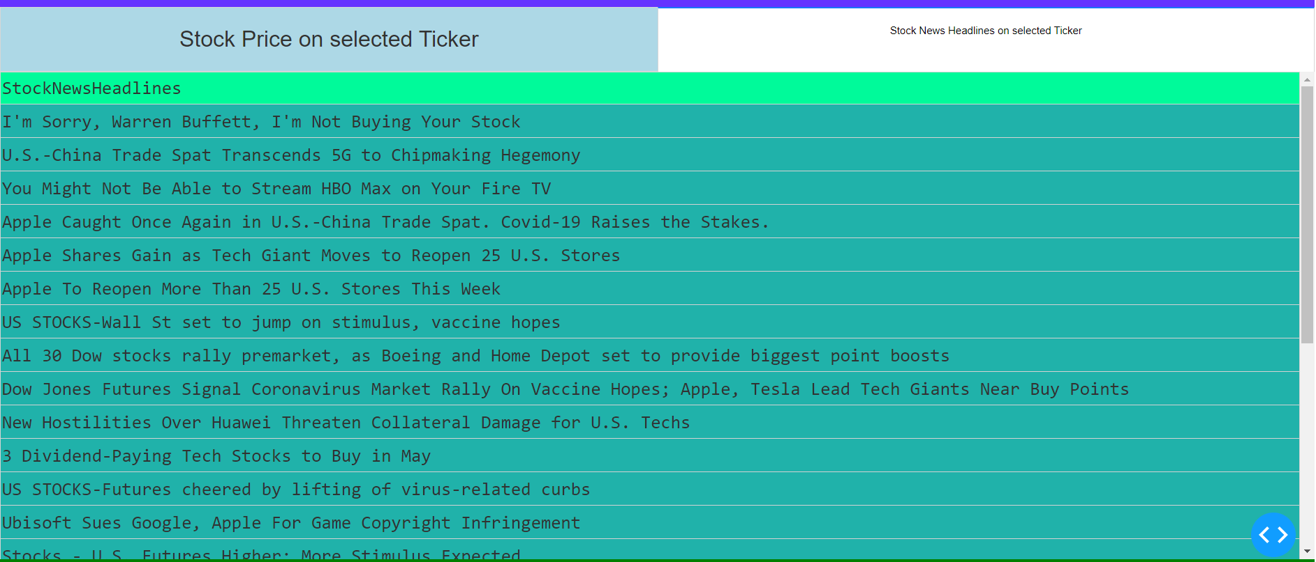
Getting StockNews Headlines from Yahoo Finance

Slide 10
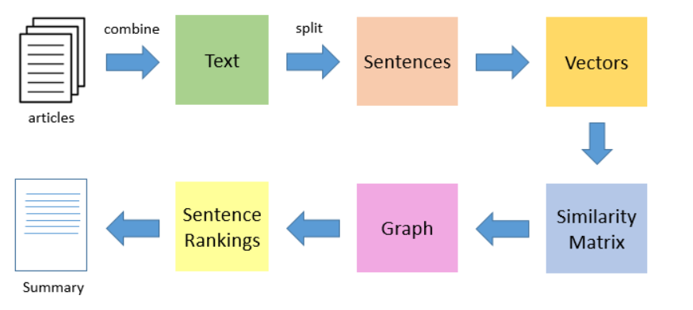
Extractive Summarization:

Slide 11
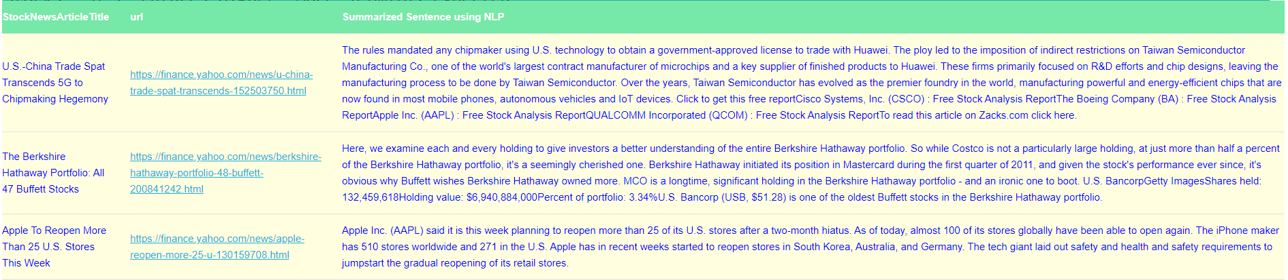
Summarizing News Article using NLP.

Slide 12
CHALLENGES
Text Summarization using Deep Learning(BART) and other Summarization method used takes some time to display summarized article on Dashboard.
Getting Stock Twits Data through requests module has a limit of 30 tweets
FUTURE WORK
Get data through Stock Twits API’S and save all data in Database so that we can see the historical sentiment trend.
Collect the data from News Articles and build a Semantic News Article Search Engine to search the historical relevant articles

Slide 13
Thanks!
Any questions?

