Slide 1
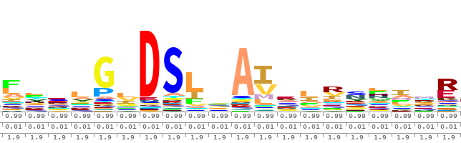
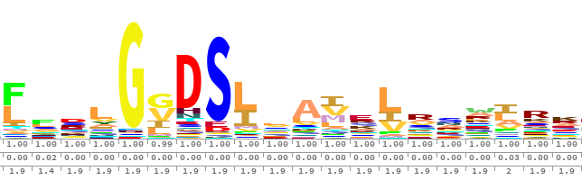
FA
HMM building
NO
X.hmm
Convergence
YES
HMM building
X.hmm
=
?
Sequence enrichment
FA
X-enriched.fa
X-enriched.hmm

Slide 2
FA
NO
HMM building
Protein
database
Convergence
YES
HMM building
=
?
Sequence enrichment
FA
FA
HMM

Slide 3
FA
HMM
FA
X.fa
X.hmm
database.fa
HMM building
Sequence Enrichment
HMM building
usearch (iter 1)
hmmsearch
X_nr.fa
X_new.fa
muscle
merge
X_nr.clw
X_merged.fa
hmmbuild
usearch
HMM
FA
X.hmm
X_enriched_nr.fa

Slide 4
FA
FA
X.fa
X_enriched_nr.fa
HMM building
HMM building
Sequence Enrichment
usearch (iter 1)
usearch
X_nr.fa
muscle
X_merged.fa.tmp
merge
X_nr.clw
hmmbuild
X_new.fa.tmp
hmmsearch
HMM
FA
X.hmm
database.fa

