Slide 1
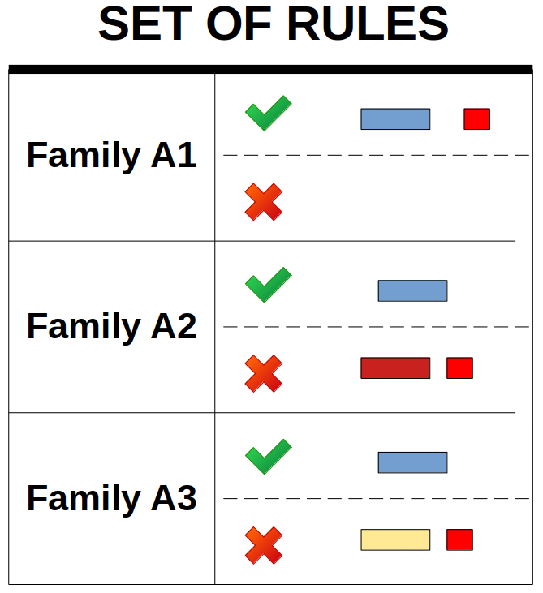


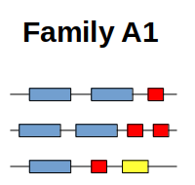
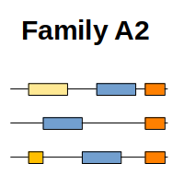
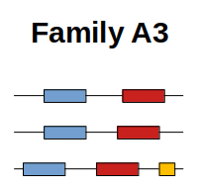
User-defined
set of rules
Protein database
to learn
HMM profile
Protein database
to search proteins by domain architectures
FA
FA
YML
FA
IterHMMBuild
HMM DB
ProSeCDA
FA
FA
FA
FA
PNG
XML
FA
PNG
XML
FA
PNG
XML

Slide 2
User-defined
set of rules
Protein database
to learn
HMM profile
Protein database
to search proteins by domain architectures
FA
FA
YML
FA
IterHMMBuild
HMM DB
ProSeCDA
FA
FA
FA
FA
PNG
XML
FA
PNG
XML
FA
PNG
XML

Slide 3
ANNOTATION
FILTERING
OUTPUT
Protein database
of interest
User-defined
set of rules
FA
FA
PNG
XML
HMM DB
FA
PNG
XML
YML
FA
FA
PNG
XML

Slide 4


User-defined
set of rules
Family A1
FA
Family A2
Family A3
FA
FA
FA
FA
PDF
XML
FA
PDF
XML
FA
PDF
XML

