Slide 1
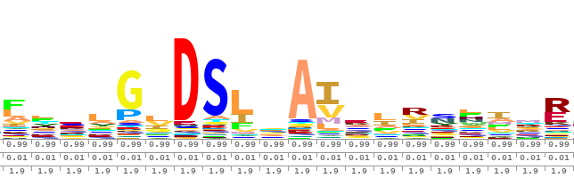
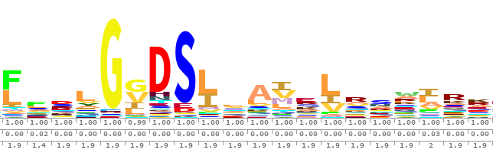
FA
HMM building
NO
X.hmm
Convergence
YES
HMM building
X.hmm
=
?
Sequence enrichment
FA
X-enriched.fa
X-enriched.hmm

Slide 2
FA
NO
HMM building
Protein
database
Convergence
YES
HMM building
=
?
Sequence enrichment
FA
FA
HMM

Slide 3
FA
HMM
FA
X.fa
X.hmm
database.fa
HMM building
Sequence Enrichment
HMM building
usearch (iter 1)
hmmsearch
X_nr.fa
X_new.fa
muscle
merge
X_nr.clw
X_merged.fa
hmmbuild
usearch
HMM
FA
X.hmm
X_enriched_nr.fa

Slide 4
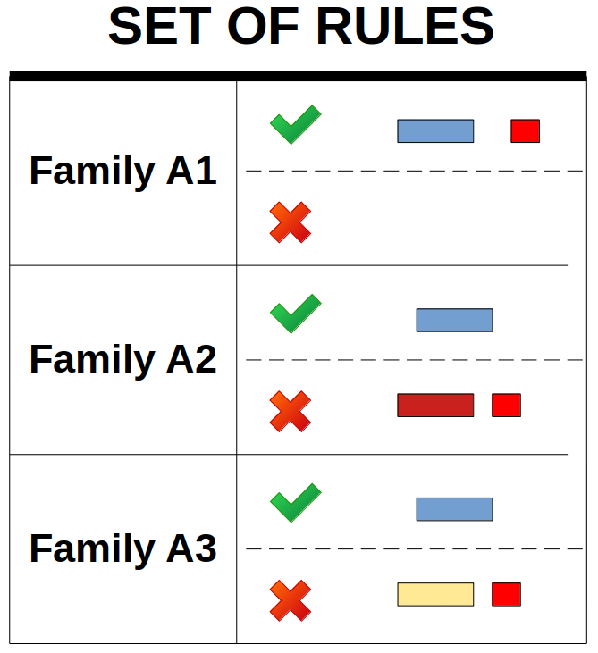


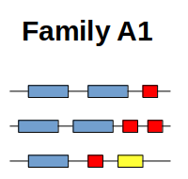
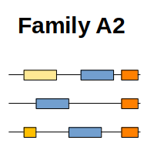
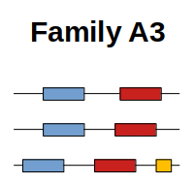
User-defined
set of rules
Protein database
to learn
HMM profile
Protein database
to search proteins by domain architectures
FA
FA
YML
FA
IterHMMBuild
HMM DB
ProSeCDA
FA
FA
FA
FA
PNG
XML
FA
PNG
XML
FA
PNG
XML

Slide 5
FA
FA
X.fa
X_enriched_nr.fa
HMM building
HMM building
Sequence Enrichment
usearch (iter 1)
usearch
X_nr.fa
muscle
X_merged.fa.tmp
merge
X_nr.clw
hmmbuild
X_new.fa.tmp
hmmsearch
HMM
FA
X.hmm
protein
database.fa

