Slide 1
NORP : Structured Project Real Time Systems (CS 6235)
Namyata Cheduri
ncheduri3@gatech.edu

Slide 2
Features Introduced
Role Based Access Control on APIs
Password Encryption
API endpoints on roles and permissions
Database Schemas and Tables

Slide 3
NORP Architecture and Tech Stack
Front End : NextJS, React
Backend: Express and MySQL

Slide 4
PK | Id (ROLE)
 | role_name
 | created_by
 | role_description
belongsTo
belongsToMany
PK | Id (USER)
FK | Role_id
 | username
 | hash
 | salt
 | created_by
 | first_name
 | last_login
 | email
 | is_active
 | is_staff
 | last_name
 | is_superuser
 | date_joined
PK | Id(PERMISSION)
 | permission_name
 | permission_description
 | created_by
 | Permission_on_resource
hasMany
belongsToMany
References
References
PK | Id (RolePermission)
 | role_id
 | Permission_id

Slide 5
API resources, Endpoints and Permissions
RESOURCE NAME: ROLE
GET | /role → Get all roles /role/:id → Get role by role_id | view_role
PUT | /role → updates and existing role | update_role
POST | /role → creates a new role /role:id → Add a permission to role | create_role, update_role
DELETE | /role → Deleted the given role id (body) | delete_role

Slide 6
RESOURCE NAME: PERMISSION
GET | /permission → Get all permissions | view_permission
PUT | /permission → updates and existing permission | update_permission
POST | /permission → creates a new permission | create_permission
DELETE | /permission → Deleted the given permission id (body) | delete_permission

Slide 7
RESOURCE NAME: USER
GET | /user → get user by username in the body | view_user
PUT | /user→ updates and existing user | update_user
POST | /user → creates a new user | create_user
DELETE | /user → Deleted the given user name (body) | delete_user

Slide 8
RESOURCE NAME: GRAPH
GET | /graph → get all graphs | view_graph
PUT | /graph→ updates and existing graph | update_graph
POST | /graph → creates a new graph | create_graph
DELETE | /graph → Deleted the given id(body) | delete_graph

Slide 9
RESOURCE NAME: VIDEO
GET | /video → get all videos | view_video
PUT | /video→ updates and existing video | update_video
POST | /video → creates a new video | create_video
DELETE | /video → Deleted the given id(body) | delete_video

Slide 10
RESOURCE NAME: PUBLICATION
GET | /publication → get all publications | view_publication
PUT | /publication→ updates and existing publication | update_publication
POST | /publication → creates a new publication | create_publication
DELETE | /publication → Deleted the given id(body) | delete_publication

Slide 11
RESOURCE NAME: PEOPLE
GET | /perople → get all people | view_people
PUT | /perople→ updates and existing person record given username | update_people
POST | /perople → creates a new person record | create_people
DELETE | /perople → Deleted the given id(body) | delete_people

Slide 12


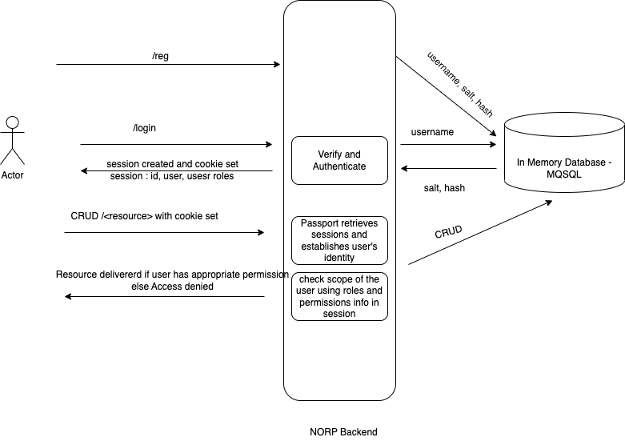



View
Model
Model View Controller
Controller

Slide 13
Future Work
UI for RBAC
Automatic provisioning of permissions for a newly added resource.
Complex interactions among the RBAC endpoints
Unit Tests and Workflow tests to ensure sanity.
Graph Databases

Slide 14
THANK YOU

