Slide 1
Job Salary Analysis Based on Text Classification and Location Feature
Group 11:
Maoxi Li, Chengqi Xie, Qi Wang,
Huiye Huang, Nanzanxuan Chen
April, 27 2022

Slide 2
Outline
Background & Business goal
Data Description
System Design
Data Preprocessing
Statistical Analysis
Text Extraction
Modeling
Evaluation
Conclusion & Insights

Slide 3
Background & Business Goal
Background:
#Determining the “right” compensation can be tricky. Not only is money a touchy subject, but so many factors(e.g., experience, location and skills) play into determining compensation rates that are both fair and competitive. (“5 essential factors for determining compensation”,2022)
Business Goal:
For Company: Analysis appropriate salary
For Job Seeker: Provide salary estimates

Slide 4
Data Description
Dataset sources: Glassdoor
Time: 2019
Data size: 49.2 MB / 15761 Job position
Data Type: Numerical , Categorical & Text(unstructured)
Description of the dataset:
This dataset contains job postings from companies in 49 states for data-related positions, such as Data Scientist, Data Analyst, Data Engineer and Business Analyst. And there are fifteen features in this dataset.
Notes:
Let’s talk about our dataset:
Our data is from glassdoor.
Our data contains more than 15,000 job listings

Slide 5
System Design
Business problem
Identify Goal & Expected Output
Exploratory Data Analysis
Data Preprocessing
Statistical Analysis
Text Extraction
Model Selection
Predict Salary Level
Model Evaluation
Project Conclusion
Notes:
We divided our system into nine steps

Slide 6
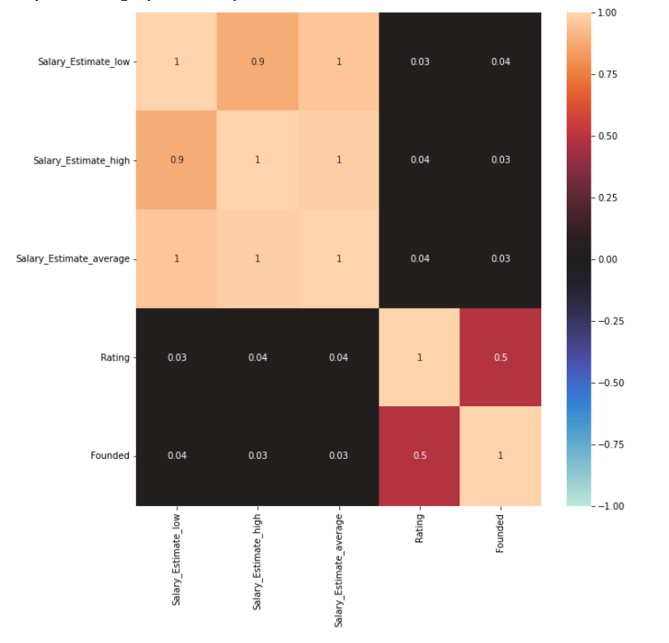
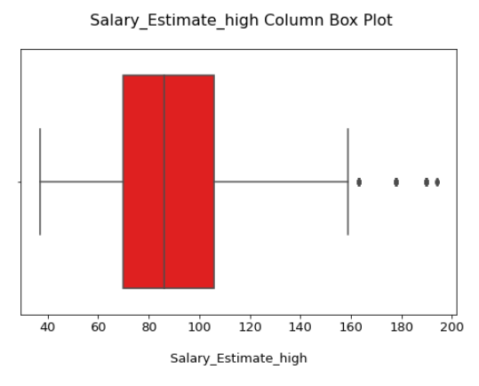
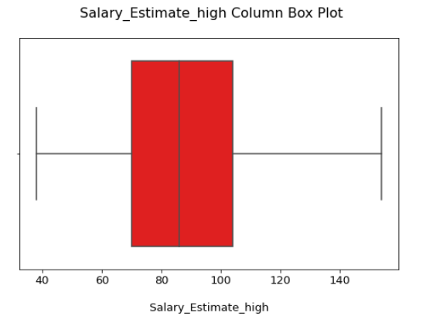
Data Preprocessing
Correlation Matrix to drop irrelative features
Draw salary boxplot for each job titles to find and drop outliers
Feature Creation :
Text extraction, dividing job positions into four job titles: DA, DS, DE and BA
Split the Salary Estimate into 3 different levels of salary e.g.Salary_Estimate_average
Split the Location into Location_city and Location_state
Create low boundary, high boundary column for each job’s salary level
Notes:
For data pre-processing, we created a correlation matrix to drop irrelative features
We aggregated the job titles using text extraction and used outlier formula to identify outliers and eliminate them.
We processed the address information into city and state.
We divide the salary estimates into three levels of income
For data pre-processing, this project used correlation matrix to drop irrelative features. This figure is a numerical features correlation matrix. For nominal features, this project assign different numbers with it to draw nominal features correlation matrix and find out the irrelative features, for example, Headquarters and Industry.
关于feature Location，因为这个feature里面含有city和state两个信息，所以这个项目需要split Location into Location_city and Location_state.
因为整合之后的4个职业的薪资范围差异较大，如果直接将整合的薪资当做base直接用公式去除outliers，出来的结果就没有针对性。所以在这个项目中，先需要对职业进行划分，再对各个职业的薪资范围设置3个区间，例如高预测工资，低预测工资和平均预测工资，然后用4个不同的职业的3个薪资范围区间画出对应的12个箱型图，之后再used outlier formula to identify outliers and eliminate them。

Slide 7
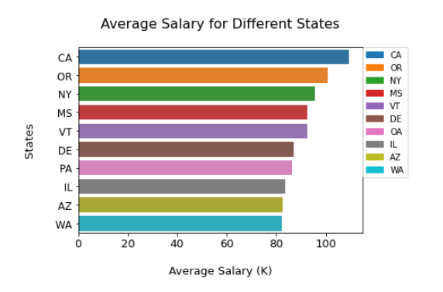
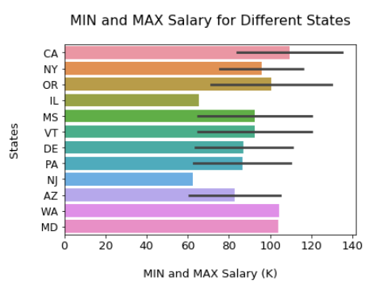
Statistical Analysis
CA, OR and NY are the three states with the highest average salary
Notes:
在这两个图中，第一个是top10average salary 的states，其中CA OR NY这三个states的average salary最高，分析后可以发现10个state中有7个state是沿海state。
第二张图是top 10 MIN & MAX的 salary的states。这张图是以top 10 MIN salary为基底做的，其中MAX salary match了8个state，换句话说就是这8个state同时上榜了MIN & MAX salary，其中的黑线就代表了他们的MIN & MAX的salary区间。彩色的柱状图代表了他们的平均值。从这张图中可以分析出，CA的min和max salary都是最高的，NY的黑线长度比其他州的小，这就说明NY的salary分布会更加集中相对其他州而言。
We created two graphs depicting the top ten average wage states, with California, Oregon, and New York having the highest average salaries. We found ten states in all, with seven of them being coastal states.
The top 10 MIN & MAX salary states are shown in the second graph. The black line shows their MIN & MAX salary interval. in other words, these 8 states are on both the MIN & MAX salary top list.
In this graph, we can see that California has the greatest minimum and maximum salaries, while New York's black line length is shorter than the other states, indicating that New York's income distribution will be more concentrated than the other states.

Slide 8
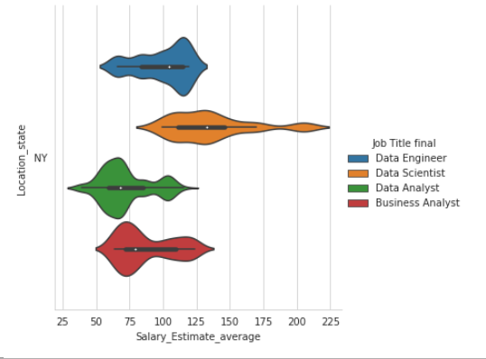
Statistical Analysis
Violin plot for 4 different job titles
Data Scientist's salary range is large
Data Engineer's average salary ranking is the second
Data Analyst and Business Analyst have similar shapes
Notes:
在这个项目对不同的job titles的salary分布进行了更深层次的分析，以NY为例子，利用violin plot将NY的4个job titles的salary分布画出来。
橙黄色是datascientist，由它的分布可以看出它的工资range是很大的，并且它的分布很均匀，它没有一个明显的众数。
DataEngineer的平均工资排名是第二名，通过它的形状我们可以看出它的大部分salary 分布和data scientist有高度重合。
DataAnalyst和BusinessAnalyst的形状相似，且平均工资也靠近，它们的平均工资也是4个jobs里面最少的两个。
总结来说，可以发现4个job titles的salary分布非常不一样，具有显著的区别。
We were particularly interested in the income distribution of various job titles, so we picked New York as an example and used the violin plot to depict the salary distribution of four job titles.
The orange color represents datascientist, we can see that its salary range is wide, and distribution is fairly even, with no clear mode.
The average income of DataEngineer is ranked second, and most of its salary distribution overlaps with data scientist’s.
The average incomes for DataAnalyst and BusinessAnalyst are identical, and their average compensation is likewise the lowest of the four jobs.
We can find that the salary distributions of the 4 job titles have significant differences.

Slide 9
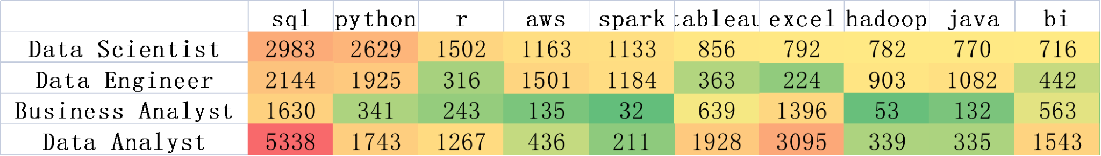
Text Extraction
Skill Requirement
Tokenize text of all job descriptions
Identify and extract top 30+ skills
Generate data frame of top 10 skills for 4 job titles
Notes:
In text extraction section, we focused on the JD column of the data, gaining insights on the requirements of skills, year of experience and degree.
To extract skills, we used Bag-of-words approach tokenizing the text of job descriptions of entire dataset
Based on the observation of tokens frequency and domain knowledge, we identified and extract top 30+ skills
Generate frequency of top 10 skills for 4 job titles
The heat map shows that SQL, Python and R are the top skills in demand.
Cloud computing skills like AWS also add value for candidates.

Slide 10
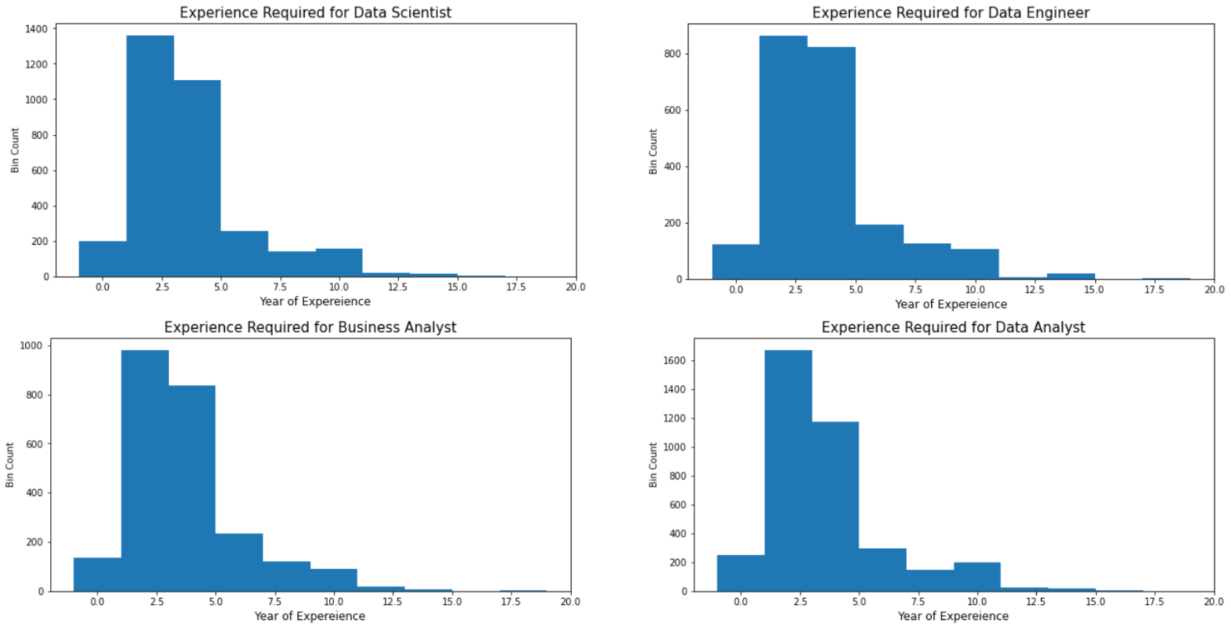
Text Extraction
Year of Experience Required
For each job title:
The distribution is similar.
The average is 4.25, 4.42, 4.29, and 4.17 years respectively.
Notes:
Next, We utilized regular expression to search and locate text strings about ‘year of experience required’ within the JD column.

Slide 11
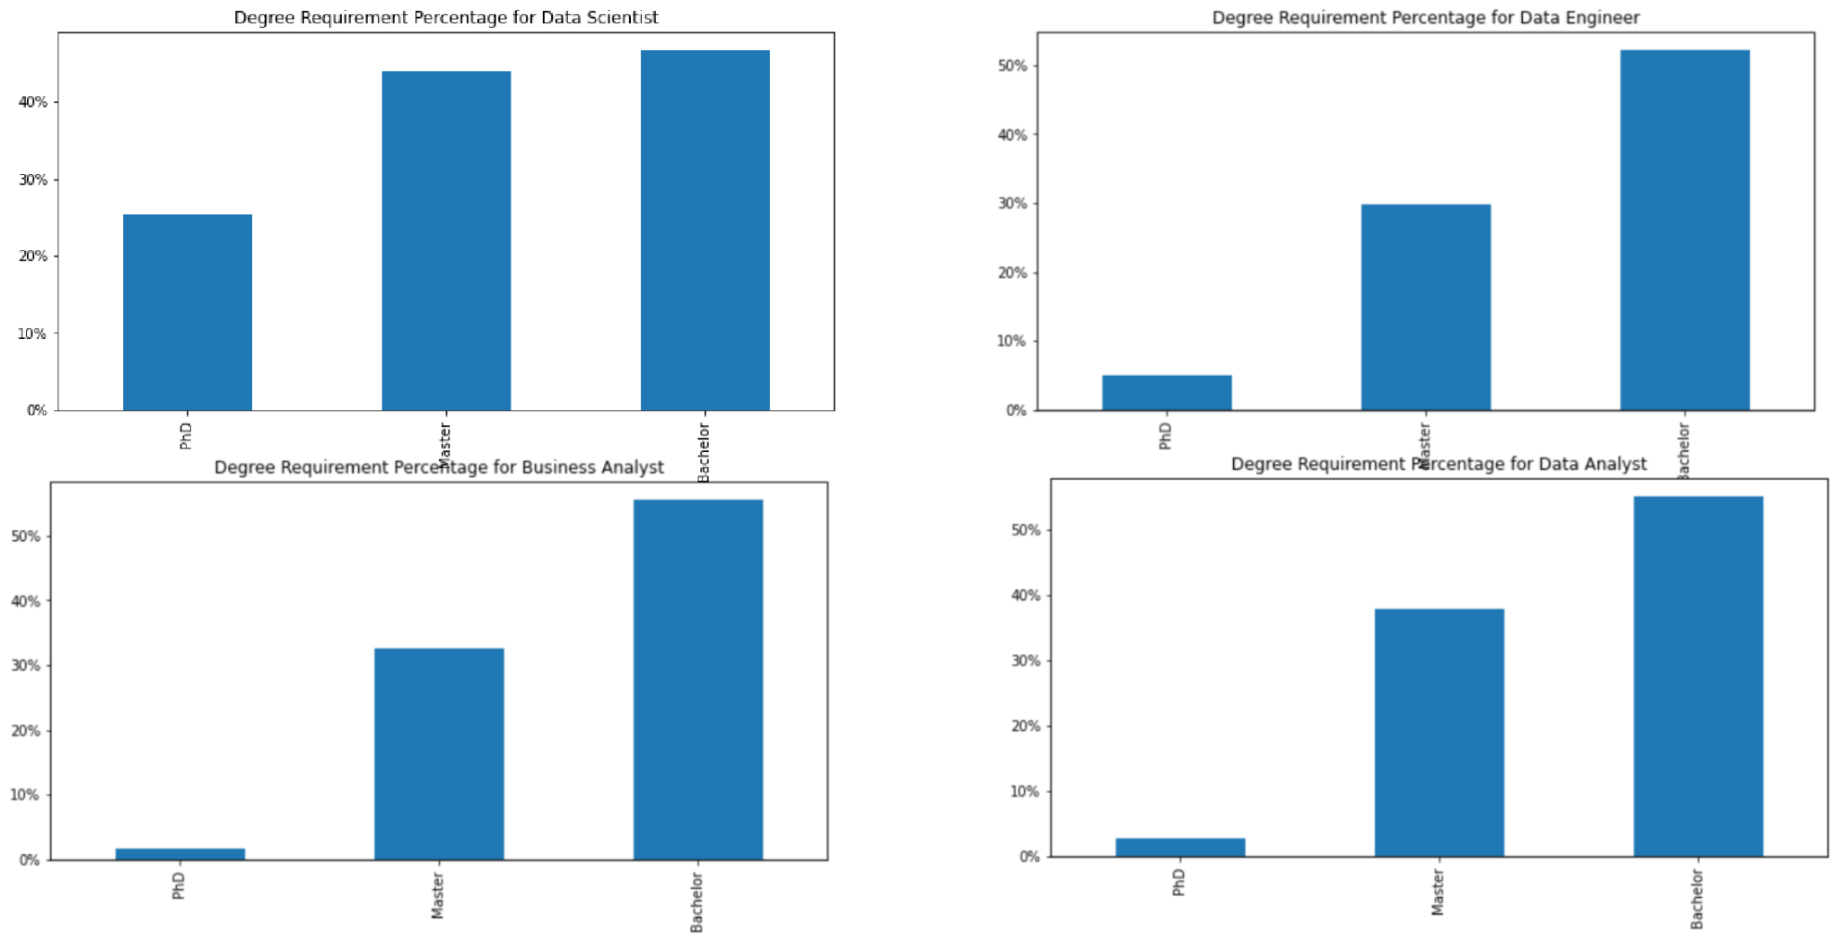
Text Extraction
Degree Requirement
Most jobs prefer a candidate holding a Master’s or Bachelor’s degree.
Data Scientist title could be considered to most technical with the highest percentage of Ph.D degree required.
Notes:
Likewise, RE method is used to extract degree requirement.

Slide 12
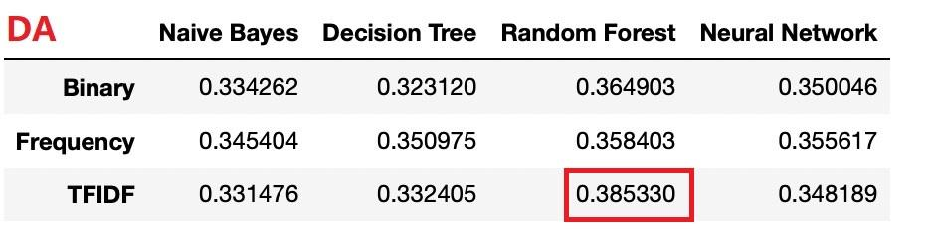
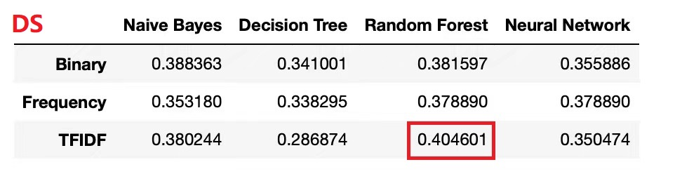
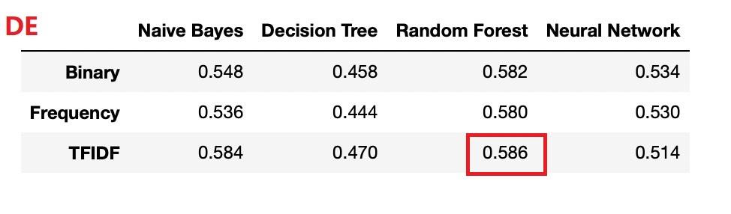
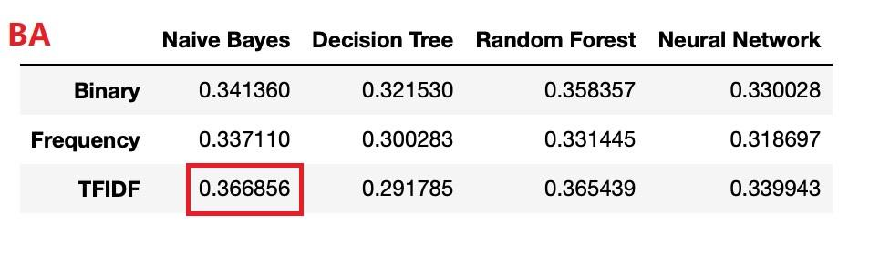
Modeling
Model 1:
Only use text extracted from job description as the feature to predict 4 job titles’ salaries separately
Performance is relatively poor for all 4 job titles
Average accuracy between 0.35 - 0.4

Slide 13
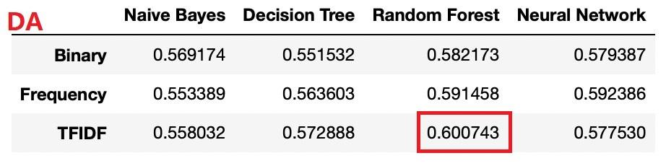
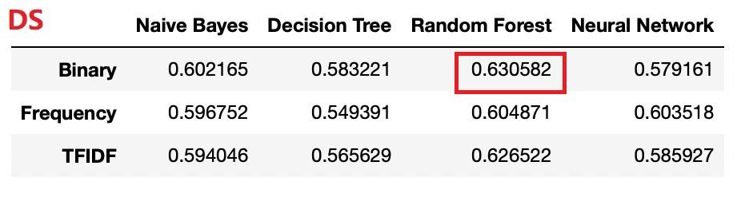
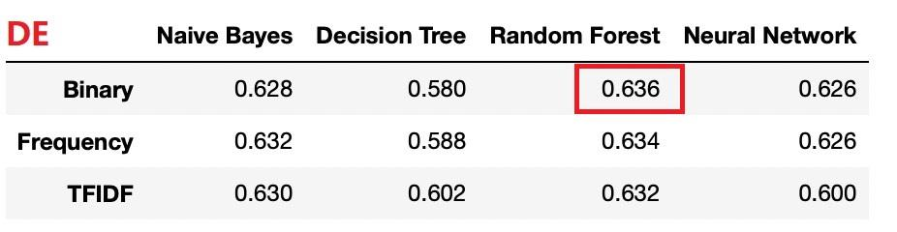
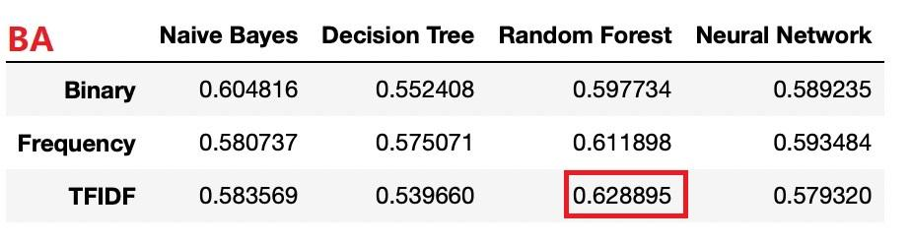
Modeling
Model 2:
Use top 10 skills + location + other features to predict salary
[‘sql’, ‘python’, ‘excel’, ‘tableau’, ‘r’, ‘bi’, ‘aws’, ‘spark’, ‘java’, ‘hadoop’, ‘Location_state’, ‘Rating’, ‘Founded’]
Performance significantly improved
Average accuracy between 0.55 - 0.65

Slide 14
Evaluation
If we only use information extracted from the text for modeling, performance could be poor even if text analytics techniques are implemented to remove noise.
Using unique top keywords and implementing domain knowledge can significantly improve model performance. There also could be other significant features not included in data set (education, age, etc.)
The best performing combination is TFIDF + Random Forest.

Slide 15
Conclusion & Insights
Conclusion：
TFIDF-Random Forest perform well
Skill is the most important factors
Location and other factors influence salary
Business Insights：
For company: consider skills rating and location instead of position title
For Job seeker: improved their skills

Slide 16
Reference
https://www.kaggle.com/code/ryanvu/data-science-job-market-eda-and-text-analysis/notebook#Data-Science-Job-Market-EDA-and-Text-Analysis
https://www.kaggle.com/code/nikhilbhathi/100-insights-data-science-jobs-eda/notebook#8.-Skills-Required-by-Companies-for-Each-Job-Title
https://resources.careerbuilder.com/recruiting-solutions/how-to-build-employee-compensation-programs

