Slide 1
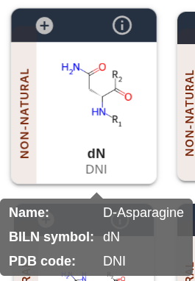
R-groups
Monomer name
BILN name
3 letter name (PDB)

Slide 2
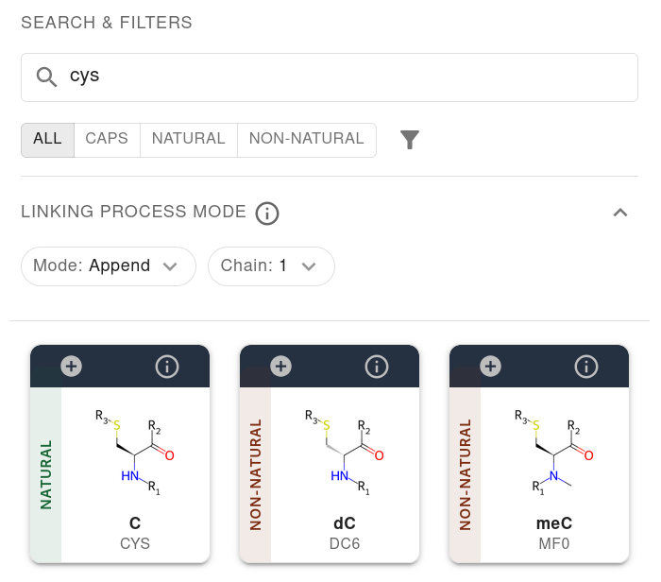
Text search
Monomer class
Append/prepend/ monomer to BILN sequence of given Chain
Proposed Monomers

Slide 3
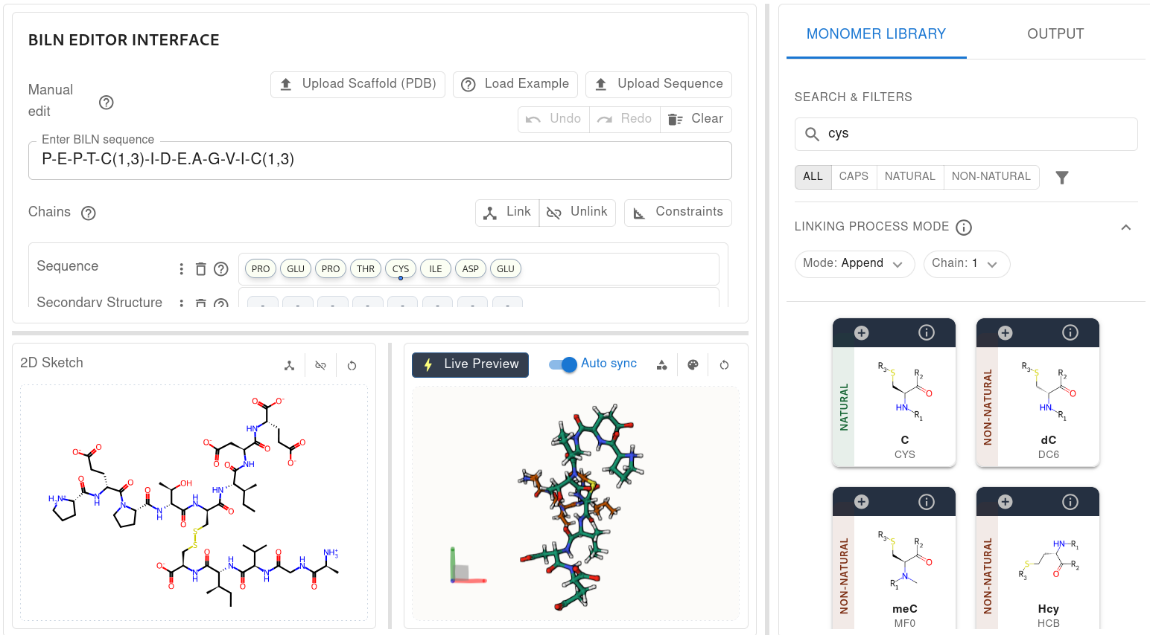
BILN sequence
3D constraints
Access to 1D/2D/3D output
Monomer
library
2D depiction
3D depiction

Slide 4
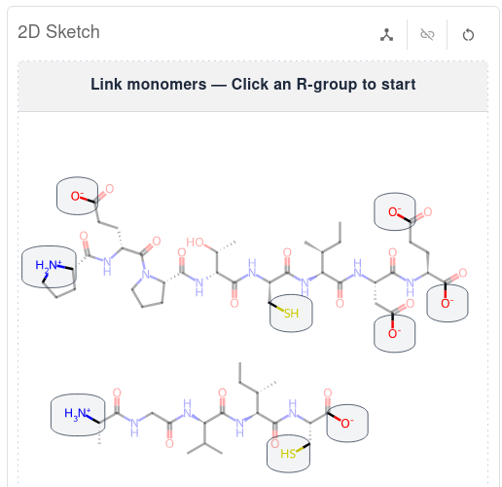
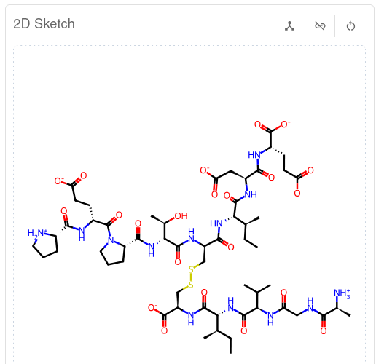
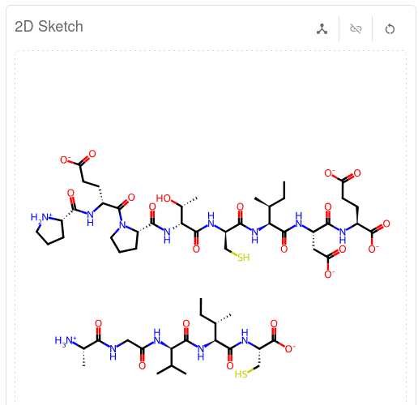
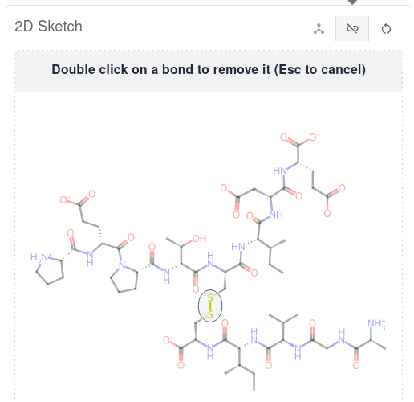
Linking
Click 1
Click 2
Unlinking
Double click

Slide 5
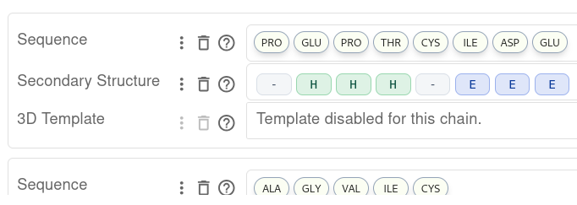

Slide 6
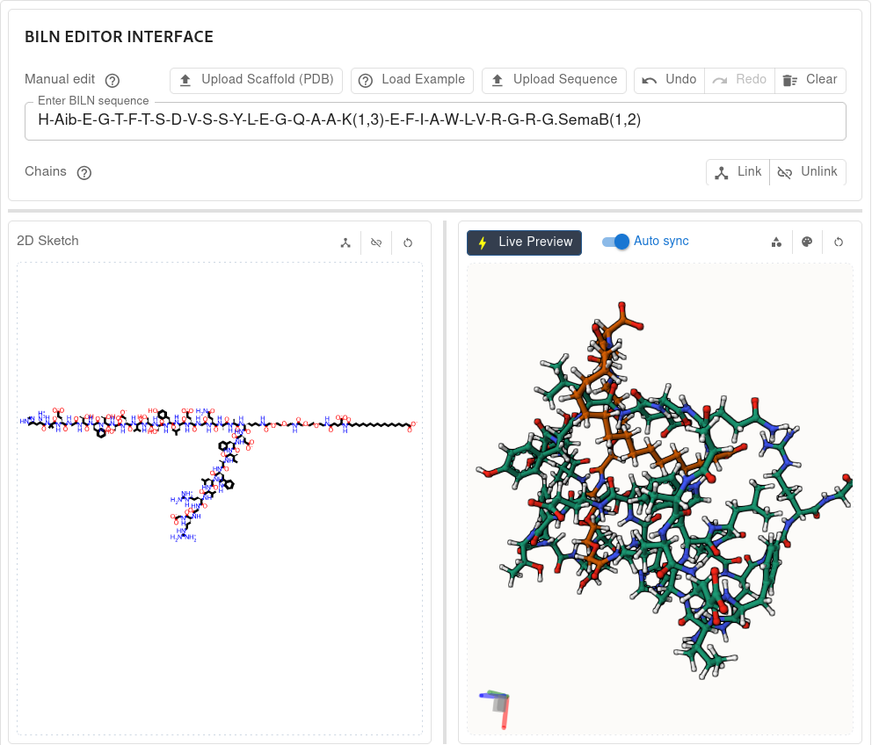

Slide 7
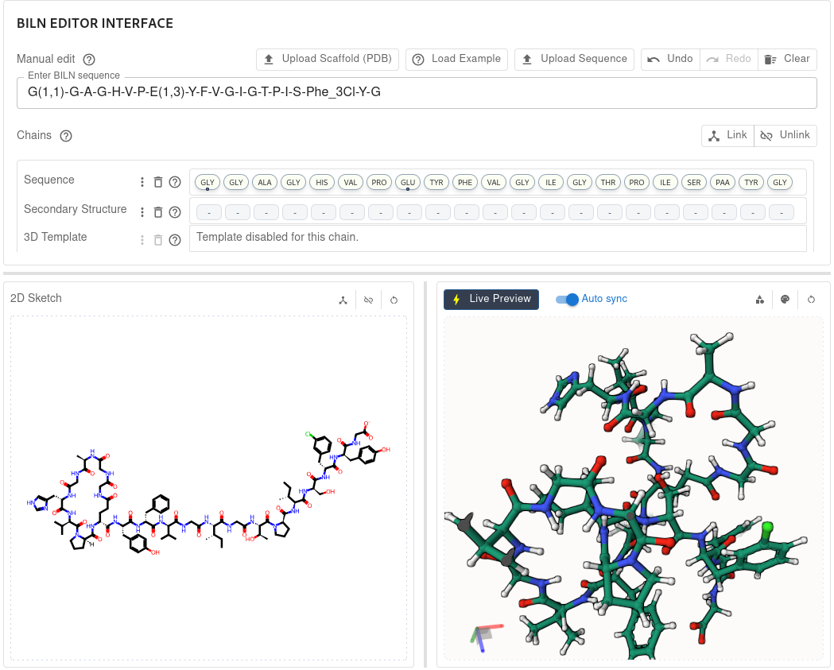
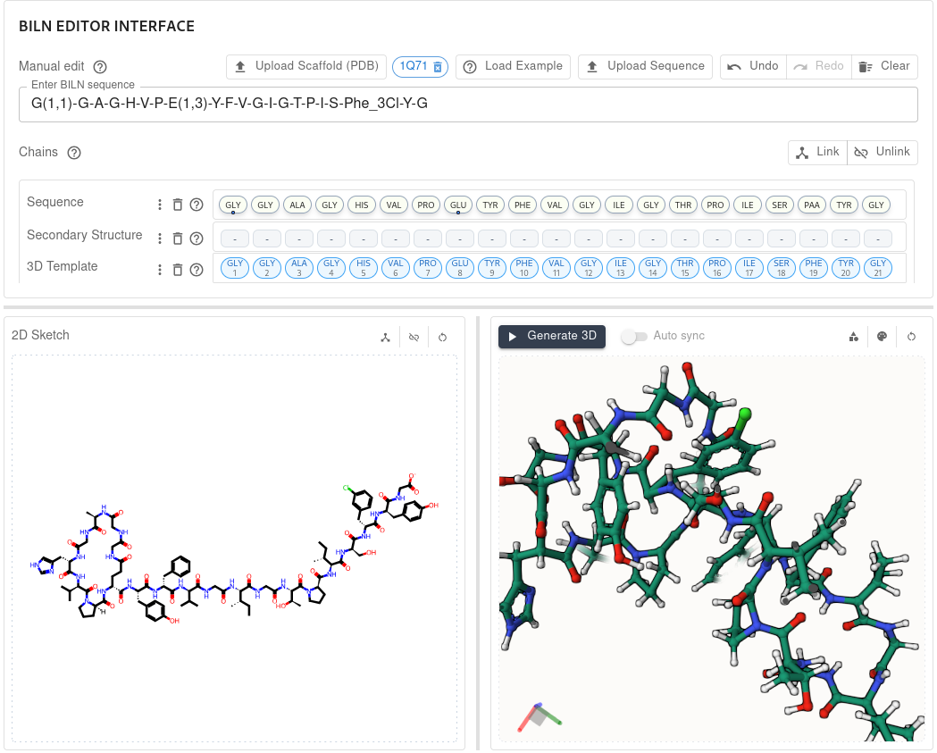
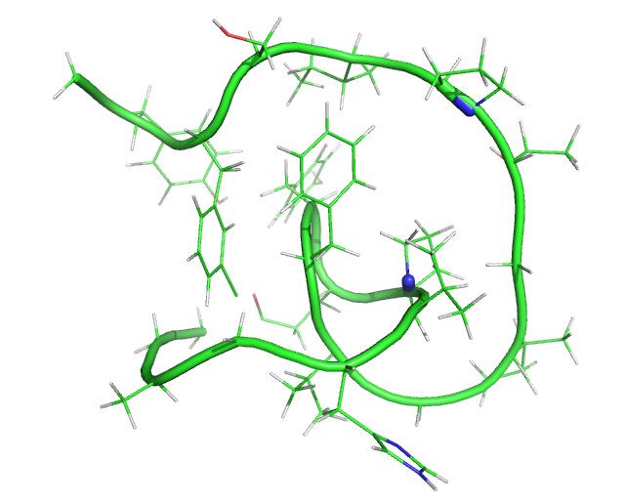
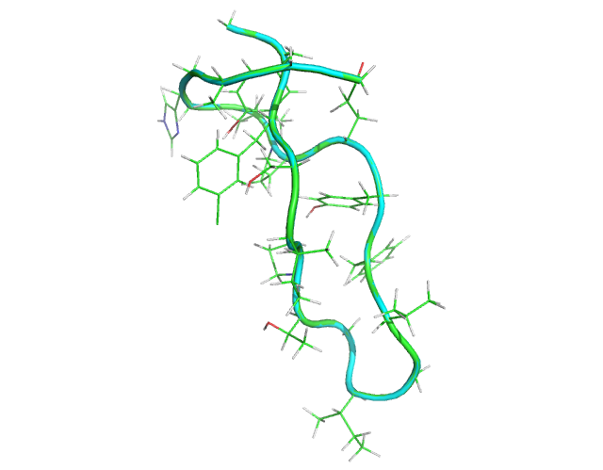

Slide 8
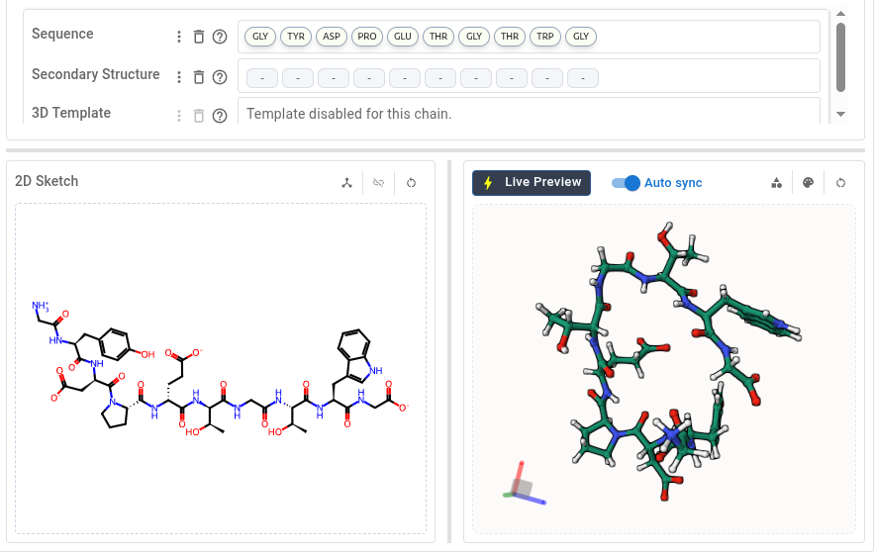
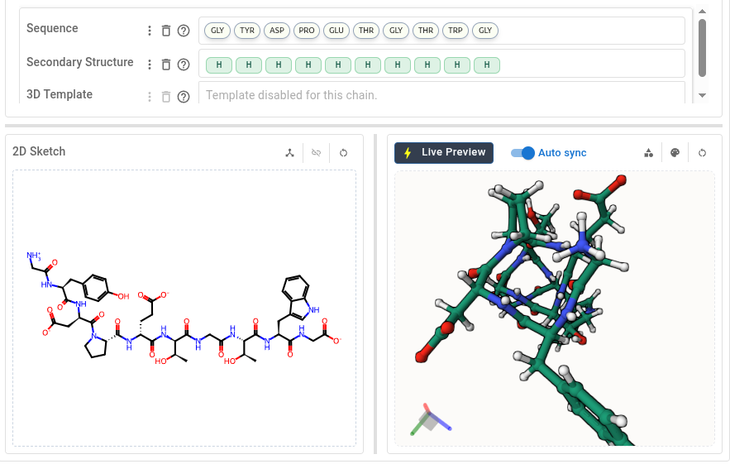
Click to select secondary structure
Type secondary structure symbol to refine per residue
Impose secondary structure

Slide 9
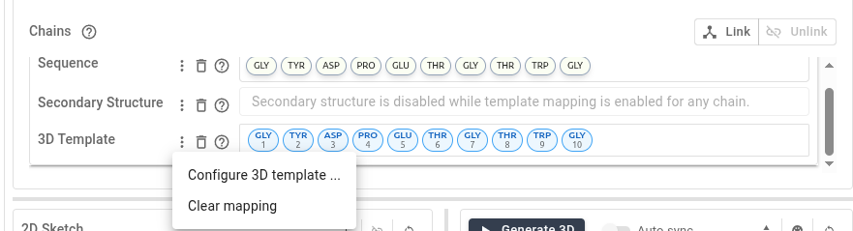
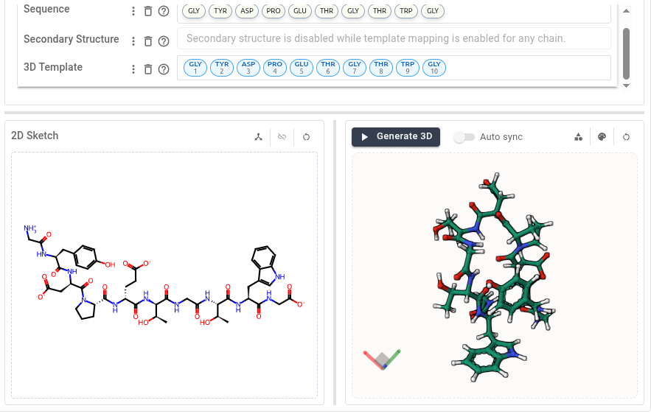
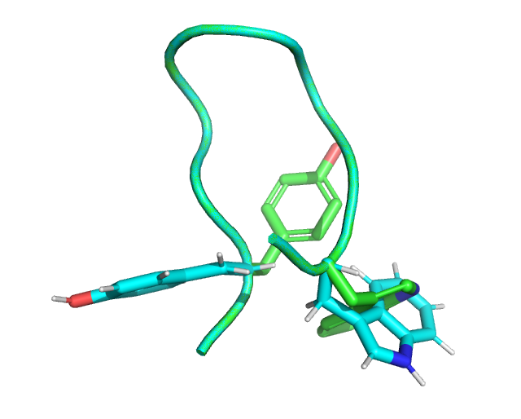
Click to select secondary structure
Type secondary structure symbol to refine per residue
Imposing secondary structure
Click 1
Using a 3D template
Modifying chignolin using wild type structure with new sequence:
G-dY-D-P-E-T-G-T-dW-G

Slide 10
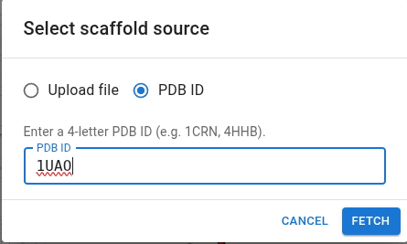
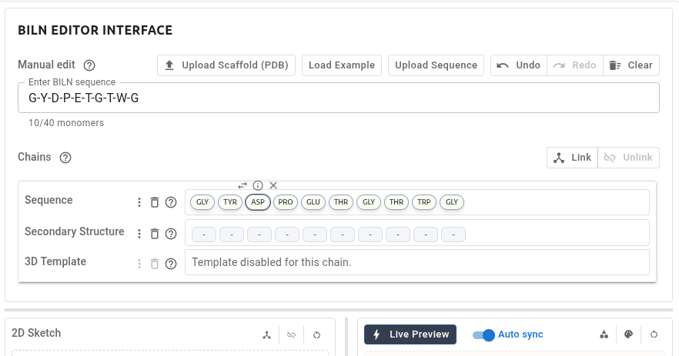
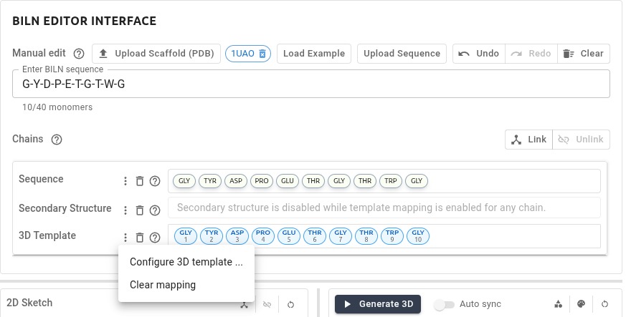
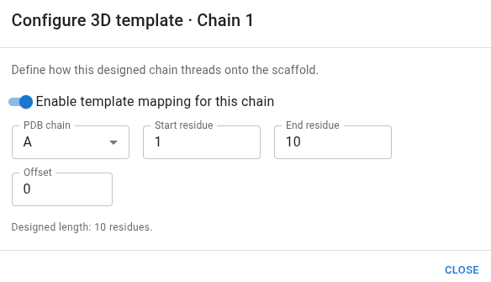
1. Click to select 3D template
4 Refine mapping on a per residue basis
5. Click to generate 3D
2. Click to configure 3D template mapping
3. Refine Mapping
(chain, offset)

