Slide 1
Panic Model x RainFrog
Preliminary Analyses
February 13, 2025

Slide 2



STAND at ELAC ALACRITY Center and Signature Project
Tiered system involving three levels of care
Tier 2 (moderate severity) is coach-supported digital therapy
Signature Project: aims to match individuals to the appropriate tier
Michelle Craske
Co-Director
Notes:
RainFrog is currently being implemented at the STAND at ELAC Research Center

Slide 3
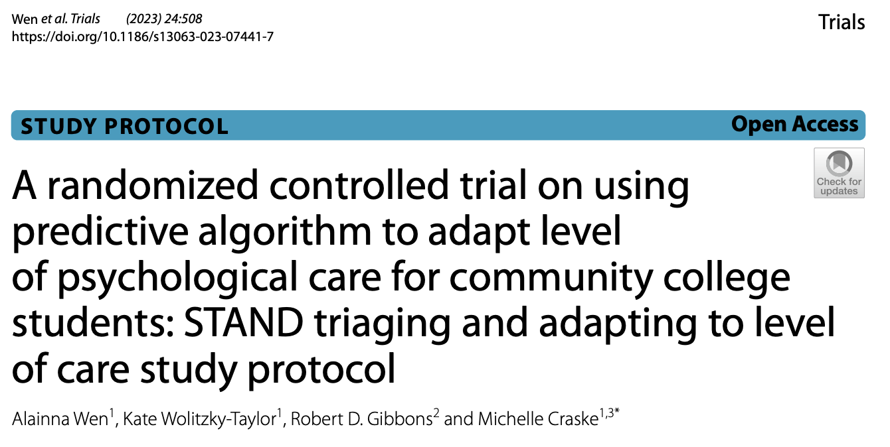

ALACRITY Signature Project Study Protocol
https://doi.org/10.1186/s13063-023-07441-7
Notes:
-If you want to learn more about the ALACRITY Signature Project, there is a protocol paper published in Trials that we link to here, can share the slides afterwards

Slide 4
Additional Protocol Info
Participants above threshold for Panic Disorder or Agoraphobia were eligible for the Panic Disorder Treatment Package
Only participants who were above threshold for Panic Disorder received repeated PDSS assessments

Slide 5
Demographics and Clinical Characteristics at Baseline
Demographics
Clinical Characteristics
 | Other | Panic
Age M(SD) | 26.90 (6.48) | 27.79 (6.66)
Gender
Male | 6 (15.79%) | 5 (38.46%)
Female | 29 (76.32%) | 8 (61.54%)
Transgender | 1 (2.63%) | 0 (0.00%)
Other Gender | 1 (2.63%) | 0 (0.00%)
Prefer Not to Answer | 1 (2.63%) | 0 (0.00%)
Race
White | 22 (57.89%) | 4 (30.77%)
Black | 1 (2.63%) | 0 (0.00%)
Asian | 2 (5.26%) | 0 (0.00%)
Native American | 1 (2.63%) | 2 (15.38%)
Pacific Islander | 2 (5.26%) | 0 (0.00%)
More Than One Race | 2 (5.26%) | 2 (15.38%)
Other Race | 8 (21.05%) | 5 (38.46%)
Hispanic/Latnix | 34 (89.47%) | 11 (84.62%)
Non-Hispanic/Latinx | 4 (10.53%) | 2 (15.38%)
 | Panic (N=13) | Other (N=38)
Variable | M(SD) | M(SD)
PDSS | 14.15 (3.85) | 12.13 (3.29)
Disorders | 4.54 (14.15) | 5.21 (12.13)
Total Modules | 3.85 (2.66) | 3.29 (3.15)
Coaching Sessions | 4.69 (4.54) | 4.49 (5.21)

Slide 6
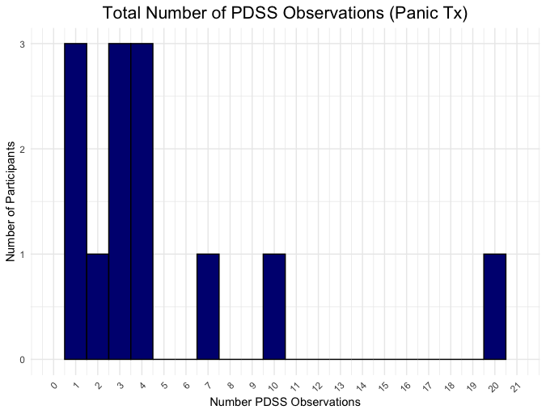
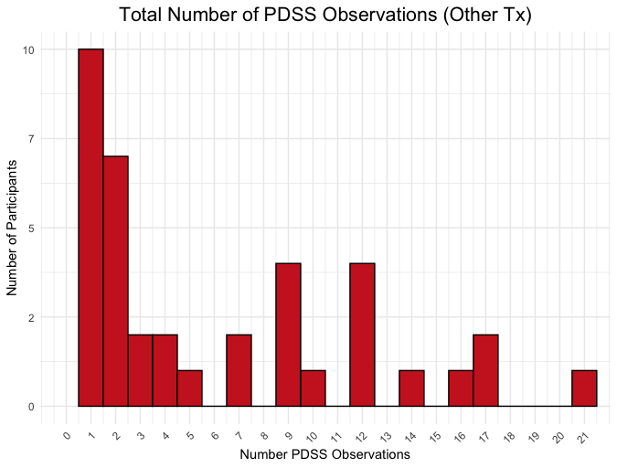
Number of PDSS Observations

Slide 7
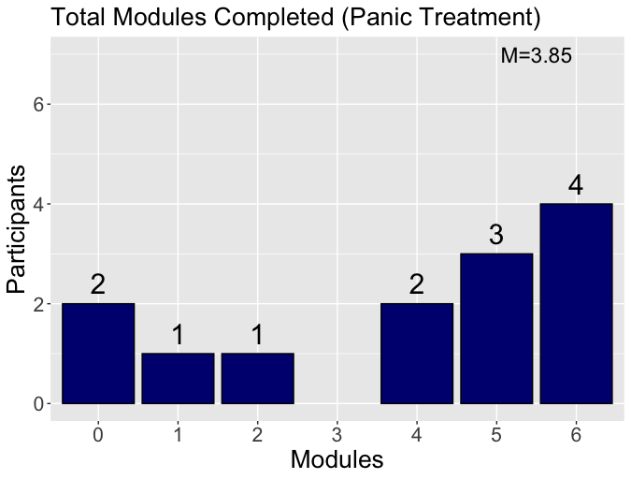
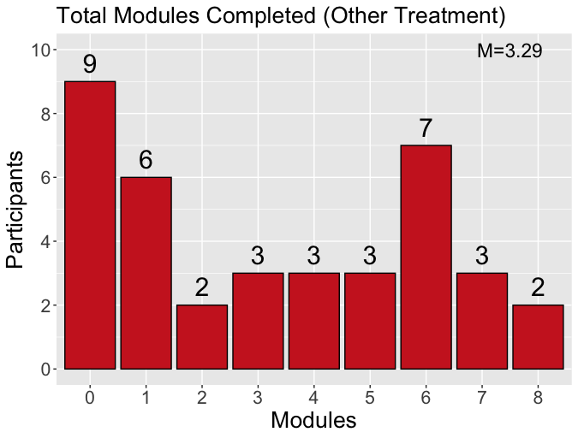
Total Modules Completed

Slide 8
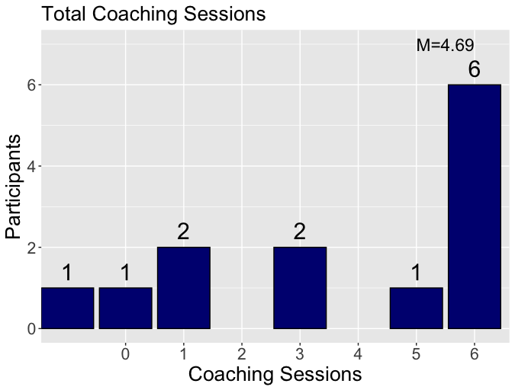
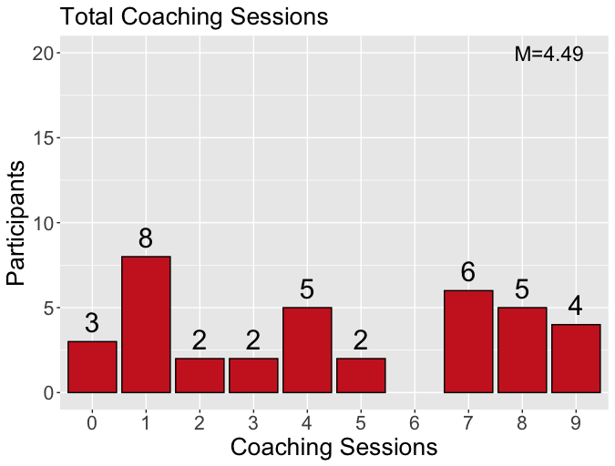
Total Coaching Sessions Completed

Slide 9
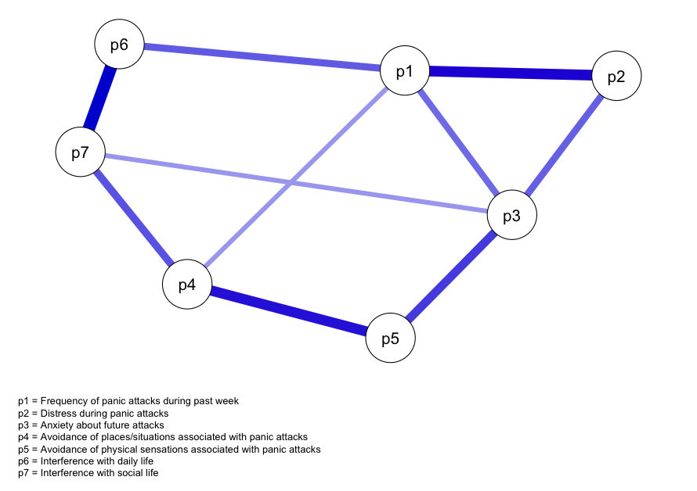
Baseline PDSS Symptom Network (N=162)
***includes participants who did not start a module

Slide 10
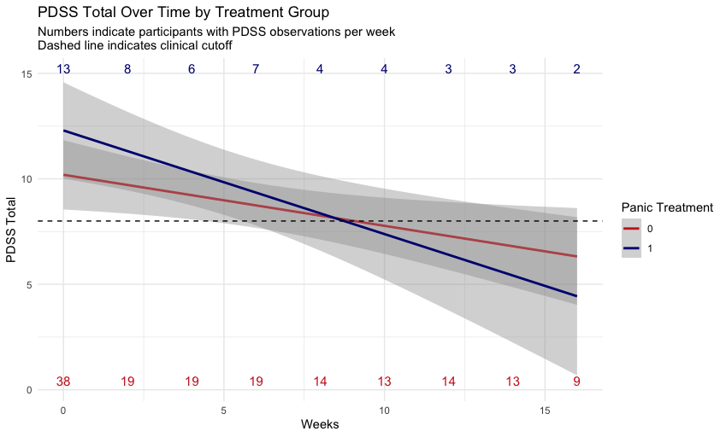
PDSS Symptom Trajectory by Tx Group
N_{Panic} = 13
N_{Other} = 38

Slide 11
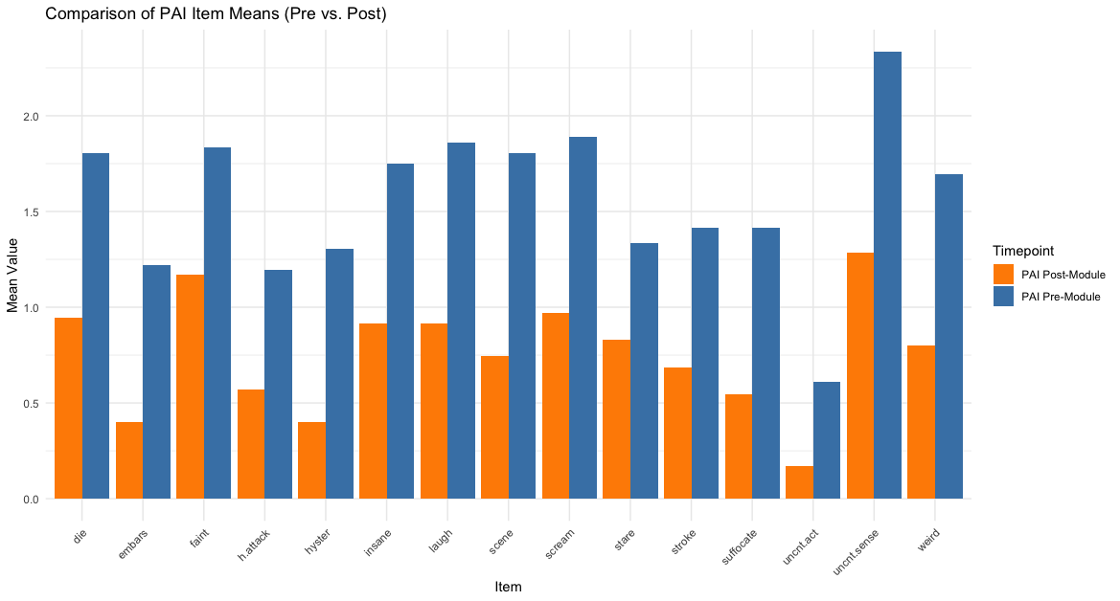
Change in PAI-2 Scores During Psychoeducation Module (N=36)

Slide 12
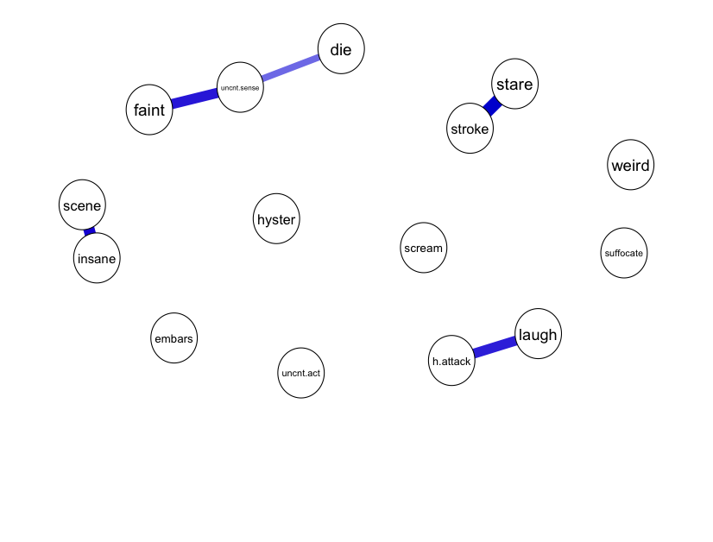
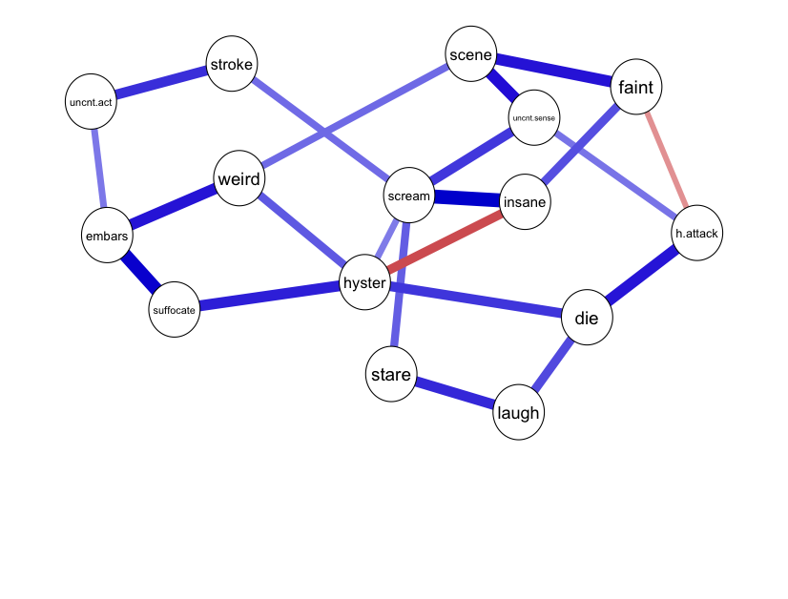
Comparison of PAI-2 Network Structures Before and After Psychoeducation Module (N=36)
Pre-Module
Post-Module

