Slide 1
Panic Model x RainFrog
Preliminary Analyses
February 13, 2025

Slide 2



STAND at ELAC ALACRITY Center and Signature Project
Tiered system involving three levels of care
Tier 2 (moderate severity) is coach-supported digital therapy
Signature Project: aims to match individuals to the appropriate tier
Michelle Craske
Co-Director
Notes:
RainFrog is currently being implemented at the STAND at ELAC Research Center

Slide 3
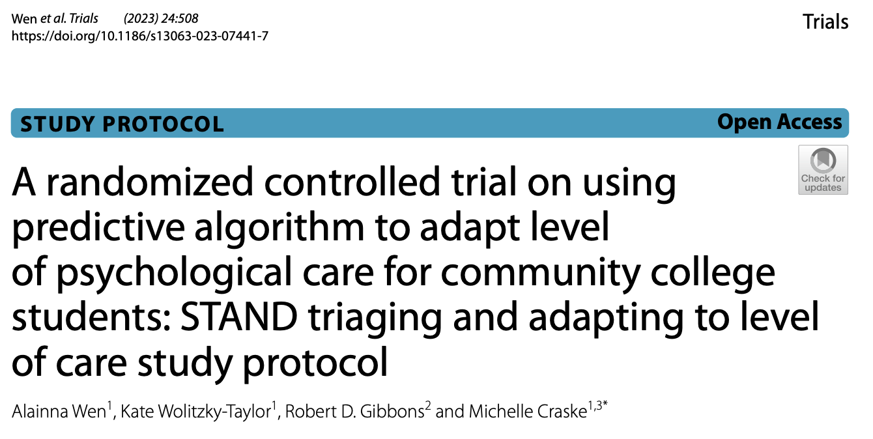

ALACRITY Signature Project Study Protocol
https://doi.org/10.1186/s13063-023-07441-7
Notes:
-If you want to learn more about the ALACRITY Signature Project, there is a protocol paper published in Trials that we link to here, can share the slides afterwards

Slide 4
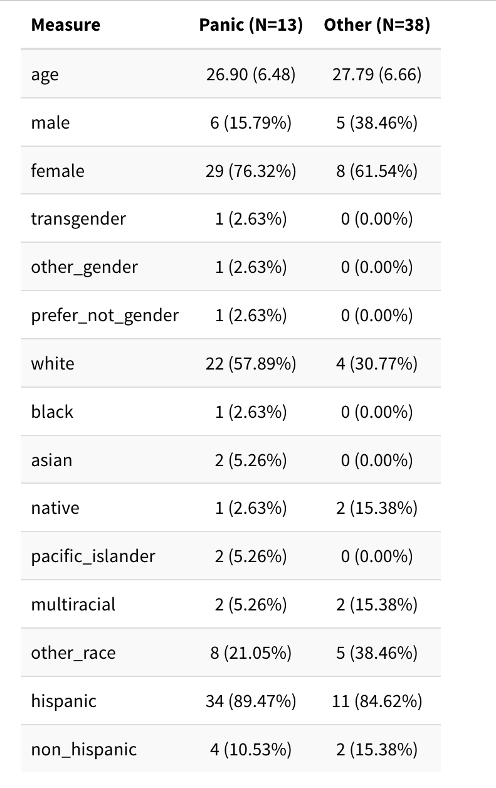
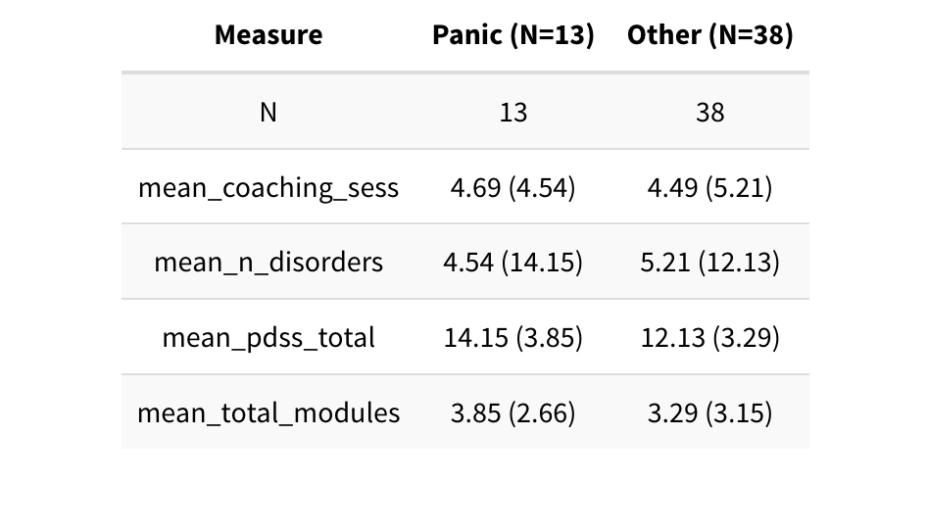
Demographics and Clinical Characteristics at Baseline

Slide 5
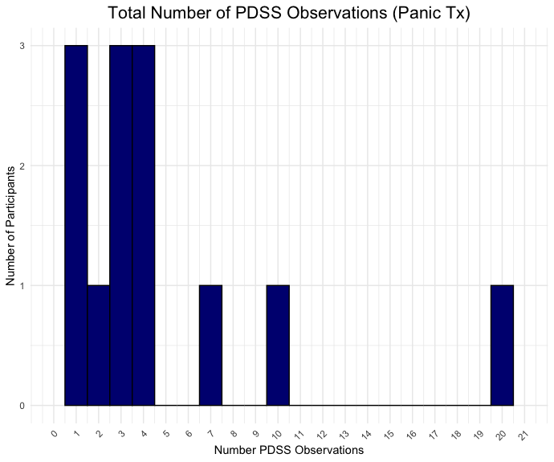
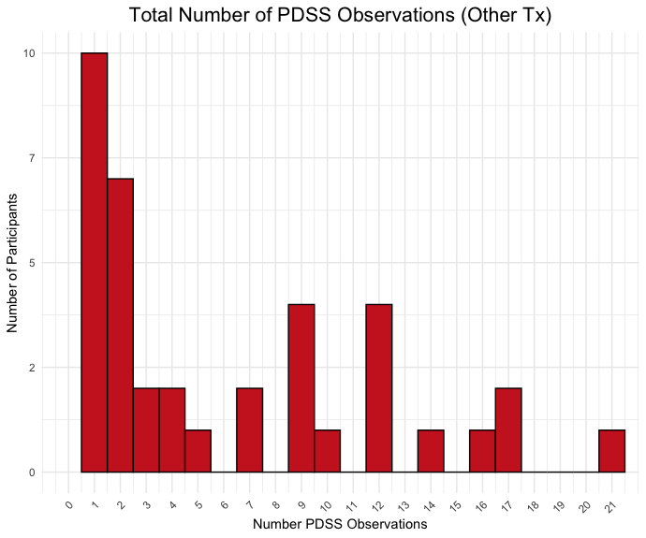
Number of PDSS Observations

Slide 6
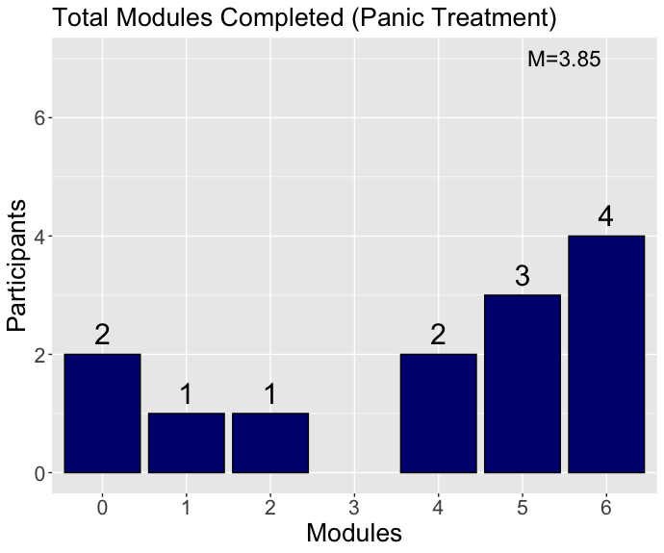
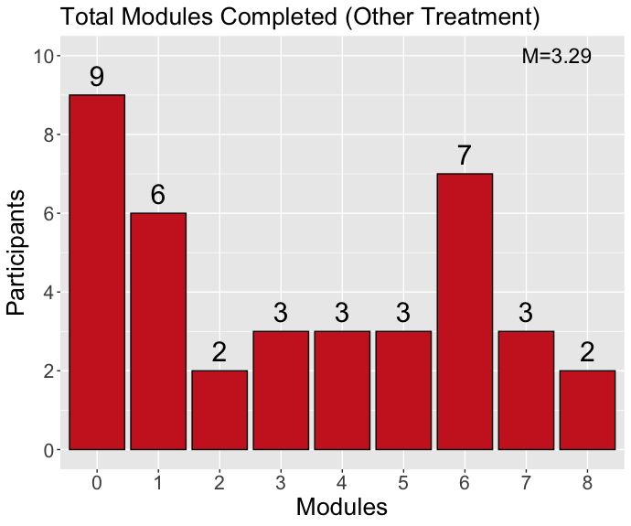
Total Modules Completed

Slide 7
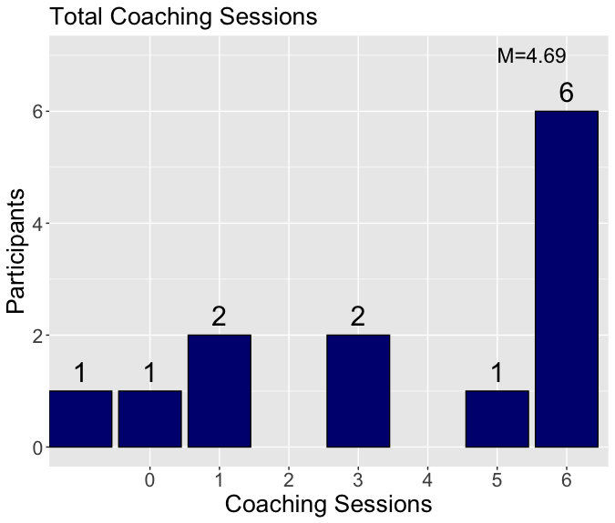
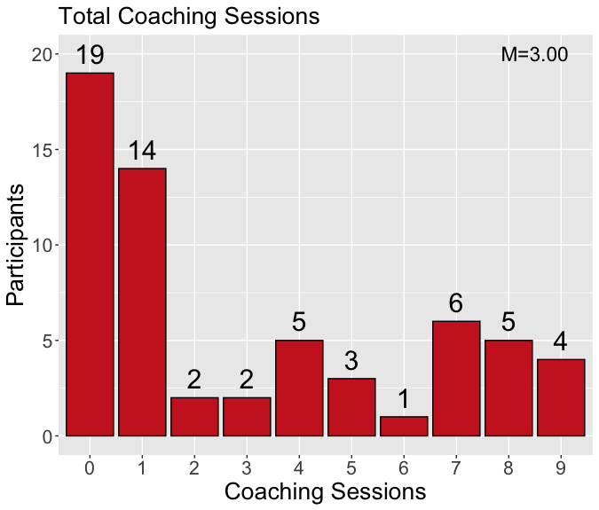
Total Coaching Sessions Completed

Slide 8
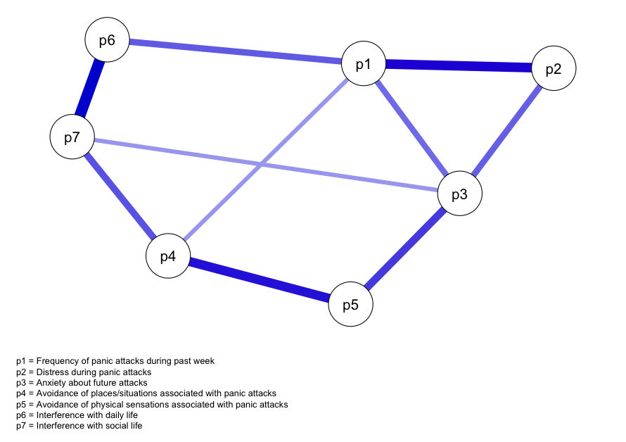
Baseline PDSS Symptom Network (N=162)
***includes participants who did not start a module

Slide 9
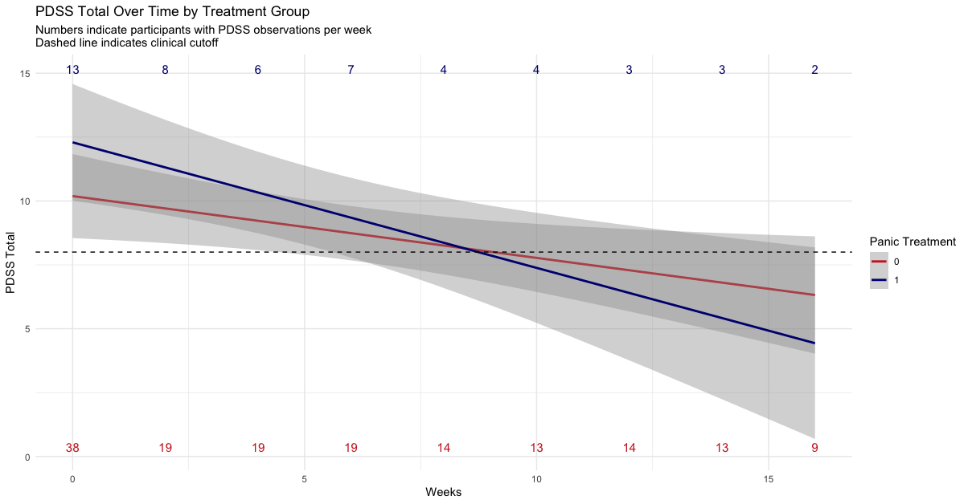
PDSS Symptom Trajectory by Tx Group

Slide 10
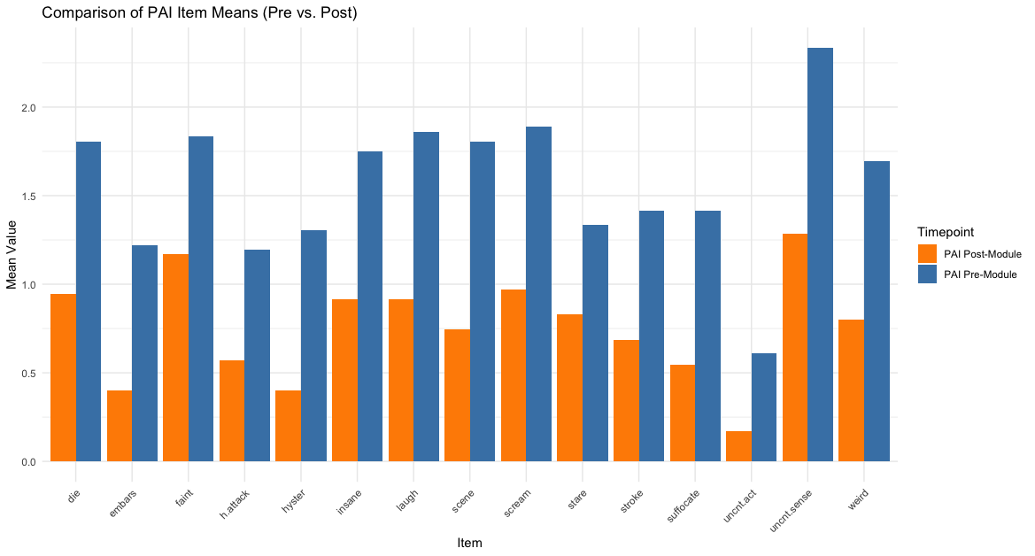
Change in PAI-2 Scores During Module 1 (Psychoeducation)

Slide 11
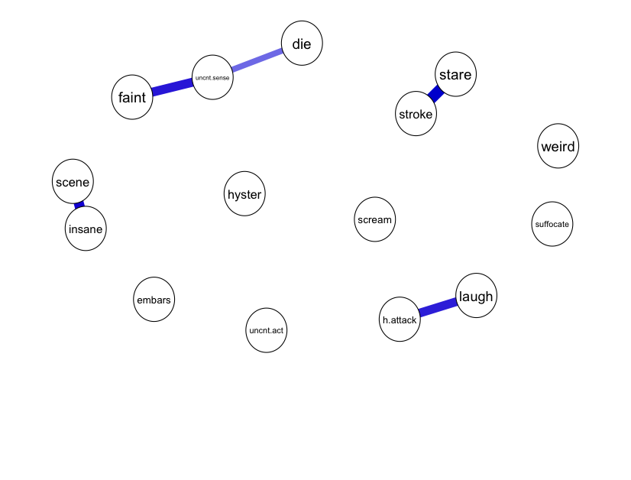
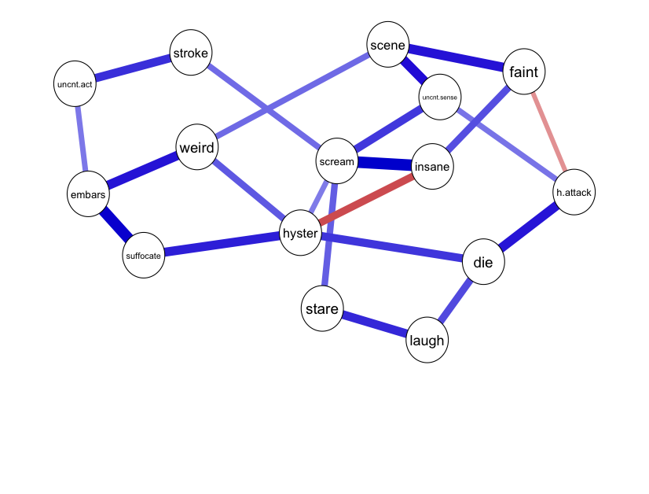
Comparison of PAI-2 Network Structures Before and After Psychoeducation Module
Pre-Module
Post-Module

