Slide 1
BARRADiff

Slide 2
Intro to climate downscaling task
Also known as super resolution in computer vision
Enhance image resolution: Convert low-res (LR) to high-res (HR) output
Goal: recover high-frequency details such as textures, sharpness etc lost in the low-res images
Challenges: 1) Ill-posed inverse problem: Multiple HR images can map to one LR 2) Must hallucinate plausible high-frequency details without artifacts

Slide 3
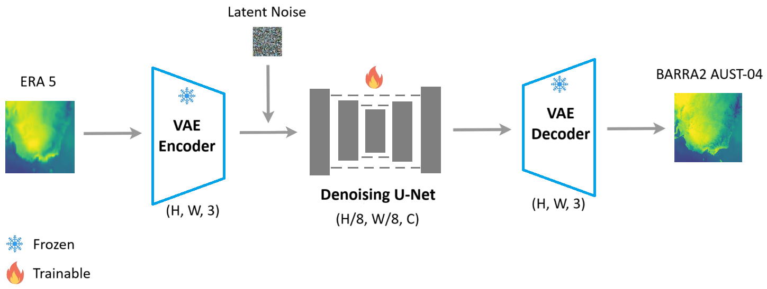
Methods Overview
Compute efficiency – 64x less compute than pixel space
Sample efficiency – compressed away redundant pixels
dddd

Slide 4
Training data
Input: ERA 5, target: BARRA2-C2 AUST-04
12 surface variables
6 pressure variables with 4 pressure levels each
Time period 2000 – 2022
Number of training samples: 3.6 million
We thank Christian Stassen (BOM) for helping the variable mapping between ERA5 and BARRA2!

Slide 5
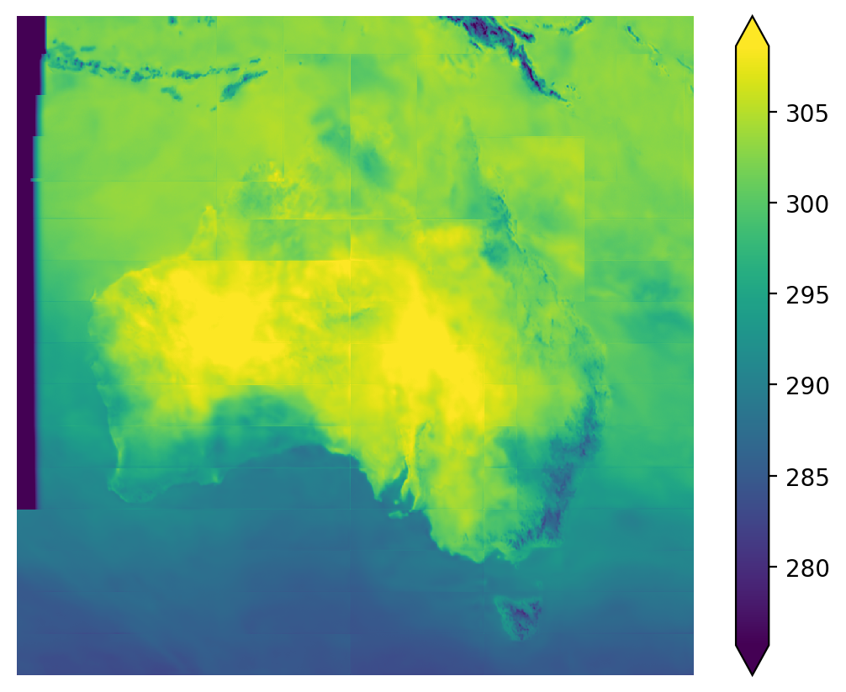
Results - last year
Initial attempt last year
Strong tiling artifacts
Individual tiles are ok

Slide 6
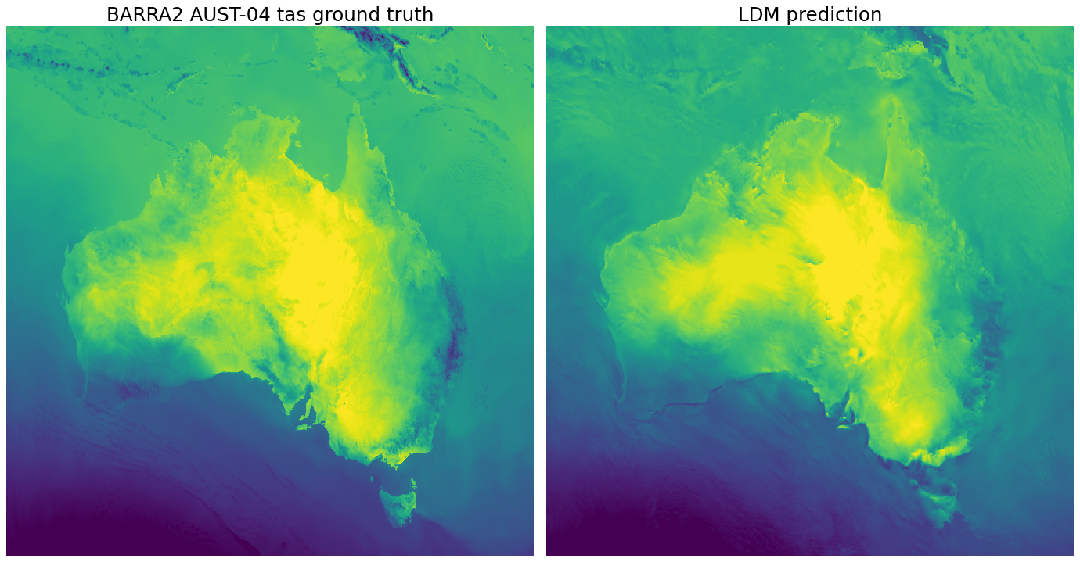
Results - regional

Slide 7
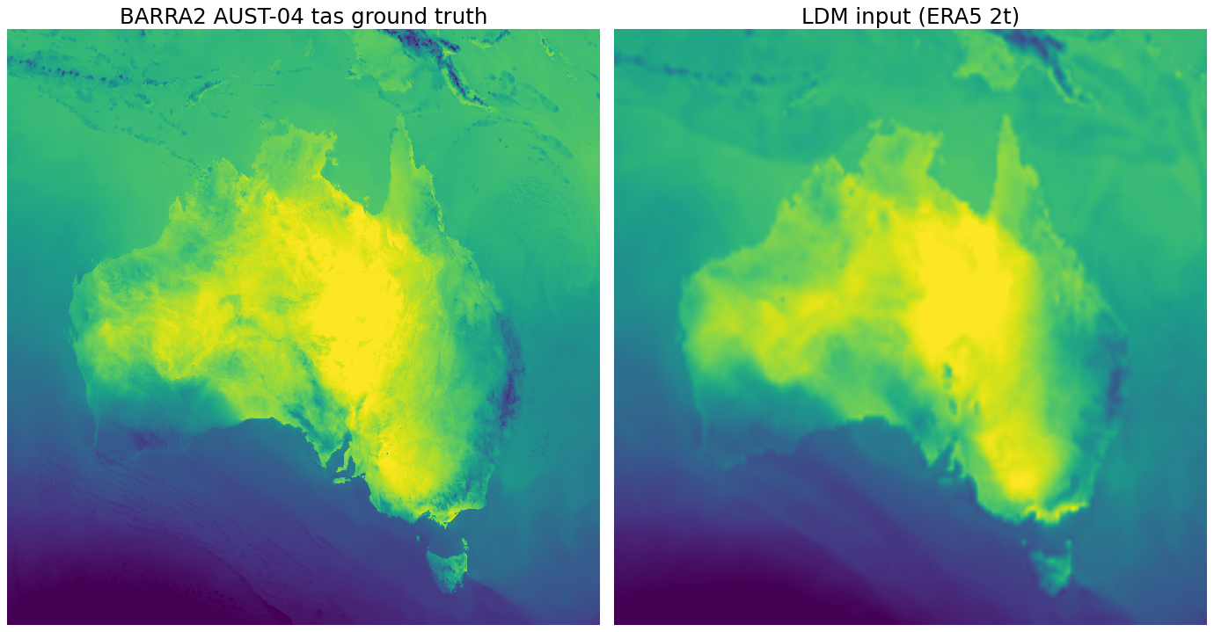
Results - regional

Slide 8
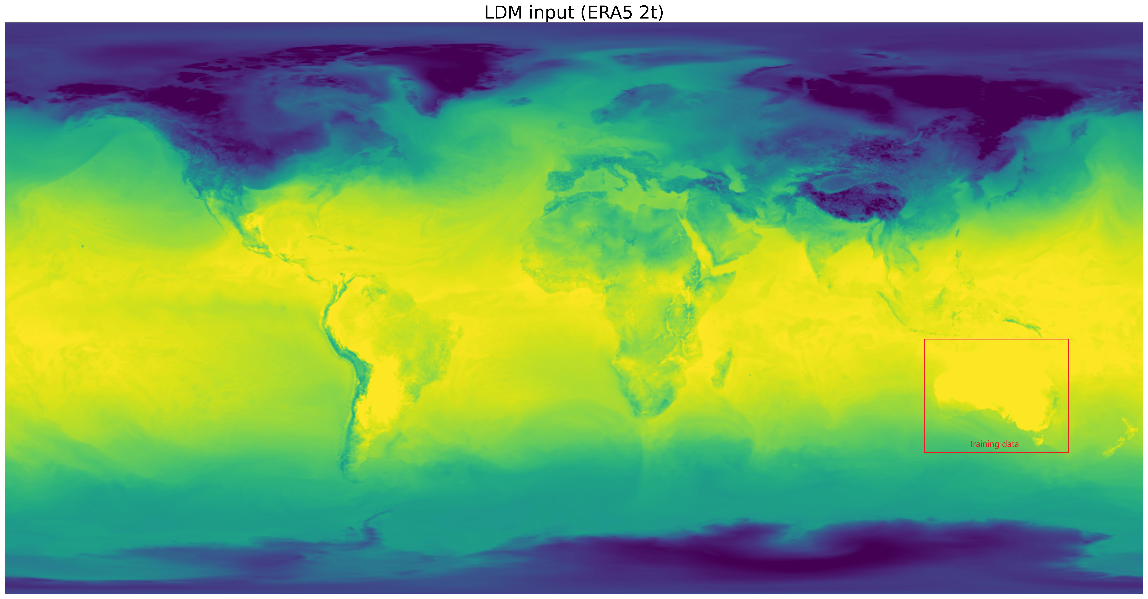
Results – global

Slide 9
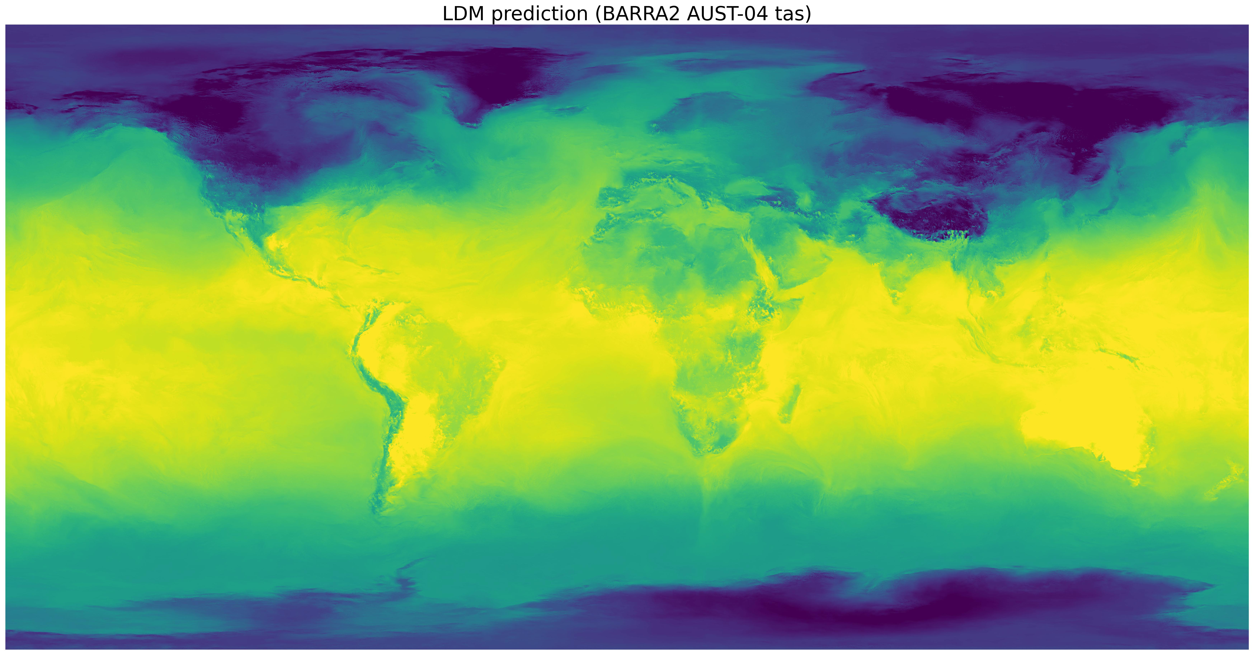
Results – global

Slide 10
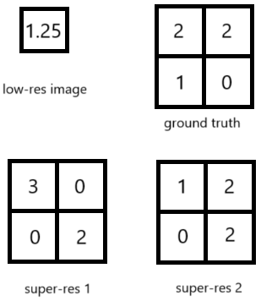
Evaluation challenge
No valid pixel-by-pixel comparison
Downscaling/super-resolution problems are ill-posed due to non-unique solutions. Consider the hypothetical 2x super-resolution task for the low-res 1x1 image with a known degradation process of being spatial averaging of the high-res ground truth
? Distribution comparison
? Spectral comparison
Needs community help …

Slide 11
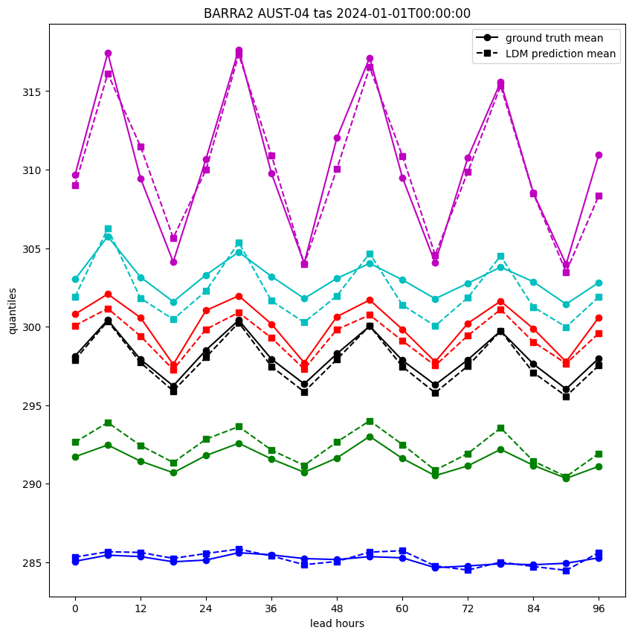
Evaluations
X-axis: leading hours from 2024-01-01T00:00:00
Y-axis: tas over the AU region for each of the quantiles [0, 0.25, 0.5, mean, 0.75, 1]
Ground truth: circles with solid line
LDM predictions: squares with dashed line

