Slide 1
Slide 1 of 4
Install and test GSKY server
TL;DR
Setup a Virtual Machine
scp ‘build_all.sh’ to the home directory
chmod 755 build_all.sh
sudo ./build_all.sh
Slide show will begin in 5 seconds !
It will take 6 minutes to run through this demo. If too fast or too slow, then open the editable *.pptx file and manually run the slideshow.
This is a quick overview of the process. See the README document for details.
Copyright © 2018 by NCI. Created on 28 Nov 2018.
Contact: Arapaut.Sivaprasad@anu.edu.au

Slide 2
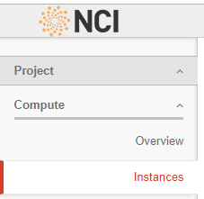

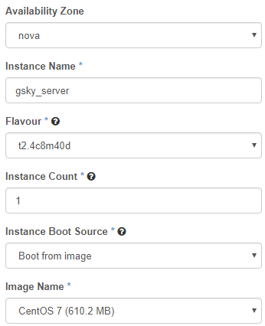
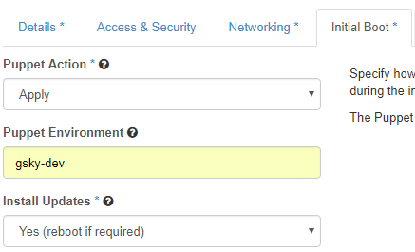

Slide 2 of 4
Setup a Virtual Machine
(If not using a dedicated server)
This will setup a virtual machine on ‘tenjin’
https://tenjin.nci.org.au/dashboard/project/instances/
scp build_all.sh130.56.242.xx:/home/900/user
ssh user@130.56.242.xx
chmod 755 build_all.sh
sudo ./build_all.sh
Next: Setup GSKY server

Slide 3
Slide 3 of 4
Install GSKY server
Process flow and code snippets
Git
Dev
Deps
JPEG
Open
JPEG
GEOS
PROJ
Zlib
PostgreSQL Database
Next Slide
GO
PostGIS
HDF4
‘source /home/900/user/build_all.sh’
Pre-install dependencies
All dependencies
JPEG software
OPENJPEG Library
GEOS - Geometry Engine
Cartographic Projection Procedures
Zlib Data Compression Library
Hierarchical Data Format HDF4
Hierarchical Data Format HDF5
Network Common Data Form (NetCDF )
XML C parser
JSON implementation in C (JSON-C)
GDAL with OpenJPEG support
PostGIS extension to PostgreSQL Database
GO Language
Build GSKY
Copy files
Setup MAS database
Config file
Start the OWS server
Test the OWS server on Terria MAP
Single command to setup a VM and install GSKY server.
Git clone the repository.
  git clone https://github.com/nci/gsky.git
  yum -y groupremove "Development Tools"
  yum -y groupinstall "Development Tools"
  yum -y remove wget
  yum -y install wget
  yum -y remove cmake
  yum -y install cmake
  yum -y remove python-devel
  yum -y install python-devel
  yum -y install readline-devel
  Test the running GSKY server online.
  View the data on the map.
  v=5.1.0
  vd=1.7
  set -xeu
  wget -q http://download.osgeo.org/proj/proj-${v}.tar.gz
  tar -xf proj-${v}.tar.gz
  wget -q http://download.osgeo.org/proj/proj-datumgrid-${vd}.zip
  unzip proj-datumgrid-${vd}.zip -d proj-${v}/nad/
  cd proj-${v}
  ./configure --prefix="$prefix"
  make -j4
  make install
  prefix=/local/gsky
  export GOROOT=$prefix/go
  export GOPATH=$prefix/gopath
  export PATH="$PATH:$GOROOT/bin"
  export PKG_CONFIG_PATH=/usr/local/lib/pkgconfig
  go get github.com/${repo}/gsky
  rm -rf $GOPATH/src/github.com/${repo}/gsky
  git clone https://github.com/${repo}/gsky.git $GOPATH/src/github.com/${repo}/gsky
  cd $GOPATH/src/github.com/${repo}/gsky
  ./configure
  make all
  prefix=/local/gsky
  export GOPATH=$prefix/gopath
  mkdir -p $prefix/share/gsky; mkdir -p $prefix/share/mas
  cp -f $GOPATH/src/github.com/${repo}/gsky/concurrent $prefix/bin/concurrent
  cp -f $GOPATH/bin/api $prefix/bin/api
  cp -f $GOPATH/bin/gsky $prefix/share/gsky/gsky
  cp -f $GOPATH/bin/grpc-server $prefix/share/gsky/grpc_server
  cp -f $GOPATH/bin/gdal-process $prefix/share/gsky/gsky-gdal-process
  cp -f $GOPATH/bin/crawl $prefix/share/gsky/gsky-crawl
  cp -f $GOPATH/src/github.com/${repo}/gsky/crawl/crawl_pipeline.sh $prefix/share/gsky/crawl_pipeline.sh
  cp -f $GOPATH/src/github.com/${repo}/gsky/mas/db/* $prefix/share/mas/
  cp -rf $GOPATH/src/github.com/${repo}/gsky/*.png $prefix/share/gsky/
  cp -rf $GOPATH/src/github.com/${repo}/gsky/templates $prefix/share/gsky/
  cp -rf $GOPATH/src/github.com/${repo}/gsky/static $prefix/share/gsky/
  mkdir -p /local/gsky_temp; chown -R nobody:nobody /local/gsky_temp
  prefix=/local/gsky
  export GOPATH=$prefix/gopath
  export MAS=$prefix/share/mas
  export LD_LIBRARY_PATH="/usr/local/lib:${LD_LIBRARY_PATH:-}"
  ldconfig
  export PGUSER=postgres
  export PGDATA=/usr/local/pgsql/data
  export PGHOST=${PGHOST:-''}
  export PGPORT=${PGPORT:-5432}
  cp $GOPATH/src/github.com/$repo/gsky/mas/api/mas.sql $MAS
  cd $MAS
  psql -v ON_ERROR_STOP=1 -A -t -q <<EOD
  \\i schema.sql
  \\i mas.sql
  EOD
  input=$home/gsky/install/config.json
  ip=`curl ifconfig.me`
  while IFS= read -r var
  do
  line=${var/OWS_IP_ADDRESS/$ip}
  echo "$line" >> /usr/local/etc/config.json
  done < "$input"
  ln -s /local/gsky/share/gsky /usr/local/share/gsky
  export LD_LIBRARY_PATH=/usr/local/lib:/usr/lib
  pid=`ps -ef | grep gsky | grep -v grep | awk '{split($0,a," "); print a[2]}'`
  if [ $pid ]
  then
  kill $pid
  fi
  /local/gsky/share/gsky/gsky -p 80&
  v=2.3.1
  set -xeu
  wget -q http://download.osgeo.org/gdal/${v}/gdal-${v}.tar.gz
  tar -xf gdal-${v}.tar.gz
  cd gdal-${v}
  ./configure --with-geos=yes --with-netcdf --with-openjpeg=$include
  make -j4
  make install
  mkdir -p /var/lib/pgsql
  mkdir -p /usr/local/pgsql/data
  chown postgres /usr/local/pgsql/data
  su - postgres -c '/usr/local/pgsql/bin/initdb -D /usr/local/pgsql/data; /usr/local/pgsql/bin/postgres -D /usr/local/pgsql/data >/tmp/logfile 2>&1 &’
JPEG Software
OPENJPEG Library
GEOS - Geometry Engine
Cartographic Projection Procedures
Zlib Data Compression Library
HDF4 and HDF5
NetCDF
XML C parser
JSON-C
GDAL with OpenJPEG support
PostGreSQL
PostGIS
GO
GSKY
  v=1.2.8
  set -xeu
  wget -q ftp://ftp.unidata.ucar.edu/pub/netcdf/netcdf-4/zlib-${v}.tar.gz
  tar -xf zlib-${v}.tar.gz && cd zlib-${v}
  ./configure --prefix="$prefix"
  make -j4
  make install
  v=4.2.13
  set -xeu
  wget -q https://support.hdfgroup.org/ftp/HDF/HDF_Current/src/hdf-${v}.tar.gz
  tar -xf hdf-${v}.tar.gz
  cd hdf-${v}
  ./configure --enable-shared --disable-fortran --prefix="$prefix"
  make -j4
  make install
  v=1.8.13
  set -xeu
  wget -q ftp://ftp.unidata.ucar.edu/pub/netcdf/netcdf-4/hdf5-${v}.tar.gz
  tar -xf hdf5-${v}.tar.gz && cd hdf5-${v}
  ./configure --enable-shared --enable-hl --prefix="$prefix"
  make -j4
  make install
  v=4.1.3
  set -xeu
  wget -q http://www.unidata.ucar.edu/downloads/netcdf/ftp/netcdf-${v}.tar.gz
  tar -xf netcdf-${v}.tar.gz && cd netcdf-${v}
  ./configure --enable-netcdf-4 --enable-shared --enable-dap --prefix="$prefix"
  make -j4
  make install
  v=2.9.8
  set -xeu
  wget -q ftp://xmlsoft.org/libxml2/libxml2-${v}.tar.gz
  tar -xf libxml2-${v}.tar.gz
  cd libxml2-${v}
  ./configure --prefix="$prefix"
  make -j4
  make install
  v=0.13.1
  set -xeu
  wget -q https://s3.amazonaws.com/json-c_releases/releases/json-c-${v}.tar.gz
  tar -xf json-c-${v}.tar.gz
  cd json-c-${v}
  ./configure --prefix="$prefix"
  make -j4
  make install
  v=2.3.1
  set -xeu
  wget -q http://download.osgeo.org/gdal/${v}/gdal-${v}.tar.gz
  tar -xf gdal-${v}.tar.gz
  cd gdal-${v}
  ./configure --with-geos=yes --with-netcdf --with-openjpeg=$include
  make -j4
  make install
  v=2.4.4
  set -xeu
  wget -q https://download.osgeo.org/postgis/source/postgis-${v}.tar.gz
  tar -xf postgis-${v}.tar.gz
  cd postgis-${v}
  ./configure --with-pgconfig=/usr/local/pgsql/bin/pg_config
  make -j4
  make install
  ln -s /usr/local/lib/libgdal.so.20 /usr/local/pgsql/lib/libgdal.so.20
  prefix=/local/gsky
  mkdir -p $prefix
  mkdir $prefix/gopath
  mkdir $prefix/bin
  C_INCLUDE_PATH=$(/usr/bin/nc-config --includedir)
  export C_INCLUDE_PATH
  wget -q -O go.tar.gz https://dl.google.com/go/go1.10.3.linux-amd64.tar.gz
  tar -xf go.tar.gz
  mv go $prefix/go
v=9c
wget -q http://www.ijg.org/files/jpegsrc.v${v}.tar.gz
tar -xf jpegsrc.v${v}.tar.gz
cd jpeg-${v}
./configure --prefix="$prefix"
make -j4
make install
v=2.3.0
set -xeu
wget -q -O openjpeg-v${v}.tar.gz https://github.com/uclouvain/openjpeg/archive/v${v}.tar.gz
tar -xf openjpeg-v${v}.tar.gz
cd openjpeg-${v}
mkdir build
cd build
cmake .. -DCMAKE_BUILD_TYPE=Release -DCMAKE_INSTALL_PREFIX="$prefix"
make -j4
make install
v=3.6.2
prefix=${PREFIX:-/usr}
set -xeu
wget -q http://download.osgeo.org/geos/geos-${v}.tar.bz2
bunzip2 geos-${v}.tar.bz2
tar -xf geos-${v}.tar
cd geos-${v}
./configure --prefix="$prefix"
make -j4
make install
Terria MAP
GSKY
Postgre
SQL
HDF5
acceptance_tests/ CITATION.md config_json.md configure* | install/ LICENSE-2.0.txt Makefile.in mas/ | static/ templates/ testsuite/ utils/
configure.ac crawl/ data_unavailable.png docker/ | ows.go ows_test.go processor/ README.md | worker/ zoom.png
OWS
COPY
GDAL
NetCDF
CONFIG
MAS
JSON-C
XML-C

Slide 4

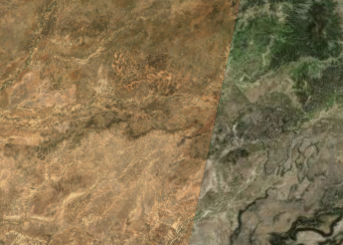
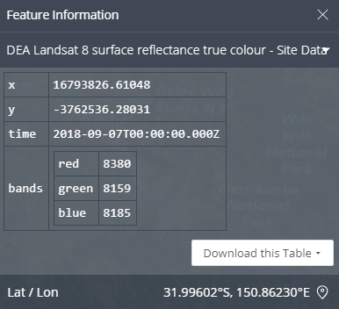
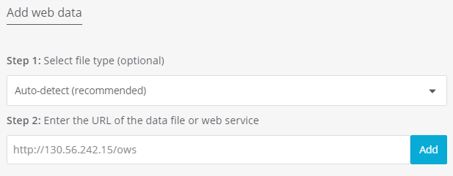
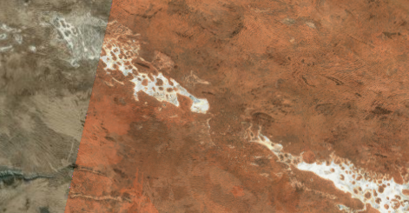
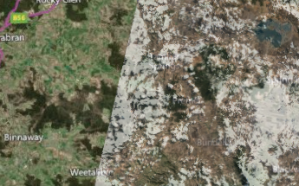



View on Terria JS
Web-based Geospatial Catalogue Explorer
Slide 4 of 4
Add Data
My Data
Add Web Data
GSKY Server
Title
Click

