Slide 1
Breaking Ciphers with Neural Networks
Nick Cichoski

Slide 2
Motivation

Slide 3
Approach

Slide 4
Data

Slide 5
Results

Slide 6
Building up the Model

Slide 7
Takeaway

Slide 8
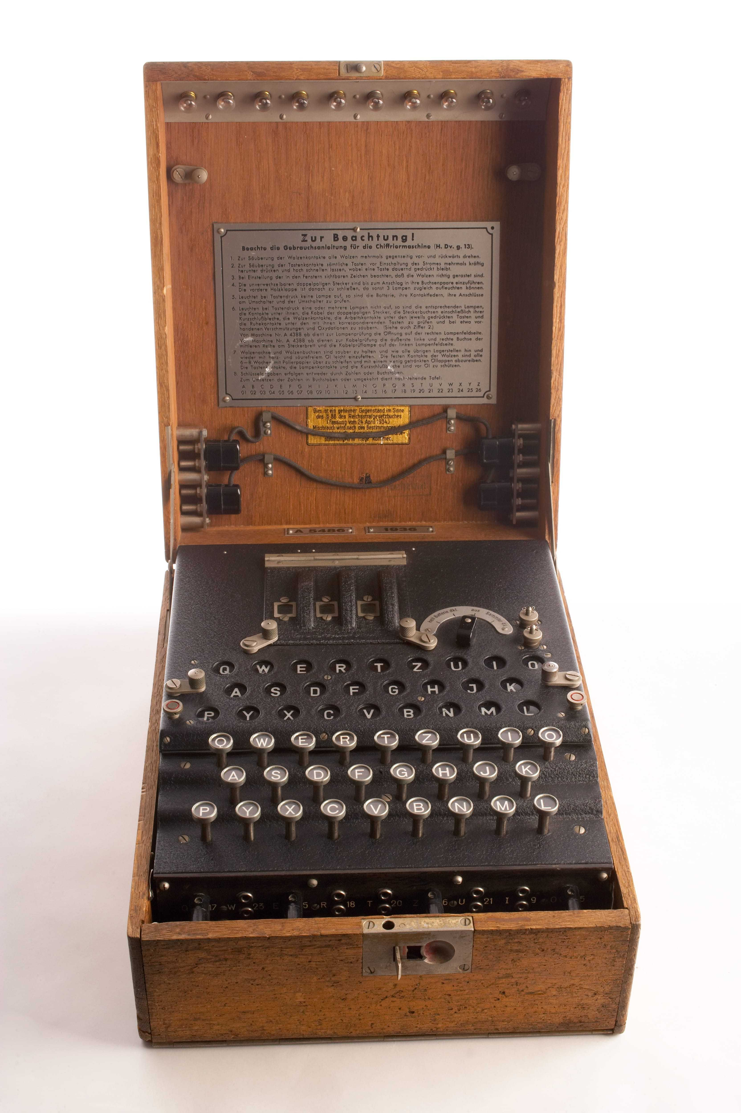
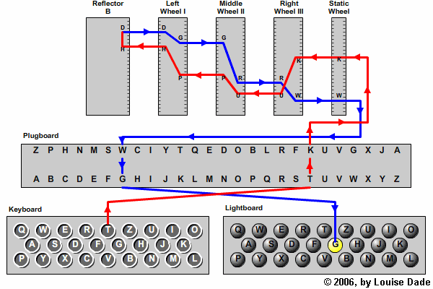
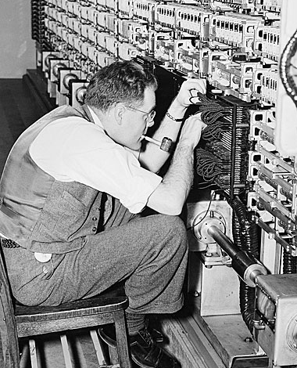
Can a neural network effectively adapt to complex logical tasks?
Goal: Develop a neural network that successfully learns to translate encrypted text to decrypted text using substitution ciphers and the Enigma cipher.
Motivation:
Above: Picture of a WWII Enigma machine
Top Right: Chart depicting the route electricity takes through an Enigma machine.
Right: Alan Turing working on the Bombe machine, which would eventually break the Enigma code
Test how effectively neural networks adapt to strict reasoning tasks
Highlight the developments in computer science over the past 80 years
Solve an interesting problem

Slide 9
Data Processing:
Downloaded from Project Gutenberg
Every ten lines of text were joined
Text lines were shuffled
Text was fed into an enigma machine or a substitution cipher
Data Sources:
Shakespeare's works
The Bible
War and Peace
Ulysses
Data Statistics:
Lines: 27,529
Chars per line: 492
Words per Line: 94
Substitution Cipher Example
Enigma Cipher Example
Original Text: as he sat upon the mount of olives the disciples came unto him privately saying tell us when shall these things be and what shall be the sign of thy coming and of the end of the world
Cipher: pz do zpu jqsc udo rsjcu sx slfeoz udo afztfqloz tpro jcus dfr qvfepuolh zphfcy uoll jz idoc zdpll udozo udfcyz ko pca idpu zdpll ko udo zfyc sx udh tsrfcy pca sx udo oca sx udo isvla
Original Text: stand ho give the word ho and stand what now lucilius is cassius near he is at hand
Cipher: MBVUYRIDZNYTGGHDPJOBBODSURIANBDVUPYIHZTOCFGNGHODFCZIXFOMWKVGRNLQKXWJOJL

Slide 10
The Encoder-Decoder based model
Fully Connected Layer
Method #1 (baseline): Letter Frequency
Count the letter frequencies in an encoded sequence
Match letters to the most common English word frequencies
Method #2: Encoder-Decoder Model
Create an encoder-decoder-based neural network using PyTorch – based on the outline to the right
Utilize byte-level encoding
Stack encoder-decoder blocks to improve performance
Method #3: Fine-tuned Google Byt5
Load Google/byt5-small from Huggingface
Fine tune model on cipher data
Normalize
Feed Forward Layer
Normalize
Normalize
Feed Forward Layer
x8
Multi-head Attention
x8
Normalize
Normalize
Multi-head Attention
Masked Attention
Embedding
Embedding
Tokenization
Tokenization
Text
Text

Slide 11
Accuracy by Model
Model | Substitution Cipher | Enigma Cipher
Baseline | 4.54% | 4.09%
Encoder-Decoder | 63.11% | 63.12%
Byt5-Small | NA | 4.45%
Takeaways:
Small encoder-decoder architectures fail to fully solve the ciphers
The model adapts to substitution and enigma cyphers equally well
Byt5 requires significant fine-tuning to adapt it to the very specific task
Substitution Cipher
Text: and rack thee in their fancies enter mariana and isabella welcome
Encoding: avs waxj npyy iv npyiw lavxiyq yvnyw rawiava avs iqafyhha myhxkry
Generation: eyx.vqx.q:.x.vqx.q:.xeox.vqx.npqxeox.vqx.
Enigma Cipher
Text: any moment get angrythat at his slightest inattention
Encoding: UBSPCFKAXFKDTMGNKUZMLZPYPHMFGWWBJXNOBRLOASVOBFBCHCRGE
Generation: nvdgqnuregrengs,v.qguoqgrengs,v.qguoqgrengs,

Slide 12
Does a larger model improve results?
Notes:
Models were tested on 10% of available data for time's sake
Flatlining could potentially be reduced if accompanied by an increase in training data
Output indicates diminishing returns to increasing model size
More stacks generally results in better results

Slide 13
Simple Neural Networks Fail to Adequately Decipher Messages
Challenges
Takeaways
Future Considerations
Training time and GPU access significantly limited the complexity of models
Working across a very diverse data set of text
Very specific output specifications
  Needed to line up with the input character to character
  Exact solutions
Models did not fine-tune to the problem very well
Neural Networks struggle to adapt to logical tasks
Problems that seem more complex to humans perform the same using neural networks
Fine-tuning struggles when a very specific output is required
Increases in model size generally improve performance, but with diminishing returns
Using a smaller model as a base for fine-tuning
Scale the model smarter focusing on larger feed forward networks and training
Looking for a more homogeneous dataset and presenting cleaner data as input
Setting aside longer periods of time to train models in depth

