Slide 1
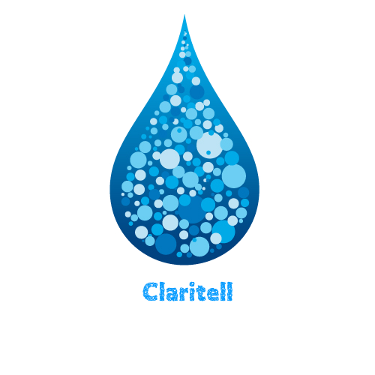
203 - MEDIA CITIES PROJECT
By James Thomas, Rob Stenhouse & Amadeus Puttock

Slide 2

IDEA SUMMARY
Arduino and Raspberry Pi project
Measures water clarity
Supported in a styrofoam boat
Data gathered is visualised in Unity and sent to the urban API

Slide 3


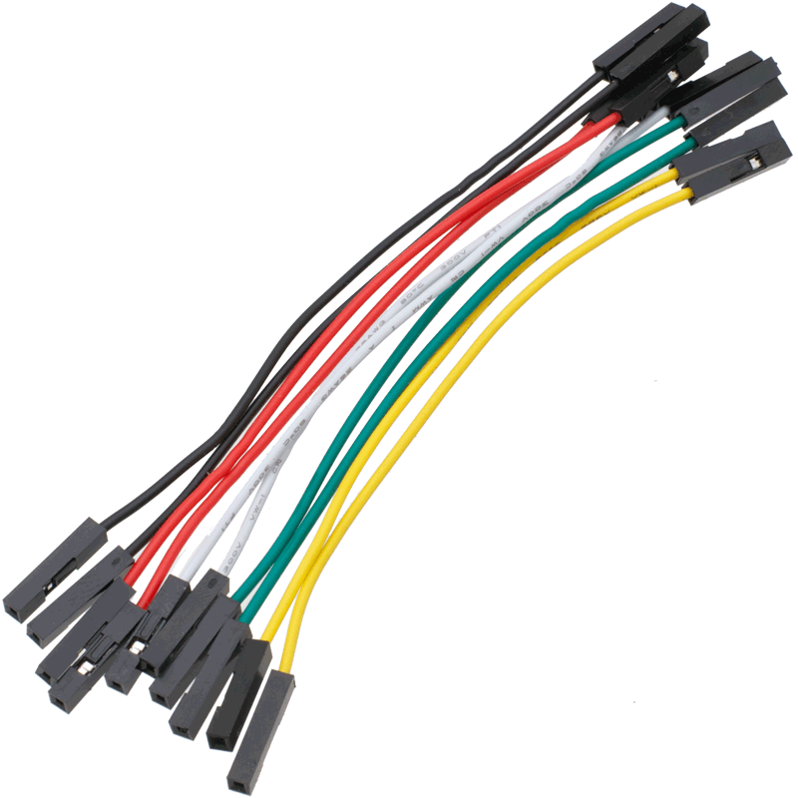



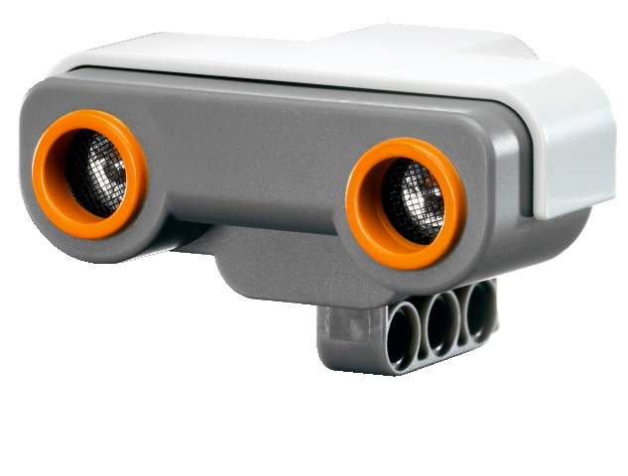

WHAT WE’VE USED
Arduino
Raspberry Pi
Wires
Unity
3G Internet
Python
Light Sensors
Twitter

Slide 4

HOW IT WORKS
The sensors are placed, one on the water and the other above
The value of both light sensors is recorded
The difference between both sensors will depend on the clarity
The greater the gap, the lower the water clarity
The data is sent to Twitter, where a Python sketch will then draw this data into the Unity visualisation

Slide 5

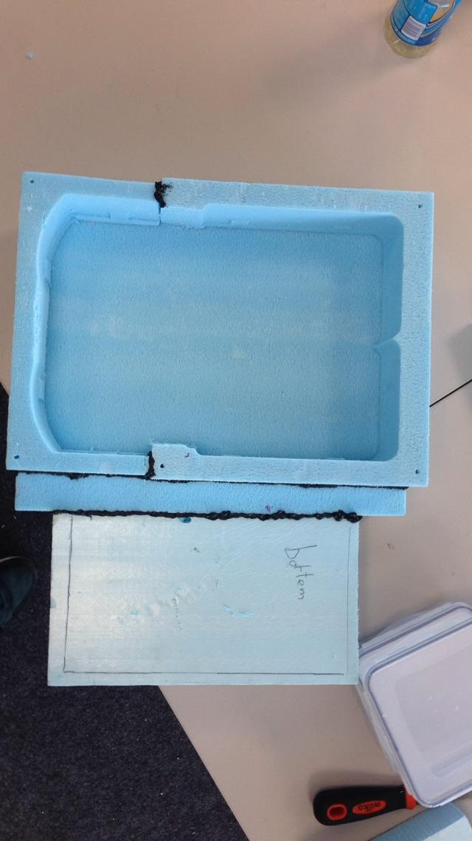
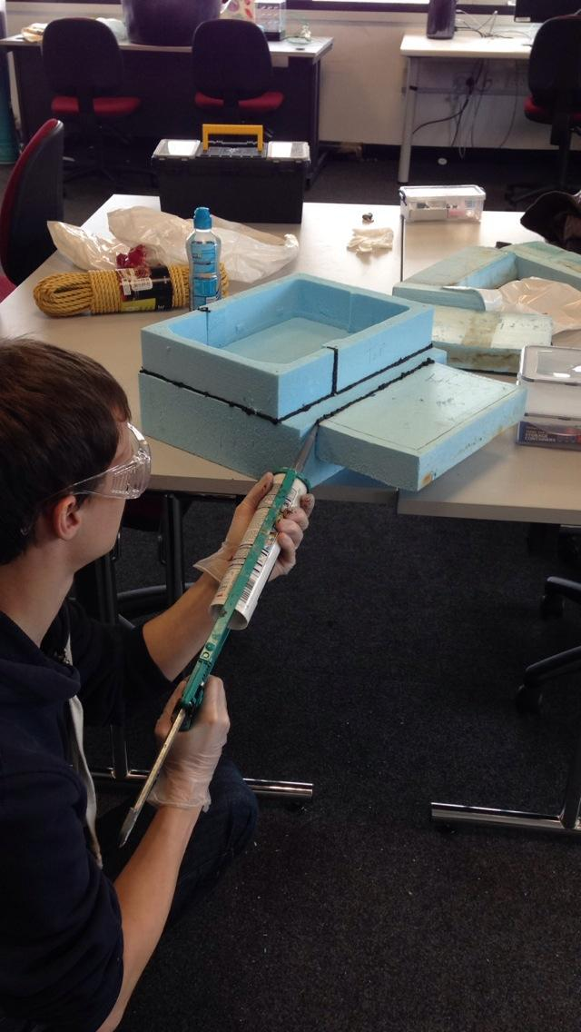
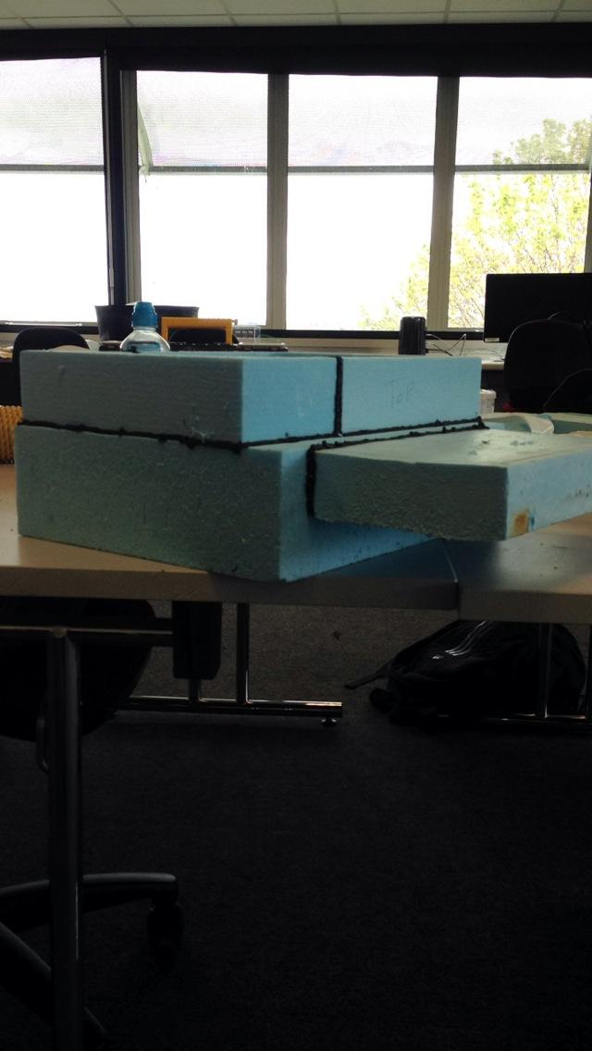
DEVELOPMENT PROCESS

Slide 6
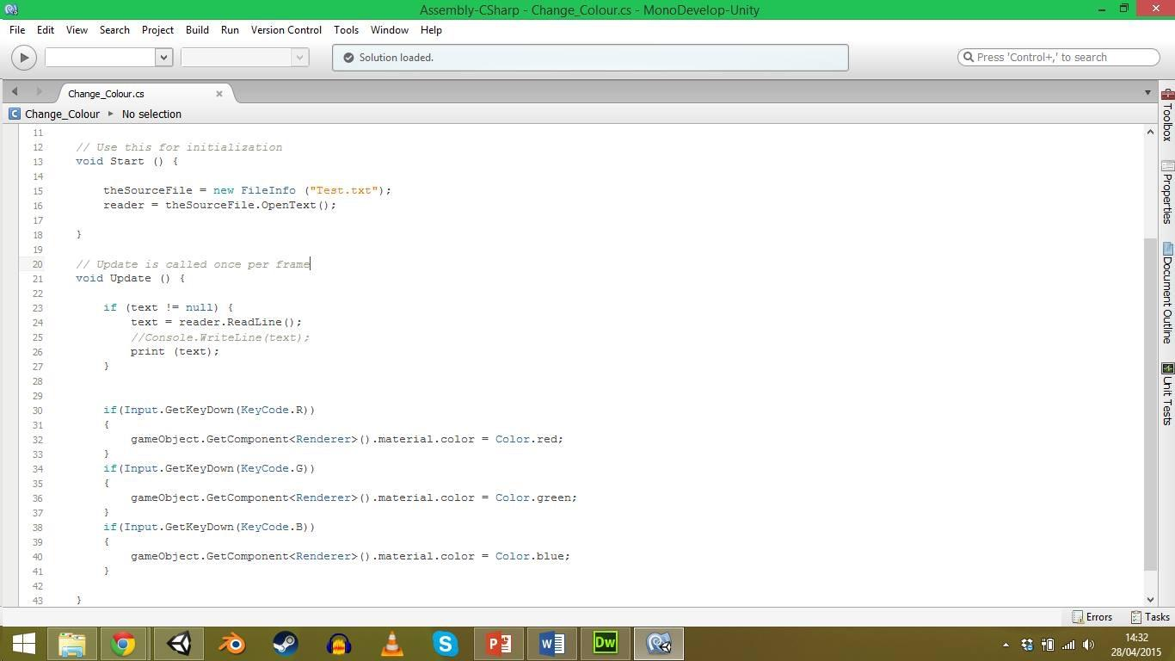
DEVELOPMENT PROCESS

Slide 7
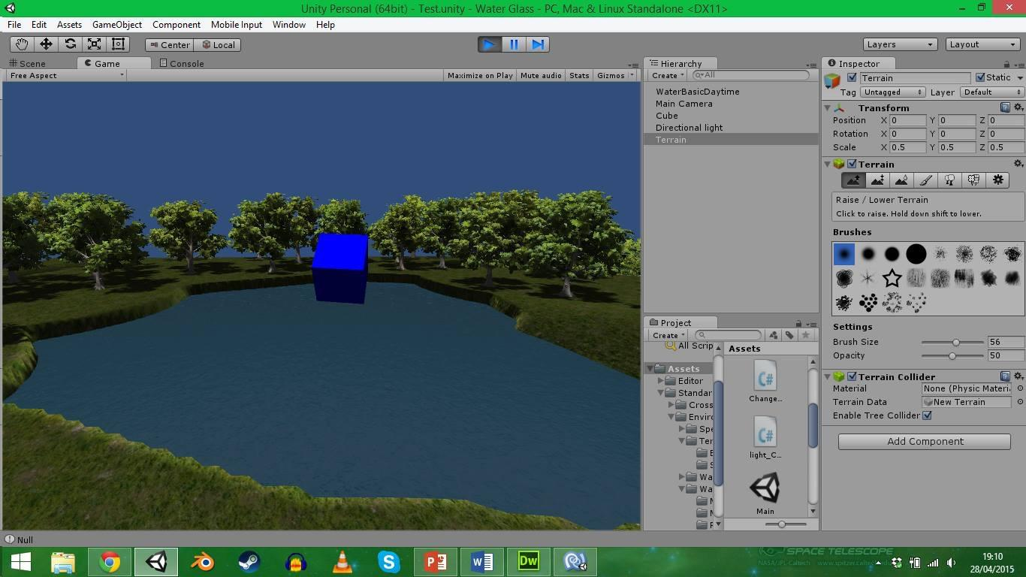
DEVELOPMENT PROCESS

Slide 8
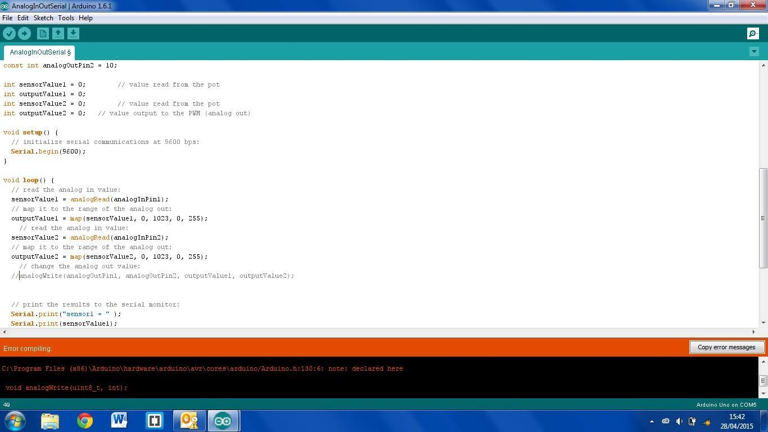
DEVELOPMENT PROCESS

Slide 9
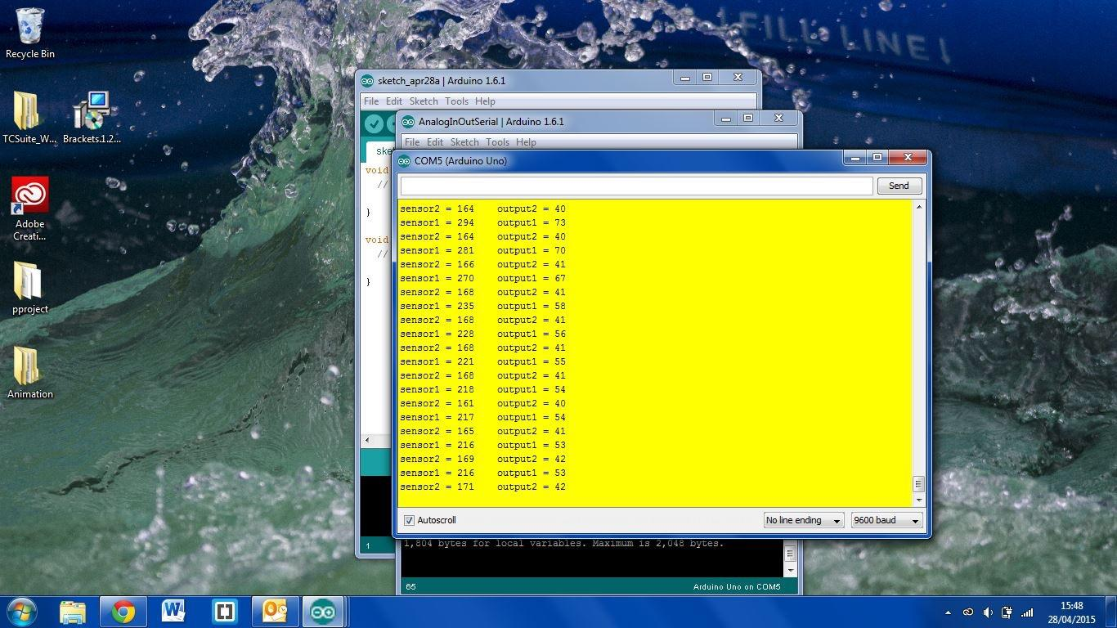
DEVELOPMENT PROCESS

Slide 10
WHY OUR TECHNOLOGY IS USEFUL
Ability to see what areas are suffering from higher levels of unclear water
Ability to see pollution trends in Plymouth
Ability to see what is potentially causing high pollution levels (for example, docks, factories etc)
We collect our own live data using the boat, so it is not outdated. We found that a lot of available data online was outdated.

Slide 11

IMPROVEMENTS
Visually appealing casing
Wireless
More boats to get a constant reading across the city
Solar power
Use a better sealant / glue
More official Twitter account

Slide 12
ANY QUESTIONS?
Thanks for listening

