Slide 1

Lending Club Case Study
CHAITANYA NAMBURU
Pritish panda

Slide 2
Approach for case study
Approach
Data Cleanup
Clean up columns
Clean data types
Data Dictionary
Understanding data variables
Univariate Analysis
Analysis of single variables
Bivariate Analysis
Observations
Analysis w.r.t two variables
Segmented Univariate Analysis

Slide 3
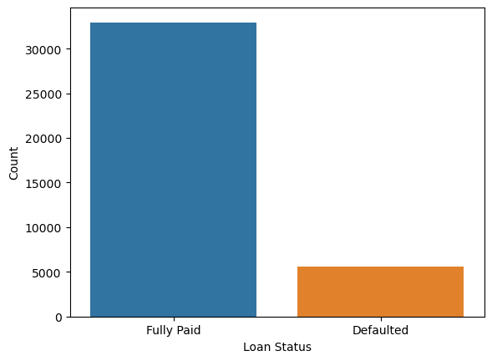
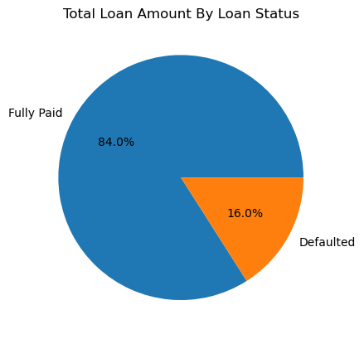
Analysis
Overall Loan Status
The overall loan status of Lending Club seems to be healthy. The total number of defaulted loans is far lesser than the fully paid loans, which bodes well for the organization. There is a total amount of 16% which was defaulted across the loans

Slide 4
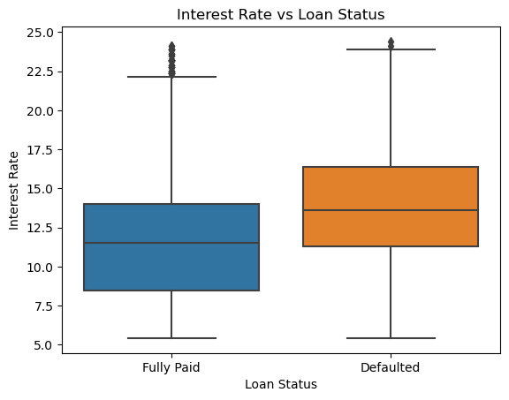
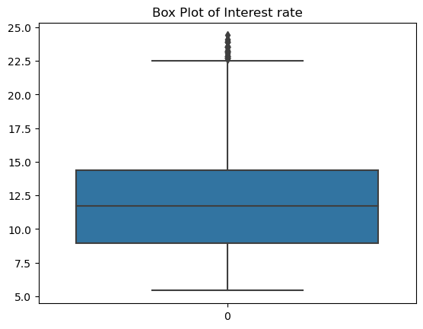
Analysis
Interest Rate
Interest rate seems to play an important role in determining loan status. The loans with higher interest rate defaulted more than those with lesser rates

Slide 5
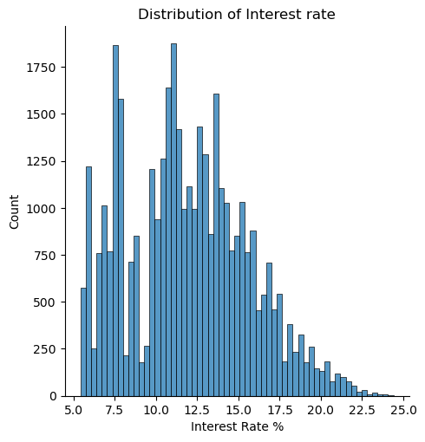
Analysis
Interest Rate (contd.)
There is a wide distribution of interest rates in the organization.

Slide 6
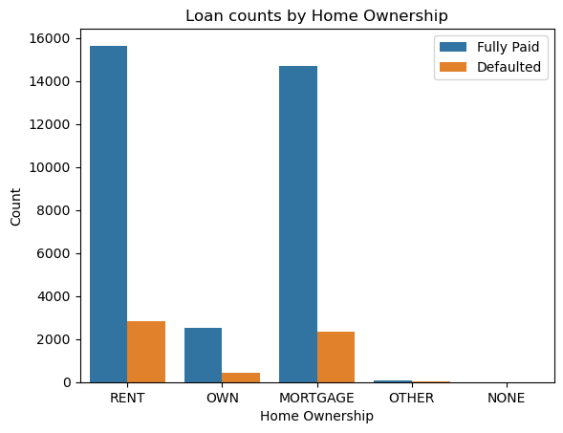
Analysis
Home Ownership
Homeowners seem to have very less default percentage. There is a higher percentage of defaulters in renters and mortgage payers

Slide 7
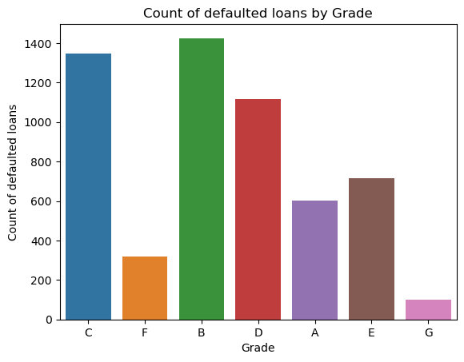
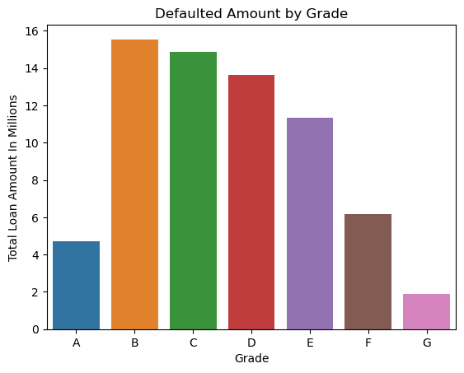
Analysis
Grade
Grade is a useful measure in estimating the loan risk. B/C/D categories of loans are causing much default count and default amount also

Slide 8
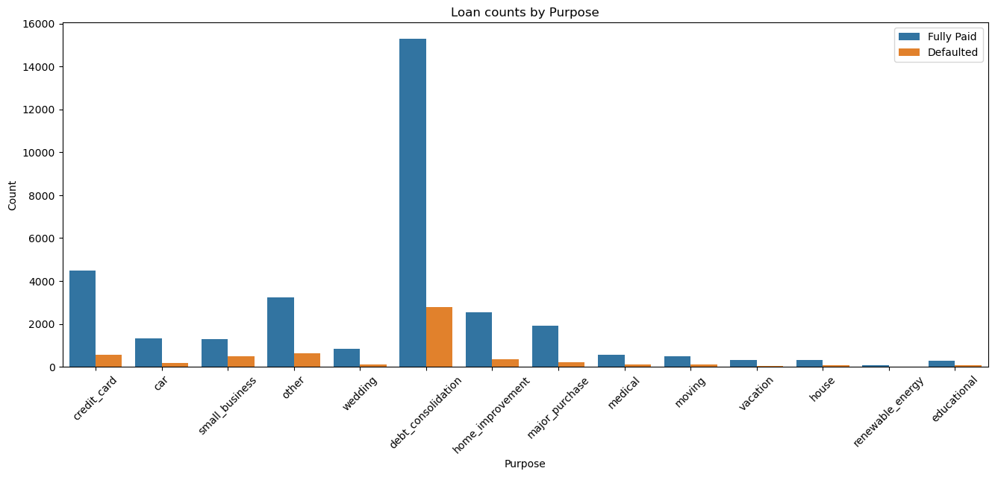
Analysis
Purpose
Purpose is also a helpful categorization. The highest number of defaults are coming from “debt consolidation” purpose which is also the highest number of loans

Slide 9
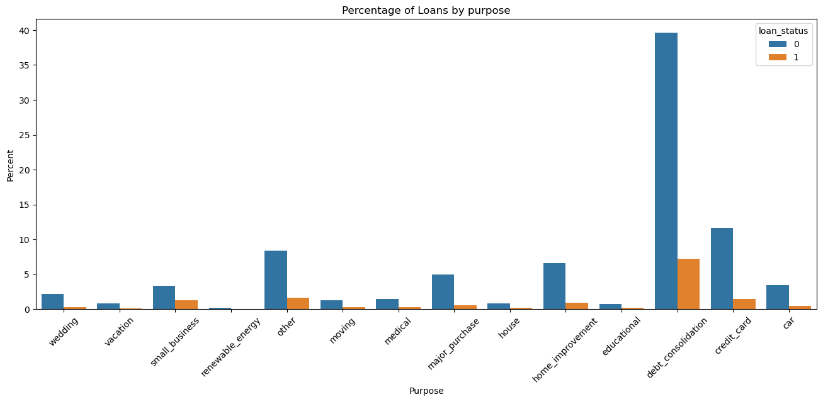
Analysis
Purpose (contd.)
Another perspective of purpose data. Presented by percentage of the loan count. “Debt consolidation” is still the biggest contender

Slide 10
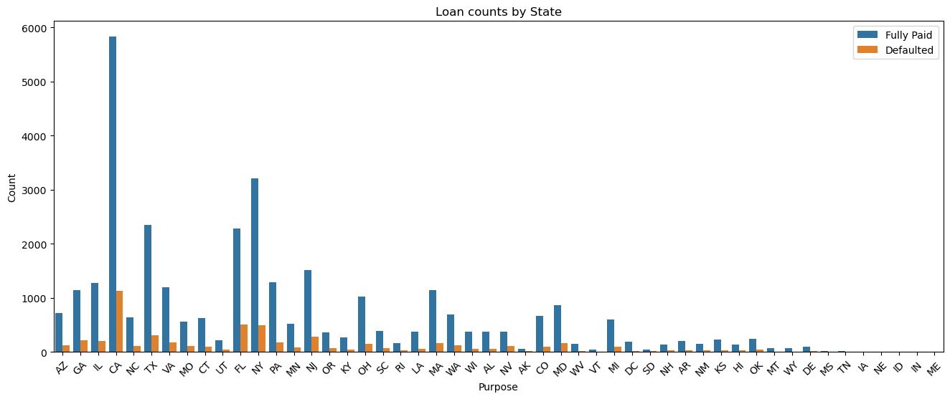
Analysis
State
California/Florida/New York/Texas are highest contenders for loans.

Slide 11
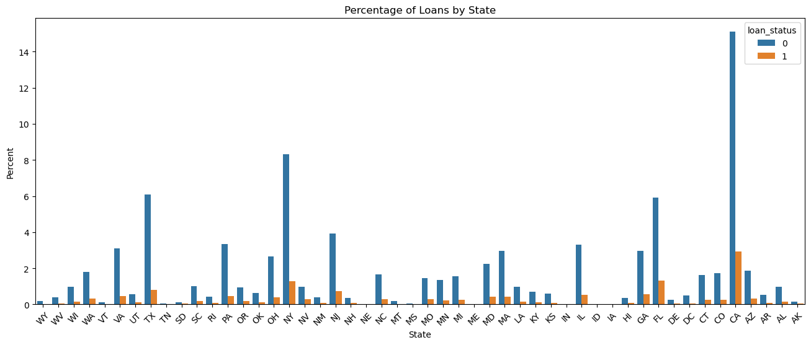
Analysis
State (contd.)
Depiction by percentage of loans

Slide 12
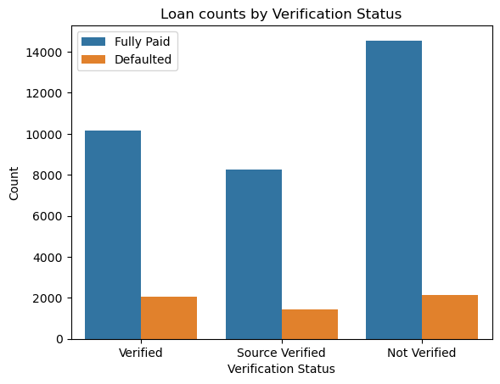
Analysis
Verification Status
There is a huge number of “Not verified” loans. Though the number of defaults is same as verified, it seems to be considerable risk factor

Slide 13
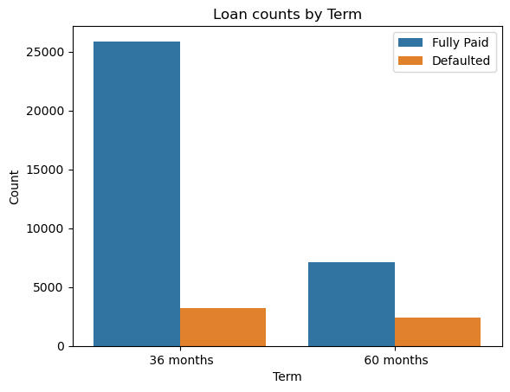
Analysis
Loan Term
There is a higher percentage of defaults in loans with longer term.

Slide 14
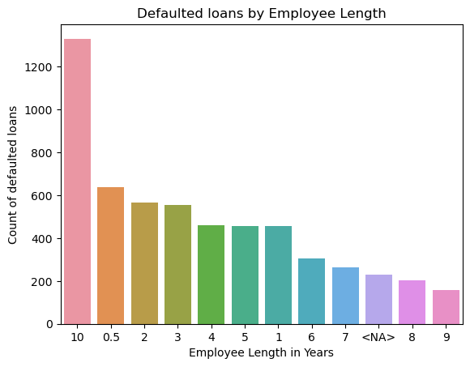
Analysis
Employment Length
“Employees with more than 10 years” and “Employees with less than 1 year” seem to have a higher default count.

Slide 15
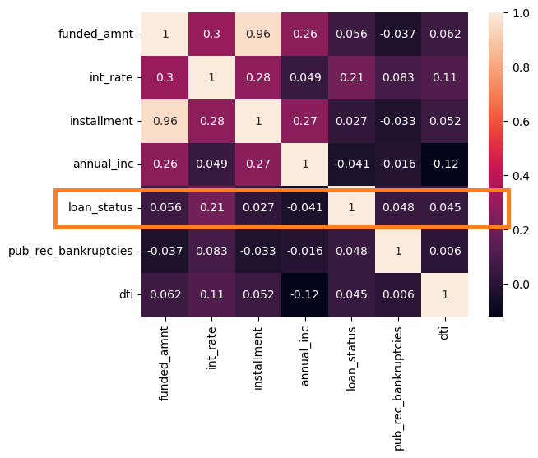
Analysis
Correlation among Numerical variables

