Slide 1
Electrofish: A Cardio-Aquatic Adventure with Microprocessors
By Nolan Knight
BME595 - BioInstrumentation

Slide 2
Physiology of Device

Slide 3
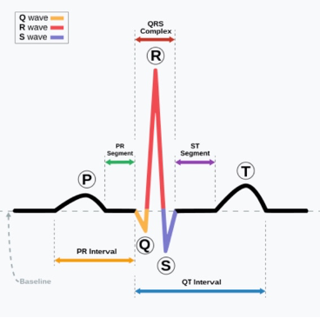
Normal Adult Sinus Rhythm [1],[2]
The typical rhythm of the heart consists of three main sections:
P-wave: The first electrical wave caused by atrial depolarization, depicting the smooth contraction of the atria.
QRS-complex: Ventricular depolarization, indicating the quick contraction of the ventricles to push blood out of the heart.
T-wave: Ventricular repolarization, signifying the recovery of the ventricles to their resting state.

Slide 4
Hardware Overview

Slide 5
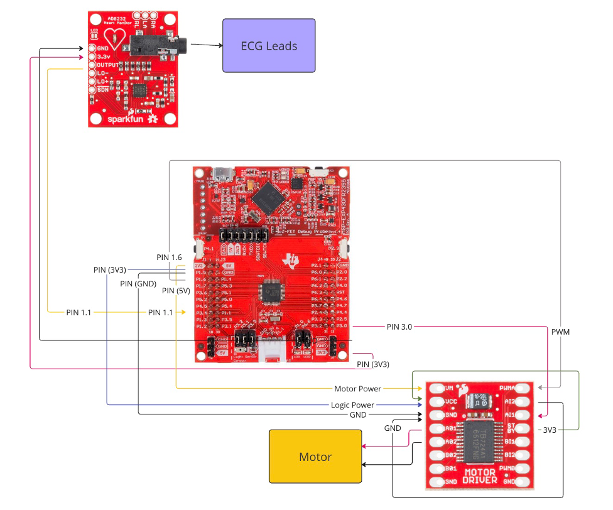
Device Hardware Overview

Slide 6
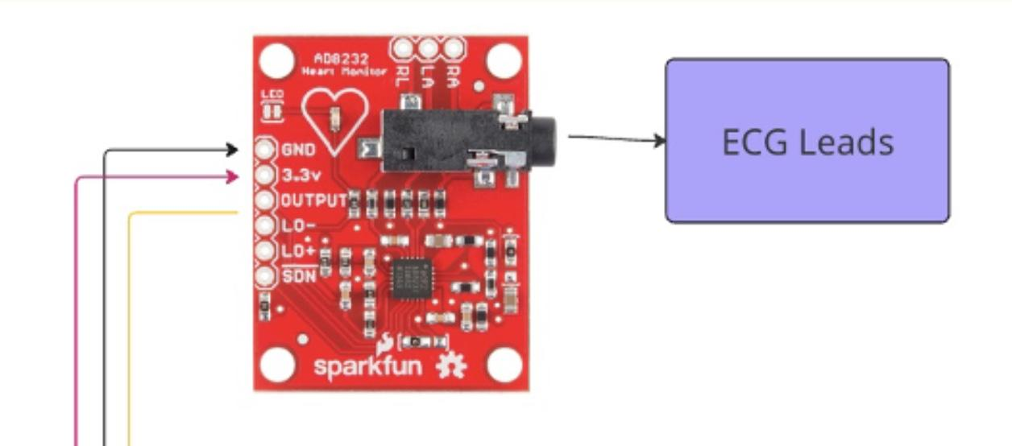
Hardware Input: ECG Module

Slide 7
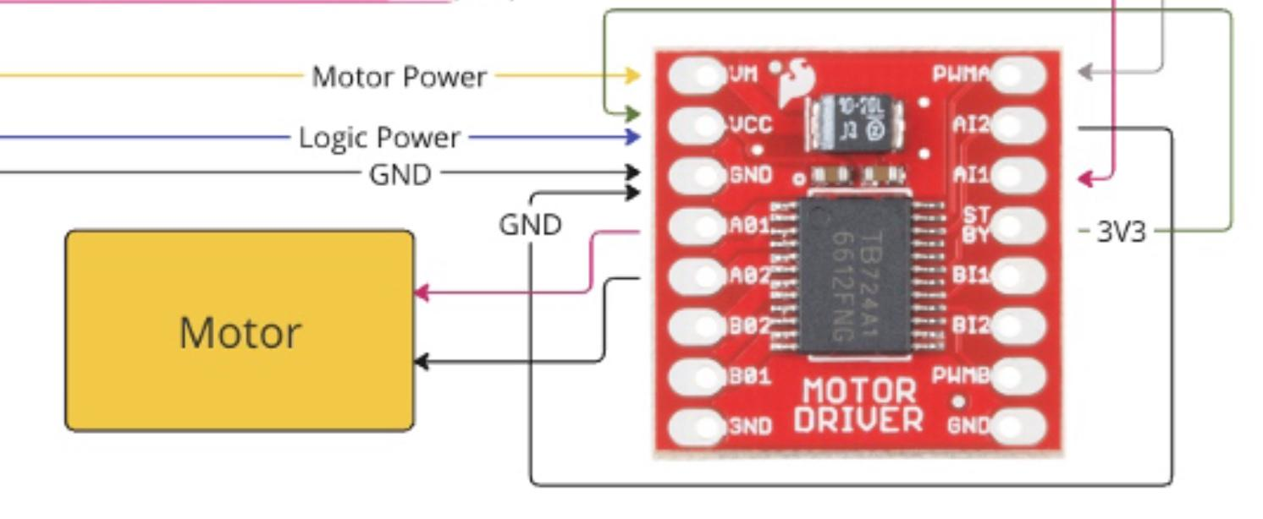
Hardware Output: Motor Driver
PIN3.0
PWM: 75%

Slide 8
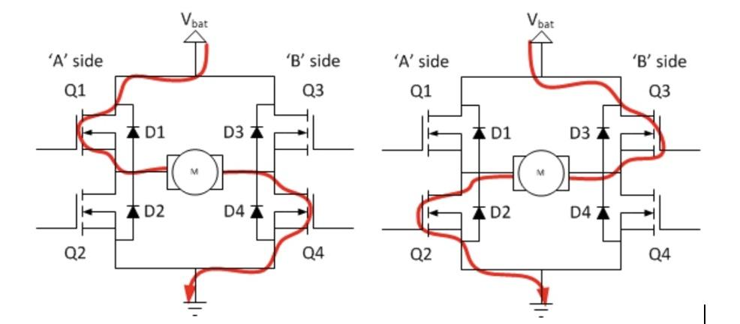
Motor Driver : H - Bridge [3]

Slide 9
Software Overview

Slide 10
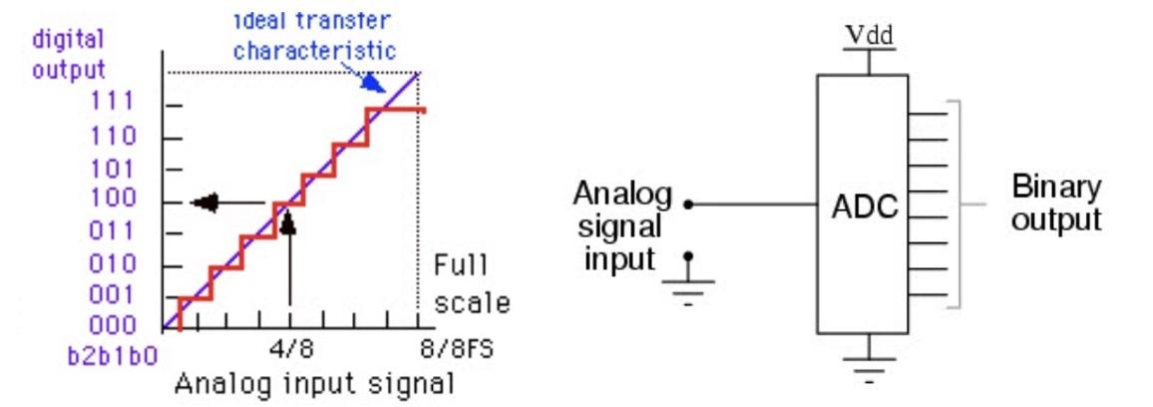
Analog to Digital Converter [4]

Slide 11
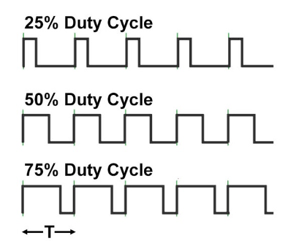
Pulse Width Modulation [5]
Source Code:
TB0CCR0 = 128; // PWM Period/2
TB0CCTL1 = OUTMOD_6; // TBCCR1 toggle/set
TB0CCR1 = 96; // TBCCR1 PWM duty cycle
TB0CTL = TBSSEL_1 | MC_3; // ACLK, up-down mode
PWM: (96/128) * 100 = 75%

Slide 12
Device Calibration

Slide 13
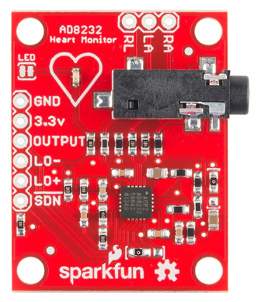
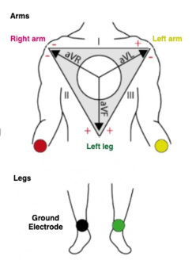
ECG Module [6], [7]
Signal Conditioning:
High and Low Pass Filters
  Remove Noise and small muscle movements.
Amplification
  Increases the voltage potential to ensure signal strength and signal integrity
DC - Offset
  Allows the microprocessor to handle analog signal as it is not equipped to handle bipolar signal. Vref = 1.5V

Slide 14
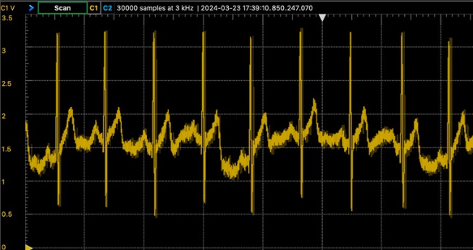
Post-Processing - ECG Module
Voltage Offset:
Vref = 1.5V
Physiology:
P-Wave: ~1.75V Peak
QRS-Complex: 3.3V Peak
T-Wave: ~2.1V Peak

Slide 15
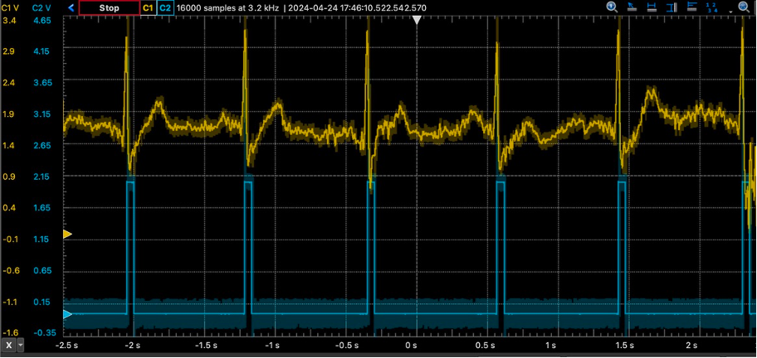
Post-Processing - Motor Trigger

Slide 16
Works Cited
[1] “QRS Complex.” Wikipedia, Wikimedia Foundation, 8 Apr. 2024, en.wikipedia.org/wiki/QRS_complex.
[2] Ayano, Yehualashet Megersa, et al. “Interpretable Machine Learning Techniques in ECG-Based Heart Disease
Classification: A Systematic Review.” Diagnostics (Basel, Switzerland), U.S. National Library of Medicine, 29 Dec. 2022, www.ncbi.nlm.nih.gov/pmc/articles/PMC9818170/.
[3] Tantos, Andras. “H Bridges - The Basics.” Modular Circuits, 2011,
www.modularcircuits.com/blog/articles/h-bridge-secrets/h-bridges-the-basics/.
[4] Agarwal, Tarun. “Analog to Digital Converter : Block Diagram, Types & Its Applications.” ElProCus, 29 Jan. 2021,
www.elprocus.com/analog-to-digital-converter/.
[5] “Led Dimming Using the Pulse Option and PWM.” NIGHTSEA, 6 Mar. 2023,
nightsea.com/articles/pwm-led-dimming/.
[6] “Sparkfun Single Lead Heart Rate Monitor - AD8232.” SEN-12650 - SparkFun Electronics,
www.sparkfun.com/products/12650. Accessed 24 Apr. 2024.
[7] “QRS Complex.” Wikipedia, Wikimedia Foundation, 8 Apr. 2024, en.wikipedia.org/wiki/QRS_complex.

Slide 17
Appendix

Slide 18
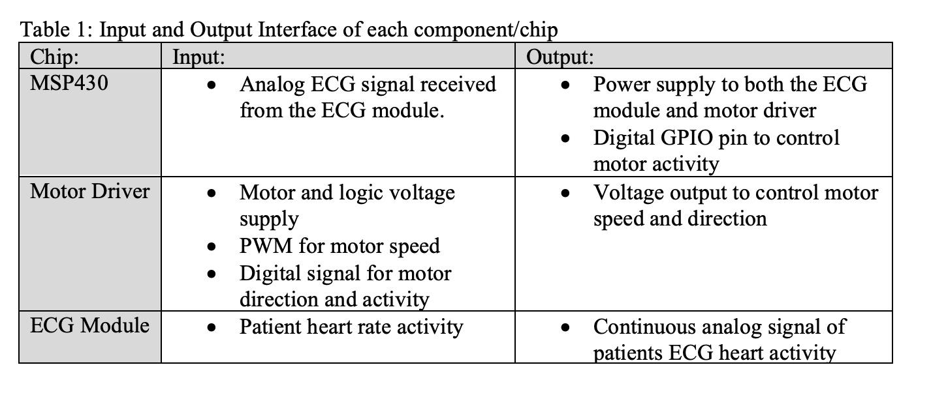
Input / Outputs:

Slide 19
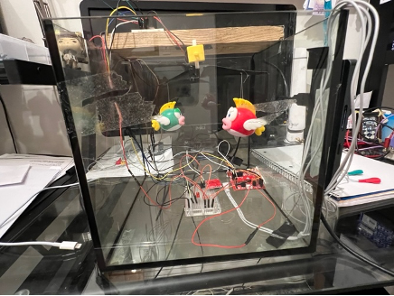

Slide 20
