Slide 1
Don’t Be
An Expert Beginner

Slide 2
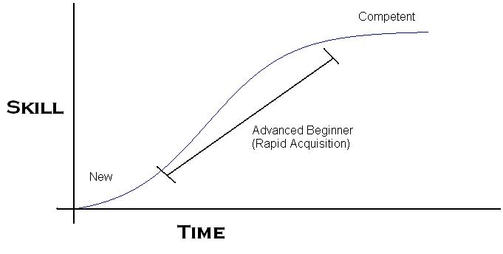
What is an Expert Beginner?
https://rb.gy/gczqoh
Trapped in permanent mediocrity
Stunted by the belief that they’ve achieved expert status and improvement is not possible

Slide 3
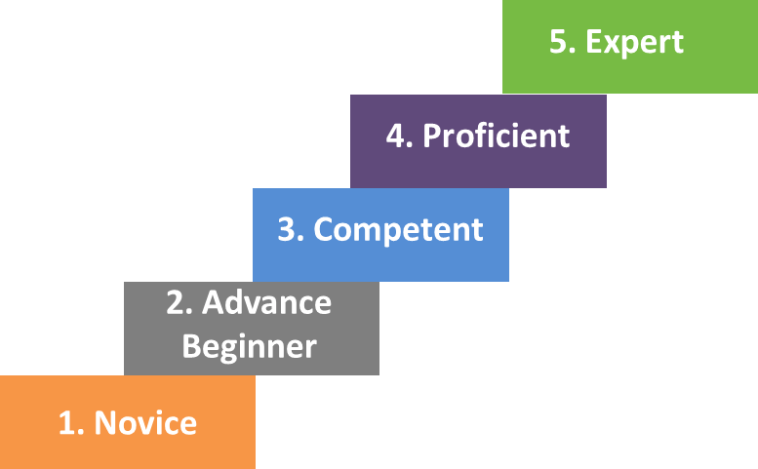

Slide 4
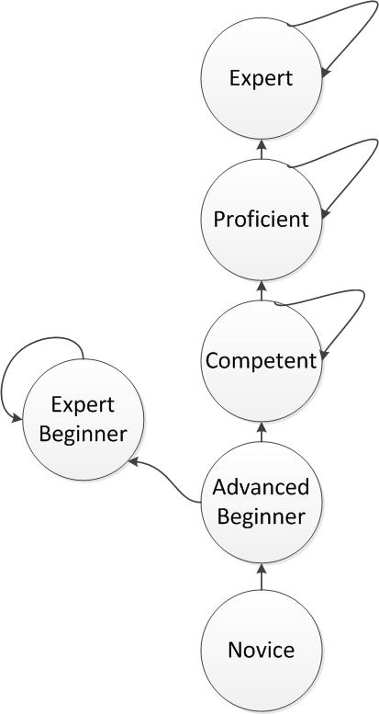
Ten years of experience
or The same year of experience ten times.

Slide 5
The Basic Premise
Check Out the Software Engineer Job Ladder
1. Give a junior developer a problem and they come back with questions
2. Give a mid-level developer a problem and they come back with a solution
3. Give a senior developer a problem and they come back with
a set of solutions and
a recommendation

Slide 6
Profiles
of a
Developer

Slide 7
Junior Developer
Give a junior developer a problem and they come back with questions
They think: "Critique is a sign of my inadequacy as a developer"
When considering the pros and cons of a solution they:
May be overwhelmed by edge cases and stunted with questions
Tries to create the perfect PR every single time
May have a hard time explaining the problem

Slide 8
Mid-Level Developer
Give a mid-level developer a problem and they come back with a solution
They think: "Critique is a sign of my solutions inadequacy"
When considering the pros and cons of a solution they:
Are able to prioritize edge cases
May take notes to help them focus without going through rabbit trails
Create PRs that can be improved
Can explain the problem and their solution

Slide 9
Senior Developer
Give a senior developer a problem and they come back with a set of solutions and a recommendation
They think: "Critique is an opportunity for growth and improvement"
When considering the pros and cons of a solution they:
Consider a range of scenarios and the edge cases that may arise in each scenario
Will take notes as they research and develop a solution
Create PRs that explain their solution so that code reviewers can easily find potential problems or edge cases
Can explain the problem and a set of solutions along with the pros and cons of each

Slide 10
How do we avoid the expert beginner trap?

Slide 11
Understanding the Problem
Asking Ourselves
Read the Docs and listen to your team
Identify Important Quality attributes
Reliability
Reusability

Slide 12
The Solution Ladder
1. Think of a naive solution that solves your problem
2. Ask yourself, what about this solution concerns you?
3. Repeat
You always have a working solution, even if it isn't ideal

Slide 13
Tackle the Tedious
Don't let tedium be a reason to avoid the work
Make work less tedious by leveraging your tools
1. Typescript
2. Tests
3. Editor (vim!)

Slide 14
Contribute to the Team
Your ideas
Your resources
Your experiences
Your knowledge
Apps I Like

Slide 15
Summary: Avoiding The Expert Developer Trap
Always seek new opportunities for growth.
Take the time to understand the problem
Use the solution ladder to bust through a block
Tackle the Tedious
Leverage your Tools
Help make the team better by sharing

