Slide 1
From Outcomes to Outputs

Slide 2
Outcome
Focused on value to the user*
Progress is measured by observable changes in user behavior
A profit center
Output
Focused on deliverables and artifacts
Progress is measured by the number of deliverables and artifacts developed
A cost center
*The user is anybody who derives value from the system, including the business stakeholders
Notes:
Example Outcomes
From not subscribing to your SaaS product, to subscribing to your SaaS product
From not sending dispute letters, to sending dispute letters
From shunning clients with low credit scores, to following up with clients after they’ve improved their credit score.
From having no data, to making decisions based on real user data
Example Outputs
A sign up workflow
An endpoints that generate PDF files of dispute letters
A SaaS application that helps clients improve their credit scores and notifies a mortgage broker when they’re ready
The implementation of analytics
Profit Center vs Cost Center Implication: Minimize Output, Maximize Outcomes
Can you think of some examples of outcomes and outputs?

Slide 3
Desired Outcomes
will be converted
To Projected Outputs
Whether we are intentional
about it or not
Notes:
As engineers, we naturally focus on outputs
But we need to be aware of outcomes. They influence how we prioritize our work and how we can maximize our impact on a project.
But we can often forget to be intentional about the transition from outcomes to outputs
This process happens when
Business stakeholders create constraints on the project
“I want the app to be highly polished”
The designer creates a mockup
The product owner or project manager creates tickets that make assumptions about implementation
The engineer rushes through a ticket
Ideally as engineers, we can be involved in this process as early as possible so we can help minimize output and maximize outcomes
But that isn’t always possible.
In either case, we need tools that help us
Intelligently convert outcomes to outputs
Reason about outputs that have already been specified by designers/product owners/ other stakeholders/etc

Slide 4
Enough Theory

Slide 5
The User Story
Role
Activity
As an author
I need to review and approve reader comments
So that the discussion remains relevant and civil
Valuable Outcome
Notes:
This is a user story
This is how product owners like to keep track of outcomes and values for their products
There is a whole lot of theory behind these things so I won’t dig in to this too much, but I wanted to bring these up to make 2 points
User Stories can be used to track value for any system, not just SaaS products or customer facing apps
These user

Slide 6
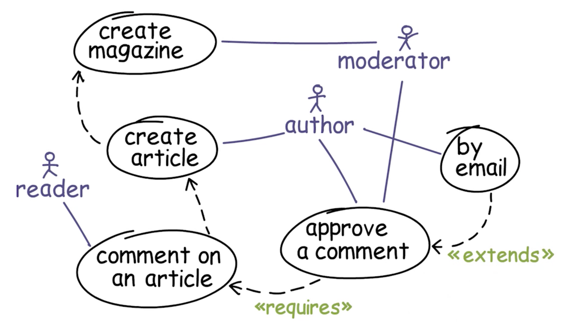
Dependency Graph
Notes:
When to use it
When you’re planning a sprint or future work
This helps us avoid creating fake, “mock” functions that will be implemented later. This simplifies validation of a ticket, and helps the project move more smoothly.

Slide 7
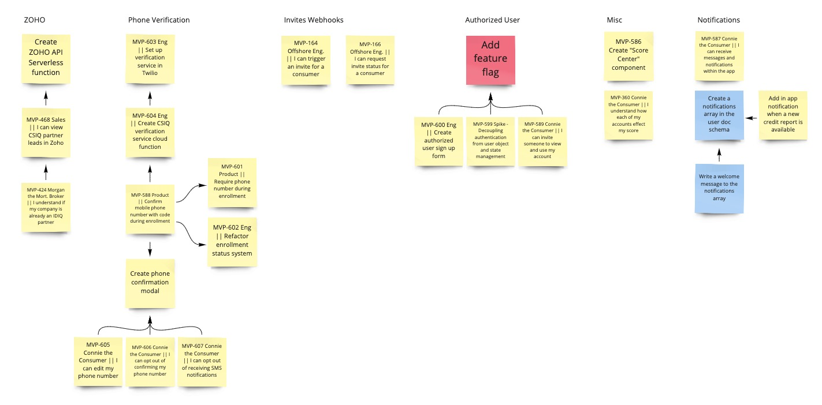
Dependency Graph

Slide 8
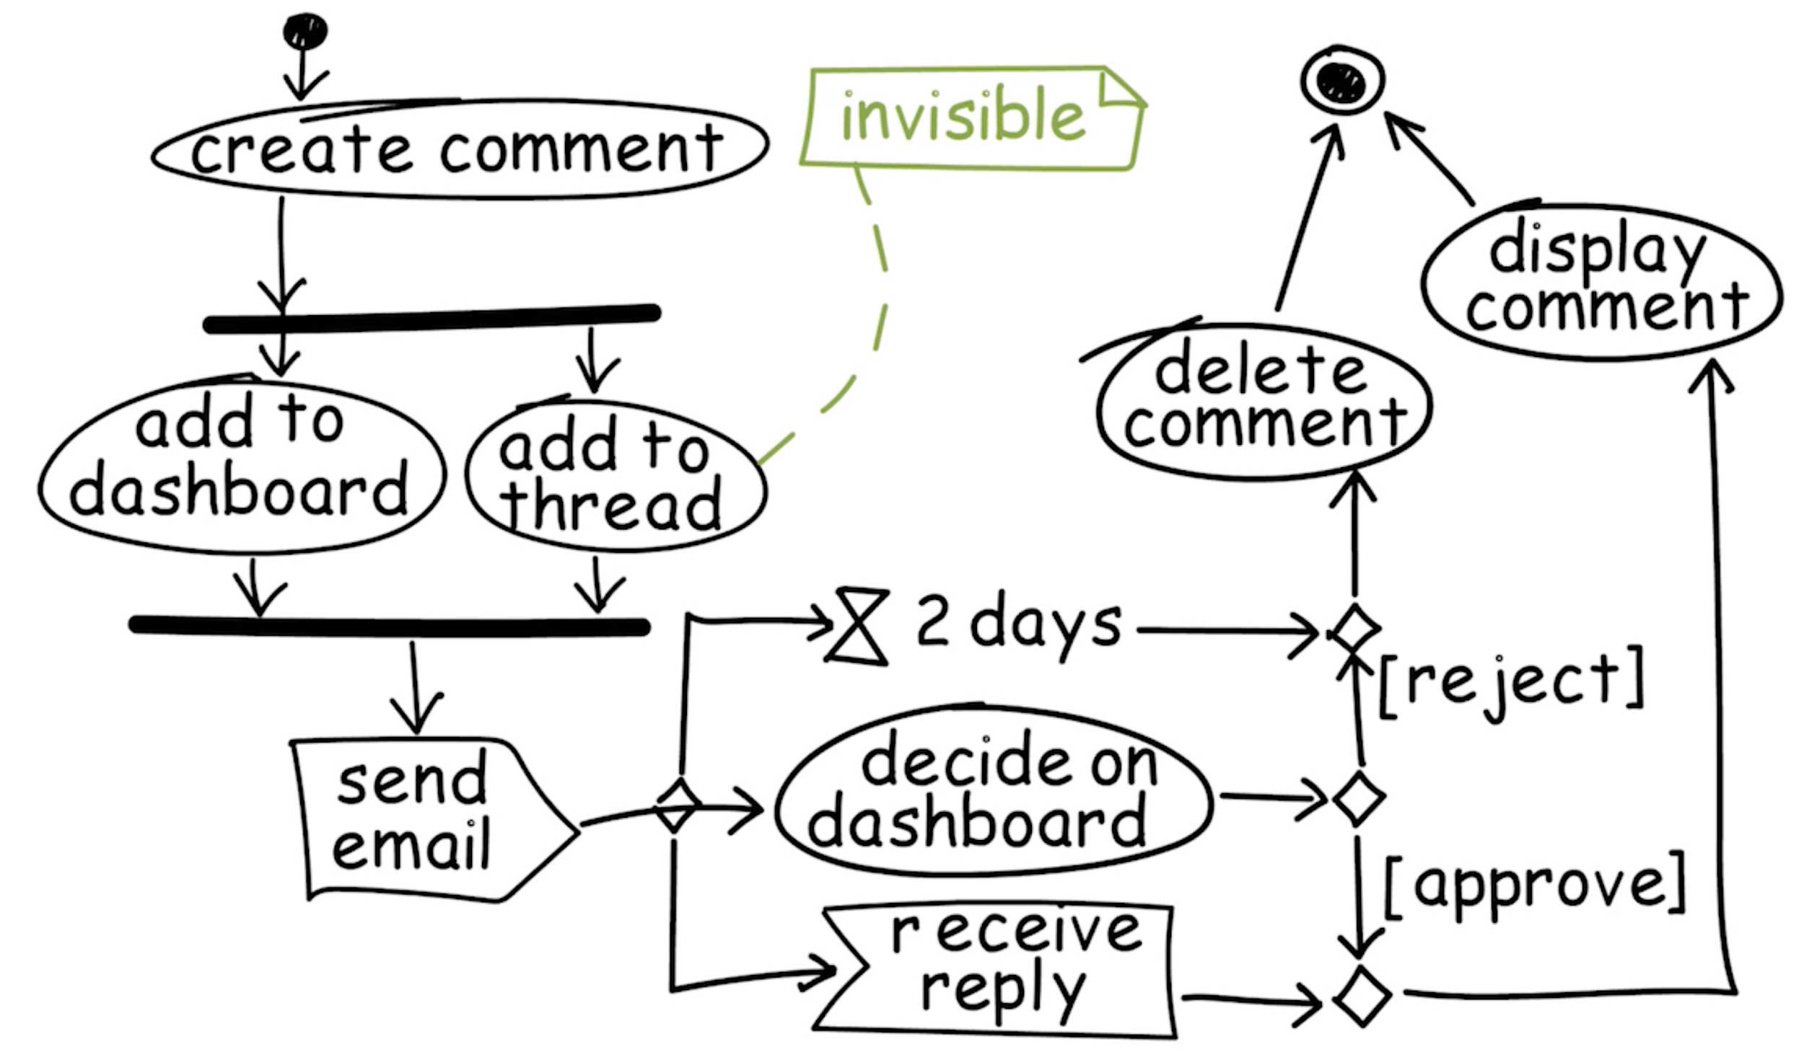
Activity Diagram
Notes:
Show the activities that comprise a story

Slide 9
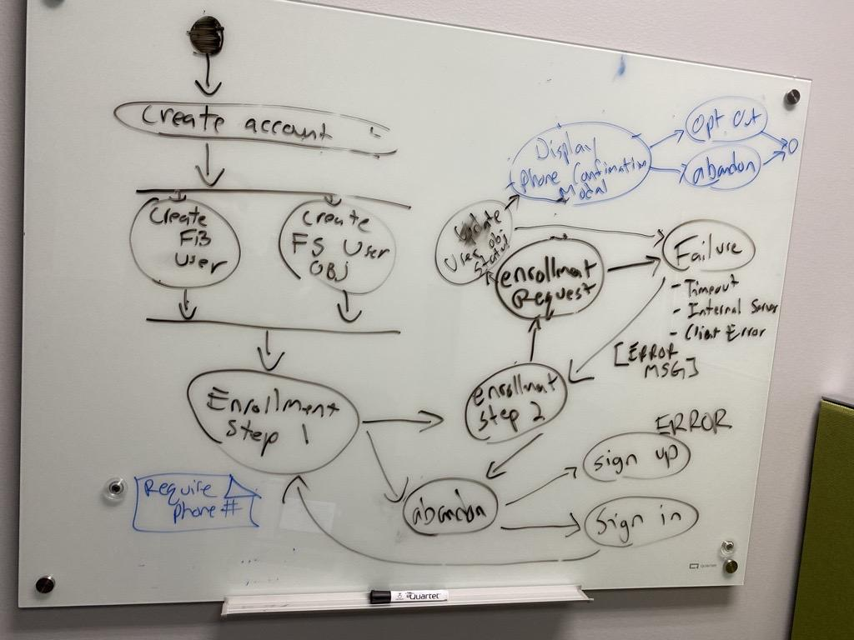
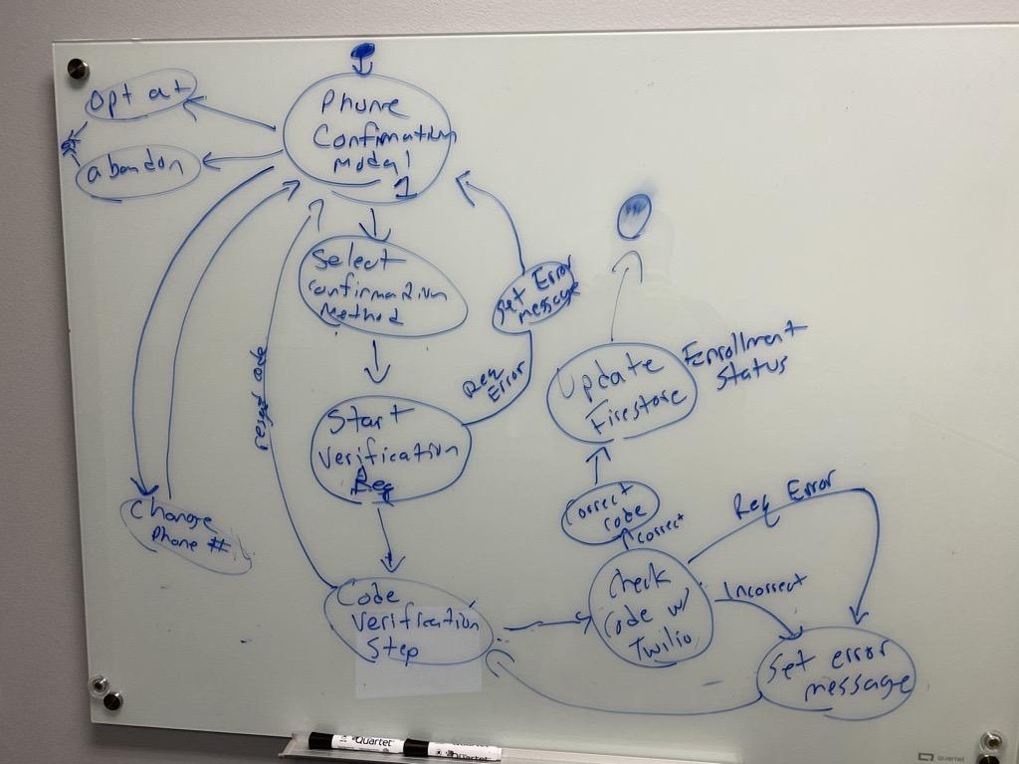
Activity Diagram
Notes:
Show the activities that comprise a story

Slide 10
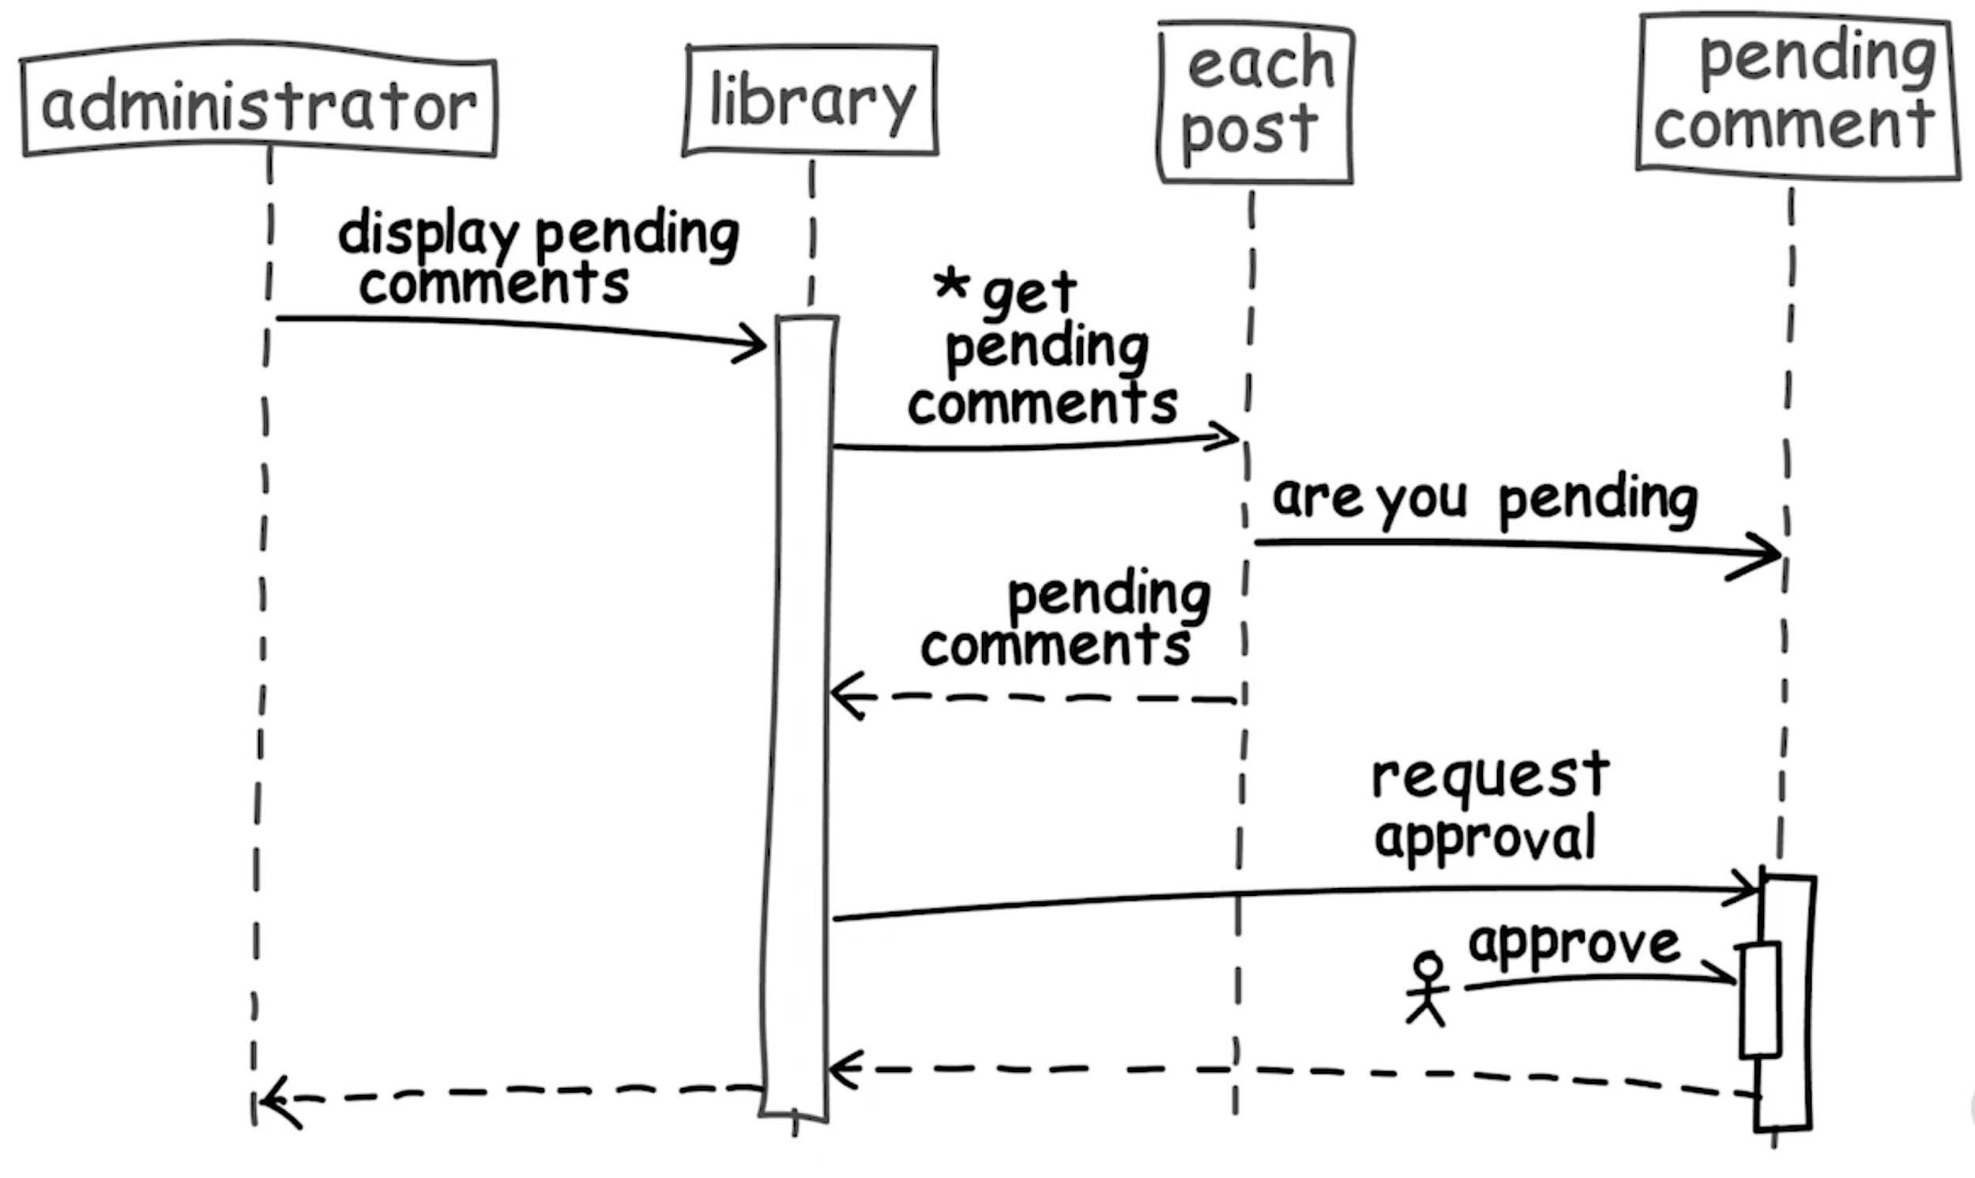
Sequence Diagram
Notes:
Show the activities that comprise a story

Slide 11
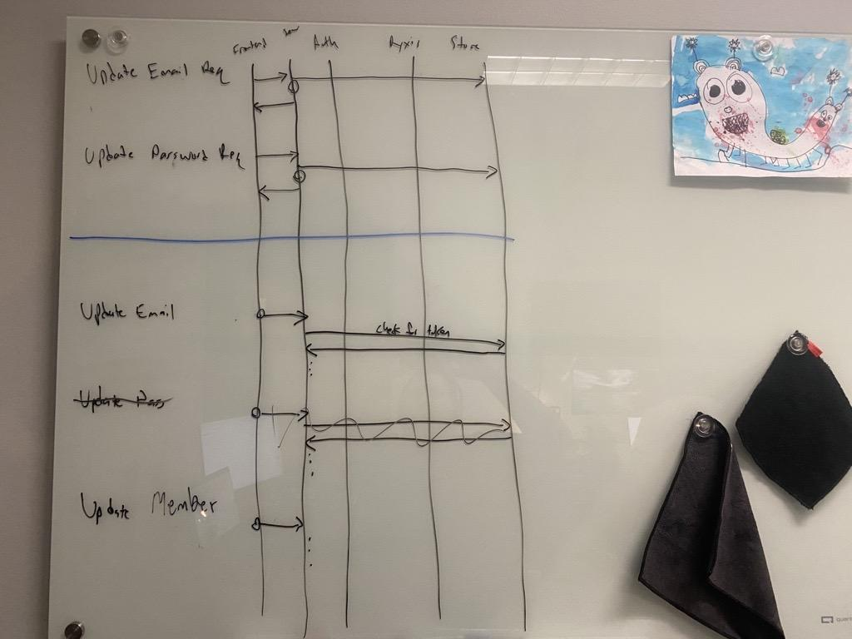
Sequence Diagram
Notes:
Show the activities that comprise a story

Slide 12
Summary
We should be intentional about converting outcomes to outputs
We need tools to help us reason about this process
The tools we went over:
Dependency Graph
Describes the dependency relationships between user story
Help us make sure we’re tackling our tasks in the right order
Activity Diagrams
Describes the steps it takes to complete a user story
Helps us identify the technical requirements for a user story
Sequence Diagram
Describes the messaging between different units in a system to complete a story
Helps us identify the specific units to be developed, and the messages they must send to each other.

