Slide 1
Kernel
黃悅民 教授
2014/03/21

Slide 2
Outline
Introduction
User mode & kernel mode
System call
Interrupt
Kernel module
Related information about Linux kernel
Lab guide

Slide 3
What is Kernel(1/2)
The most important program of operating system,
it’s contains many critical procedures that are
needed for the system to operate
– Kernel can be thought as the main software of OS,
other progarms of OS are less crucial utilities

Slide 4
What is Kernel(2/2)
Process management – Determinate process’s life cycle, control process I/O and distribute CPU resource for scheduler
Memory Management – Communicate with memory management subsystem ex: malloc/free
File System – Kernel support multiple file system
Device Control – System call will be mapping to corresponding hardware device, every device has unique code to operate, call device driver
Networking – The kernel provide send/receive mechanism to handle incoming data

Slide 5
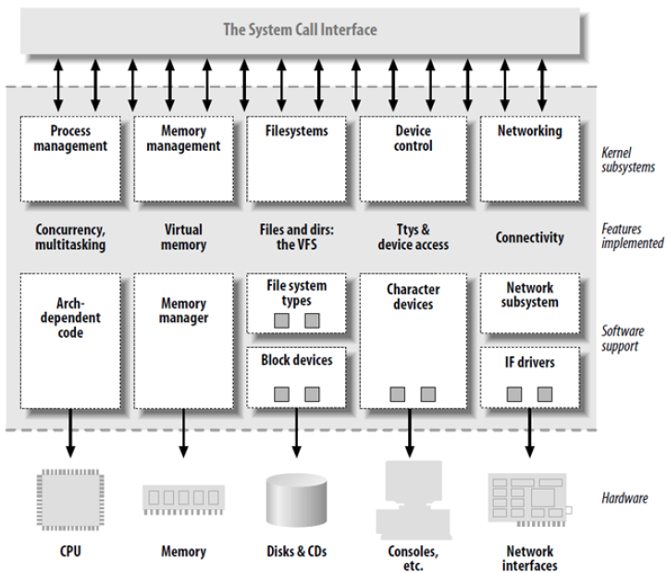
Kernel architecture
Referenced from Building Embedded Linux Systems, edited by Karim Yaghmour et al, O’REILLY

Slide 6
User mode & Kernel mode(1/3)
Hardware(processor) provides two different operative modes
– Kernel mode
– User mode
Except processor support, OS support is also
needed
This design allows the OS to run with more
privileges than application program

Slide 7
User mode & Kernel mode(2/3)
User mode
– Restricted level, the executing code has no ability to
directly access hardware or reference memory.
– Code running in user mode to access hardware or
memory must via system library(ex:glibc)

Slide 8
User mode & Kernel mode(3/3)
Kernel mode
– The most unrestricted level, allows access to all the
computer’s resources
* Any CPU instruction can be executed and every memory
address can be accessed
System calls, interrupts, and exceptions are changed mode from user to kernel

Slide 9
System call(1/3)
System call is a mechanism that is used by the
application program to request a service from
the OS
Each system call provides a basic operation, such as:
– Opening a file
– Reading a character
– etc.

Slide 10
System call(2/3)
Even for same OS version, different processor architectures make system calls in different ways
– Using a machine-code instruction that causes the processor to change mode – System call numbers are different for various processor architectures

Slide 11
System call(3/3)
System calls are generally not invoked directly, but rather via wrapper functions in system libraries, such as: – glibc(on Unix-like systems) – Native API (on Windows NT) – etc.

Slide 12
Accessing Kernel via Library interface
Invoking a system call
User mode
Kernel mode
… xyz() …
xyz(){
… int 0x80 … }
system_call: … sys_xyz()
…
ret_from_sys_call: … iret
sys_xyz(){
… }
System call invocation in application program
Wrapper routine in libc standard library
System call handler
System call service routine
Note: In Linux system, the system calls must be invoked by executing the int 0x80 Assembly instruction, which raises the programmed exception having vector 128
Referenced from Understanding the LINUX KERNEL, edited by DANIEL P. BOVET & MARCO CESATI, O’REILLY

Slide 13
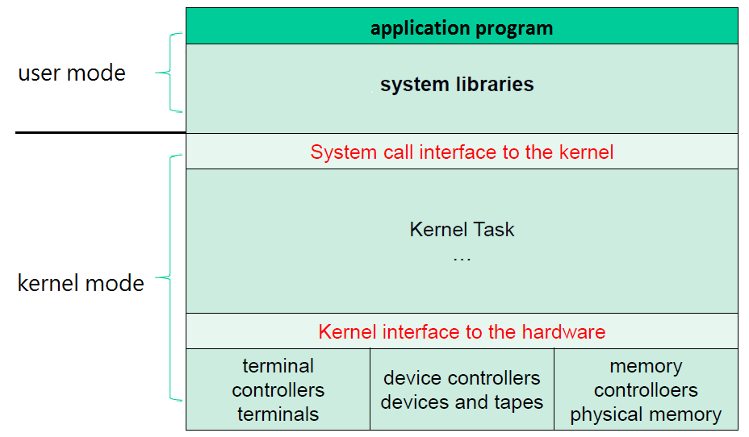
System Structure

Slide 14
What is Interrupt ?
An interrupt is usually defined as a signal to the CPU emitted by hardware or software that stops the execution of a running program and perform another action(Interrupt Service Routine)

Slide 15
Interrupt classification(1/5)
Interrupts are often divided into: – Synchronous interrupts * CPU control unit issues them only after terminating the excution of an instruction – Asynchronous interrupts * Generated by other external hardware devices at arbitrary times, it can occur in the middle of instruction execution

Slide 16
Interrupt classification(2/5)
The Intel documentation(x86 manuals) designate asynchronous & synchronous interrupts as interrupts & exceptions and classifies them as: – Interrupts * Maskable interrupts - The signal sent to the INTR pin of CPU, they can be disable by clearing the flag. All IRQs issued by I/O devices give rise to maskable interrupts.

Slide 17
Interrupt classification(3/5)
– Interrupts(cont) * Nonmaskable interrupts - The signal sent to the NMI pin of CPU, they can not disable by clearing the flag. Only a few critical events(ex: hardware failures) give rise to nonmaskable interrupts

Slide 18
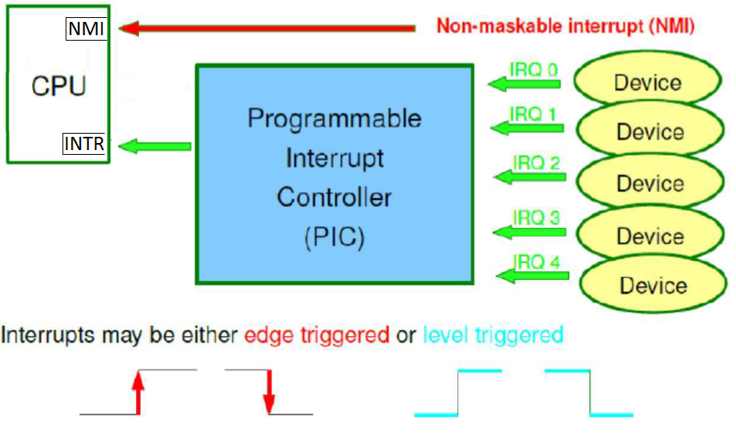
Interrupt classification(4/5)

Slide 19
Interrupt classification(5/5)
– Exceptions * Processor-detected exceptions - Generted when the CPU detects an anomalous condition (ex:divide by zero) while executing an instruction
* Programmed expections - Occur at the request of the program(system call), they are trigged by int or int3 assembly instructions - They are often called software interrupts

Slide 20
Kernel module
An object file that can be inserted or removed dynamically to the running kernel
Kernel modules are typically used to add support for new hardware or filesystem, or for adding system calls – USB – SATA – etc.

Slide 21
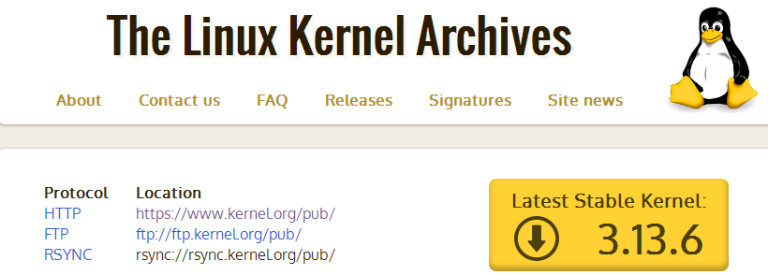
Related information about kernel
Linux kernel source official website: www.kernel.org
To date, the lastest stable version is 3.13.6
Get the version number of your Linux – $ uname -r – ex:

Slide 22
Reference
DANIEL P. BOVET and MARCO CESATI, Understanding the LINUX KERNEL, O’EILLY.
Linux kernel official web.,https://www.kernel.org/

Slide 23
Lab Guide

Slide 24
Today’s lab.
Install related package
Build kernel image file
Verify on the board

Slide 25
Getting lab file
Download lab file from course website: – http://mmn.twbbs.org
– 102學年度上學期
* [在職專班]網路嵌入式系統應用 * Account => embedded102 * Password => embedded102

Slide 26
Install related package
Install mkimage package – $ sudo apt-get install uboot-mkimage -y

Slide 27
Get kernel directory(1/2)
Uncompress linux-02.01.03.11.tar.gz – $ tar -zxvf linux-02.01.03.11.tar.gz
Enter the kernel-source directory – $ cd linux-02.01.03.11/

Slide 28
Get kernel directory(2/2)
Patching – A patch is a modify technique to update/modify
kernel – A patch file describes the changes (lines removed
or lines added) to the kernel – Using the patch command
- $ patch -p1 < ../linux‐02.01.03.11‐devkit8000‐2.patch

Slide 29
Compile Kernel steps(1/5)
Copy config file - $ cp arch/arm/configs/omap3_devkit8000_defconfig .config
$ make menuconfig

Slide 30
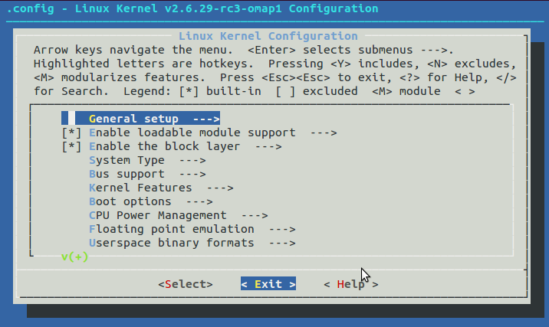
Compile Kernel steps(2/5)
It is I, not l

Slide 31
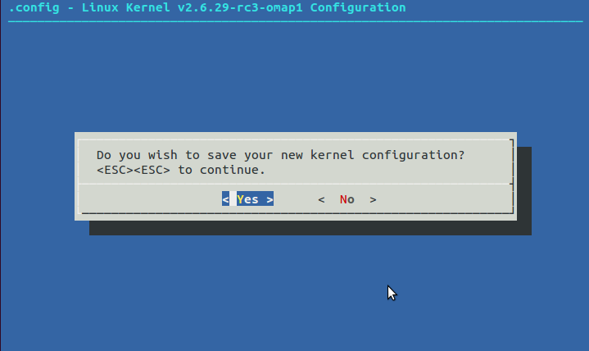
Compile Kernel steps(3/5)

Slide 32
Compile Kernel steps(4/5)
$ make
$ make uImage
It is I, not l

Slide 33
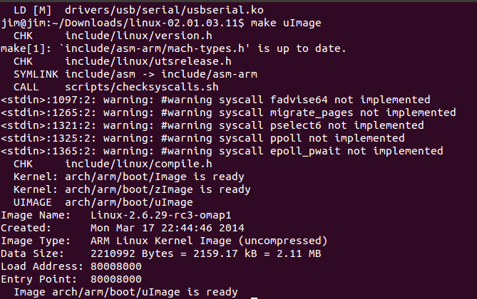
Compile Kernel steps(5/5)
When it is completed, you can see that:

Slide 34
Put kernel image into SD card
Copy uImage file from specific directory to SD card – $ cp arch/arm/boot/uImage /media/boot

Slide 35
Prepare for boot
Safely remove SD card and insert it into pandaboard.
– Note: Do not insert or remove the SD card when the board is powered on
Connecting DevKit8000 to PC by using RS232 connector.
Start serial communication software(C-Kermit) – $ sudo kermit -c
Turn on the DevKit8000 board – Plug power connector into the power slot of DevKit8000.

Slide 36
Let’s boot
Initial mmc controller. – # mmcinit
Load u-boot.bin into the RAM. – # fatload mmc 0:1 0x80300000 uImage
Booting from appropriate address of RAM. – # bootm 0x80300000

Slide 37
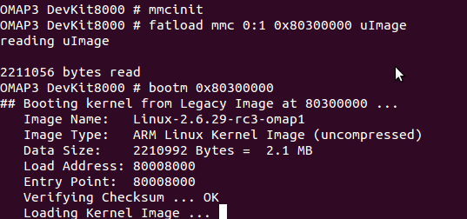
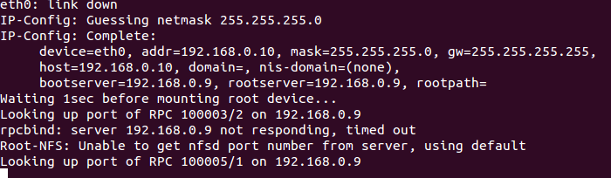
Verify

