Slide 1

Predicting Graduation Outcomes for NYC Public Schools
Nathaniel Lanier
Brown University
Data1030
Presentation date: 12/03/2020
https://github.com/ncl11/Data1030_project

Slide 2
Problem: Predict Cohort Graduation Percentage Outcomes
High School graduation has a large impact on income and overall life outcomes
Accurately predicting graduation rates can help the city allocate resources accordingly
Two types of diplomas in NY state: Regents and Local
The target variable is graduation percentages broken down on the school level, so it is a regression problem
The data is sourced from NYC OpenData: https://opendata.cityofnewyork.us/
Data cleaning, dealing with missing data and adding Income column was necessary before we began splitting
Consistent increase in graduation percent every year

Slide 3
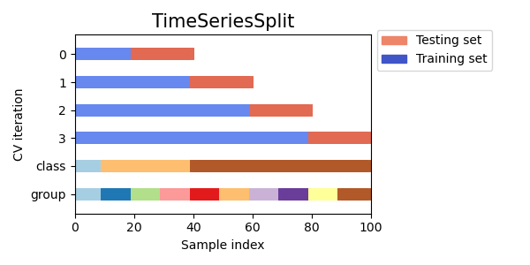
Splitting and Preprocessing
Times series split
Most other variables were relatively evenly distributed so time was the only variable taken into consideration when splitting
Number of schools is fixed so no need to perform well on unseen schools
Source for Graphic: https://scikit-learn.org/stable/auto_examples/model_selection/plot_cv_indices.html#sphx-glr-auto-examples-model-selection-plot-cv-indices-py

Slide 4
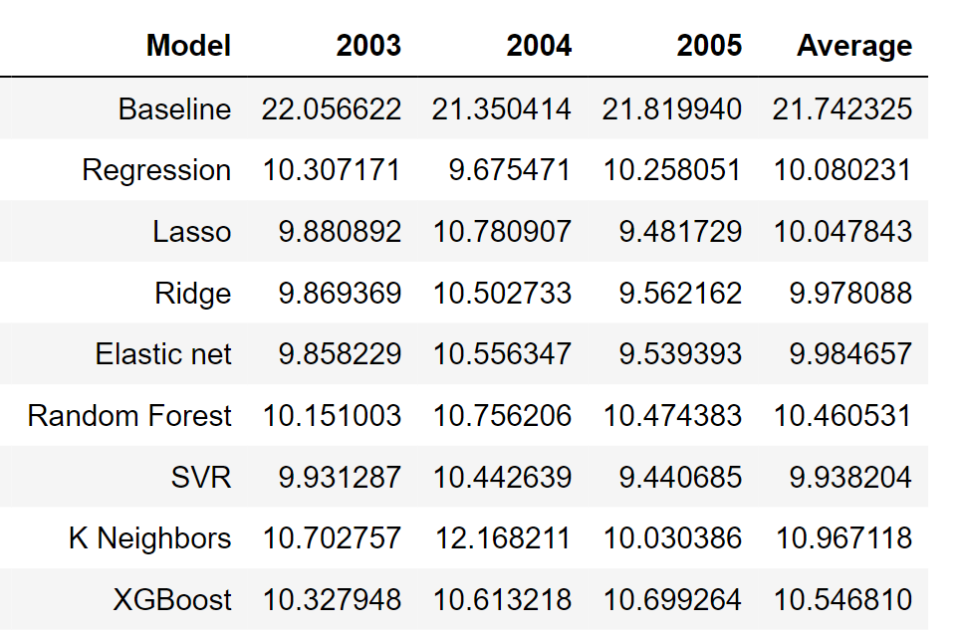
Models Tested
Scores measured in RMSE
SVR had the best average and best single year test score- kernel: rbf, gamma: 2^-13, C:128
Lasso had the second-best single year test score- alpha: 0.1
Elastic Net was third
Regular regression performed surprisingly well

Slide 5
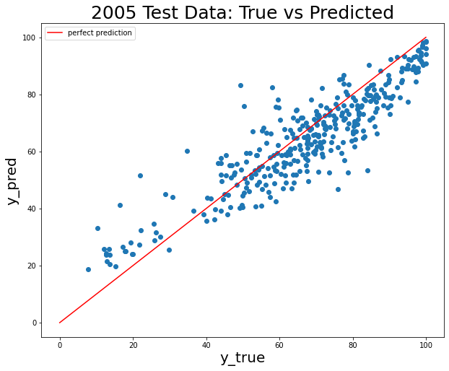
SVR Performance
Overall score is decent but some of the outlier predictions are concerning
Seems to underpredict on average
Likely caused by fact that response is non-stationary

Slide 6
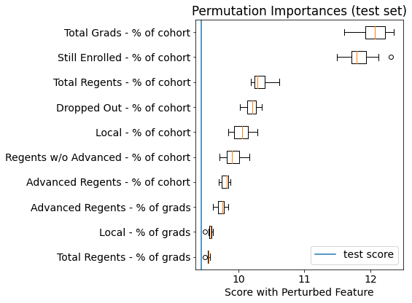
Feature Importance
Total Grads - % of Cohort and Still Enrolled - % of cohort were two most important by a significant margin
Interestingly there were several features that slightly improved the score when they were permuted

Slide 7
Outlook
Next step is to get more recent data but we are confident the pipeline built in this project could be reused
In order to improve the model we would like additional features such as some metric of parental involvement, more accurate income data, income data for school employees etc. which will likely cost additional money
Developing local feature importance measurements will be important to explain level of funding to school administrators
Given the relatively low RMSE we think this model could play an important role in resource allocation decision making

Slide 8
Thanks For Listening!
Questions?

