Slide 1






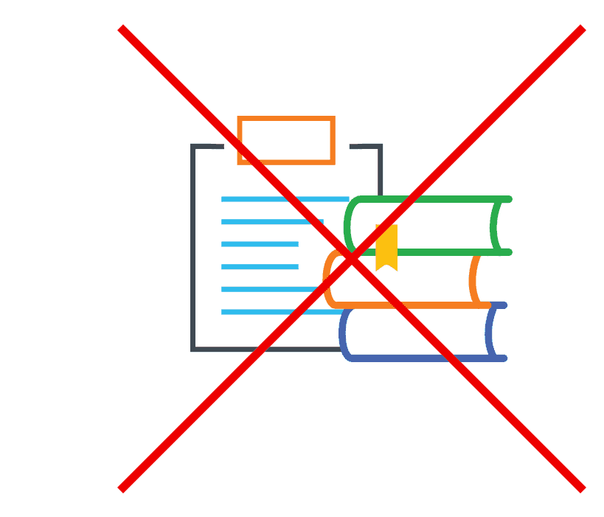
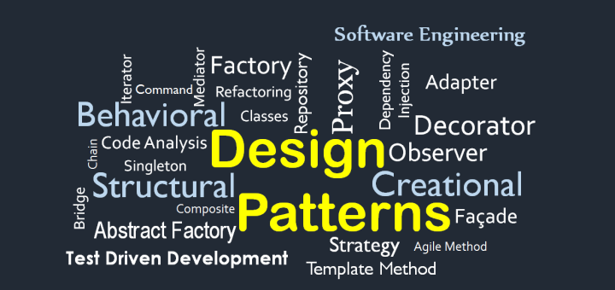





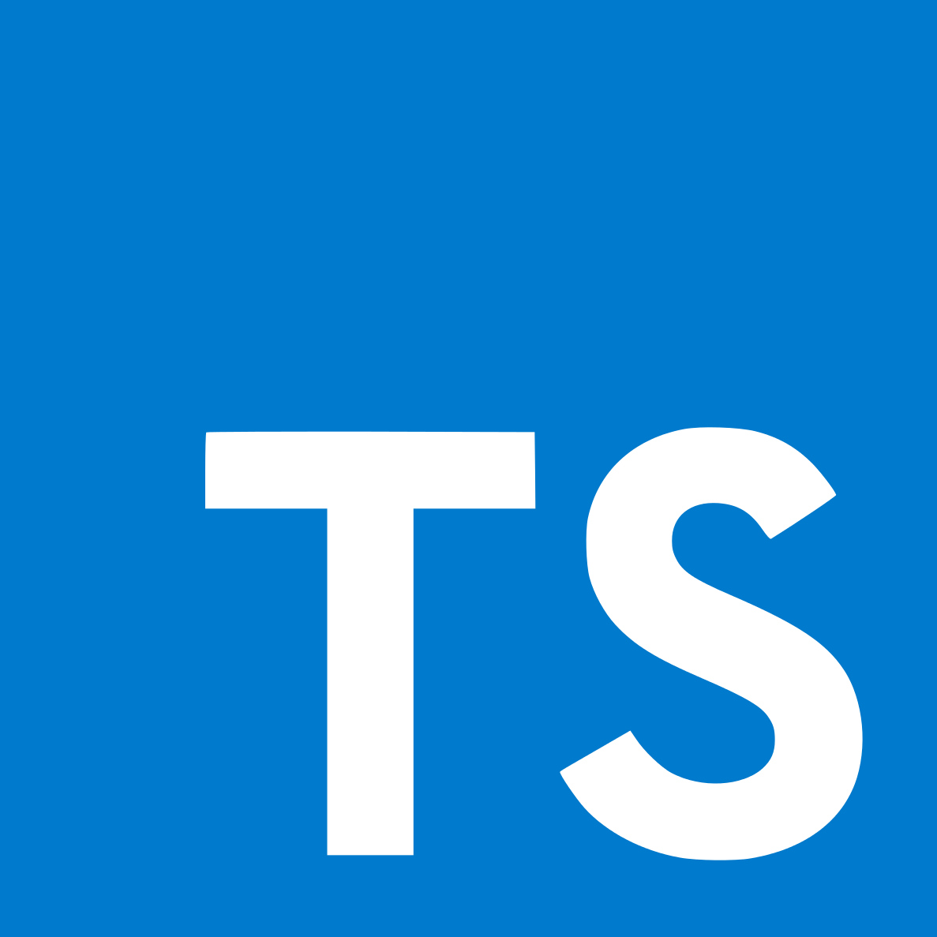

Kingternship–Seriously Playful Software Engineering
Andrei-Mihai Nicolae
2147392
How did the Kingdom raise?
Fast and Fluid
Craft and Care
King is a Swedish multinational company founded in 2003; it has evolved throughout the years into one of the top mobile games development companies, reaching 1400 employees.
Two of the core values of King, they represent the employee’s ability to adapt to any environment and do it quickly.
In my case, as a software engineer, that meant to work with agile methods and practices.
Quality Assurance and Quality Control are two of the most important features of a good software product. Having last year’s group project experience, I was able
Practices | University | Placement
Version Control | SVN | Git ☺
Issue Tracking | Trac | JIRA ☺
Continuous Integration | Jenkins | Jenkins
Scrum Meetings | Weekly | Daily ☺
Retro-spectives | Monthly ☺ | Every 2 Months
Off-Sites | ⨯ | ✓
to apply my knowledge to ensure the Gifting product follows outstanding quality standards. I put in practice a variety of techniques including mutation, smoke and regression testing, checking for bad smells in the code and trying to discover best ways to refactor the code, as well as code coverage. I also used Mockito for mocking tests– very effective, but might lead to overseeing lower-level bugs.
Quality Assurance was very promoted, as the company had weekly QA meeting where different teams, ours included, shared input on software quality improvements.
Their most famous mobile game Candy Crush Saga was played roughly by 100 million people around the globe.
In February 2016, King was bought and merged into Activision Blizzard.
My role as a Kingtern
I was part of the Gifting team, which was responsible for the design, implementation and maintenance of the platform through which King players receive gifts (e.g. gold bars, boosters). The whole team was based in the Barcelona office and I worked specifically on the interface launching fully-fledged gifting campaigns.
I worked as a full-stack software engineer using various technologies. I implemented a very large number of features that were released into production, ranging from the availability to send gifts to specific mobile platforms to redesigning most of the user interface and experience applying HCI techniques.
Creative Champion
After the weekly code review, I had the chance to speak up about what I thought could be improved.
Humble and Open
As an intern, I reinforced the attitude the university taught me to adopt, which is to be modest, attentive to what others have to say, and communicative. As we were working on launching a new version of the platform, I was asked to present my work during every demo.
This made me understand better how to be a team player and be responsible for both my achievements and failures.
Even though design patterns that I learned throughout university could solve most problems quickly and efficiently, the opportunity of being creative gave me freedom which eventually led to many useful optimizations.
The open core value at King promotes discussion, but leads to a lack of source code documentation. As a new team member, I had to ask many questions when I started in order to comprehend the code. Also, one might not remember what purpose a specific piece of code serves.
Technologies

