Slide 1
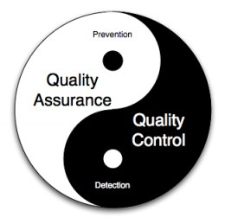





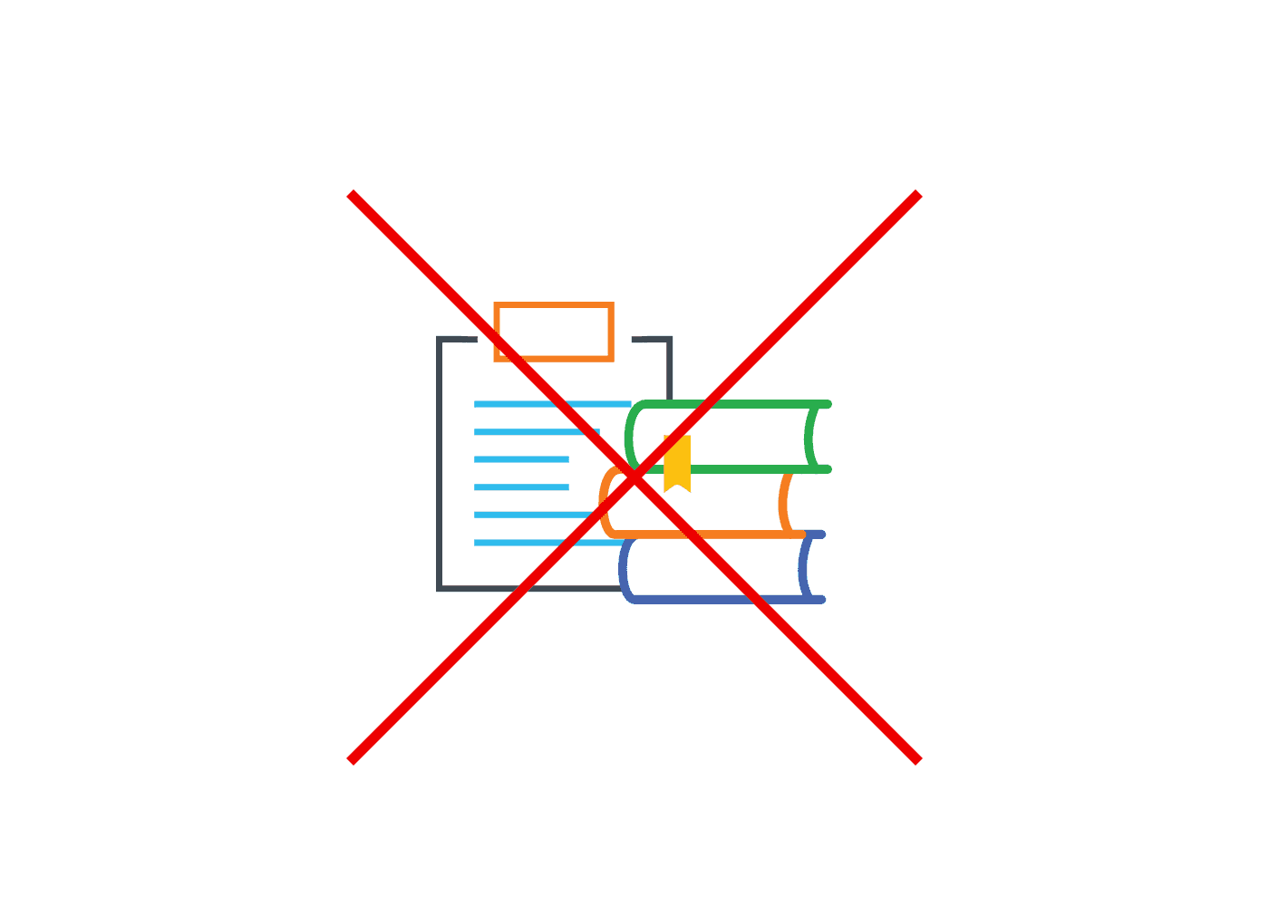

Kingternship–Seriously Playful Software Engineering
Andrei-Mihai Nicolae
2147392
How did the Kingdom raise?
Fast and Fluid
Craft and Care
King is a Swedish multinational company founded in 2003 which has evolved throughout the years into one of the top mobile games development companies. It’s also one of the largest, having roughly 1400 employees.
Two of the core values of King, they represent the employee’s ability to adapt to any environment and do it quickly.
In my case, as a software engineer, that meant to work with agile methods and practices.
Quality Assurance and Quality Control are two of the most important features of a good software product. Having last year’s group project experience, I was able
to apply my knowledge to ensure the Gifting product follows outstanding quality standards. Even though we did not follow Test Driven Development, I put in practice a variety of techniques including mutation, smoke and regression testing, checking for bad smells in the code and trying to discover best ways to refactor the code, as well as code coverage. I also used Mockito for mocking tests as it was widely used in the company – very effective, but might lead to overseeing lower-level bugs.
Quality Assurance was very promoted in the company, the Barcelona office organizing a weekly QA meeting where different teams came and discussed how they tried to improve their software quality.
At university I learned how to use SVN for version control, Trac for issue tracking and Jenkins for continuous integration. Even though at King I used either the same technologies or very similar ones (Git for version control, JIRA for issue tracking and again Jenkins for CI), there were differences in scale, planning and organization – we had daily stand-ups were we discussed progress and next steps (instead of weekly ones at university), retrospectives every 2 months with people from other teams as well that could give insight into improving our product and working cycle (compared to more often ones in university group project) and ‘off-sites’ every month – these were fun gatherings of the team outside of the office were we could both bond and discuss what to do next at a much higher level.
It has produced some of the top games on all mobile platforms including Candy Crush Saga which at its peak was played roughly by 100 million people around the globe.
In February 2016, King was bought and merged into Activision Blizzard.
My role as a Kingtern
During my placement, I was part of the Gifting team, which was responsible for the design, implementation and maintenance of the platform through which King players all around the globe receive gifts (e.g. gold bars, boosters). The whole team was based in the Barcelona office and I worked specifically on the interface through which we could launch fully-fledged gifting campaigns.
I worked as a full-stack software engineer using various technologies. I implemented a very large number of features that were released into production, ranging from the availability to send gifts to specific platforms (e.g. iOS) to redesigning most of the user interface applying human computer interaction techniques.
Sweetest and Bitterest Bits
I believe this placement was an amazing experience and I would recommend it to anyone – I learned most how to be a good team player, how to communicate effectively, how to ensure my code and software practices are outstanding. However, the fact that the internship programme at King is at the beginning, there is no guaranteed continuity and this could definitely be improved during the following years.
Humble and Open
During my placement I reinforced the attitude the university taught me to adopt, which is to be modest, attentive to what others have to say, as well as communicative. However, the humble and open core value had one consequence at King – there was no source code documentation.
Even though this promotes discussion among team members, one might forget after several months why that piece of code is there. Also, a new team member (which was my case as well) will ask many questions in the beginning in order to comprehend the code.
Technologies

