Slide 1
Steganography
Hiding messages in plain sight

Slide 2
Steganography
Steganography is the art or practice of concealing a message, image, or file within another message, image, or file. The word steganography combines the Ancient Greek words steganos, meaning "covered, concealed, or protected", and graphein meaning "writing".
Cryptography is the practice of protecting the contents of a message.
Steganography conceals the fact that a secret message is even being sent.
The advantage of steganography over cryptography is that the intended secret message does not attract attention to itself as an object of scrutiny.

Slide 3
Historically, null ciphers are a way to hide a message in another without the use of a complicated algorithm. One of the simplest null ciphers is shown in the classic examples below:
PRESIDENT'S EMBARGO RULING SHOULD HAVE IMMEDIATE NOTICE. GRAVE SITUATION AFFECTING INTERNATIONAL LAW. STATEMENT FORESHADOWS RUIN OF MANY NEUTRALS. YELLOW JOURNALS UNIFYING NATIONAL EXCITEMENT IMMENSELY.
APPARENTLY NEUTRAL'S PROTEST IS THOROUGHLY DISCOUNTED AND IGNORED. ISMAN HARD HIT. BLOCKADE ISSUE AFFECTS PRETEXT FOR EMBARGO ON BYPRODUCTS, EJECTING SUETS AND VEGETABLE OILS.
The German Embassy in Washington, DC, sent these messages in telegrams to their headquarters in Berlin during World War I (Kahn 1996). Reading the first character of every word in the first message or the second character of every word in the second message will yield the following hidden text:
PERSHING SAILS FROM N.Y. JUNE 1
http://www.garykessler.net/library/fsc_stego.html

Slide 4
Examples of “physical” steganography:
Hidden messages within wax tablets — in ancient Greece, people wrote messages on the wood, then covered it with wax upon which an innocent covering message was written.
Hidden messages on messenger's body —used in ancient Greece. a message tattooed on the shaved head of a slave, hidden by the hair that afterwards grew over it, and exposed by shaving the head again.
In the early days of the printing press, it was common to mix different typefaces on a printed page due to the printer not having enough copies of some letters otherwise. Because of this, a message could be hidden using 2 (or more) different typefaces, such as normal or italic.
During World War II, the French Resistance sent some messages written on the backs of couriers using invisible ink.
Messages written in Morse code on knitting yarn and then knitted into a piece of clothing worn by a courier.
Jeremiah Denton repeatedly blinked his eyes in Morse Code during the 1966 televised press conference that he was forced into as an American POW by his North Vietnamese captors, spelling out the word, "T-O-R-T-U-R-E". This confirmed for the first time to the U.S. Military (naval intelligence) and Americans that American POWs were being tortured in North Vietnam.
Messages written on envelopes in the area covered by postage stamps.
During and after World War II, espionage agents used photographically produced microdots to send information back and forth. Microdots were typically minute, approximately less than the size of the period produced by a typewriter. World War II microdots needed to be embedded in the paper and covered with an adhesive, such as collodion. This was reflective and thus detectable by viewing against glancing light. Alternative techniques included inserting microdots into slits cut into the edge of post cards.
Cold War counter-propaganda. In 1968, crew members of the USS Pueblo intelligence ship held as prisoners by North Korea, communicated in sign language during staged photo opportunities, informing the United States they were not defectors, but were captives of the North Koreans.

Slide 5
Digital steganography examples:
Concealing messages within the lowest bits of noisy images or sound files.
Concealing messages in executable files.
Pictures embedded in video material (optionally played at slower or faster speed).
Blog-Steganography. Messages are fractionalized and the (encrypted) pieces are added as comments of orphaned web-logs (or pin boards on social network platforms). In this case the selection of blogs is the symmetric key that sender and recipient are using; the carrier of the hidden message is the whole blogosphere.
Including data in ignored sections of a file, such as after the logical end of the carrier file.
Making text the same color as the background in word processor documents, e-mails, and forum posts.
Using hidden (control) characters, and redundant use of markup (e.g., empty bold, underline or italics) to embed information within HTML, which is visible by examining the document source. HTML pages can contain code for extra blank spaces and tabs at the end of lines, and colors, fonts and sizes, which are not visible when displayed.

Slide 6
Terms used
The payload is the data to be covertly communicated.
The carrier is the signal, stream, or data file into which the payload is hidden.
The "channel" is the type of input, such as "a JPEG image".
The resulting signal, stream, or data file which has the payload encoded into it is sometimes referred to as the package, stego file, or covert message.
The percentage of bytes, samples, or other signal elements which are modified to encode the payload is referred to as the encoding density and is typically expressed as a number between 0 and 1.
In a set of files, those files considered likely to contain a payload are called suspects.

Slide 7
As a simple example of least significant bit substitution, imagine "hiding" the character 'G' across the following eight bytes of this section of a carrier file :
10010101 00001101 11001001 10010110
00001111 11001011 10011111 00010000
A 'G' is represented in the American Standard Code for Information Interchange (ASCII) as the binary string 01000111. These eight bits can be "written" to the least significant bit of each of the eight carrier bytes as follows:
10010100 00001101 11001000 10010110
00001110 11001011 10011111 00010001 In the sample above, only half of the least significant bits were actually changed!

Slide 8
Least significant bit substitution can be used to overwrite legitimate RGB color encodings or palette pointers in GIF and BMP files, coefficients in JPEG files, and pulse code modulation levels in audio files. By overwriting the least significant bit, the numeric value of the byte changes very little and is least likely to be detected by the human eye or ear.
Least significant bit substitution is a simple, albeit common, technique for steganography. Its use, however, is not necessarily as simplistic as the method sounds. Only the most naive steganography software would merely overwrite every least significant bit with hidden data. Almost all use some sort of means to randomize the actual bits in the carrier file that are modified. This is one of the factors that makes steganography detection so difficult.

Slide 9
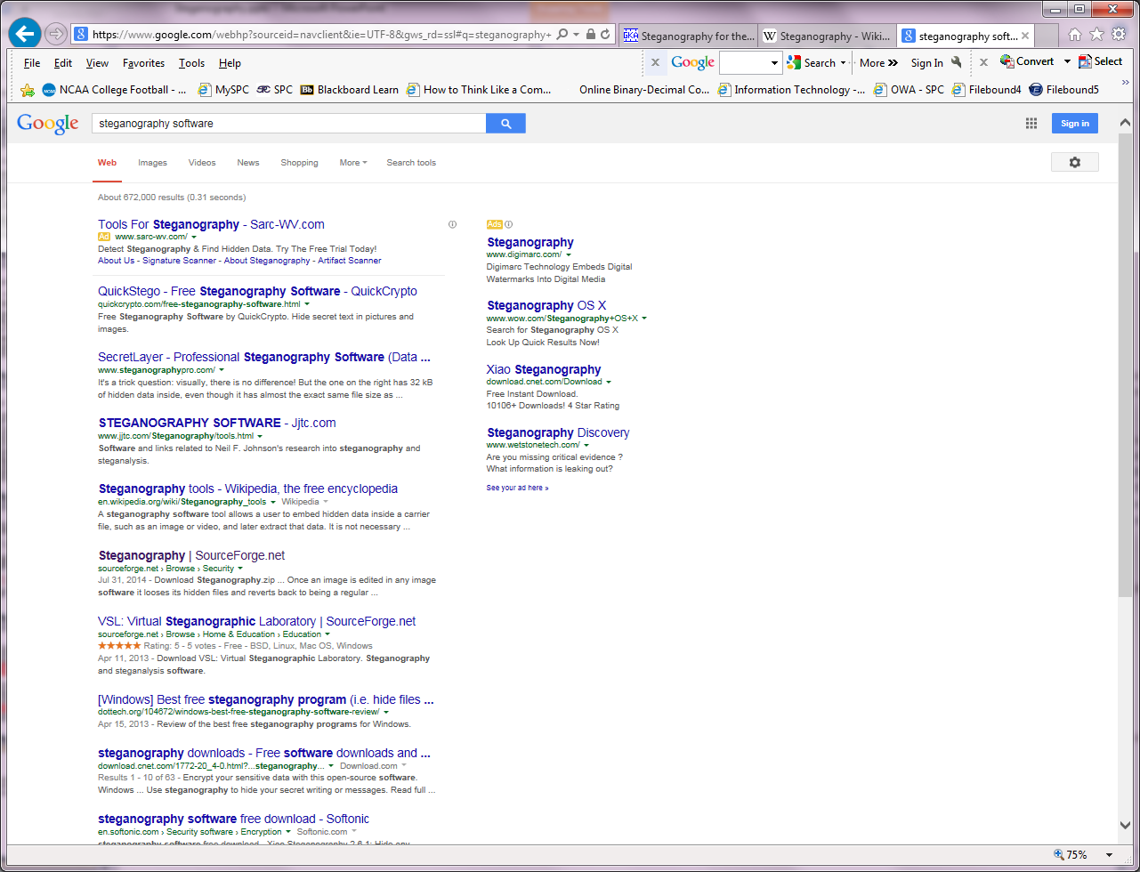
There are many steganography programs currently available, ranging from free downloads to commercial products:

Slide 10
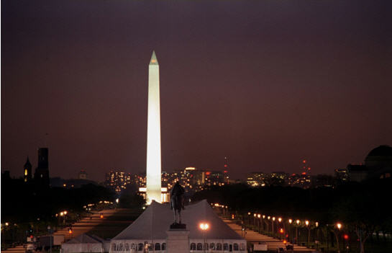
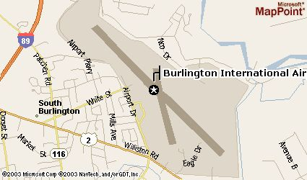
This example employs Gif-It-Up, a Nelsonsoft program that hides information in GIF files using least significant bit substitution (and includes an encryption option). The GIF image of the Washington, DC, mall at night where Gif-It-Up has been used to insert the airport map shown on the right.
11,067-byte GIF map of the Burlington, Vermont, airport
GIF carrier file (Washington DC mall at night ) containing the airport map.

Slide 11
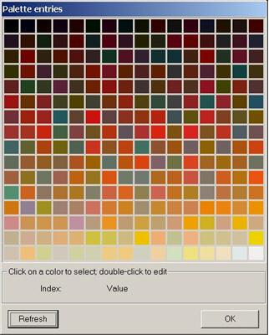
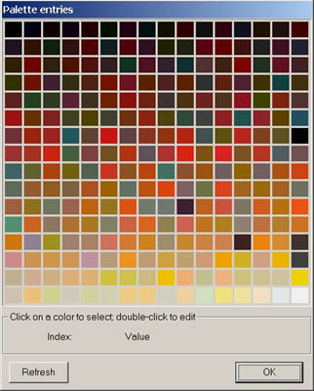
The palette from the Washington mall carrier file before (left) and after (right) the map file was hidden. The original carrier is 632,778 bytes in length and uses 249 unique colors, whereas the steganography file is 677,733 bytes in length and uses 256 unique colors. The file size is larger in the steganography file because of a color extension option used to minimize distortion in the steganography image. If color extension is not employed, the file size differences are slightly less noticeable.
http://www.garykessler.net/library/fsc_stego.html

Slide 12
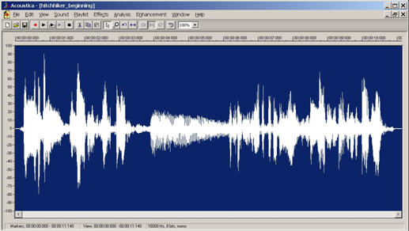
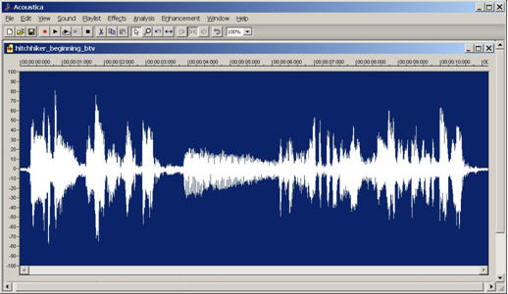
The signal level comparisons between a WAV carrier file before (above) and
after (below) the airport map is inserted. This example employs S-Tools, a program by Andy Brown that can hide information inside GIF, BMP, and WAV files. Audio files are well suited to information hiding because they are usually relatively large, making it difficult to find small hidden items.

Slide 13
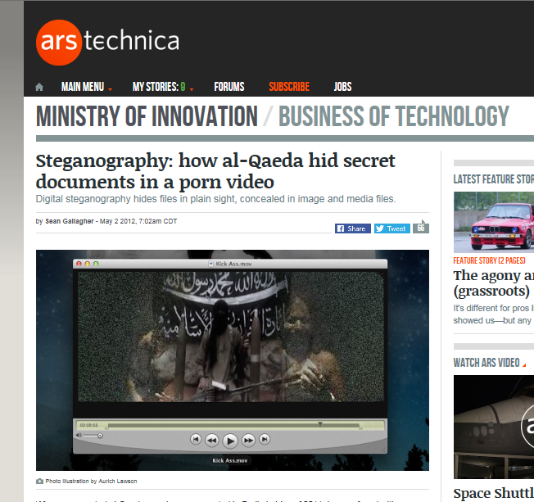
When a suspected al-Qaeda member was arrested in Berlin in May of 2011, he was found with a memory card with a password-protected folder—and the files within it were hidden. But, as the German newspaper Die Zeit reports, computer forensics experts from the German Federal Criminal Police (BKA) claim to have eventually uncovered its contents—what appeared to be a pornographic video called "K*ckA**."
Within that video, they discovered 141 separate text files, containing what officials claim are documents detailing al-Qaeda operations and plans for future operations—among them, three entitled "Future Works," "Lessons Learned," and "Report on Operations."
So just how does one store a terrorist’s home study library in a pirated porn video file? In this case the files had been hidden (unencrypted) within the video file through a well-known approach for concealing messages in plain sight: steganography.
http://arstechnica.com/business/2012/05/steganography-how-al-qaeda-hid-secret-documents-in-a-porn-video/

Slide 14
Lab assignment
Write a report or make a PowerPoint presentation about an example of digital steganography that is not already mentioned in this presentation.

