Slide 1
Drugs
Personality Test Score & Recreational Drug Use
Notes:
Dataset from the UCI Machine Learning, a record of 1885 respondents on their drug use and outcome of personality tests

Slide 2
Drugs Consumption
Demographics (Age Group, Gender, Ehtnicity)
Education level
Country of residence
The Big Five Personality traits score
Impulsiveness
Impulsive sensation seeking
Drug use frequency on a range of drugs

Slide 3
Action Plan
Modelling
5
To predict whether one is a hard drug user or not
Data Visualisation
3
4
Hypothesis Testing
Data Preparation
1
Data cleaning and re-grouping categories
2
Data Distributions
Ensuring the measures are normally distributed

Slide 4
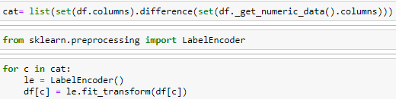

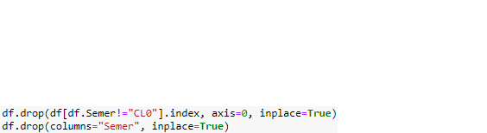
1
Data Preparation
2
3
Drug use frequency
Hard drugs & Variety of drug type used
Semeron
A fictious drug included on the survey to identify those who exaggerate their drug usage, hence removed from our study
Notes:
8 respondents removed from the Semeron.
No missing values (yay!)

Slide 5
Drug use frequency (last used)
Non-User
User
User
User
User
User
CH1
CH2
CH3
Over a decade ago
Current decade
Last Year
CH4
CH5
CH6
Last Month
Last Week
Last Day
Notes:
Each type of drugs is coded from CH0 – CH6

Slide 6
Drug Types
A variety of drugs where recorded:
From Chocolate, Caffeine, Nicotine…
… to Meth, Coke, Heroin etc.
Fictitious drug “Semeron”
Our study is interested in “Hard Drugs” consumptions:
Amphetamines, Benzodiazepine, Coke, Crack, Ecstasy, Heroin, Legal highs, Meth
Notes:
Alcohol alcohol consumption (output attribute)
Amphet amphetamines consumption (output attribute)
Amyl amyl nitrite consumption (output attribute)
Benzos benzodiazepine consumption (output attribute)
Caff caffeine consumption (output attribute)
Cannabis cannabis consumption (output attribute)
Choc chocolate consumption (output attribute)
Coke cocaine consumption (output attribute)
Crack crack consumption (output attribute)
Ecstasy ecstasy consumption (output attribute)
Heroin heroin consumption (output attribute)
Ketamine ketamine consumption (output attribute)
Legalh legal highs consumption (output attribute)
LSD LSD consumption (output attribute)
Meth methadone consumption (output attribute)
Mushrooms magic mushrooms consumption (output attribute)
Nicotine nicotine consumption (output attribute)
Semer fictitious drug Semeron consumption (output attribute)
VSA volatile substance abuse consumption (output attribute)

Slide 7
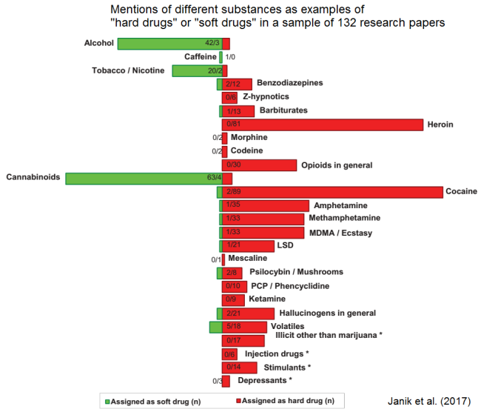

Slide 8

Big Five Personality Traits
Indicates how outgoing and social a person is.
Optimistic view of human nature and get along well with others
Extraversion
Agreeableness
Neuroticism
Openness
Conscientiousness
Likeliness to experience feelings such as anxiety, worry, fear, anger, frustration, envy etc.
Openness to experience new things
Self-discipline, plan following and perseverance

Slide 9
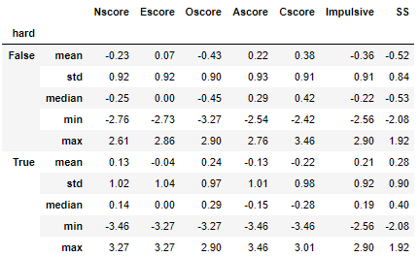
Overview
The personality scores descriptive summary between non-user and hard drug user.

Slide 10
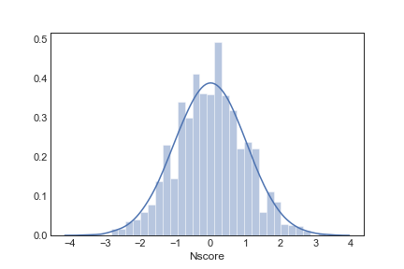
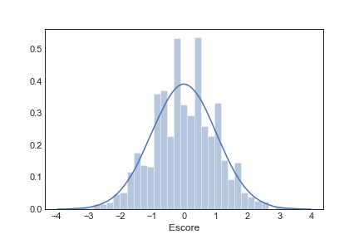
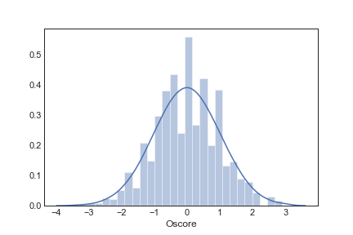
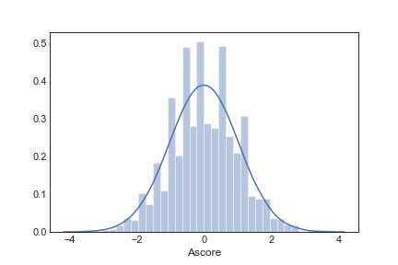
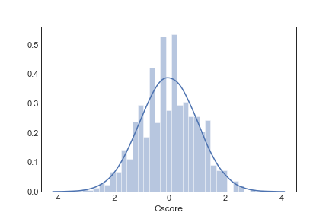
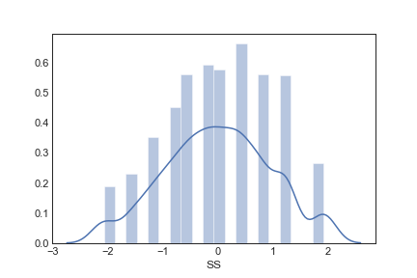
Data Distributions
All the personality measures have been converted to T-score based on normative data.

Slide 11
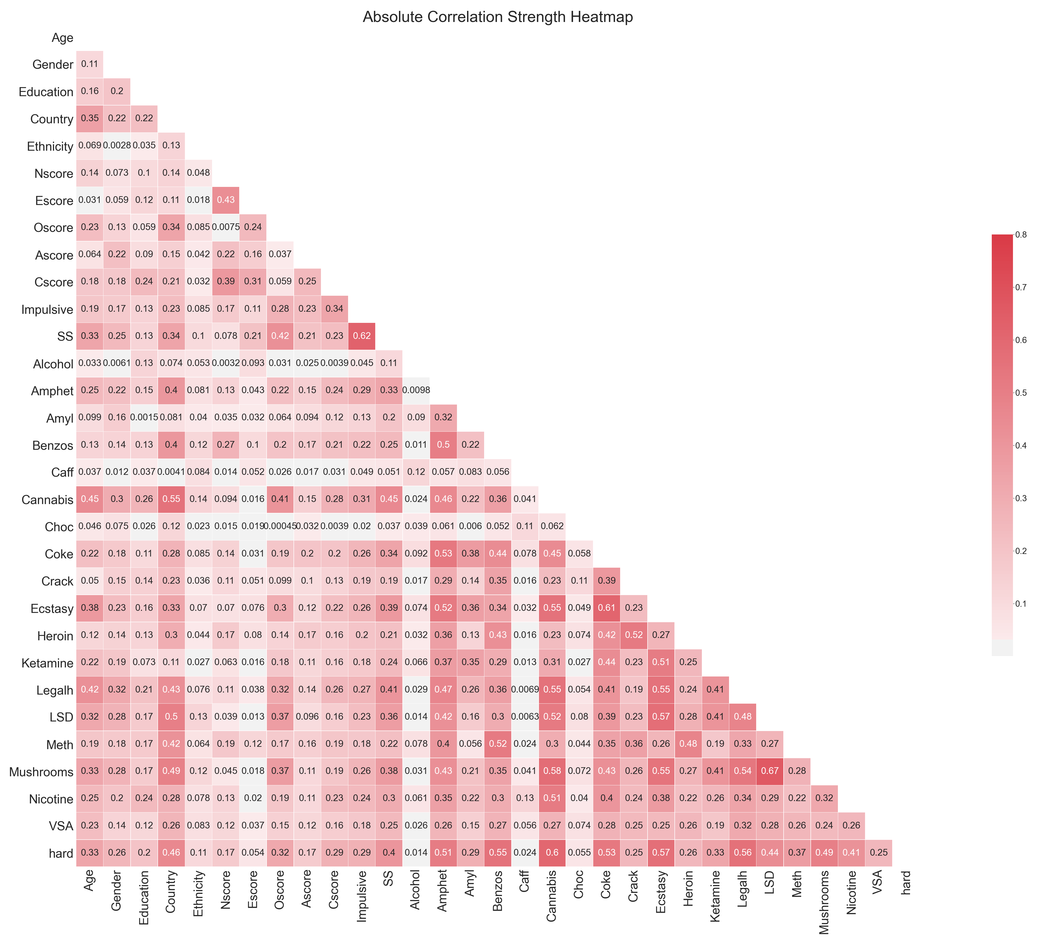

Slide 12
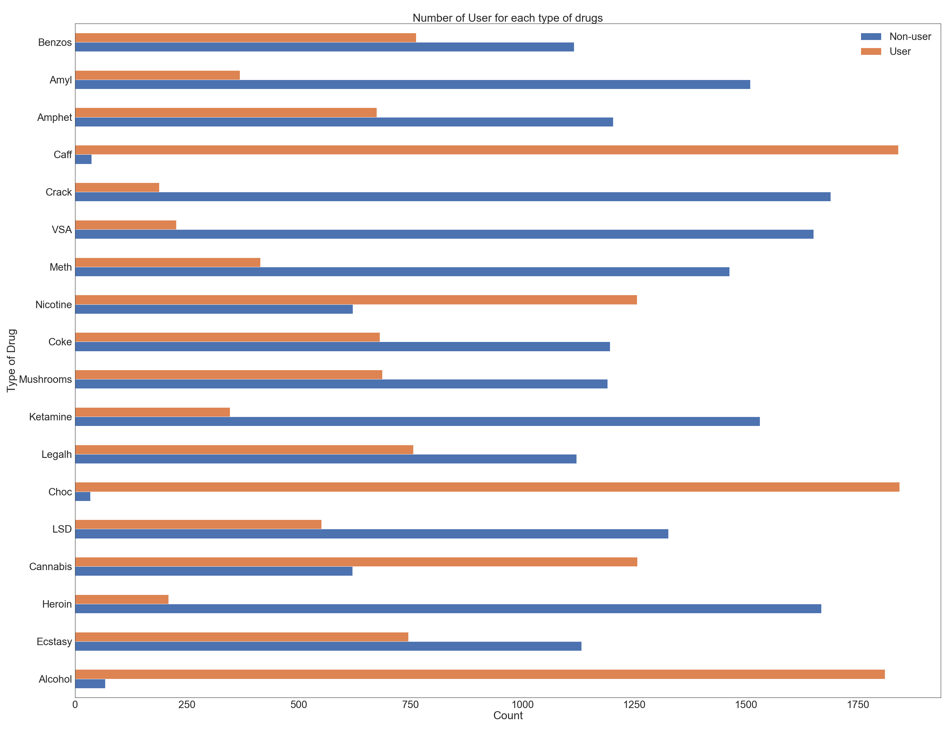

Slide 13
Whoa!
Hypothesis Testing on the dataset and Data Visualisation on those with significant difference

Slide 14

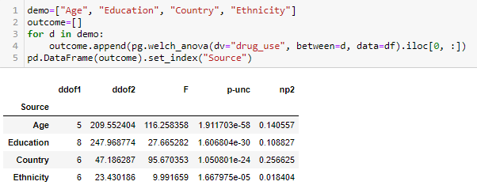
1
Welch ANOVA
Pingouin package
Pairwise Games-Howell

Slide 15
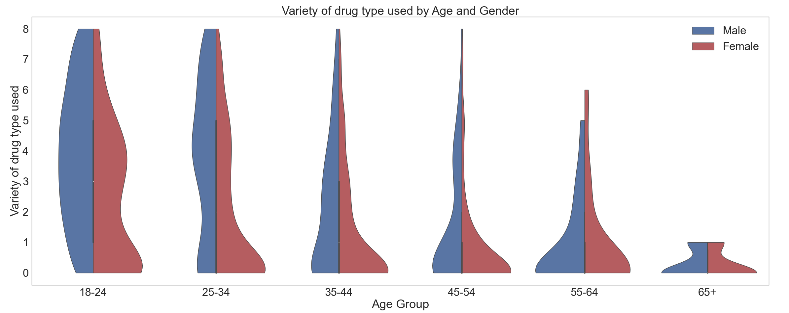

Slide 16
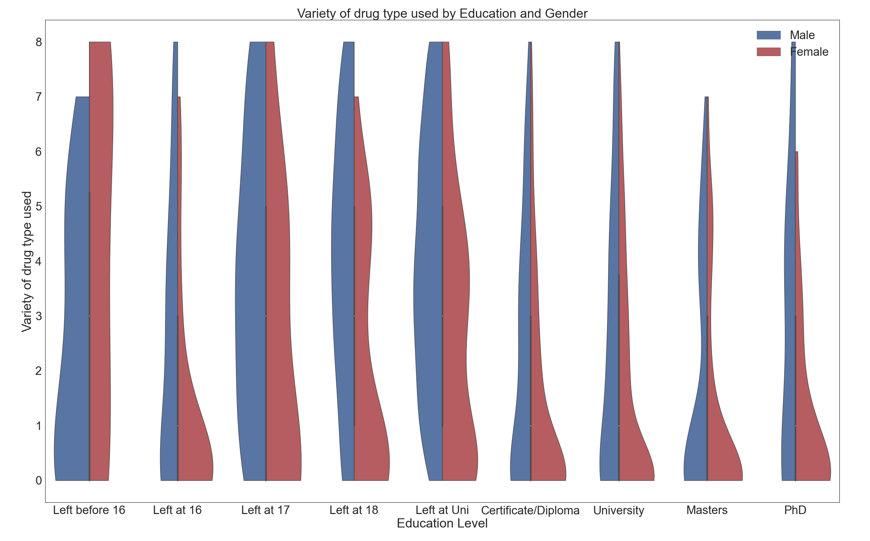

Slide 17
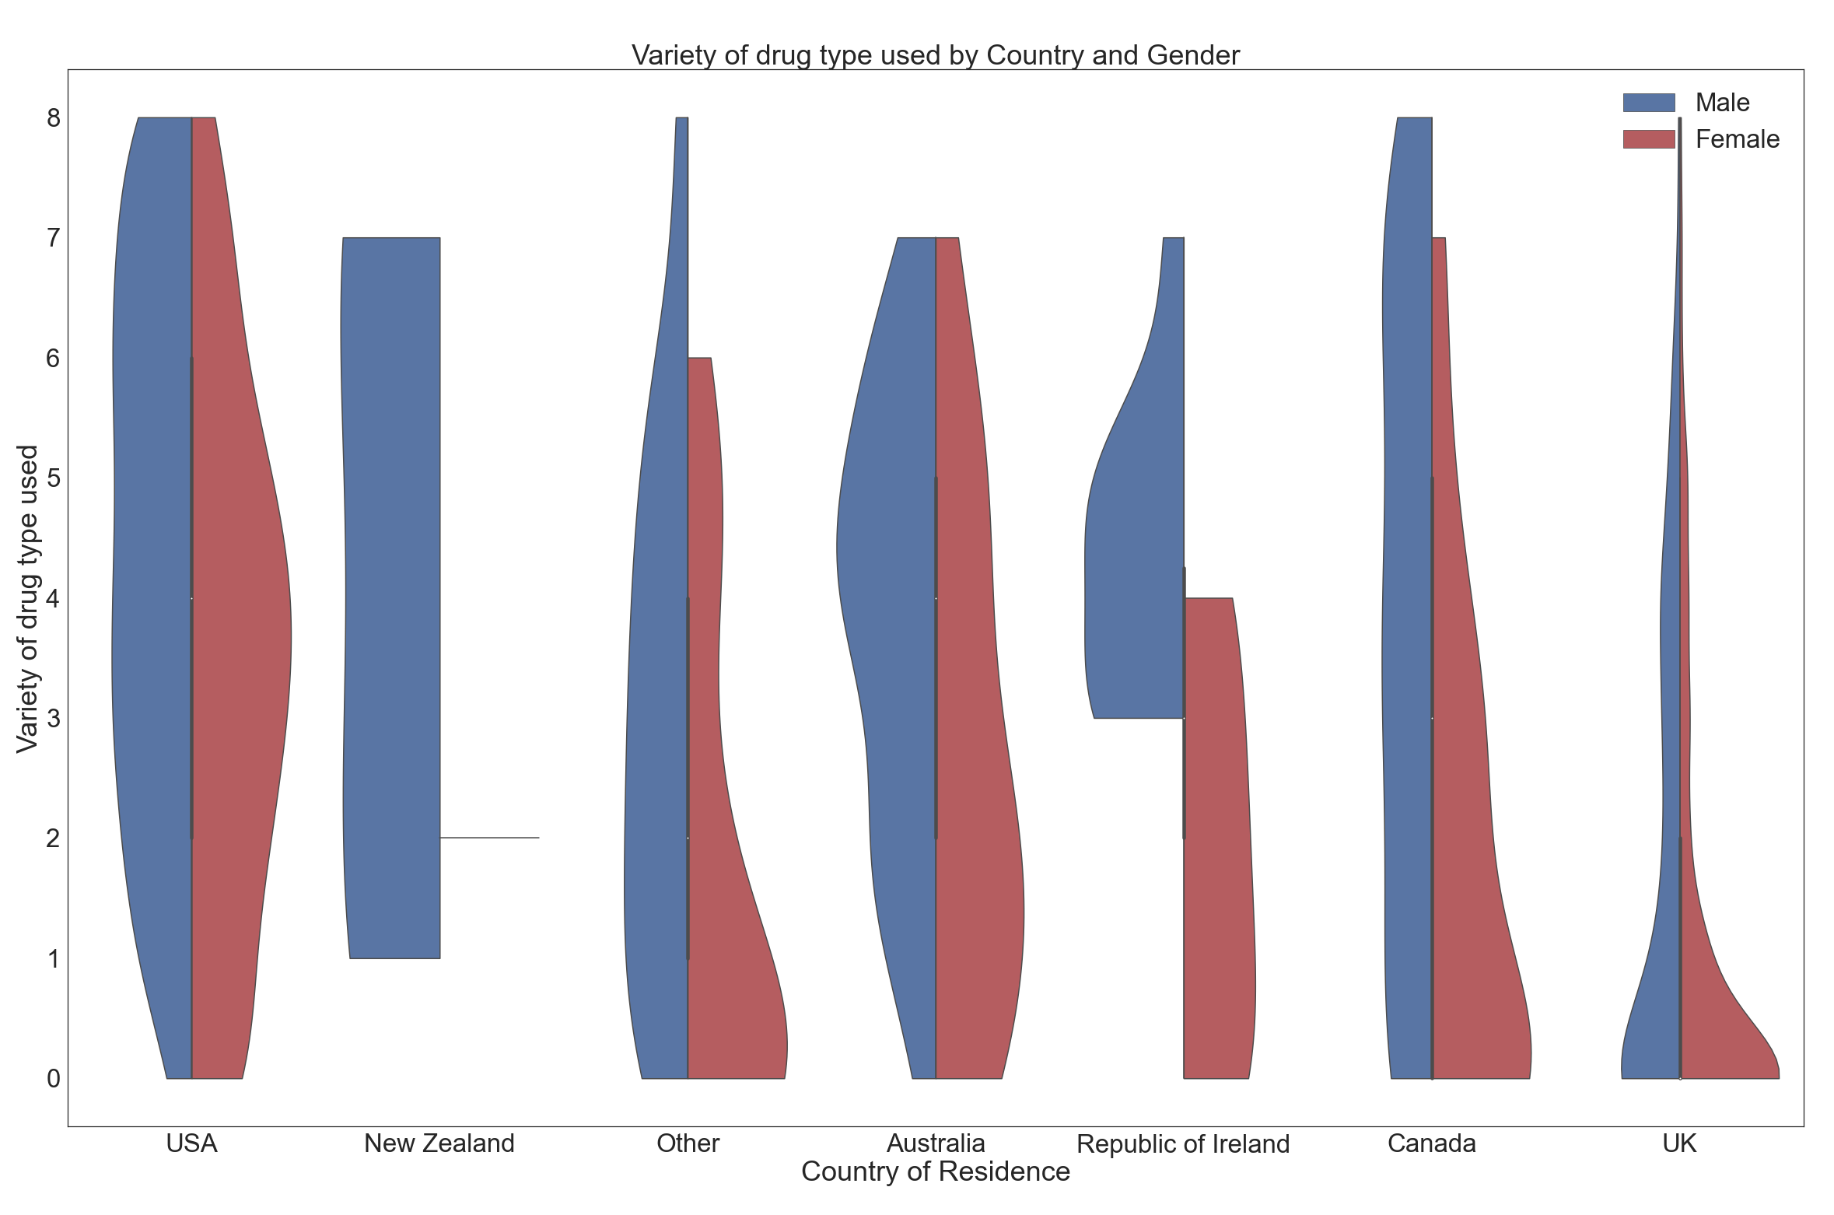

Slide 18
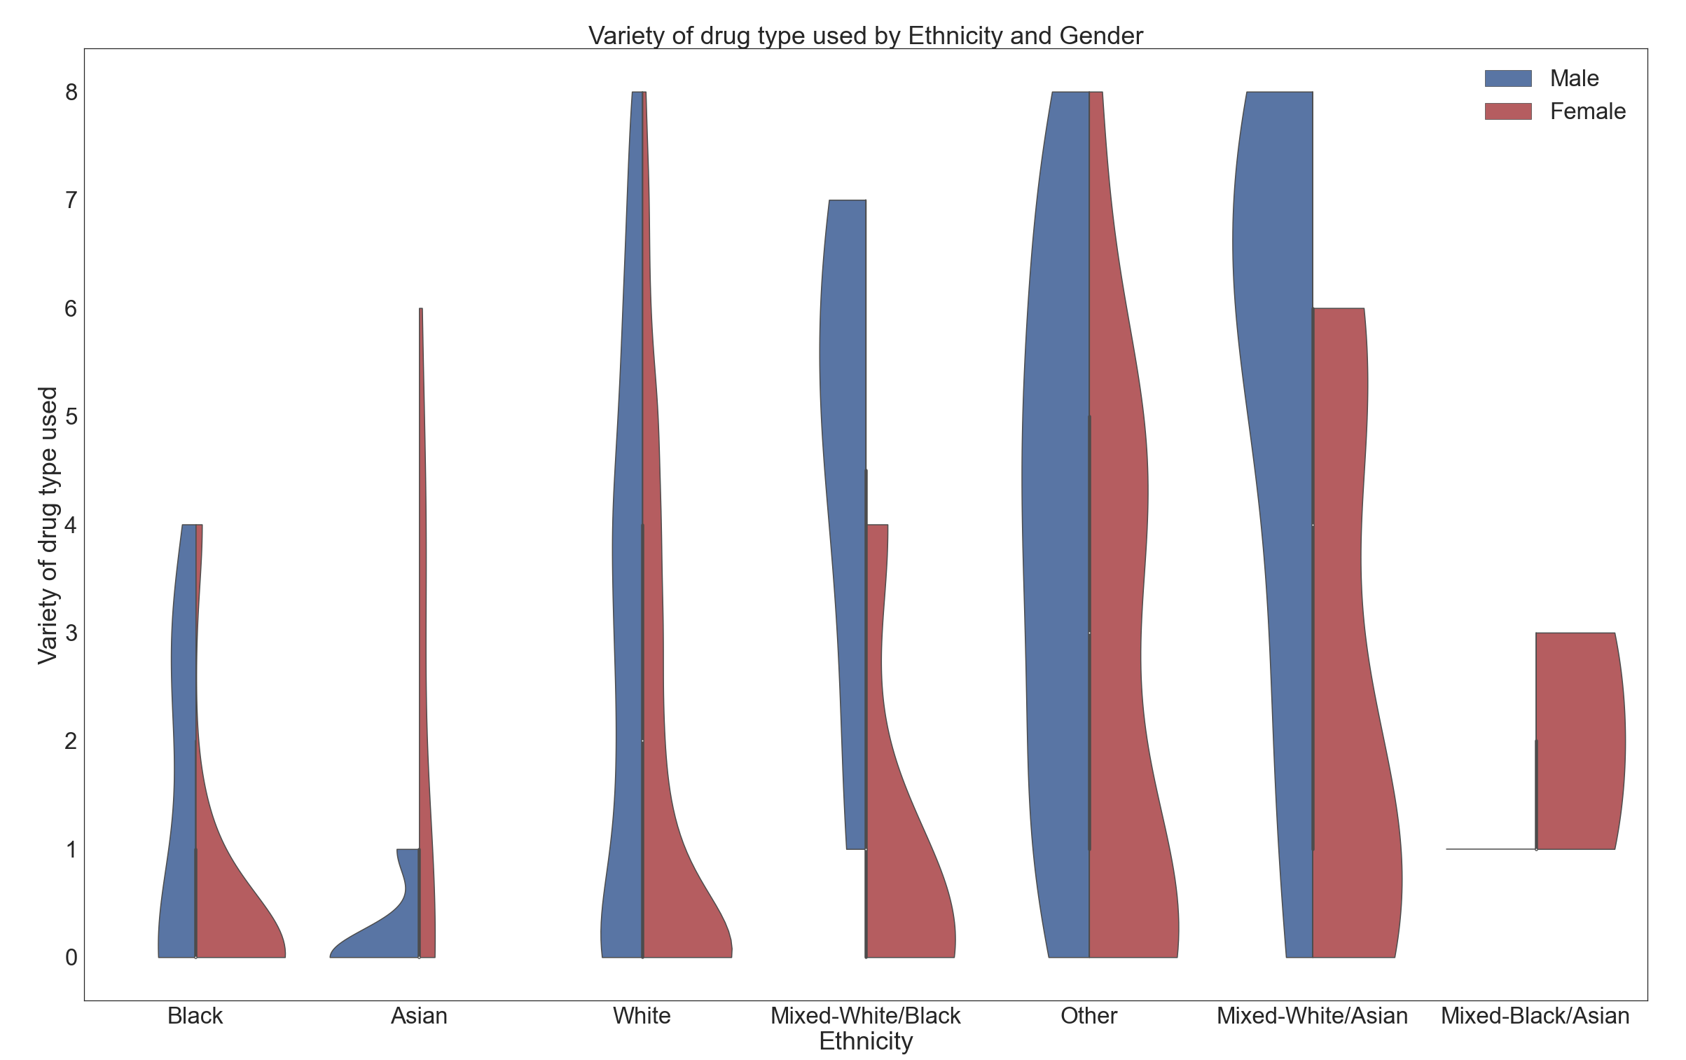

Slide 19
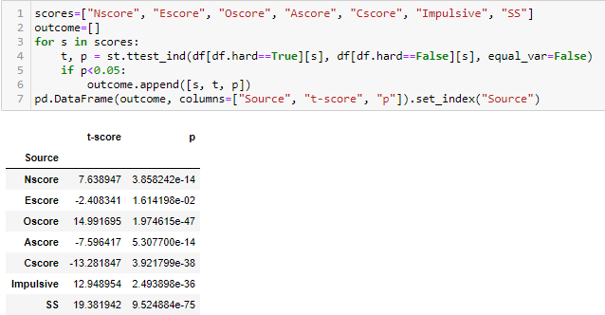
T-test
The significant difference between the personality scores among non-users and users

Slide 20
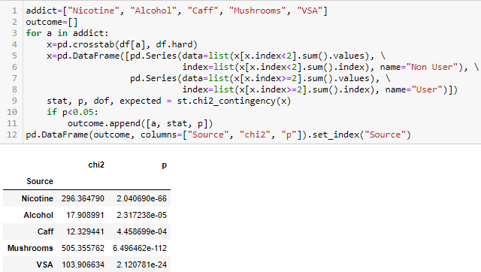
Chi-Square
An addict of a particular substance and the likelihood difference to become a hard drug user

Slide 21
Modelling
Prediction on whether an individual would be a hard drug user

Slide 22
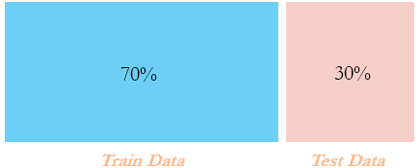


Train & Test Data

Slide 23
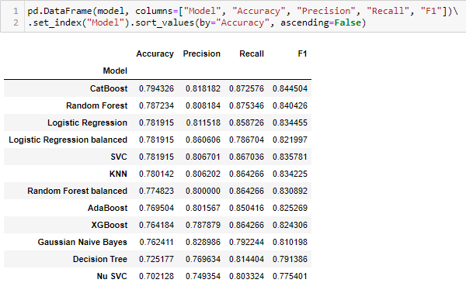
Outcome

Slide 24
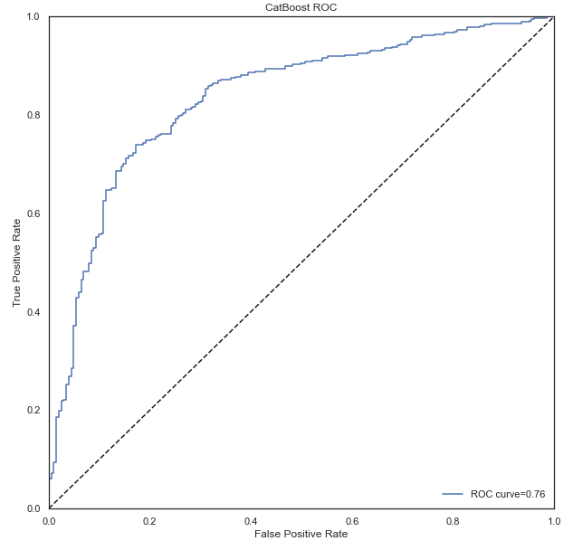
CatBoost ROC

Slide 25
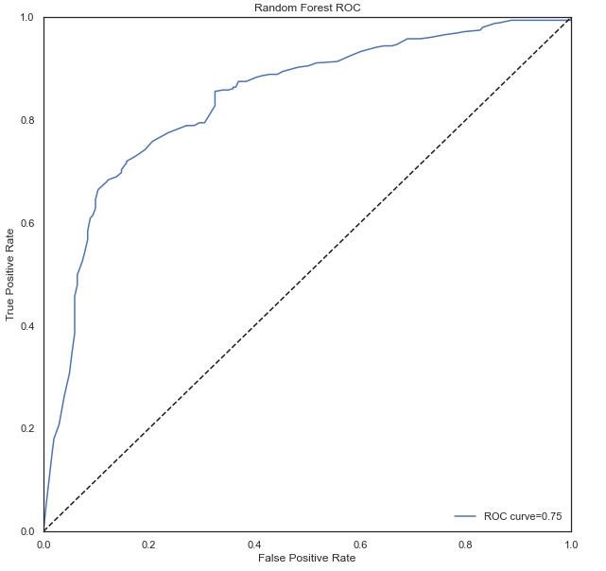
Random Forest ROC

Slide 26
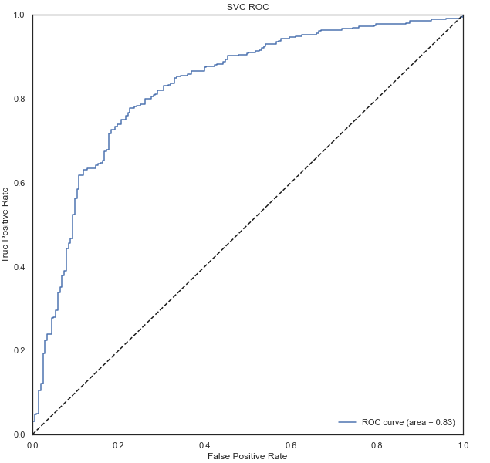
SVC ROC

Slide 27
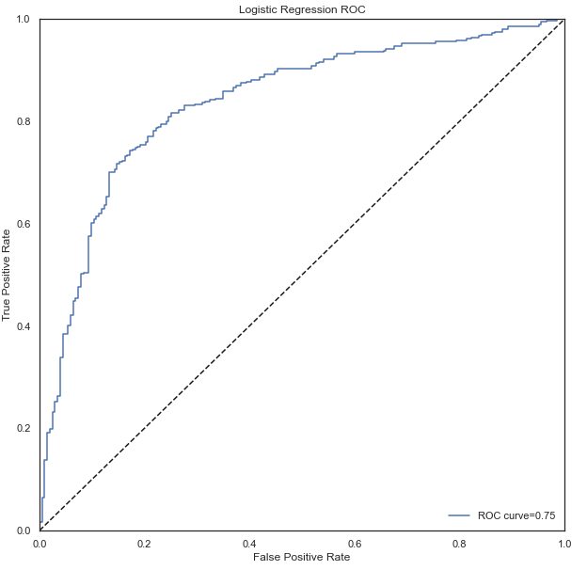
Logistic Regression ROC

Slide 28
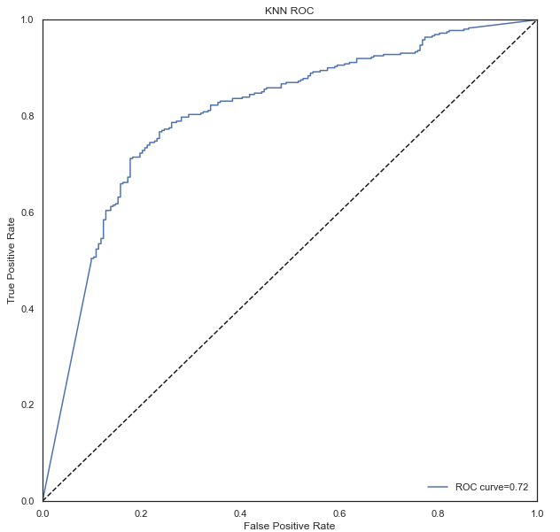
KNN ROC

Slide 29
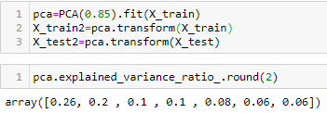

SVC Model using PCA

Slide 30
Conclusion
SVC Model: Accuracy 0.78 ROC 0.83

