Slide 1
StOut
Montana Tech Student Outcome Website
Sponsor: Montana Tech
Mentor: Jeff Braun
Team: Abdulrahman Alduraiwesh
Jesse Anderson
Nathaniel Lewis
Trevor Brooks

Slide 2
Problem
•All Montana Tech degree programs must be reviewed on an annual or biannual basis for ABET and/or Northwest Accreditation.
•All programs have student outcomes that must be assessed and evaluated as part of the program review.
•Collecting and organizing the outcome assessment data can be a time consuming process for instructors and administrators.
•The outcome assessment and evaluation process must be documented and applied in a consistent manner within each program.

Slide 3
Objectives
Gathering information about the older system.
Designing the new improved system.
Building the user centered design where the users will be able to transfer work routine seamlessly.

Slide 4
Requirements
Different actors need to use Stout in different ways.
Actors : Administrator, Program Coordinator, Faculty and Observers

Slide 5
Administrator
Must be able to manage specific program or overall running of system.
Manage faculty and program coordinator within their assigned programs.

Slide 6
Program Coordinator
In charge of gathering and overseeing the process of accreditation.
Manage both metrics and outcomes.
Ties classes to outcomes and metrics.

Slide 7
Faculty
Main priority is to enter outcome data for students and courses/offerings.

Slide 8
Observer
Registered user that is only able to see reports and similar information.
Cannot edit data.
Used to allow accreditors access to the information.

Slide 9
Constraints
Ease of Use
System Requirements

Slide 10
Front End Design

Slide 11
Front End Design
Ember.js framework
JavaScript/Ember JavaScript Libraries
HTML (Handlebars)
CSS (SASS)
Mock ups
Current Work
Models/Forms

Slide 12
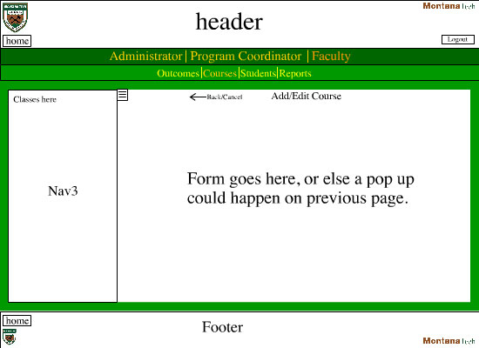

Slide 13
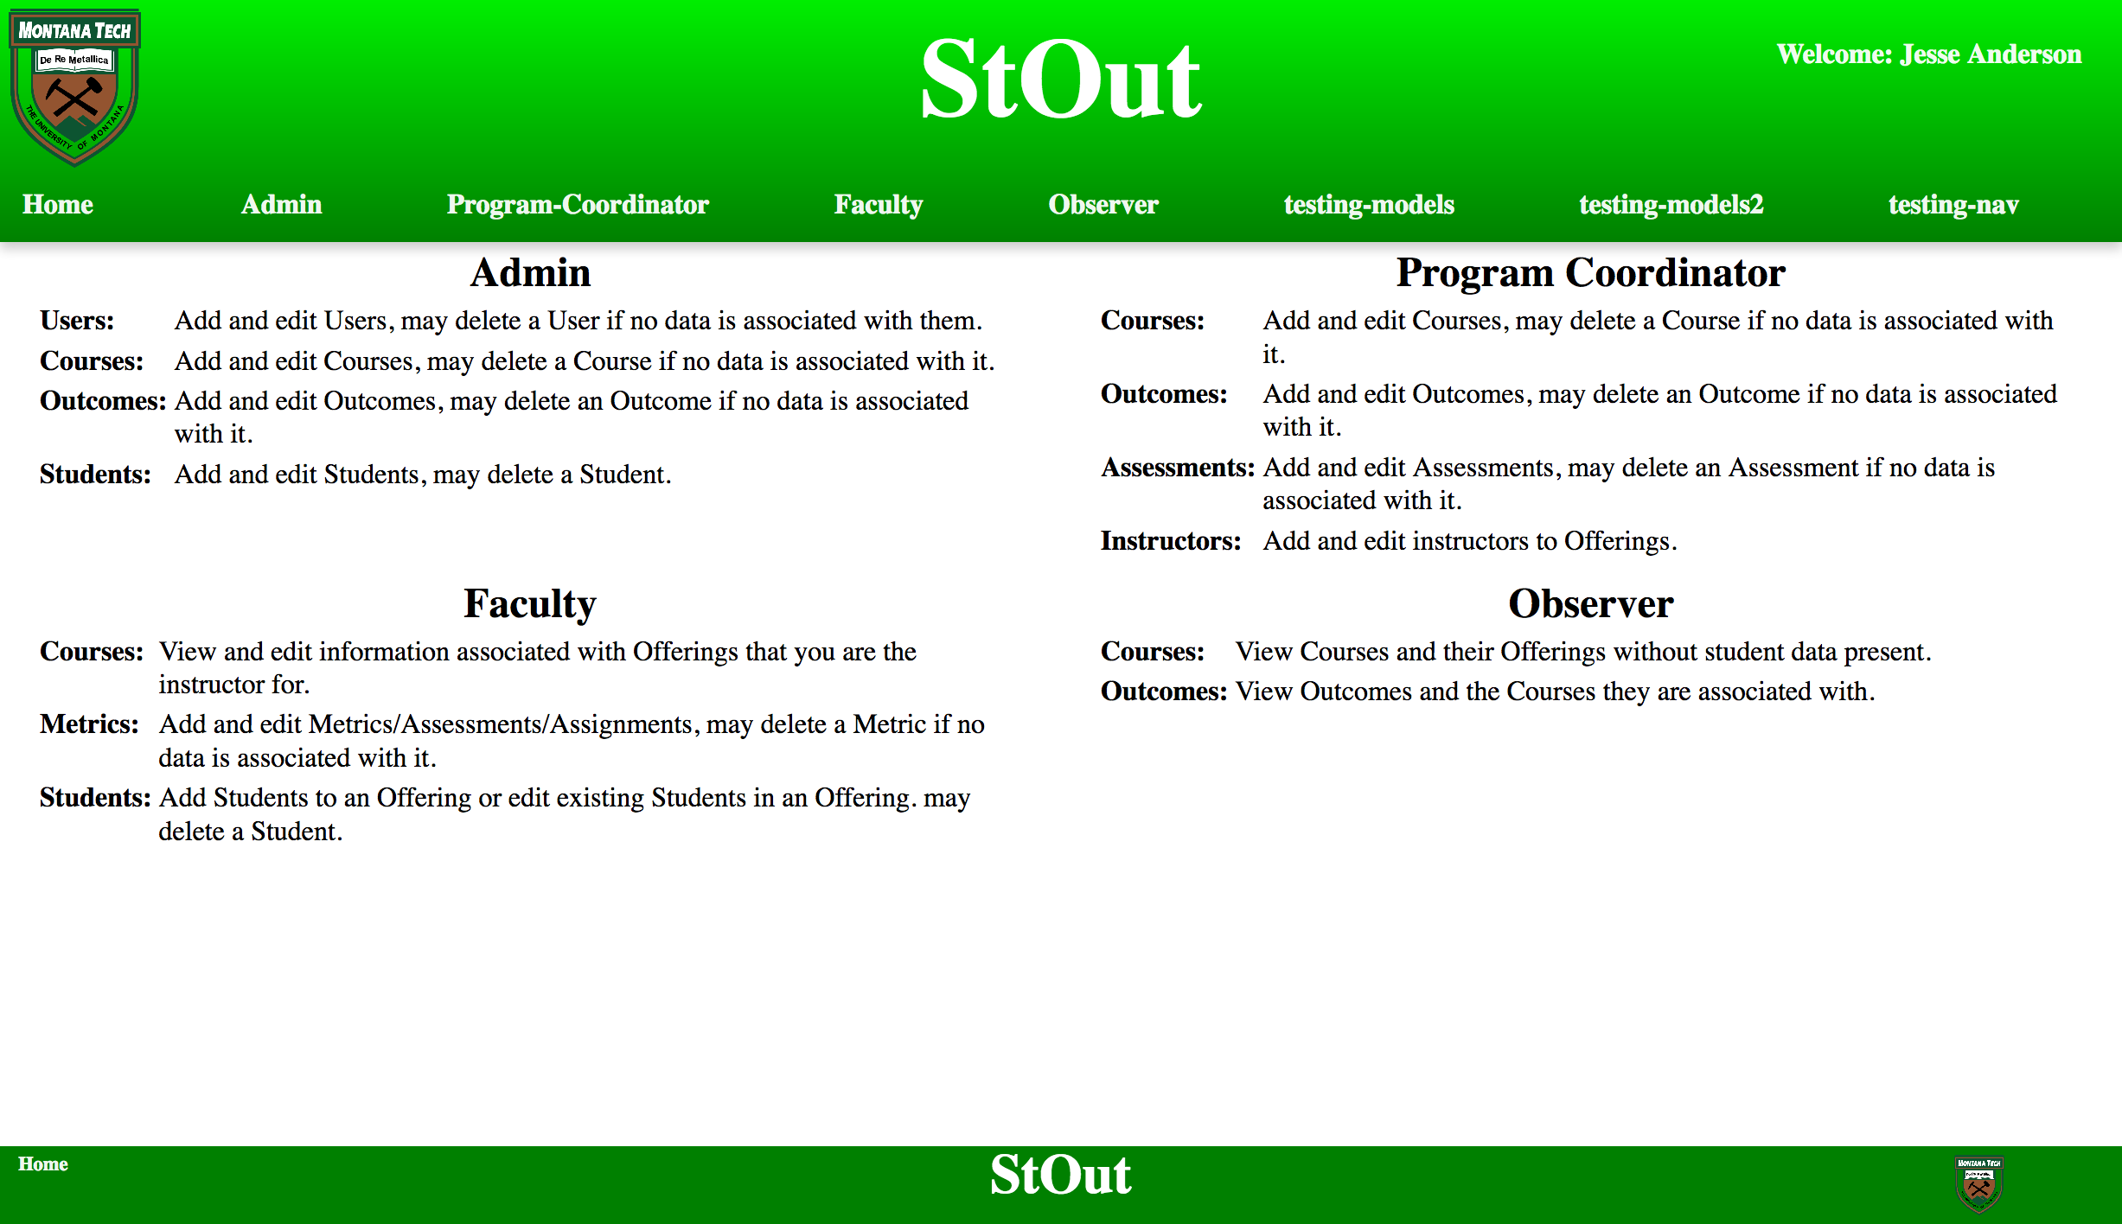
Current Front-end

Slide 14
Models
Models are a method for storing data
Automates representations between parts of the system.
Allows for caching (temporarily saving).
Gives a method to name data from the backend for the frontend.

Slide 15
Components
Components allow for less repetitive modules
Breaks page into smaller pieces
Take a model and render it to a form
Same base can then render it into a table, etc
Isolates changes to single areas
Validation and visibility handled in a single area

Slide 16
Backend Design

Slide 17
Backend Design
RESTful Backend
Standardized design pattern for backends over HTTP/S
Database to frontend data model transfer being built now.
Database
Ran off MySQL / MariaDB System
Separated virtual machine from other projects
Runs HTTPS with individual certificate for secure communication.

Slide 18
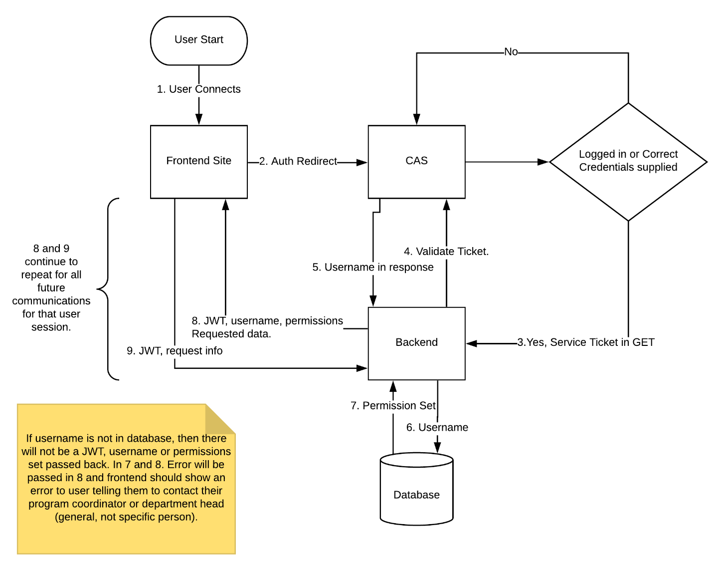
Authentication and Security

Slide 19
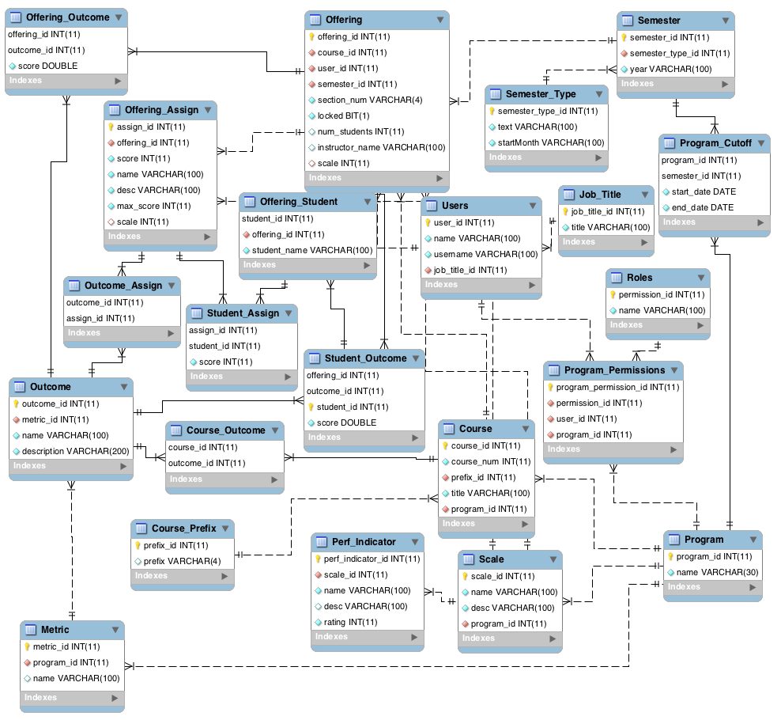
Database Design

Slide 20
Progress and Future Goals

Slide 21
Current Work Synopsis
Completed a basic authentication scheme.
Front-end design work completed.
Database has been built.
Majority of data retrieval and update methods completed.

Slide 22
Future Work Synopsis - Frontend
Form views for frontend
Report views
Displaying data in frontend in non-editable views

Slide 23
Future Work Synopsis - Backend and Documentation
Automation of jobs such as pre-calculation and generation of semesters
Manuals and updates to documentation based on finished processes

