Slide 1
Student Outcome Assessment Tracking
Jesse Anderson
Abdul Rahman Alduraiweesh
Trevor Brooks
Nathan Lewis
Mentor: Jeff Braun
Sponsor: Montana Tech

Slide 2
Problem
•All Montana Tech degree programs must be reviewed on an annual or biannual basis for ABET and/or Northwest Accreditation.
•All programs have student outcomes that must be assessed and evaluated as part of the program review.
•Collecting and organizing the outcome assessment data can be a time consuming process for instructors and administrators.
•The outcome assessment and evaluation process must be documented and applied in a consistent manner within each program.

Slide 3
Deliverables
Software Requirements Specification
Web Application
Database
User Manual
Sample Data Files
Testing Suite

Slide 4
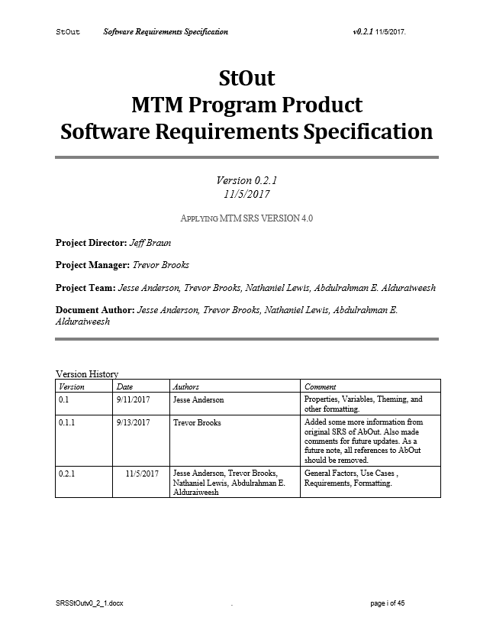
Software Requirements Specification
Currently 45 pages, due to increase.
The team, project manager, and client use this.
Contains:
Use Cases
Requirements
Functional
Non-functional
Future Enhancements

Slide 5
Actors (Users) of the Database
Administrator
Program Coordinator
Faculty Member Active
Observer
Faculty Member Inactive

Slide 6
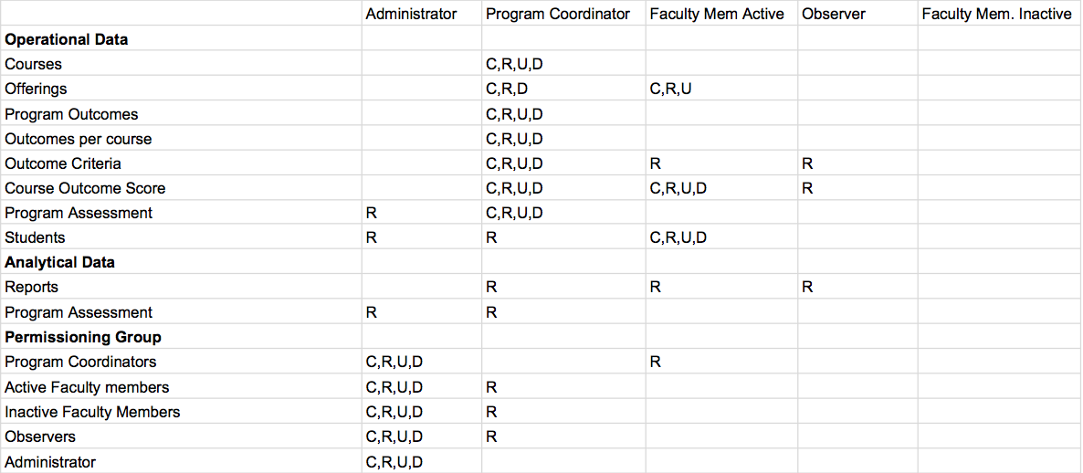
CRUD Matrix

Slide 7
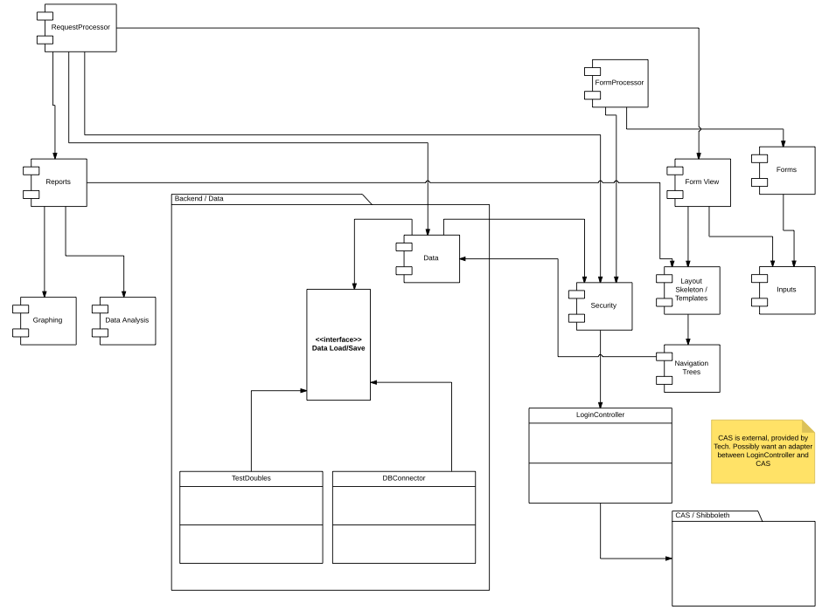
Web Application

Slide 8
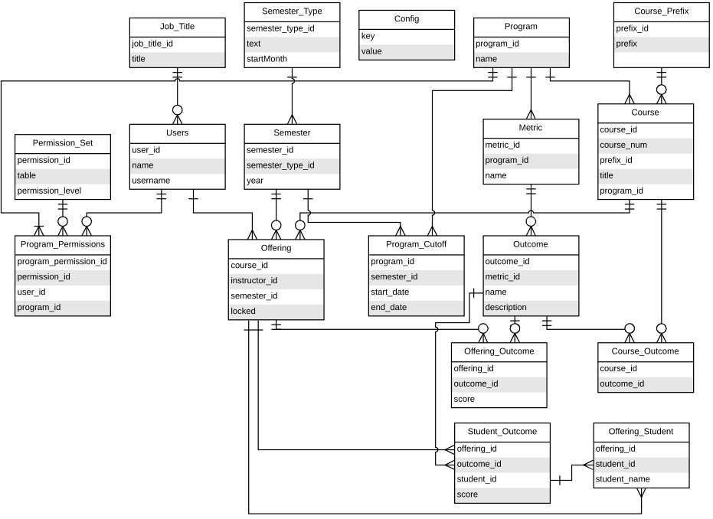
Database Model

Slide 9
Testing Suite
Automated testing on code updates
Uses Gitlab pipelines
Verifies Requirements and Constraints
Streamlines development process

