Slide 1
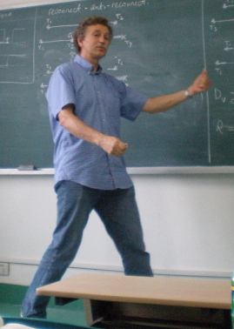

Diagrammatic Monte Carlo Method for
the Fermi Hubbard Model
Youjin Deng
Univ. of Sci. & Tech. of China (USTC)
Adjunct: Umass, Amherst
Nikolay Prokof’ev
UMass
Boris Svistunov
UMass
ANZMAP 2012, Lorne
Notes:
1
Front page

Slide 2
Outline
Fermi-Hubbard Model
Diagrammatic Monte Carlo sampling
Preliminary results
Discussion

Slide 3
Fermi-Hubbard model
Hamiltonian
momentum representation:
Rich Physics:
Ferromagnetism
Anti-ferromagnetism
Metal-insulator transition
Superconductivity
? Many important questions still remain open.

Slide 4
Feynman’s diagrammatic expansion
Quantity to be calculated:
The full Green’s function:
Feynman diagrammatic expansion:
The bare Green’s function :
The bare interaction vertex :

Slide 5
A fifth order example:
Full Green’s function is expanded as :
=
+
+
+
+
+
+
+
+ …

Slide 6
Boldification:
Calculate irreducible diagrams for to get
Dyson Equation :
Calculate irreducible diagrams for to get
The bare Ladder :
The bold Ladder :

Slide 7
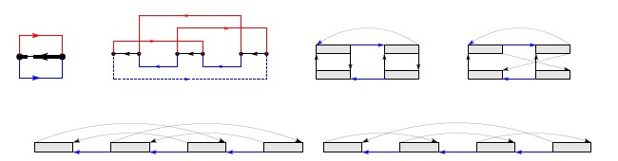
Two-line irreducible Diagrams:
Self-consistent iteration
Diagrammatic expansion
Dyson’s equation

Slide 8
Monte Carlo sampling
Diagrammatic expansion
Why not sample the diagrams by Monte Carlo?
Configuration space = (diagram order, topology and types of lines, internal variables)

Slide 9
Standard Monte Carlo setup:
- configuration space
- each cnf. has a weight factor
- quantity of interest
Monte Carlo
configurations generated from the prob. distribution

Slide 10
Diagram order
MC update
MC update
MC update
Diagram topology
This is NOT: write diagram after diagram, compute its value, sum

Slide 11
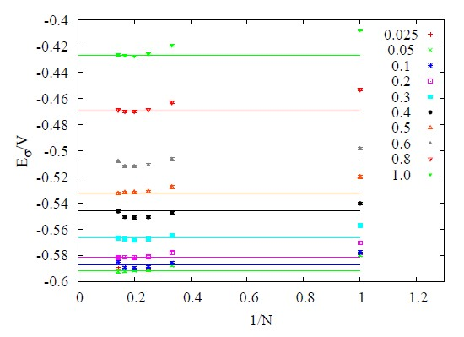
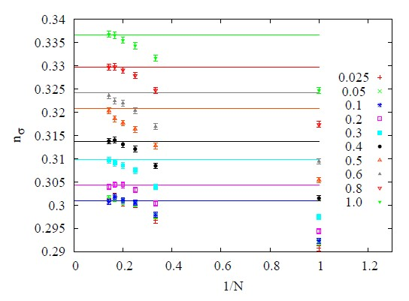
Preliminary results
2D Fermi-Hubbard model in the Fermi-liquid regime
N: cutoff for diagram order
Series converge fast

Slide 12
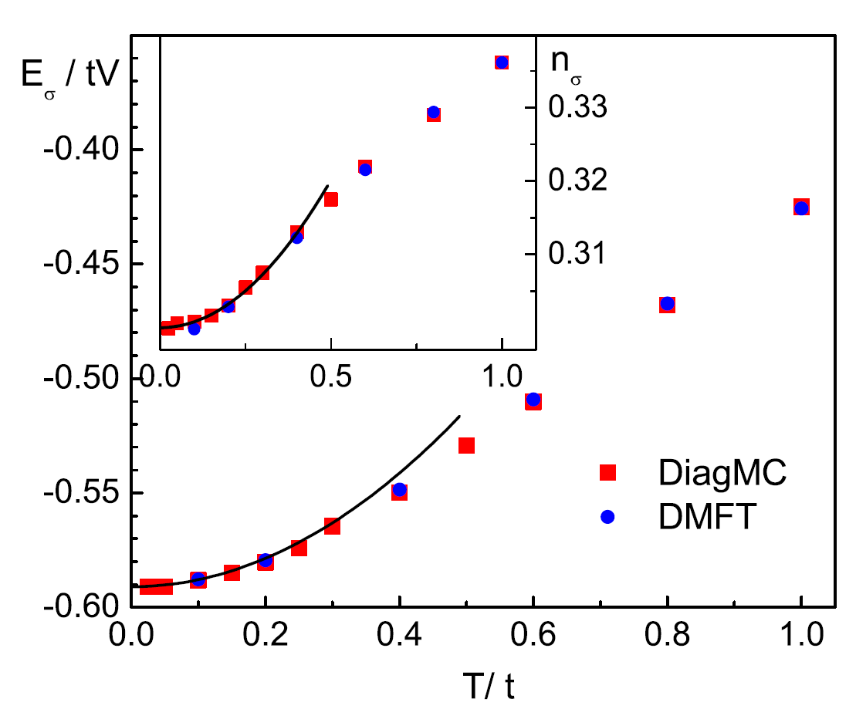
Fermi –liquid regime was reached

Slide 13
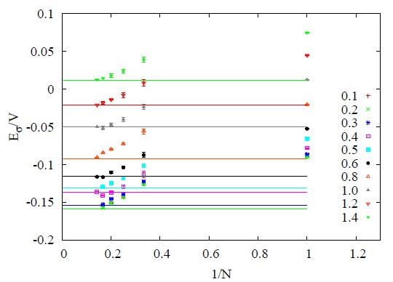
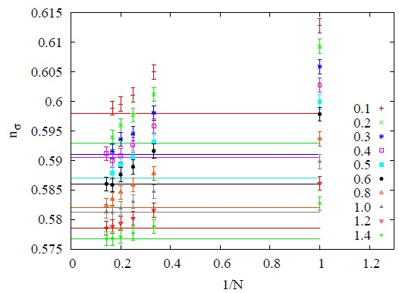

Slide 14
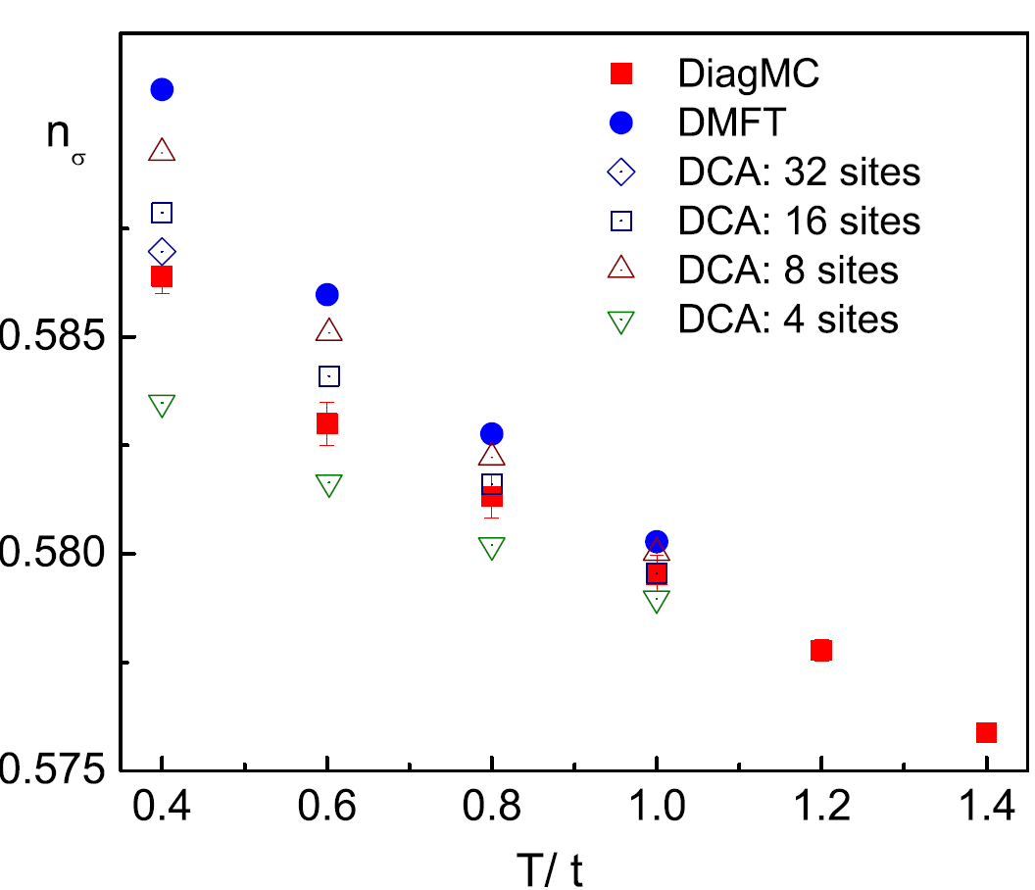
Comparing DiagMC with cluster DMFT
(DCA implementation)
!

Slide 15
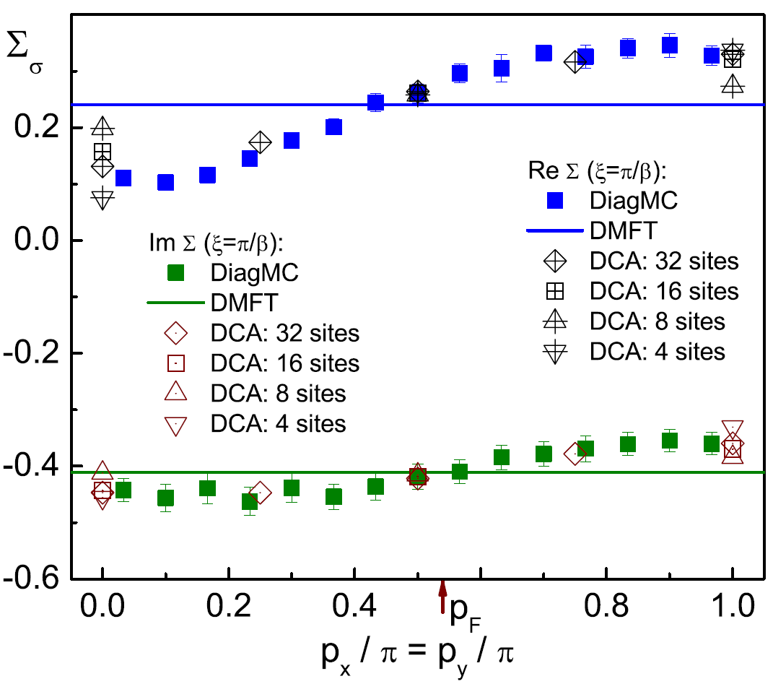
2D Fermi-Hubbard model in the Fermi-liquid regime
Momentum dependence of
self-energy
along

Slide 16
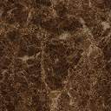

Discussion
Absence of large parameter
The ladder interaction:
Trick to suppress statistical fluctuation

Slide 17


Define a “fake” function:
Does the general idea work?

Slide 18
Skeleton diagrams up to high-order: do they make sense for ?
NO
Diverge for large even if
are convergent for small .
Dyson: Expansion in
powers of g is asymptotic
if for some (e.g. complex) g one finds pathological behavior.
Electron gas:
Bosons:
[collapse to infinite density]
Math. Statement:
# of skeleton graphs
asymptotic series with
zero conv. radius
(n! beats any power)
Asymptotic series for
with zero convergence radius

Slide 19
Skeleton diagrams up to high-order: do they make sense for ?
YES
# of graphs is
but due to sign-blessing
they may compensate each other to accuracy better then
leading to finite conv. radius
Divergent series outside
of finite convergence radius
can be re-summed.
Dyson:
Does not apply to the resonant Fermi
gas and the Fermi-Hubbard model at
finite T.
not known if it applies to skeleton
graphs which are NOT series in bare
coupling : recall the BCS answer
(one lowest-order diagram)
- Regularization techniques
From strong coupling
theories based on one
lowest-order diagram
To accurate unbiased theories based on millions of diagrams and limit

Slide 20
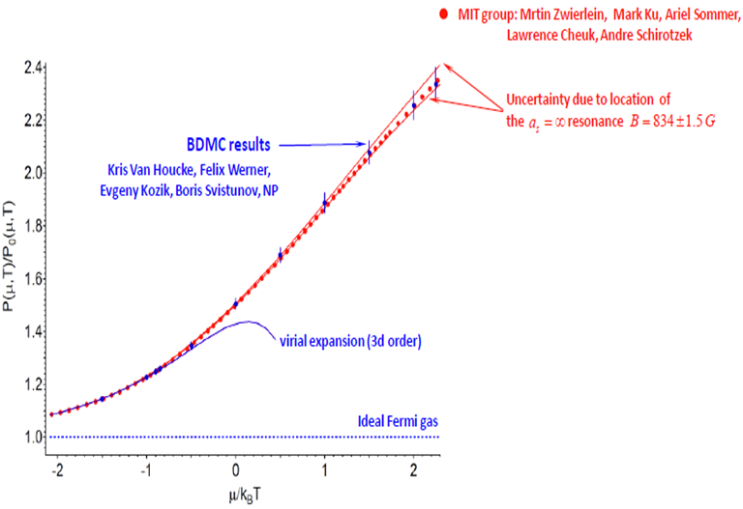
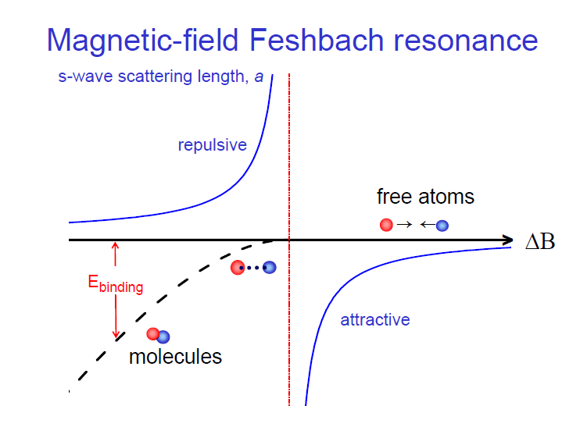
Proven examples
Resonant Fermi gas:
Nature Phys. 8, 366 (2012)
Universal results in the zero-range, , and thermodynamic limit

Slide 21
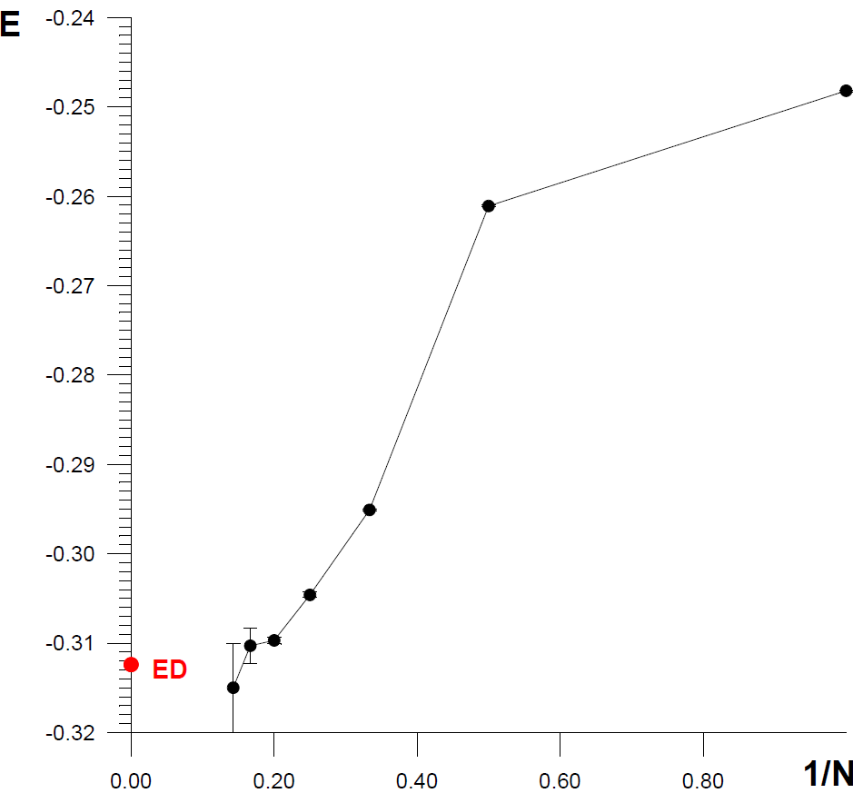
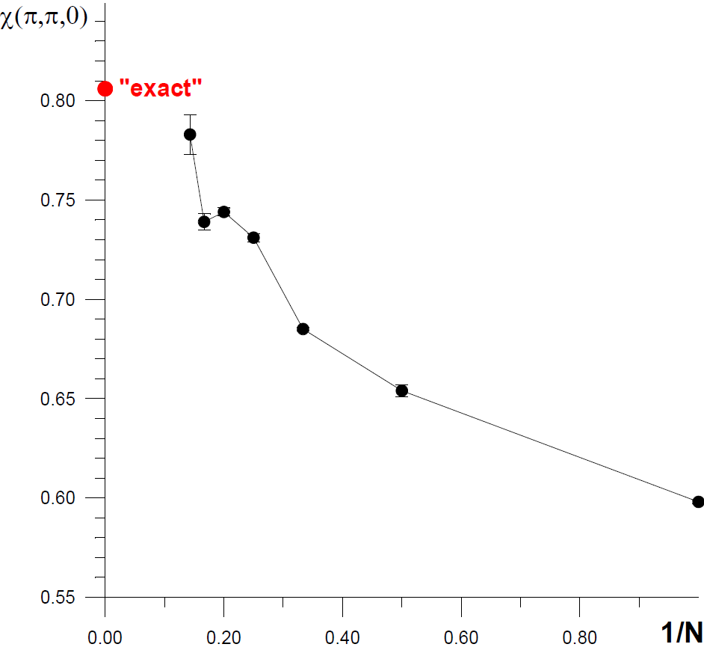
Square and Triangular lattice spin-1/2 Heisenberg model test:
arXiv:1211.3631
Square lattice (“exact”=lattice PIMC)
Triangular lattice (ED=exact diagonalization)

Slide 22
Computational complexity
Sign-problem
Variational methods
Determinant MC
Cluster DMFT / DCA methods
Diagrammatic MC
+ universal
- often reliable only at T=0
- systematic errors
- finite-size extrapolation
+ universal
- diagram-order extrapolation
+ “solves” case
- CPU expensive
- not universal
- finite-size extrapolation
+ universal
- cluster size extrapolation
Computational complexity
Is exponential :
Cluster DMFT
Diagrammatic MC
diagram order
for irreducible
diagrams
linear size

Slide 23
Thank You!

Slide 24
Key elements of DiagMC
resummation technique
Example:
Define a function
such that:
(Gauss)
(Lindeloef)
Construct sums and extrapolate to get

Slide 25
Key elements of DiagMC
self-consistent formulation
Calculate irreducible diagrams for , , … to get , , …. from Dyson equations
Dyson Equation:
Screening:
Irreducible 3-point vertex:
More tools: (naturally incorporating Dynamic mean-field theory solutions)
Ladders:
(contact potential)

Slide 26


What is DiagMC
=
+
+
+
+
+
+
+ …
MC sampling Feyman Diagrammatic series:
Use MC to do integration
Use MC to sample diagrams of different order and/or different topology
What is the purpose?
Solve strongly correlated quantum system(Fermion, spin and Boson, Popov-Fedotov trick)

