Slide 1

Ground state properties of first row atoms:
Variational Quantum Monte Carlo
Ebrahim Foulaadvand
Zanjan University, Zanjan, Iran

Slide 2
Outline
Variational Quantum Monte Carlo
Quantum Monte Carlo Wave functions
Wave Function optimization by Steepest Descent method
Optimization Trial Wave Function by Newton’s method

Slide 3
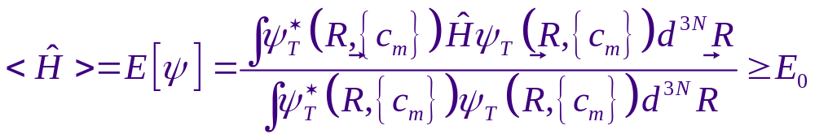
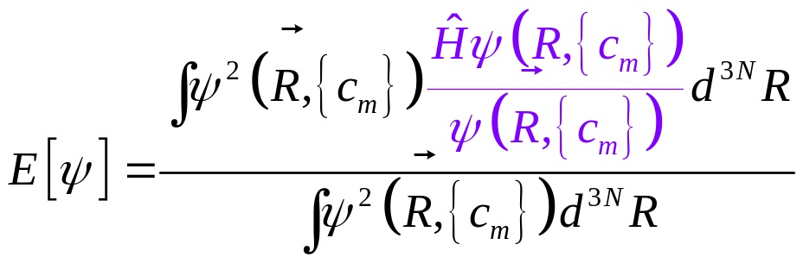
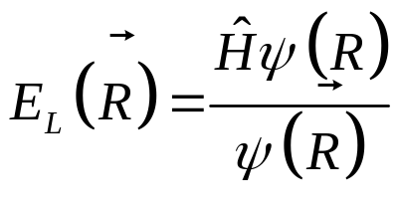
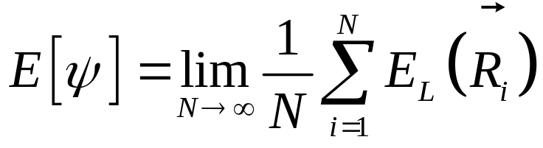
Variational Quantum Monte Carlo (VMC)
Variational Principle
Ground state energy
Local energy

Slide 4
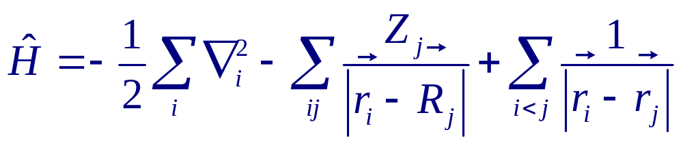
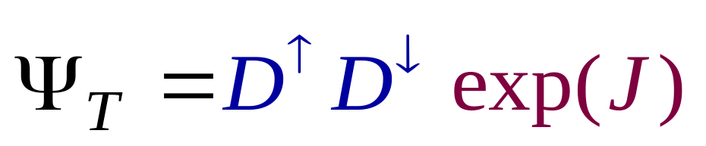
Variational Quantum Monte Carlo
Hamiltonian of Many-body particle systems
Trial Wave function
Slater determinants
Jastrow function

Slide 5
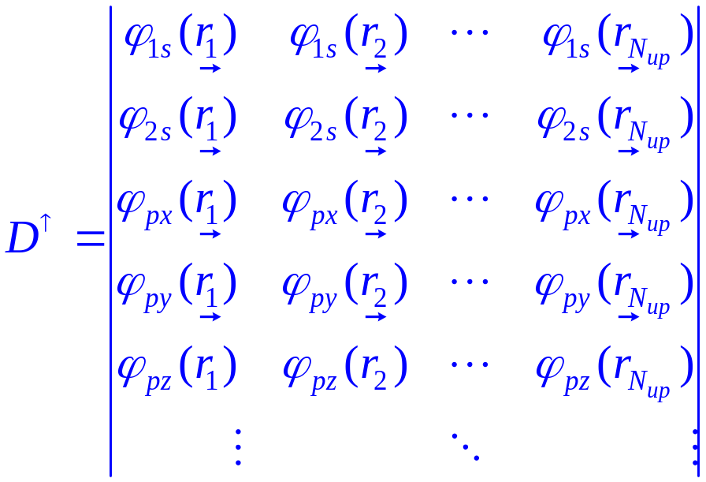
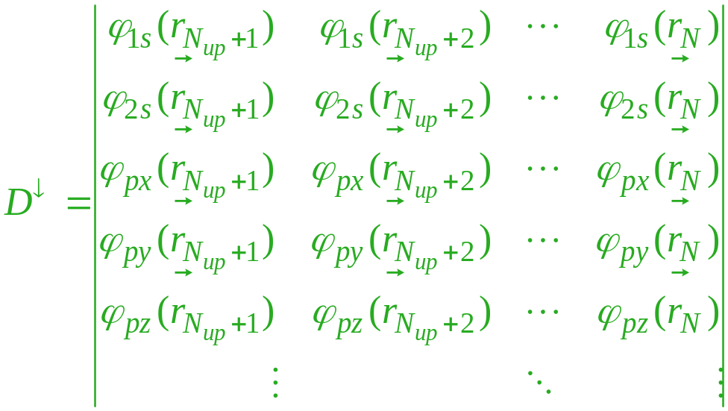
Variational Quantum Monte Carlo
Slater determinants

Slide 6
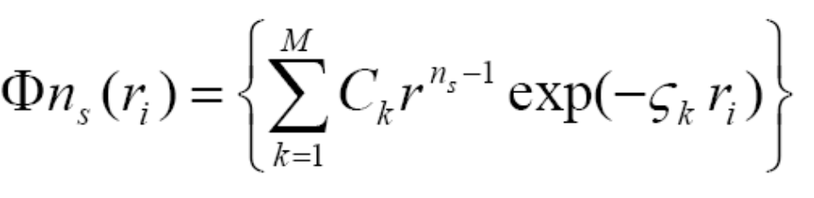
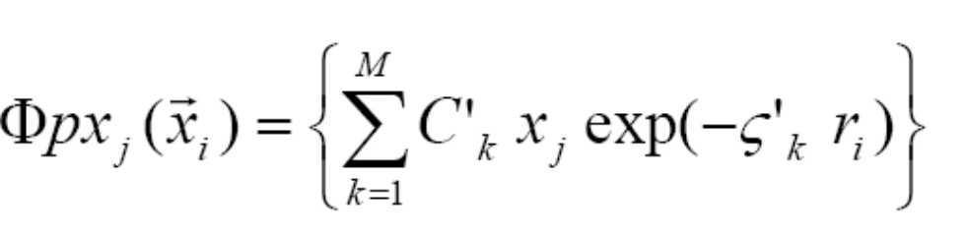
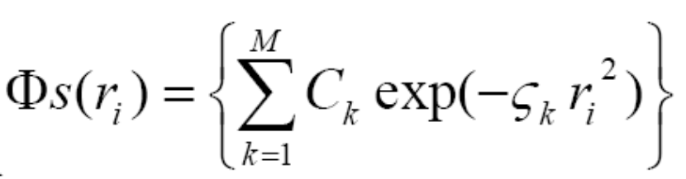
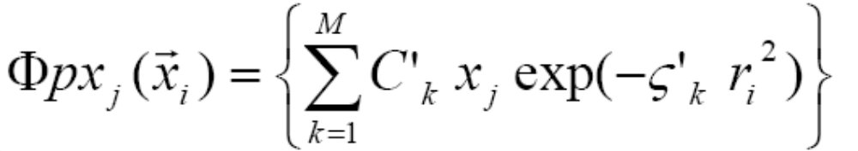
Quantum Monte Carlo Wave function
Slater Type Orbitals (STO)
Gaussian Type Orbitals (GTO)

Slide 7
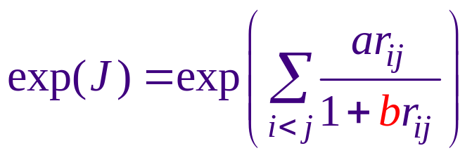
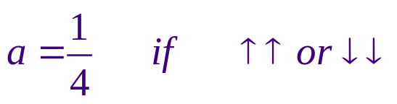
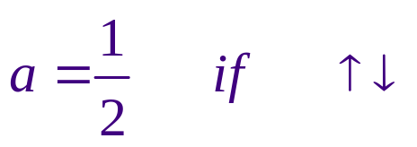
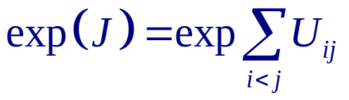
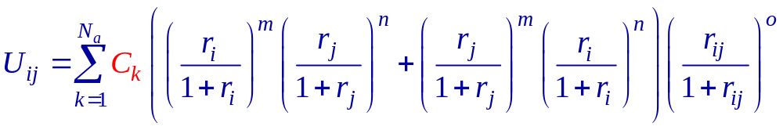
Quantum Monte Carlo (QMC) Wave function
Two body Jastrow-Pade function
*Smith and Moskovitz approch
K. E. Schmidt and J. W. Moskowitz, J. Chem. Phys. 93, 4172 (1990)

Slide 8
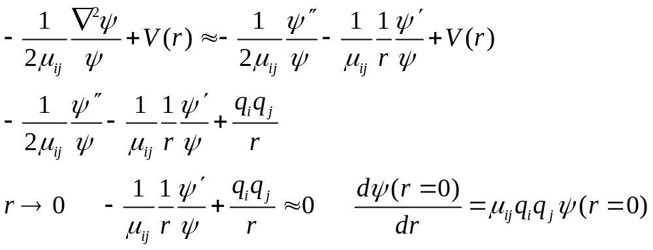
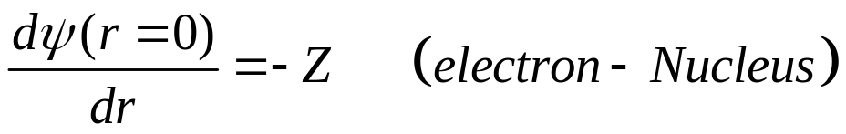
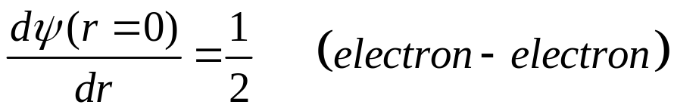
Quantum Monte Carlo Wave function
Cusp Conditions
Slater Determinat
Jastrow function

Slide 9
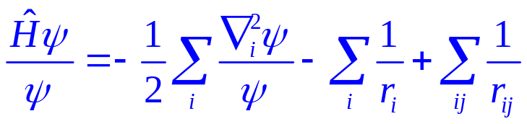
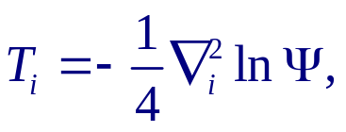
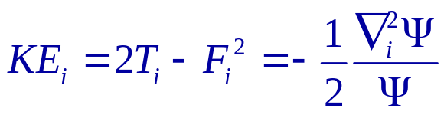
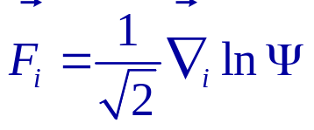
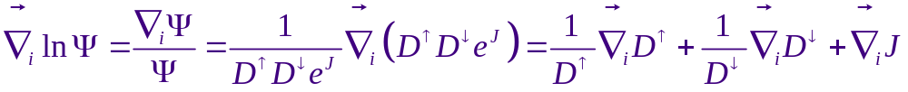
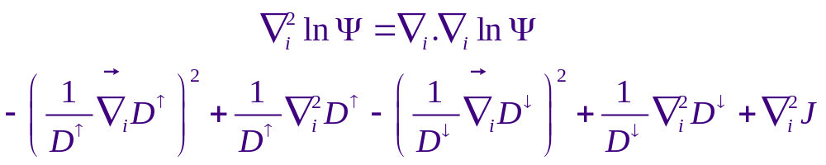
Variational Quantum Monte Carlo
Calculating Local Energy

Slide 10
Variational Quantum Monte Carlo
Initial Trial wave function
Initial Configuration
Initial Parameters
Cusp conditions
Propose a move
Evaluate
Probability ratio
Yes
Update
electron position
Metropolis
No
Calculate Local Energy
Output

Slide 11
Optimization Quantum Monte Carlo Wave functions
Direct Methods
In this method we must calculate first and second energy derivatives respect to parameters
1
Newoton’s method
Steepest Descent
Conjugate Gradient
Indirect methods
2
Variance minimization
Genetic algorithm as a new method in QMC wave function optimization
1
Xi Lin, Hongkai Zhang and Andrew M. Rappe, J. Chem. Phys. 112, 2650 (2000).
2
C. J. Umrigar, K. G. Wilson and J. W. Wilkins, Phys. Rev. Lett. 60, 1719 (1988).

Slide 12
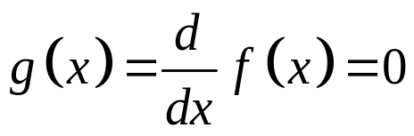

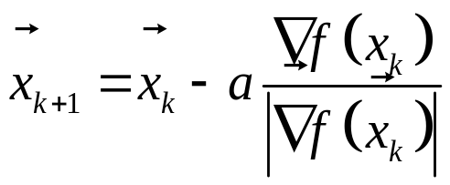
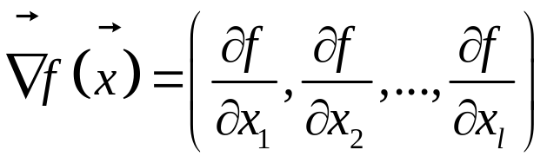
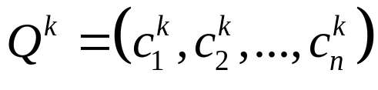
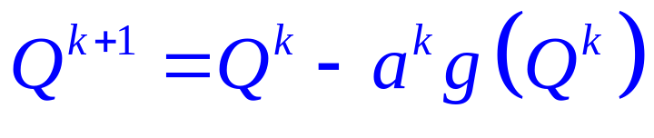
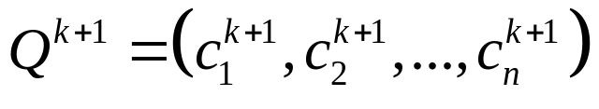
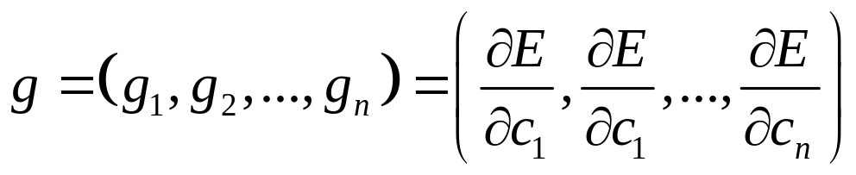
Steepest Descent Method
Optimization by Steepest Descent

Slide 13
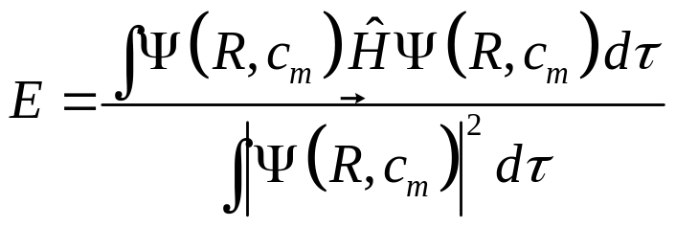
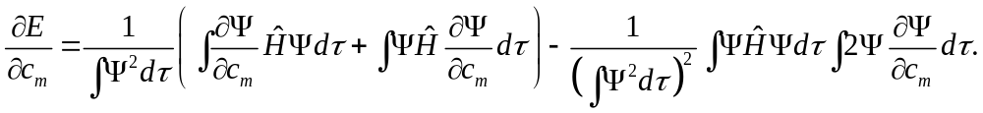
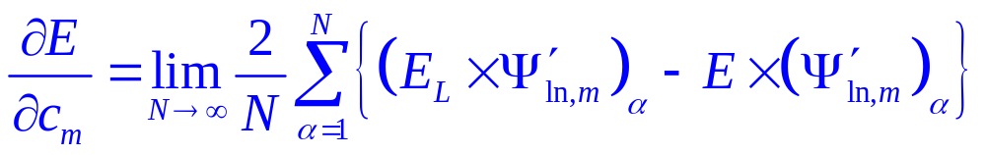
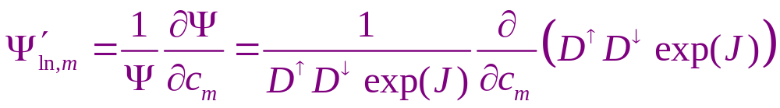
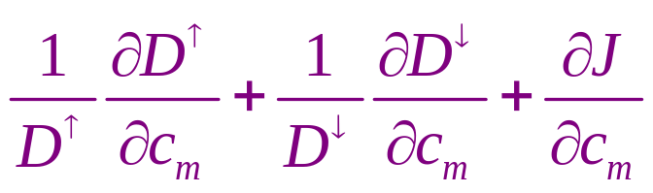
Steepest Descent Method

Slide 14
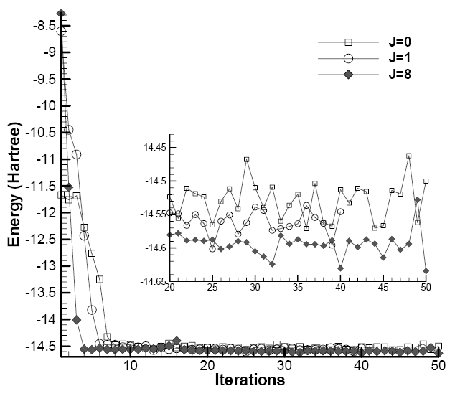
Optimization Trial Wave Function by Steepest Descent method
Energy of Be atom versus iteration

Slide 15
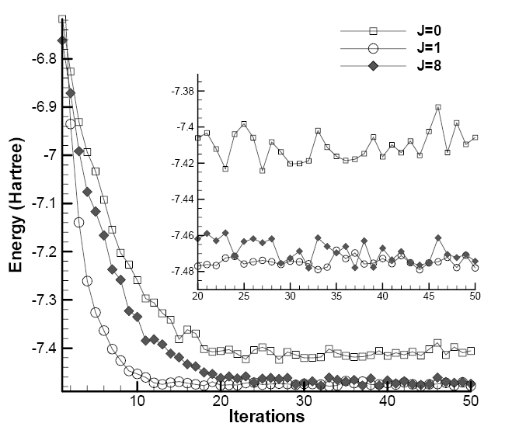
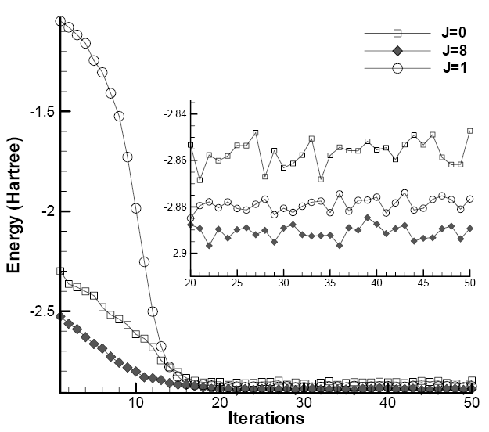
Optimization Trial Wave Function by Steepest Descent method
Li
He

Slide 16
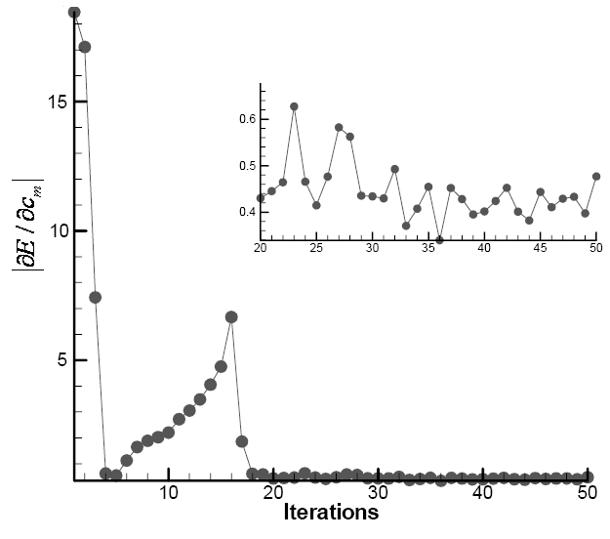
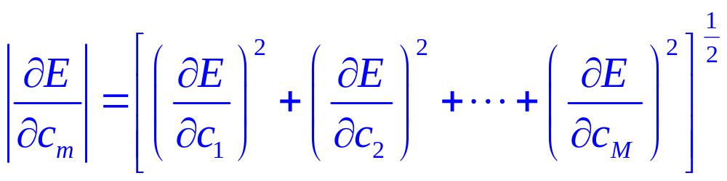
Optimization QMC Wave function by Steepest Descent Method

Slide 17
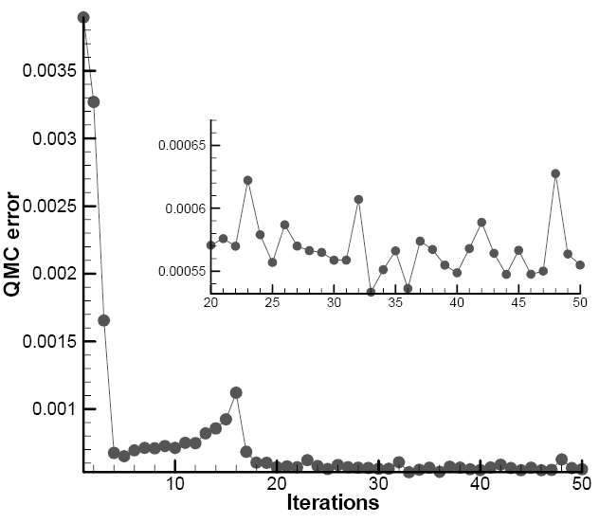
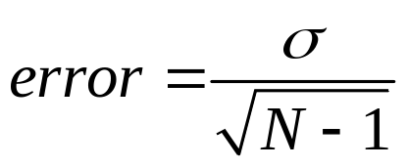
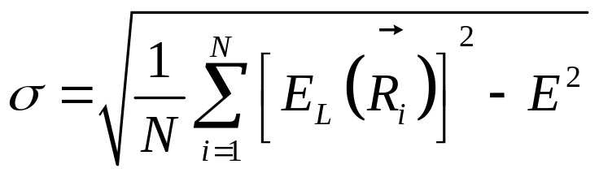
Optimization QMC Wave function by Steepest Descent Method
Error in Quantum Monte Carlo Calculations
Be

Slide 18
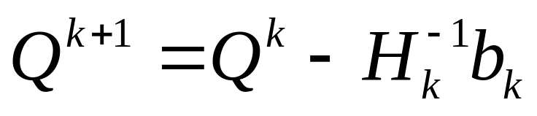

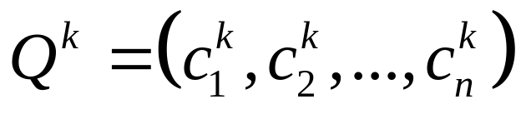
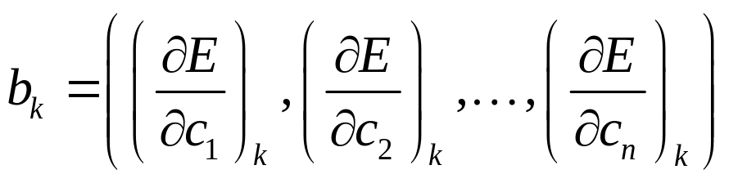
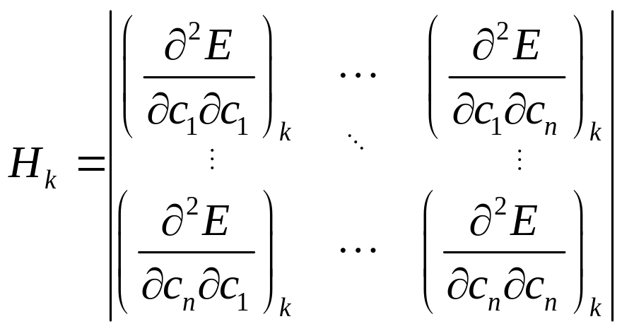
Newton’s Method

Slide 19




Newton’s Method
Second energy derivative respect to variational parameters

Slide 20



Newton’s Method

Slide 21







Newton’s Method
We must propose an algorithm to calculate these values

Slide 22




Newton’s Method
Singularity in Hessian Matrix
1. Singular Value Decomposition (SVD)
2. We determine the eigenvalues of the Hessian and add to the diagonal of the Hessian the negative of the most negative eigenvalue plus a constant

Slide 23
Newton’s Method
Details in Calculations by Newton’s method
We have chosen initial parameters randomly.
The first six iterations employ a very small Monte Carlo samples, NMC=300000, and a-diag =2 For each of the next six iterations we increase NMC and decrease a-diag by a multiplicative factor of 0.1
The remaining 11 iterations are performed with the values at the end of this process, namely, NMC= 2000000, and a-diag = 0.002

Slide 24



Optimization QMC wave function by Newton’s Method
Be
Li
He

Slide 25


Energy Minimization
Results
Ground State Energy by Newton’s method
Ground State Energy by Steepest Descent method
S. J. Chakravorty, S. R. Gwaltney, E. R. Davidson, F. A. Parpia, and C. F. Fischer, Phys. Rev. A 47, 3649 (1993).
K. E. Schmidt and J. W. Moskowitz, J. Chem. Phys. 93, 4172 (1990)

