Slide 1

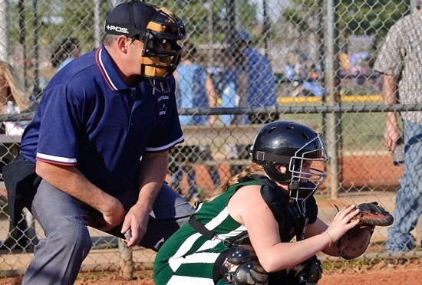
NCLL Umpire Introduction
Huber Cooney, UIC
Eric Evans, Umpire Coordinator
Pat Murphy, UIC Emeritus

Slide 2
Agenda
Goals of the NCLL Ump
Why do we do this?
Gameday
Teen program
Next steps

Slide 3
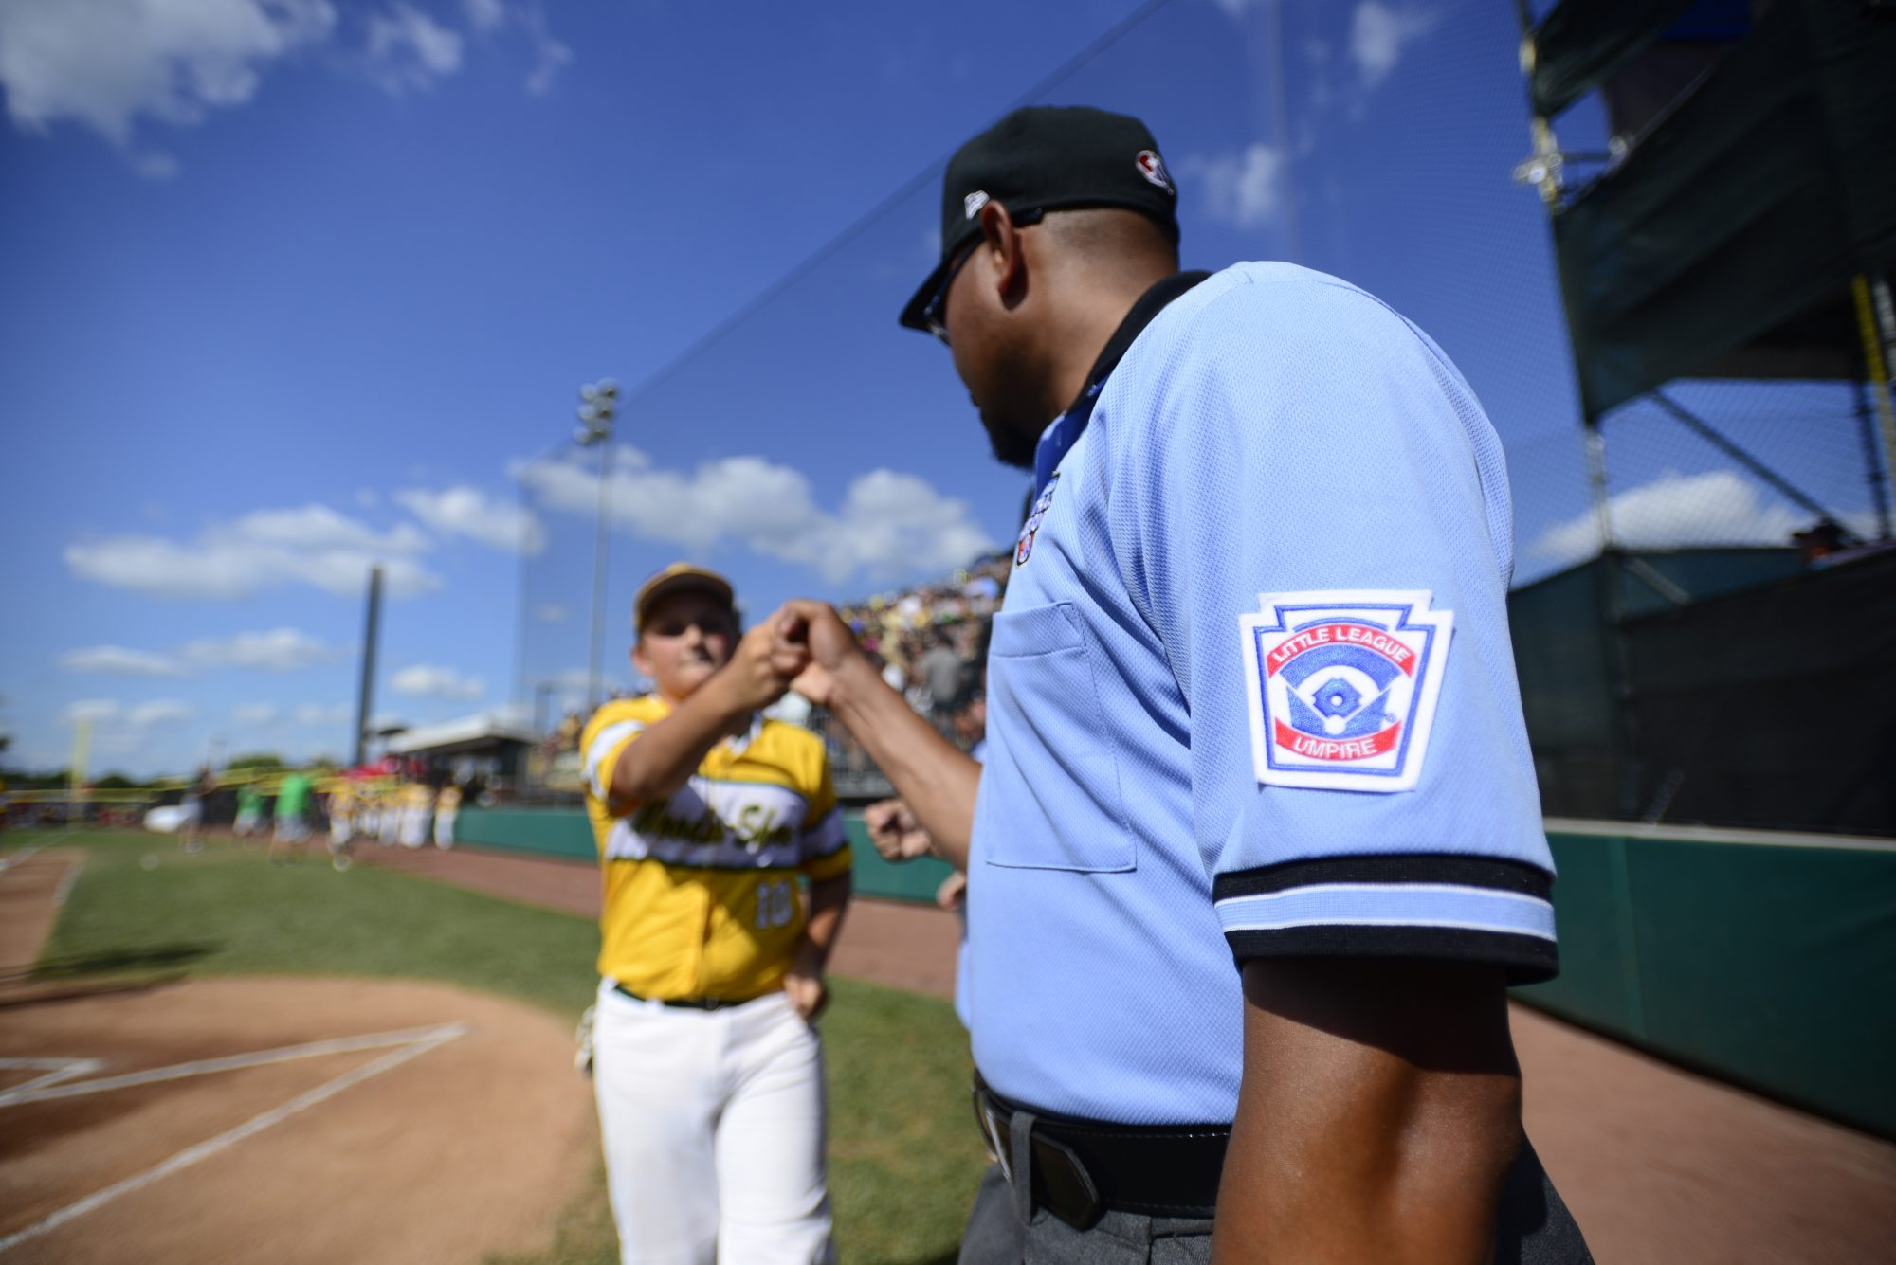
Goals of the NCLL Umpire
Kids have a good experience
Keep everyone as safe as possible
Enforce the rules
Have fun yourself!

Slide 4
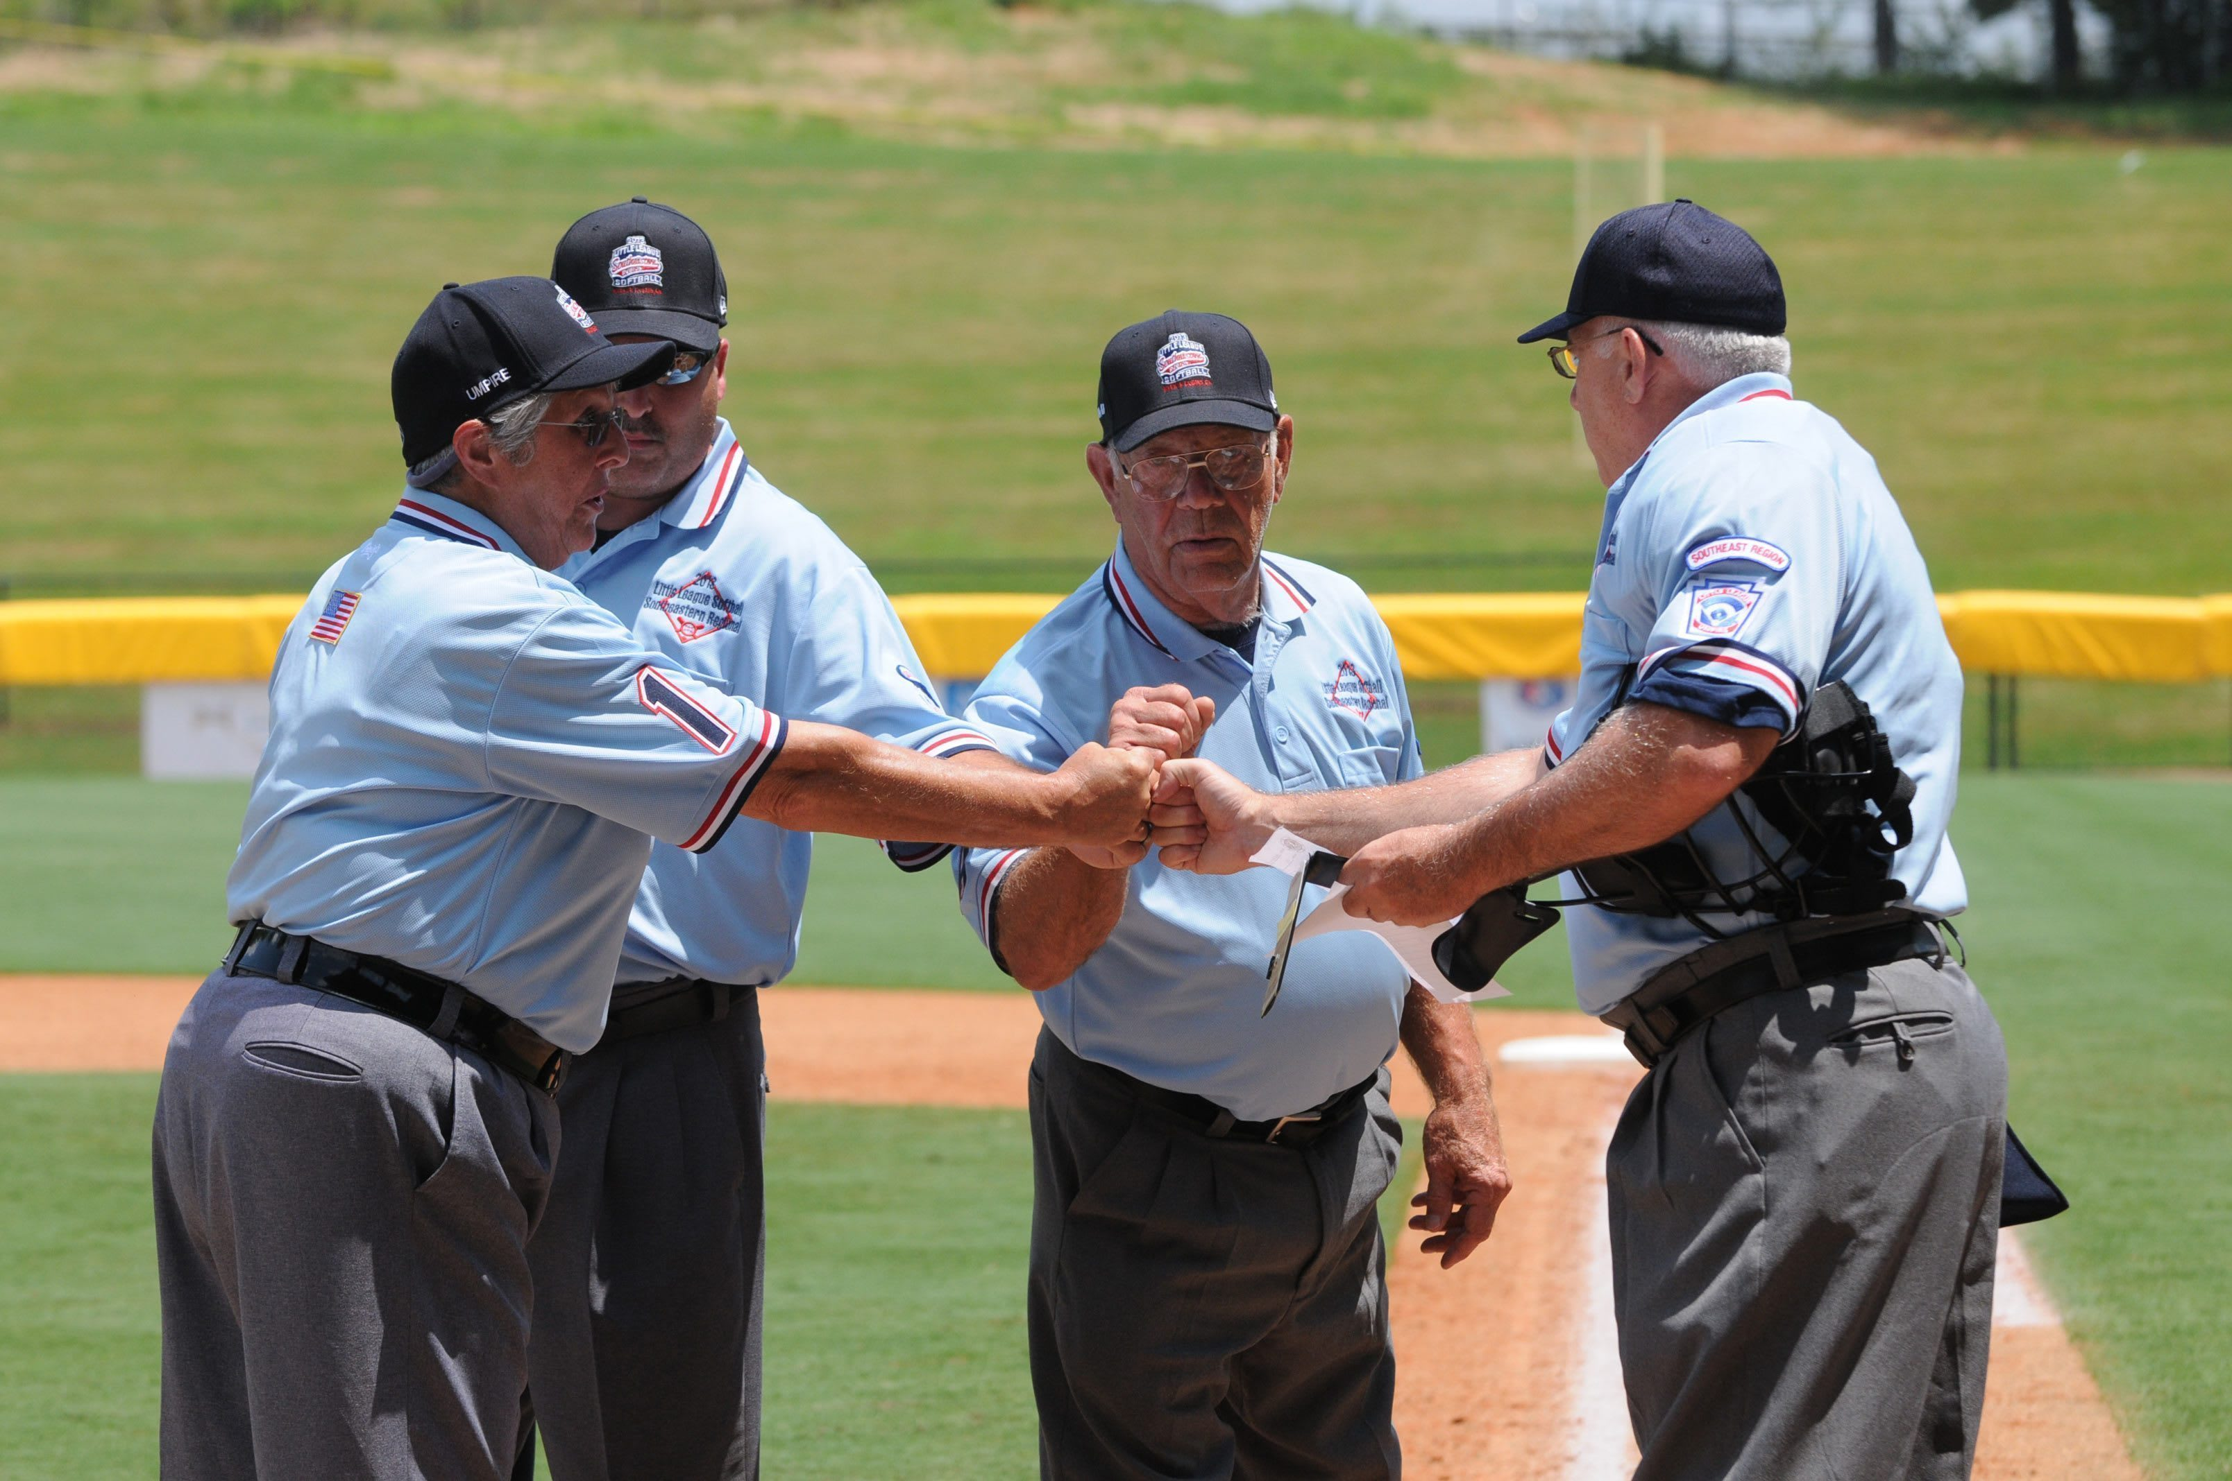
Why do we do this?
Love the game
Satisfaction
Cameraderie
It’s fun

Slide 5
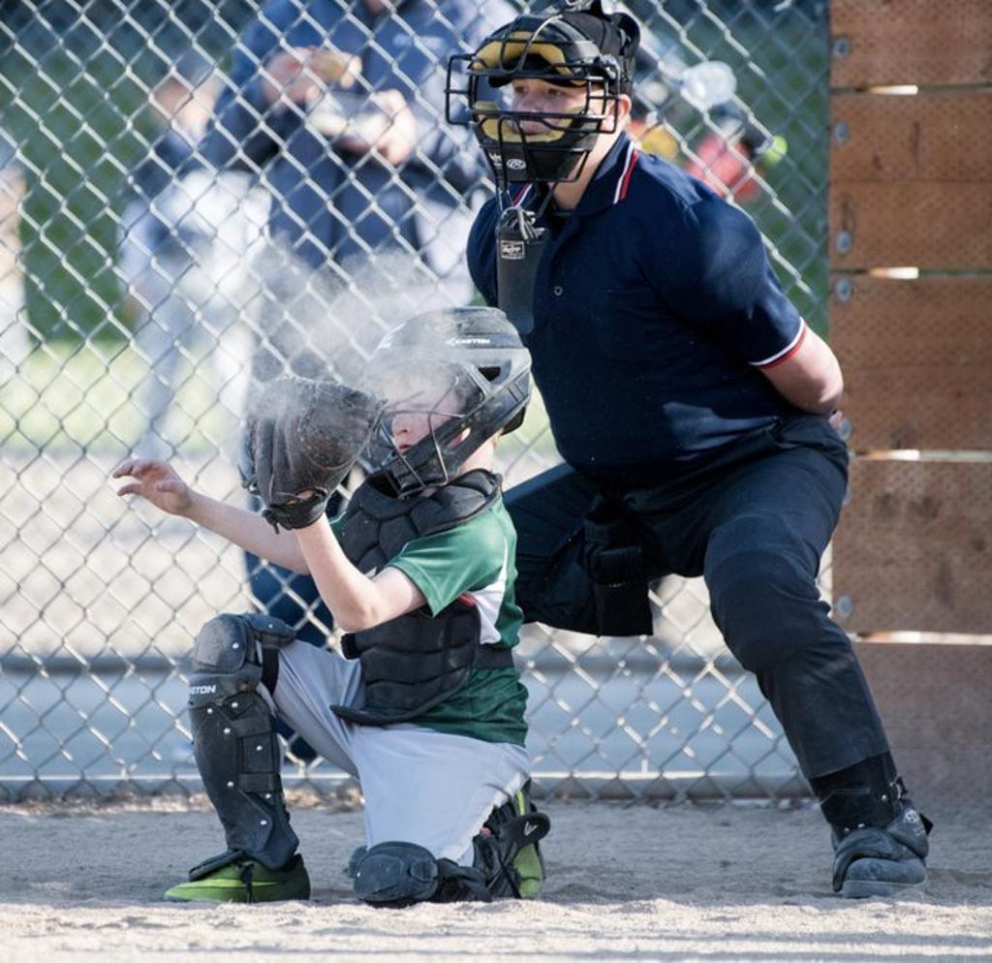
A Gameday In The Life
Arrive 15 mins before gametime, in uniform/gear
Quick plate meeting with managers 5 minutes before game
  Script provided
  Coordinate w/other ump(s)
Calling “play”
  Beginning of inning
  After foul ball
  After “time”
Make calls for 90-120 minutes
Accept thanks from players, coaches and parents

Slide 6
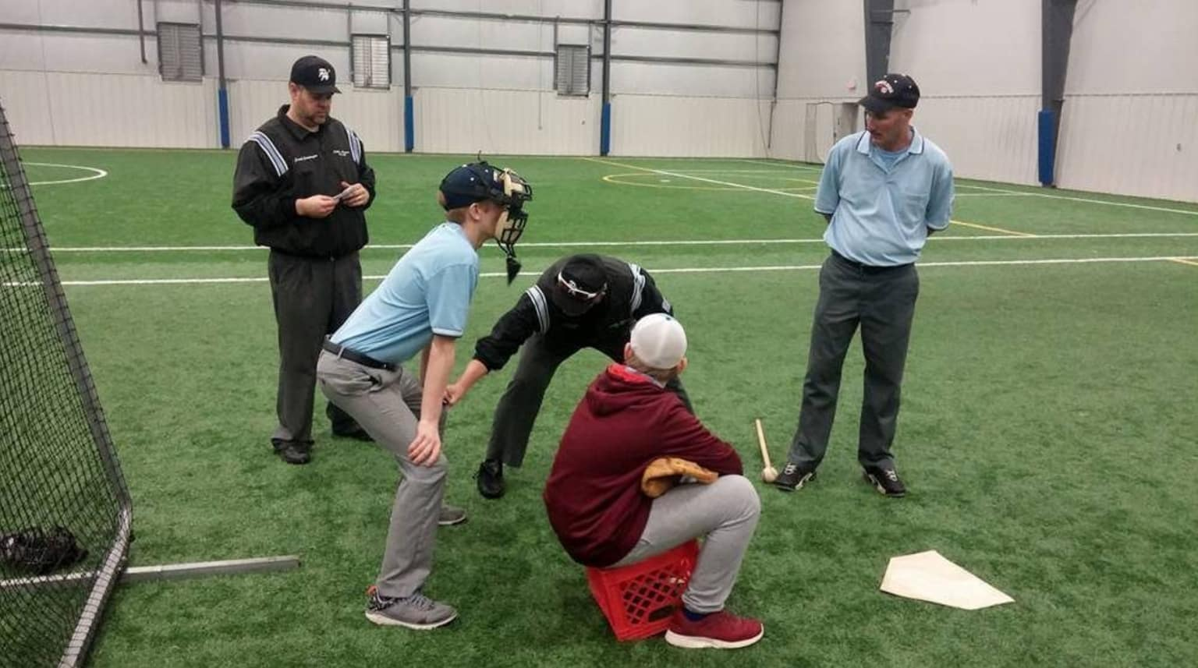
Teen Ump Program
Same training/org
Start with AA games, then move up!
Choice
  $30 (that’s cash money in US dollar!)
  Community credit for high school

Slide 7
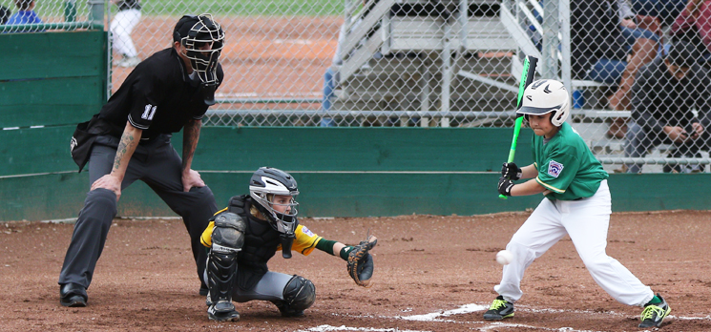
Next Steps
Register as a volunteer on Umps page (ncllball.com/volunteers-umpires)
Email Ump Coordinator (ncllumpirecoordinator@gmail.com)
  Contact info
  Teams/leagues you expect to ump for
Peruse resources on Umps page
  Training section
  Subscribe to calendar and attend
    Orientation/rules session
    Mechanics clinic
Signup for games

