Slide 1


















information
ENRICHMENT
series
New Business and Underwriting
Module 1 – New Business Application Processing

Slide 2

01
GETTING TO KNOW YOUR
NB & UW PARTNERS
05
APPLICATION PROCESSING AND TURN AROUND TIME
Table of Organization
Sections & Assignments
NB & UW Personnel Demographics
Authority limits
End-to-end NB application processing including TAT
Requirements Processing
Refund Processing
Procedures in making follow-ups, submitting requirements, requesting for reconsideration
02
DIFFERENT TYPES OF
APPLICATION FORMS
06
SCORECARD: OURS
AND YOURS
SIO, GIO, REGULAR APPLICATION FORM, FNARPQ, PROPOSAL
03
REVIEW OF VALID IDS
07
QUIZ
Primary and Secondary ID
04
COMMONLY OMITTED
QUESTIONS IN THE
APPLICATION FORMS
Example Portion of the Application Form
MODULE
OVERVIEW

Slide 3

New Business and Underwriting Services as of MARCH 06, 2019
01
99
5/6
9/10
11/12
06
02
Warm Bodies
2017 Hired/Approved Head Count
2018 Hired/Approved Head Count
2019 Hired/Approved Head Count
For Replacement
Consultants
Chief NB & UW
2019
Three Sections in New Business and Underwriting Services
We still need:
2 NB Review Associate and Analysts
6 Underwriters
New Business Review Associate and Analyst
Underwriter
Facilitator
Pending Approved Additional Head Count
Reviews created records and executes auto appraisal
Performs simple underwriting involving occupation and foreign travel guidelines up to their approval limit
Final status of speedy processed applications
Reviews and releases policy contract
Analyzes the applications that are not approved by NB Review Associates which are more complex in nature or with medical, financial, and legal concerns
Performs appropriate risk classification based on provided information, probability of death, or disability guided by Sun Life Underwriting Manual and Reinsurance Group of America Manual
Returns medical records to doctors
Prepares offer forms and computes extra premiums (for traditional products only)
Processes refund of premium
Processes payment of doctors for APS reports; reimburses advisors of the medical costs they advanced for UW requirements
Processes NPW fees and charging of unnecessary requirements submitted by advisor
01
WHO ARE WE?
THE MEN AND WOMEN
BEHIND NB & UW SERVICES
Notes:
97 warm bodies –
BREAKDOWN
Policy Issue & Facilitating = 1
NB Review = 49
Facilitating = 10
Underwriters = 33
NB & UW Support = 4
challenge
2017 – target 6 hiring – only 5 were hired
2018 – target 10 hiring - only 9 were hired
2012 – target 12 hiring – 7 were hired already
We still lack 7 staff + 4 (resignation) = lack 11 staff
For 2019:
NB – 1 replacement + 7 new staff : 8
UW – 3 replacement+ 6 new staff: 9

Slide 4
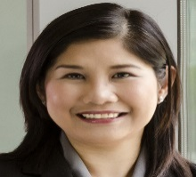
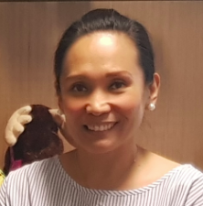
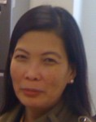

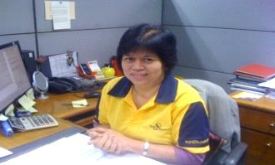
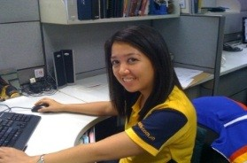
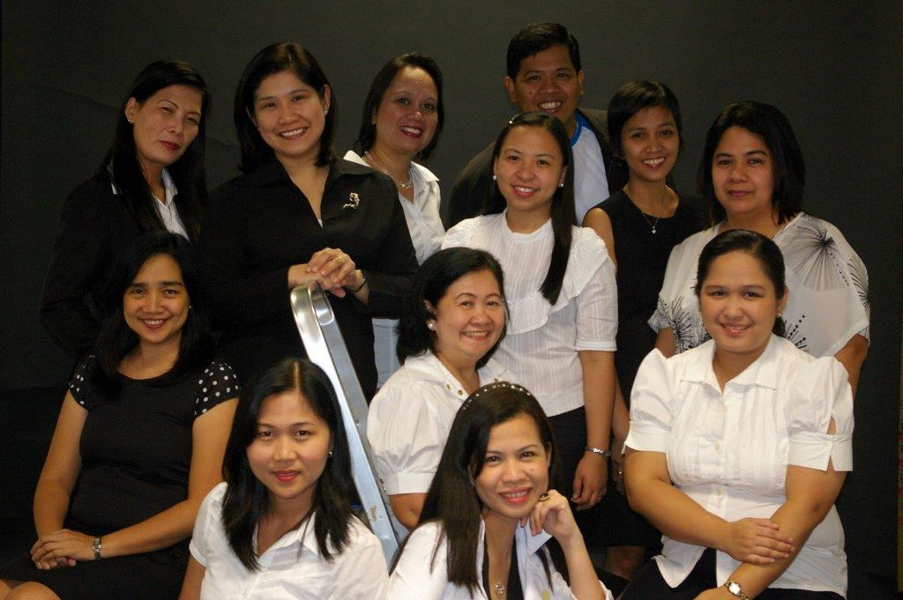

Karen Casas
Chief Operations Officer
New Business and Underwriting Services
Tina Dizon, PCS, FLMI, FALU
Head, NB & UW
Date of Entry: April 1995
Vilma Tubig, PCS, FLMI
Manager 3
NB Review, Facilitating
and Post-Issue
Date of Entry: Nov 1999
Lara Miguel, ACS, FLMI, FALU
Manager 3
SLOCPI Territory 1
Date of Entry: Feb 1997
Territory 1 Head Partner – Al Quitangon (30 Branches)
Malou Ramos, ACS, FLMI, FALU
Manager 3
SLOCPI Territory 2
Date of Entry: Aug 1989
Territory 2 Head Partner – Tim Crisologo (33 branches)
Dalla Labisto, PCS, FLMI, FALU
Manager 2
SLGFI, Post Issue, Group and Technical Support for SLOCPI and SLGFI
Date of Entry: Jan 2011
Grace Repuyan,
ACS, FLMI, FALU
Consultant
Date of Entry:
Oct 1985
Table of Organization

Slide 5
Karen Casas
Chief Operations Officer
Territory 1
Territory 1 Head Partner – Al Quitangon (30 Branches)
BAOBAB HYPERION TREE OSMANTHUS
BIRCH IRONWOOD PHOENIX PALM
CEDAR JOSHUA TREE REAP ISO
CYPRESS KARRI RED SPRUCE
DIAMOND TREE LAURELWOOD RED SYCAMORE
DURIAN MAJESTY REDWOOD
EMPRESS MANGO ROYAL POINCIANA
EUCALYPTUS MANGROVE SAKURA
GOLDENRAIN MULBERRY TINDALO
GREEN FIR NARRA TJIKKO
Tina Dizon, PCS, FLMI, FALU
Head, NB & UW
Date of Entry: April 1995
Territory 2
Territory 2 Head Partner – Mon Sto. Domingo (33 branches)
ACACIA COPAIBA JARRAH
ALMOND CORINTHIAN MAGNOLIA WOODS
ANGEL OAK COTTONWOOD MIRACLE TREE
BAMBOO DAU MOLAVE
BAYWOOD DRAGONWOOD MULAWIN
BLUEWOOD EVERGREEN OLIVE
BRISTLECONE GENUS PINE PALM
CANONBALL HEATHER TREE QUEBRACHO
CHESTNUT IRON OAK ROSEWOOD
COACHWOOD IVY SEQUOIA
COCONUT JACARANDA TREE OF LIFE
Lara Miguel, ACS, FLMI, FALU
Manager 3
SLOCPI Territory 1
Date of Entry: Feb 1997
Malou Ramos, ACS, FLMI, FALU
Manager 3
SLOCPI Territory 2
Date of Entry: Aug 1989
Dalla Labisto, ACS, PCS, ALMI, FLMI, FALU
Manager 2
SLGFI, Post Issue, Group and Technical Support for SLOCPI and SLGFI
Date of Entry: Jan 2011
Grace Repuyan,
ACS, FLMI, FALU
Consultant
Date of Entry:
Oct 1985
Underwriting Services

Slide 6
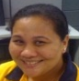
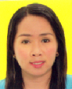


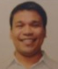
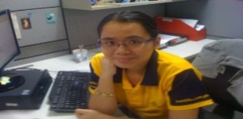


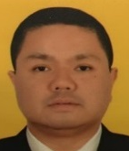


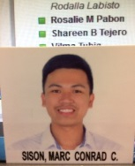
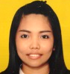
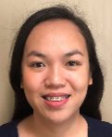
Tina Dizon, PCS, FLMI, FALU
Head, NB & UW
Date of Entry: April 1995
SLOCPI
Territory 1 - Underwriters
Lara Miguel, ACS, FLMI, FALU
Manager 3
SLOCPI Territory 1
Date of Entry: Feb 1997
15
Warm
Bodies
Anne Baello
FALU, 4B
Date of Entry:
Nov 2012
Ayn Ramirez
ACS, ALMI,
AALU,4B
Date of Entry:
July 2011
John Vincent
Escalante, 4B
Date Entry in NB &
UW: Feb 2016
Dianne Carmela
San Agustin, 5A
Date of Entry:
June 2014
Erwin U. Imperio
4B (T)
Date Entry in NB &
UW: June 2018
Tere Gravador, PCS, AALU
Manager 1
Team 1
Date of Entry: Oct 2011
Sha Tejero, ACS, ALMI, FALU
Manager 1
Team 2
Date of Entry: Jun 2007
Mark Angelo
Suarez, 4A
Date of Entry:
Apr 2016
Minette Marquez,
ACS, AALU
Supervisor
Team 3
Date of Entry:
Jun 2013
Kathleen Gae
Arandia, 4A
Date of Entry:
June 2014
Precious
Bandoquillo, 4A
Date of Entry:
Apr 2017
Marc Conrad
Sison, ACS, 4A
Date of Entry:
Apr 2017
Marcela S. Doligon
4A (T)
Date Entry in NB &
UW: May 2019
Ruzelle Dacles
4A (T)
Date Entry in NB &
UW: May 2019
Notes:
TEAM 1
SLOCPI NB Appraisal
Conduct IES/Training sessions for advisors within the territory
Coordinate with Client Care on issues relating to NB Calls (providing trainings when necessary, updating Client Care when there are changes in guidelines, handling calls that may need to be elevated to UW due to complexity)
TEAM 2
1. SLOCPI NB Appraisal
2. Conduct IES/Training sessions for advisors within the territory
3. Audit of Underwriters under Band 5A
4. Continue to represent Sun Life to the HOLUAP board until completion of term
TEAM 3
SLOCPI NB Appraisal
Handle the Polcon on-hold and Retrigger databases and ensure cases are resolved within 10 days from release of the report. Ensure action plans are provided and carried out. Provide quarterly summary.

Slide 7
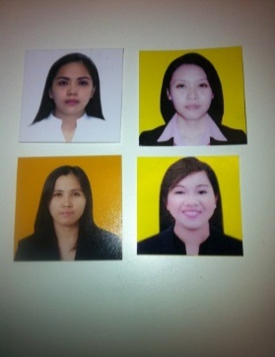
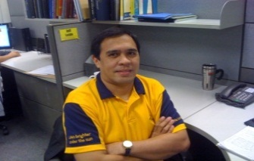
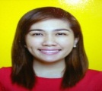
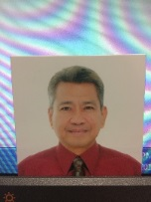
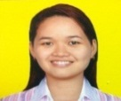
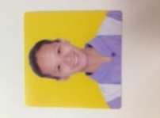
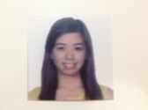
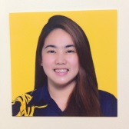
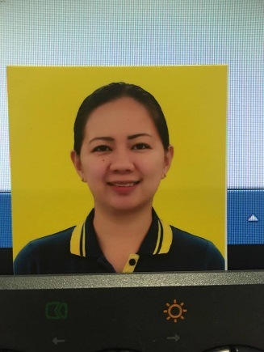
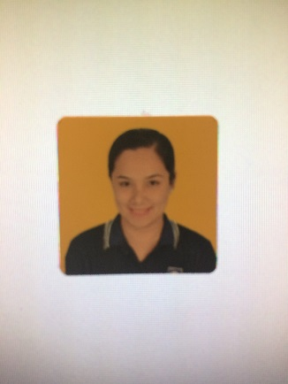
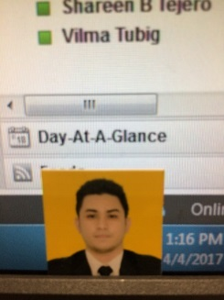
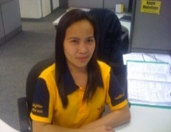
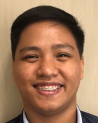
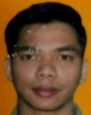
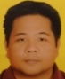
Tina Dizon, PCS, FLMI, FALU
Head, NB & UW
Date of Entry: April 1995
SLOCPI
Territory 2 - Underwriters
Underwriting Services
Malou Ramos, ACS, FLMI, FALU
Manager 3
SLOCPI Territory 2
Date of Entry: Aug 1989
16
Warm
Bodies
Joanna Audrey
Zarcal, 5A
Date of Entry:
Nov 2013
Maria Teresa
Fundano, 4B
Date of Entry:
July 2014
Hanie Jill
Mercado, 4B
Date of Entry:
Sep 2015
Jeff Leido,
ACS, FLMI, ARA, AIRC, FALU
Underwriter 4
Date of Entry: Jan 2011
Nina Argallon, AALU
Manager 1
Team 1
Date of Entry: Apr 2013
Gene Bayan, FLMI
Supervisor
Team 2
Date of Entry: May 2017
Madel Petalcorin-San Roman
Supervisor
Team 3
Date of Entry:
Jun 2013
Jazzelle
Del Rosario,4B
Date Entry:
Sep 2015
Paula Rogan, 4A (T)
Date of Entry:
Aug 2018
Scarlet Bielza,
4A
Date Entry:
May 2017
Janxent B. Tumbagahon
4A (T)
Date Entry in NB &
UW: Apr 2017
Angie Maladaga
ACS, PCS, AFSI, FLMI
Underwriter 4
Date of Entry:
Mar 2011
Raymond Bucao
4A (T)
Date Entry in NB &
UW: May 2019
Mark Joseph M. Grimaldo
4A (T)
Date Entry in NB &
UW: May 2019
Emmanuel
Canonigo, 4B
Date of Entry:
Jun 2016
Notes:
TEAM 1
SLOCPI NB Appraisal
Conduct IES/Training sessions for advisors within the territory
Prepare/ Update IES modules for use of all advisors and prepare Learning session curricula for use of all underwriters. Coordinate also w/ Training Dept. if there are decks originating from NB & UW that need to be revised/updated
TEAM 2
SLOCPI NB Appraisal
Conduct IES/Training sessions for advisors within the territory
TEAM 3
SLOCPI NB Appraisal
Handle coordination with Compliance relating to Random test/High Risk databases and with Medical Dept. for List of Examiners/Labs
Handle coordination of concerns affecting NB & Underwriting such as problems with the Proposal system, NB portion in Advisors' Portal, etc.

Slide 8
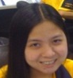
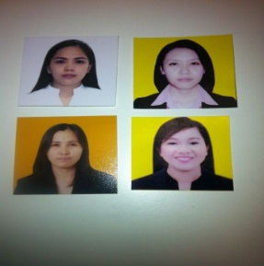
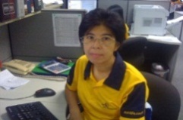
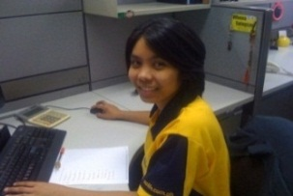
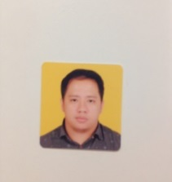

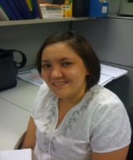
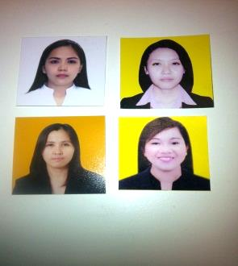
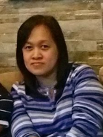
Tina Dizon, PCS, FLMI, FALU
Head, NB & UW
Date of Entry: April 1995
Underwriting Services
Dalla Labisto, PCS, FLMI, FALU
Manager 2
SLGFI, Post Issue, Group and Technical Support for SLOCPI and SLGFI
Date of Entry: Jan 2011
10
Warm
Bodies
Eunice Davie
Mendoza, 4B
Date of Entry:
Nov 2013
Agnes Javier-Jones
ACS, FLMI
Consultant
Date of Entry:
Mar 2011
Whena Salagsag
4A - Technical Support
Date of Entry:
Jun 2008
Joemar Adel
4B
Date of Entry:
Jun 2016
Melai Barrera
4A - Technical Support
Date of Entry:
July 2012
Rosalie Pabon
4A - NB & UW Support
Date of Entry:
Apr 2011
Vacant –
Paula Sevilla, ACS
ALMI, Manager 1
Team 1
Date of Entry: Feb 2011
Angela Marie
Cajudo, 4B
Date of Entry:
Nov 203
Liezl A. Silverio
ACS
4A - Technical Support
Date of Entry:
Nov 2017
SLGFI,
Post Issue, Group and Technical Support for SLOCPI and SLGFI
Notes:
TEAM 1
Review and approval of SLGFI New Business Applications
Review and approval of SLGFI PPC/Group cases
Conduct IES/training sessions to SLGFI advisors/BSOs
Provide monthly scorecard results w/ summary to Agency/Banca heads
Provide support to Ivy when she is on leave or when volume of PPC/Group transaction is high
Provide support to Technical group in terms of RAED Review when staff in charge is on leave or volume of transactions is high
Provide support to SLOCPI when SLGFI’s volume is low
Technical Support:
BR Reviews
2. UAT
Documentation of Procedures
RAED Review and Approval for SLOCPI/SLGFI New Business apps
Review and approve requests for transfer of ownership to entities
Replacement of Ma’am Ivy
Review and approval of SLOCPI PPC/Group cases
Review and approval of complex beneficiary changes for SLOCPI
Audit of underwriter up to 4B .

Slide 9


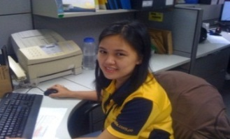
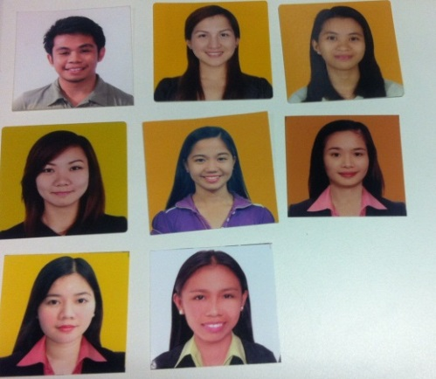
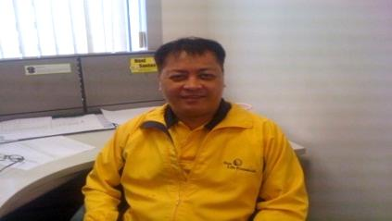
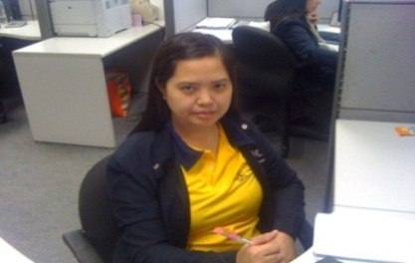

Tina Dizon, ACS, PCS, FLMI, FALU
Head, NB & UW
Date of Entry: April 1995
Vilma Tubig, PCS, FLMI
Manager 3
NB Review, Facilitating and Post-Issue
Date of Entry: Nov 1999
Novita Fernandez, ACS, Manager 1
Team 1 – SLOCPI
E-App & Regular App
Date of Entry:
Feb 1997
Jimmy Valdez
Manager 1
Team 2 - SLOCPI
GIO & Regular App
Date of Entry:
June 2004
Beverly Esparas, ACS, Supervisor
Team 3 - SLOCPI
SIO, Sun Fit & Well & Regular App
Date of Entry:
Mar 2003
Crizalyn Rutaquio, Supervisor
Team 4 - SLOCPI
Corp Account & Regular App
Date of Entry:
Oct 2013
Noel Santos, Manager 1
Team 5 - SLGFI & Policy Issuance
(SLGFI & SLOCPI)
Date of Entry:
Jun 1996
Sheila Pascual,
ACS, Manager 1
Team 6 - Facilitating SLOCPI/SLGFI
Date of Entry:
Feb 2002
Abi Ballena,
ALMI, ACS Supervisor
Team 7 - QA & Production Support
Date of Entry:
Mar 2013
New Business Services

Slide 10
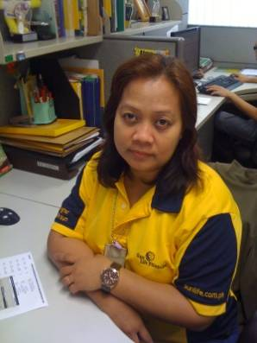

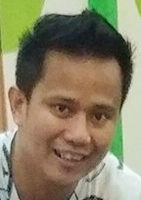
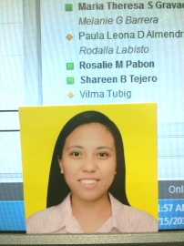
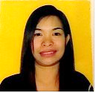
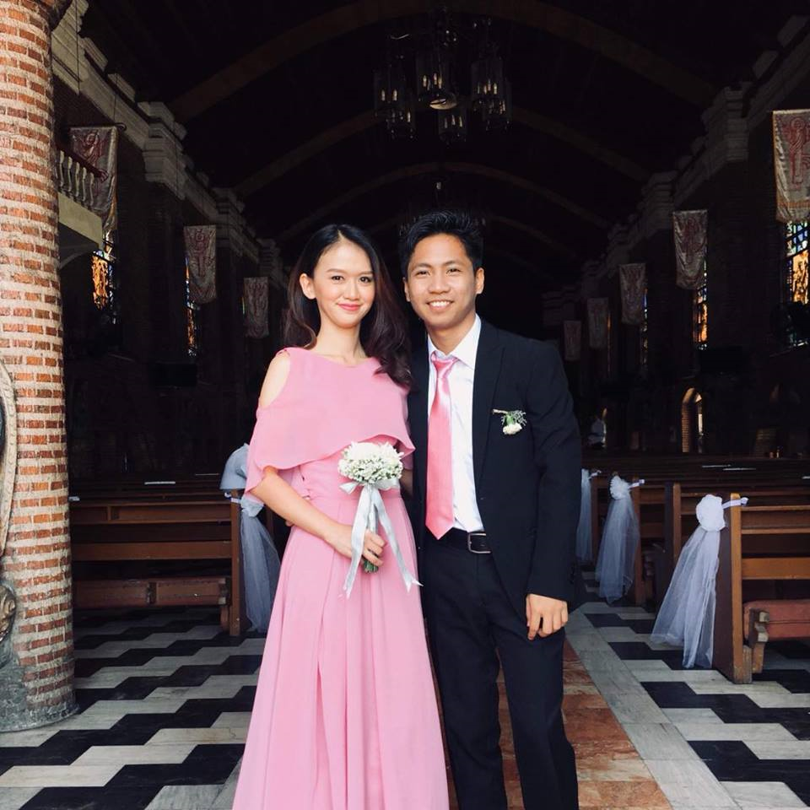

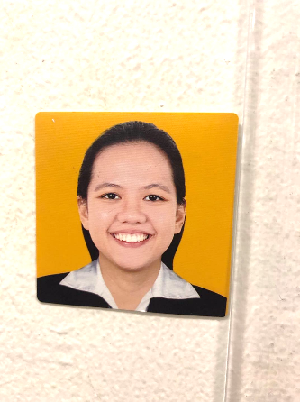
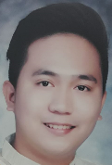
Vilma Tubig, ACS, PCS, FLMI
Manager 3
NB Review, Facilitating and Post-Issue
Date of Entry: Nov 1999
10
Novita Fernandez,
ACS, Manager 1
Team 1 – SLOCPI E-App & Regular App
Date of Entry: Feb 1997
Warm
Bodies
Alma
Pascual, 4A
Date of Entry:
Sep 1999
Maricel
Buce, 3A
Date of Entry:
Oct 2013
Alexander C. Buncad Jr., 3A
Date of Entry:
May 2019
Livian
Cabarle, 3A
Date of Entry:
Mar 2017
Ann Crisbelle Celestial, 3A
Date of Entry:
Feb 2017
Richard
Bagwisa, 3A
Date of Entry:
May 2018
Mary Walter Legaspi, 4B
Date of Entry:
Sep 2018
Joanna Paula Natividad, 3A
Date of Entry:
Feb 2019
Kristoffer John
Lamsen, 3A
Date of Entry:
Feb 2019
New Business Services
Team 1 – SLOCPI E-App & Regular App
Notes:
TEAM 1
SLOCPI
E-app & Regular app
1. SLOCPI e-APP and Regular app initial review/auto appraisal up to authority limit
2. Referrals of cases for settlement over the limit of Reviewers/EDD- High risks up to authority limit
3. Resource person for system enhancements relating to the assigned type of application
4. Prod Support to ePDS encoders
5. Ensure that the team's target are met

Slide 11
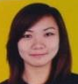
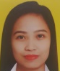






Vilma Tubig, ACS, PCS, FLMI
Manager 3
NB Review, Facilitating and Post-Issue
Date of Entry: Nov 1999
Jimmy Valdez
Manager 1
Team 2 - SLOCPI GIO & Regular App
Date of Entry: June 2004
9
Warm
Bodies
Ira Espanol, 3B
Date of Entry:
Oct 2013
Rhealyn
Duzon, 3B
Date of Entry:
Nov 2016
Joanne
Bermejo, 3A
Date of Entry:
May 2017
Rozezene E.
Plaza, 3A
Date of Entry:
May 2019
VACANT – Replacement
Of C Bambico
Lorraine
Edillor, 3A
Date of Entry:
Sep 2017
Catherine
Naval, 3A
Date of Entry:
Feb 2019
Dodge
Aceveda, 3A
Date of Entry:
Feb 2019
Nikka
Patarata, 3A
Date of Entry:
Mar 2019
New Business Services
Team 2 – SLOCPI GIO & Regular App
Notes:
TEAM 2
SLOCPI
GIO & Regular app
1. SLOCPI GIO and Regular app initial review/auto appraisal up to authority limit
2. Referrals of cases for settlement over the limit of Reviewers/EDD- High risks up to authority limit
3. Resource person for system enhancements relating to the assigned type of application
4. Prod Support to ePDS encoders
5. Ensure that the team's target are met

Slide 12









Vilma Tubig, ACS, PCS, FLMI
Manager 3
NB Review, Facilitating and Post-Issue
Date of Entry: Nov 1999
Beverly Esparas, ACS, Supervisor
Team 3 - SLOCPI
SIO, Sun Fit & Well & Regular App
Date of Entry: Mar 2003
10
Warm
Bodies
Karl Anthony
Chua, 3A
Date of Entry:
May 2017
Dorris Anne Omlas, 3A
Date of Entry:
Feb 2017
Joshua Goyo, 3A
Date of Entry:
Oct 2017
Sarah Bebe Marcaida, 3A
Date of Entry:
May 2018
Francis
Jaronel, 3B
Date of Entry:
Mar 2019
Kris Ann
Flores, 3A
Date of Entry:
Jul 2018
John Elmer Uriguel, Jr., 3A
Date of Entry:
Jul 2018
Brian William
Casia, 3A
Date of Entry:
Feb 2019
Maria Corina
Benedicto, 3A
Date of Entry:
Feb 2019
New Business Services
Team 3 – SLOCPI SIO, Sun Fit & Well & Regular App
Notes:
TEAM 3
SLOCPI
SIO, Sun Fit & Well & Regular app
1. SLOCPI SIO, Sun Fit & Well and Regular app initial review/auto appraisal up to authority limit
2. Referrals of cases for settlement over the limit of Reviewers/EDD- High risks up to authority limit
3. Resource person for system enhancements relating to the assigned type of application
4. Ensure that the team's target are met

Slide 13







Vilma Tubig, ACS, PCS, FLMI
Manager 3
NB Review, Facilitating and Post-Issue
Date of Entry: Nov 1999
Crizalyn Rutaquio
Supervisor
Team 4 - SLOCPI Corp Account & Regular App
Date of Entry: Oct 2013
08
Warm
Bodies
Bryan Regner, 3A
Date of Entry:
May 2018
Beulah Grace
Valderama, 3A
Date of Entry:
May 2018
Mar Neil
Manaoat, 3A
Date of Entry:
Sep 2018
Cheska Mae E. Maranan, 3A
Date of Entry:
Feb 2019
Kurt Russell P. Mengullo, 3A
Date of Entry:
May 2019
Rizel Sario, 3A
Date of Entry:
Apr 2017
Roxanne Irish Roque, 3A
Date of Entry:
Jun 2017
New Business Services
Team 4 – SLOCPI Corp Account & Regular App
Notes:
TEAM 4
SLOCPI
Corp Account & Regular app
1. SLOCPI Corp Account and Regular app initial review/auto appraisal up to authority limit
2. Referrals of cases for settlement over the limit of Reviewers/EDD- High risks up to authority limit
3. Resource person for system enhancements relating to the assigned type of application
4. Ensure that the team's target are met

Slide 14





Vilma Tubig, ACS, PCS, FLMI
Manager 3
NB Review, Facilitating and Post-Issue
Date of Entry: Nov 1999
06
Noel Santos, Manager 1
Team 5 - SLGFI & Policy Issuance (SLGFI & SLOCPI)
Date of Entry: Jun 1996
Warm
Bodies
Karla
Lanuza, 3A
Date of Entry:
Jul 2013
Louie
Gallardo, 3A
Date of Entry:
Oct 2016
Aris Vincent
Hizon, 3A
Date of Entry:
Jun 2018
Mary Kris
Densing, 3A
Date of Entry:
Feb 2019
Kat Bravo, 4B
Date of Entry:
Oct 2012
Vacant
New Business Services
Team 5 – SLGFI & Policy Issuance (SLGFI & SLOCPI)
Notes:
TEAM 5
SLGFI & Policy Issuance
(SLGFI & SLOCPI)
1. Maricel Buce , Louie Gallardo and Marn Pagapulan - SLGFI - initial review; SLGFI ING edits; SLGFI Polcon ; SLGFI phone calls; Assist in SLOCPI Polcon when volume is high
2. Karla Lanuza and Johanna Hortaleza - SLOCPI Polcon, assist in SLGFI initial review, SLGFI ING edits and POLCON when volume is high.
3. Additional for Noel- referrals of cases for settlement over the limit of Reviewers/EDD- High risks up to authority limit; Monitor UBIX- Policy Issue ; on hold cases ; Requesting of Polcon supplies and coordinate with Abi
4. Prod Support to ePDS encoders; resource person for the system enhancements relating to the assigned type of application.
5. Ensure that the team's target are met

Slide 15








Vilma Tubig, ACS, PCS, FLMI
Manager 3
NB Review, Facilitating and Post-Issue
Date of Entry: Nov 1999
9
Sheila Pascual, ACS, Manager 1
Team 6 - Facilitating SLOCPI/SLGFI
Date of Entry: Feb 2002
Warm
Bodies
Jane Bernardez, ACS, 3B
Date of Entry:
Jul 2011
Rose
Obidos, 3A
Date of Entry:
Jul 2012
Rina
de Asis, 3B
Date of Entry:
Apr 2013
Jesse
Tanay, 3A
Date of Entry:
Jan 2015
Gretchen Antang, 3A
Date of Entry:
Oct 2015
Rose Ann
Gonzaga, 3A
Date of Entry:
May 2016
Melody
Razo, 3A
Date of Entry:
Jun 2018
Jee Ann
Sale, 3A
Date of Entry:
Mar 2019
New Business Services
Team 6 – SLOCPI/SLGFI Facilitating
Notes:
TEAM 6
SLOCPI/SLGFI
Facilitating
1. Refund; forms prep, matching/indexing ( SLGFI cases), APS payment; monitor RTS cases; return borrowed records
2. Sheila Pascual - CAS approval and signing of refund letters; backdating/reinstatement ; approval of OR

Slide 16





Vilma Tubig, ACS, PCS, FLMI
Manager 3
NB Review, Facilitating and Post-Issue
Date of Entry: Nov 1999
06
Abi Ballena, ALMI, ACS
Supervisor
Team 7 - QA & Production Support
Date of Entry: Mar 2013
Warm
Bodies
Bobot Raymundo,4B
Date of Entry:
Jun 2005
Edgie Ignacio, 4A
Date of Entry:
Jul 2013
Sylvia Gener, 3B
Date of Entry:
Oct 2013
Maria Cecilia Ledesma, 4A
Systems and Training
Date of Entry:
May 2015
Camelle Pilaza, 3A
Date of Entry:
Oct 2015
New Business Services
Team 7 – QA & Production Support
Notes:
TEAM 7
QA & Production Support
1. Edgie & Syl - Audit ( Reviewers - Initial review ), Update Speedy Issue Guidelines , Retrigger and assist in handling calls during closing and critical periods
2. Cecile Ledesma - Audit (Facilitating /Policy Issue), Prepare monthly reports, Documentation of Procedures, on hold monitoring, Prepare Learning session PPT for use of NB Review and Facilitating; Assist in handling calls during closing and critical periods
3. Bobot - Phil-follow; checking of cases in RVWawaiting payment queue, assist in handling calls during closing and critical periods, assist in ING edits when volume is high
4. Cai Pilaza - ING edits; checking of cases in RVWawaiting payment queue, assist in handling calls during closing and critical periods, Assist in Phil-follow-up when volume is high
5. Abi Ballena - Prepare Audit executive summary for submission to COO; Investigation of complicated cases; Update IES Module ; Assist in Conducting IES ; Be the point person for Compliance related issues : QA - Supervisors, Monitor supplies of NB Review

Slide 17

TITLE | BAND | MAXIMUM APPROVAL LIMIT
NB Review Associate Level 1 | 3A | SL – PHP 2.5M ALL CO – PHP 12.5M
NB Review Associate Level 2 | 3B | SL – PHP 5M ALL CO – PHP 12.5M
NB Review Analyst Level 3 | 4A | SL – PHP 7.5M ALL CO – PHP 12.5M
NB Review Analyst Level 4 | 4B | SL – PHP 10M ALL CO – PHP 12.5M
New Business Review Associate and Analysts’ Authority Limit

Slide 18
TITLE | BAND | MAXIMUM APPROVAL LIMIT
Underwriter 1 | 4A | Ps 5M or US$100,000 – applied for SL Ps15M or US$300,000 - total all companies
Underwriter 2 | 4B | Ps. 10M or US$200,000 – applied for SL Ps 20M or US$400,000 - total all companies
Underwriter 3 Or Underwriting Supervisor | 5A | Ps. 20M or US$400,000 – applied for SL Ps 40M or US$ 800,000 – total all companies
Underwriters’ Authority Limit

Slide 19
TITLE | BAND | MAXIMUM APPROVAL LIMIT
Underwriter 4 Or Manager 1 | 5B | Ps 30M or US$500,000 – applied for SL (ING) Ps. 40M or US$800,000 – applied for (WMS for training purposes) Ps 60M or US$1.2M– total all companies
Manager 2 | 6A | Ps 50M or US$ 1M – applied for SL Ps 100M or US$2M – total all companies
Underwriters’ Authority Limit

Slide 20
TITLE | BAND | MAXIMUM APPROVAL LIMIT
Manager 3 | 6B | Ps 75M or US$ 1.5M – applied for SL (ING) Ps. 200M or US$ 4M – applied for SL (WMS for training purposes) Ps 125M or US$2.5M (Jumbo limit) – total all companies
Head, Underwriting | 7A | Ps 200M or US$ 4M - total with SL Ps 125 M or US$ 2.5M (Jumbo limit) – total all companies
Underwriters’ Authority Limit

Slide 21




Regular Application Form: Owned by NB&UW - This is the application form for VUL and traditional regular applications; combined information for life to be insured, applicant/owner and business owner.
GIO Application Form: Owned by NB&UW - This is the form for guaranteed issue products.
SIO Application Form: Owned by NB&UW - This is the form for simplified issue products.
02
DIFFERENT TYPES OF NB & UW FORMS
Notes:
GIO Application Form: This is the form for guaranteed issue products (example: Sun MaxiLink One, Sun Dollar Maximizer, Tranche).
SIO Application Form: This is the form for simplified issue products (example, Sun First Aid, Sun Start Up, Sun Healthier Life)

Slide 22




Pre-Submission Checklist: Owned by NB & UW + Compliance –
This serves as a guide to assist Advisors in submitting the mandatory regulatory and other NB & UW requirements.
Proposal: Owned by Sales and Compliance-
This document shows the plan details and the features of the product.
02
DIFFERENT TYPES OF NB & UW FORMS
Notes:
GIO Application Form: This is the form for guaranteed issue products (example: Sun MaxiLink One, Sun Dollar Maximizer, Tranche).
SIO Application Form: This is the form for simplified issue products (example, Sun First Aid, Sun Start Up, Sun Healthier Life)

Slide 23



Financial Needs analysis (FNA) and Risk Profile Questionnaire (RPQ): Owned by Sales –
This is a combined document of 2 forms:
FNA shows how the insurance need was calculated
RPQ helps determine the client’s risk appetite for VUL products.
General Information Sheet and Salary Deduction Authorization Form (GISSDAF): Owned by Employee Marketing -
This form provides the Employee Marketing information and the authorization to deduct the premium from the employee’s salary.
02
DIFFERENT TYPES OF NB & UW FORMS
Notes:
GIO Application Form: This is the form for guaranteed issue products (example: Sun MaxiLink One, Sun Dollar Maximizer, Tranche).
SIO Application Form: This is the form for simplified issue products (example, Sun First Aid, Sun Start Up, Sun Healthier Life)

Slide 24

PRIMARY ID
Passport
Driver's License
PRC ID
SSS ID
GSIS e-Card
Digitized Student Permit
Digitized Philhealth ID Card
Digitized Postal ID
Unified Multipurpose ID (UMID)
Senior Citizen's Card
Other IDs issued by the Government of the Philippines
CHARACTERISTICS OF ACCEPTABLE IDs
SECONDARY ID
Must be valid (not expired)
Government - issued
Photo – bearing
Other IDs issued by GOCCs
Birth Certificate issued by Phil Statistics Authority
Marriage Certificate issued by Phil Statistics Authority
Utility Billing Statement
Non-digitized Postal ID
Barangay Resident ID
Integrated Bar of the Phil ID
OLD Philhealth ID
BIR ID
Other IDs issued by companies regulated by BSP, SEC, IC.
03
FOR CITIZENS OF OTHER COUNTRIES
Review of Valid IDs
The client must present a valid passport and present any one (1) of the following original IDs issued by the Philippine government to foreigners:
Alien Certificate of Registration (ACR) i-Card
Alien Employment Permit (AEP)
Special Resident Retiree’s Visa (SRRV) ID
Notes:
Why do we require IDs?
In line with the Company's obligations to comply with the Anti-Money Laundering Act (AMLA) and Foreign Account Tax Compliance Act (FATCA) requirements.
Why did we revise the list of acceptable IDs?
The revision is intended to incorporate additional IDs allowed under the 2016 implementing Rules and Regulations of RA no. 1960 and rationalize acceptable IDs according to degree of reliance.
For further verification of the client’s identity, it is mandatory that the ID submitted must, aside from the name, contain at least one the following information:
Birth date;
Address;
TIN; or
SSS No. / GSIS No.
An identifiable applicant on the photograph
Clear picture or photograph
With readable information
Identifiable signature
Date of issue and/or expiration are visible
Free from alterations, erasures or tampering

Slide 25



To avoid delay in application processing time:
Print clearly
Use black ink
AVOID omissions
If there are given choices, please select accordingly
Indicate N/A if question is not applicable
Any erasures, superimpositions, or alterations must be signed by the insured/applicant
Advisor’s report is not acceptable for “application form omissions”
Any yes answers on health information section should be supported with details
Advisor must use his or her own proposal system access
Take note of Market Conduct Guidelines re: ownership and beneficiary
04
Commonly Omitted Questions in the Application Forms

Slide 26




Top 30 Application Form Omissions and Discrepancies
Discrepancy on the name and birthdate of insured/applicant on submitted ID versus the application form declaration.
Complete middle name of clients are not declared.
TIN and SSS/GSIS number is omitted or answered as N/A but the client is actively or previously employed.
Permanent/Present/Business address are mostly incomplete, omitted or answered as N/A or S/A.
Page 1: Country/ies of Legal Residence
Page 1: Government Position
Page 2: Section B Question 70: source of funds
Page 3: Section E Questions 78-85: Plan details for Traditional Product Applications
Unit of measurement for height and weight is either omitted or incorrect.
Section K: Third party details regarding source of fund - student/Housewife receiving allowance/allotment.
Notes:
Discrepancy in Name and birthdate - App vs ID
Using middle initial only for insured.
TIN/SSS - with occupation but omitted.
Permanent/Present/Business address -incomplete/omitted/answered N/A.
Q.6 Country/ies of Legal Residence pg.1
Q.25 Government Position pg.1 - omitted or answered N/A.
Omission in Page 2 Section B Q#70 regarding source of funds.
Omission in Page 3 (Q#75-85) - Plan details for Traditional Applications.
Height and weight - no unit of measurement.
Third party details in Section K omitted for student/Housewife receiving allowance/allotment.
Family history in Page 4 Q#94 - for insured and applicant.
Mobile number, Philippine mobile number and Email address omitted but elected billing type as SMS+E-notice / SMS+Printed Copy. ( Do not use International mobile number if billing type is with SMS.)
Inconsistent smoking habit (application vs proposal)
Page 3 Sec.F Insurance History Q.86-89 - omitted/answered N/A.
Q#90 - omitted/no details if declared occ is housewife and; Q#91 - omitted insurance of family and applicant/owner
Sec C Beneficiary (Omitted Relationship to insured, Citizenship and Birthday) Wife/Husband as beneficiary - different surname - should have submitted Marriage Certificate / MCERT.
Advisor already married but declared as beneficiary - not allowed per Market Conduct Guidelines.
Q#95 - w/ yes answer but family history on Q#94 - all healthy
Q.92 a-c birth weight pg.4
Page 4 Q#96 - medication - omitted/answered N/A or incomplete details.
Page 4 Q#98 - weight change - omitted/incomplete details/ answered N/A.
Page 4 Q#93 letter A,B,C for female - omitted/incomplete details/answered N/A.
Annual income of insured/applicant - omitted or sometimes declaring monthly income only.
Additional beneficiary noted as remarks in Advisor's report (Page 8 not included in contract)
Inconsistent smoking habit (application vs proposal)
Q.102 details to yes answer on Sec G (for Q.95-101)
Page 7 #20-22 - signature of advisor as witness.
Previous Occupation – for Retired/Unemployed omitted especially for GIO
Businessman, Self-employed/online selling - omitted nature/name of business/business address
With YES answer in Q#99-101 - but no details noted.
Section I Q#1-3 Temporary life insurance questions - omitted/answered N/A.
Insured age is 18yrs old++ make sure to indicate the signature in last page of app Q#3
If Grandmother/Grandfather is the applicant, make sure that the signature of parents is present in last page of app Q#12-13
FATCA questions omitted or answered as N/A

Slide 27




Top 30 Application Form Omissions and Discrepancies
Page 3 Section D Question 70: Inconsistent smoking habit : smoker or non – smoker on application form vs. proposal rate
Page 2 Question 64-69: Mobile number or Philippine mobile number and email address, specially if the elected billing type is SMS+E-notice / SMS+Printed Copy. ( Do not use International mobile number if billing type is with SMS.)
Page 3 Section F: Insurance History Questions 89-92.
Page 3 Section F: Question 93 for housewife and Question 94: insurance details of family and applicant/owner for dependent insured.
Annual income of insured/applicant is sometimes declared as monthly income only.
Notes:
Mobile number, Philippine mobile number and Email address omitted but elected billing type as SMS+E-notice / SMS+Printed Copy. ( Do not use International mobile number if billing type is with SMS.)
Inconsistent smoking habit (application vs proposal)
Page 3 Sec.F Insurance History Q.86-89 - omitted/answered N/A.
Q#90 - omitted/no details if declared occ is housewife and; Q#91 - omitted insurance of family and applicant/owner
Annual income of insured/applicant is sometimes declared as monthly income only.

Slide 28


Top 30 Application Form Omissions and Discrepancies
Beneficiary
Relationship of beneficiaries to insured, citizenship and birthday of beneficiaries
Different surname of insured’s spouse must be supported with marriage certificate.
Violation of Market Conduct Guidelines wherein Advisor is declared as beneficiary but not considered already as immediate relative in view of marital status
Additional beneficiaries are declared on page 8 Advisor’s report and not on amendment of application form
Additional beneficiaries are listed on blank sheet of paper and not on amendment of application form
Notes:
Sec C Beneficiary (Omitted Relationship to insured, Citizenship and Birthday) Wife/Husband as beneficiary - different surname - should have submitted Marriage Certificate / MCERT.
Advisor already married but declared as beneficiary - not allowed per Market Conduct Guidelines.
Additional beneficiary noted as remarks in Advisor's report (Page 8 not included in contract)
Additional beneficiaries are listed on blank sheet of paper.

Slide 29


Top 30 Application Form Omissions and Discrepancies
Health Information
Question 95: birth weight for insured below age 5.
Question 96: for women insured/WPDD or WPD applicant aged 16 years old and above.
Question 97: Family history table is omitted or Question 98 details for yes answer is not provided.
Question 99: medication
Question 100 and 101: unit of measurement and weight change
Notes:
Q#95 - w/ yes answer but family history on Q#94 - all healthy
Q.92 a-c birth weight pg.4
Page 4 Q#96 - medication - omitted/answered N/A or incomplete details.
Page 4 Q#98 - weight change - omitted/incomplete details/ answered N/A.
Page 4 Q#93 letter A,B,C for female - omitted/incomplete details/answered N/A.
Q.102 details to yes answer on Sec G (for Q.95-101)
Page 7 #20-22 - signature of advisor as witness.
Previous Occupation – for Retired/Unemployed omitted especially for GIO
Businessman, Self-employed/online selling - omitted nature/name of business/business address
With YES answer in Q#99-101 - but no details noted.
Section I Q#1-3 Temporary life insurance questions - omitted/answered N/A.
Insured age is 18yrs old++ make sure to indicate the signature in last page of app Q#3
If Grandmother/Grandfather is the applicant, make sure that the signature of parents is present in last page of app Q#12-13
FATCA questions omitted or answered as N/A

Slide 30



Top 30 Application Form Omissions and Discrepancies
Signature and Consent
Section I Temporary life insurance questions are omitted or with yes answers but details are not provided.
For insured aged 18 years old and above - make sure to let them sign on page 7, question 130-132.
If the applicant is insured’s grandparent, consent of insured’s parent must be reflected on page 7, 139-143.
FATCA questions
Page 7 questions 157-159 - signature of applicant and advisor as witness.
Notes:
Section I Q#1-3 Temporary life insurance questions - omitted/answered N/A.
Insured age is 18yrs old++ make sure to indicate the signature in last page of app Q#3
If Grandmother/Grandfather is the applicant, make sure that the signature of parents is present in last page of app Q#12-13
FATCA questions omitted or answered as N/A
Page 7 #20-22 - signature of advisor as witness.

Slide 31

Additional Reminders
Previous occupation, name of company and annual income prior to retirement should be declared for retired or unemployed clients, especially for GIO product applicant.
Nature of business, business name and products sold should be listed if insured/applicant is a businessman, self-employed or generating income from online selling.
FNA + RPQ should be completed and must be signed by the client.
Page 1 – Financial Need
Page 2 – Total Score
04
Commonly Omitted Questions in the Application Forms
Notes:
No answer in Page 1 KEY FINANCIAL NEEDS. Score in Page 2.

Slide 32

Additional Reminders
Advisor’s report:
Specify name, position and relationship to applicant if Question A.2 (relative of government officials).
Source of sale
Source of cash if payment is made via validated deposit slip
Correct advisor’s code and commission sharing percentage should be written clearly
Incorrect mode of payment based on initial payment e.g. declared quarterly mode but paid for the whole year (Annual)
Declared as family member of advisor – but relationship to the applicant is not indicated
Use the remarks or additional comments tab to list the details for:
JFW, beneficiary details, simultaneous applications, maiden name vs. married name, instructions for excess payment, details of duties, vehicles used or job position of client.
04
Commonly Omitted Questions in the Application Forms
Notes:
Page 8 Question #2 regarding relative with Government position-omitted. (Specify rank/position) if Answered YES.
Page 8 Question #5 - source of sale omitted.
Page 8 Question #6 answered Validated Deposit slip but did not indicate source of cash.
Wrong Bank branch/Referrers code (SLGFI)
Correct agent code and sharing should be written clearly
Declared as family member of advisor – but no relationship indicated
Incorrect mode of payment based on initial payment e.g. declared quarterly mode but paid for the whole year (Annual)
Seaman - not specified designation/position (Details of duties and nature of business)
Collector/Messenger-using motorcycle and Pastor if missionary or non-missionary - Same on all other occupation that needs to be specified.

Slide 33


Additional Reminders
Proposal:
Name, Age, Smoker/Non-smoker’s rate, Signature on last page
Plan name and riders/ face amount – check the riders on application form, especially for Traditional plan
Extra Occupational or Medical Rating (per thousand, per mil or multiple extra)
FLAT EXTRA (/th) vs. MULTIPLE EXTRA (x)
Gender
Version
Servicing advisor vs. Advisor who generated the proposal. Indicate on advisor’s report if application was solicited under JFW
Applying for FCM/FCI rider but FMBQ is not submitted
Applying for Sun Maiden but FMBQ is not submitted
Different serial numbers
Incomplete proposal pages
rating
04
Commonly Omitted Questions in the Application Forms
Notes:
Incorrect rating applied.
Incorrect Gender.
Different advisor generates the proposal but not under JFW.
Old version submitted.
Incorrect age of insured/applicant.
Applying for FCM/FCI rider but no FMBQ submitted.
Applying for Sun Maiden but no FMBQ submitted.
Proposal generated by other advisors without remarks on AGR under JFW.
Discrepancy in Application vs Proposal in riders applied.
Discrepancy in proposal's serial number.

Slide 34

05
New Business Application Processing and
Turnaround Time (TAT)
Client Service Centers/ ISO
Payment and Scanning
Application / document will be routed for data entry (no SMS)
Encoding
Assignment of Policy Number (with SMS Notification)
Policy Nos. Ending in 00 – proceed with random medical & cotinine testing upon receipt of SMS
Initial New Business Review and Speedy Appraisal*
Automated by the system
Review of mandatory requirements
15-day deadline of submission for initial requirements
Initial Underwriting Appraisal
Medical cases and application rejected by auto appraisal system
Review of routine requirements based on published UW guidelines
10-day deadline to submit UW requirements.
Policy Contract Issue
(with SMS notification)
Delivery date is within 2 weeks to advisor’s Preferred Mailing Location (PML).
Please return to the acknowledgement receipt 10 days after delivery of the policy contract.
Turn-Around Time (TAT): within 24 hours
During peak submission days– up to 48 hours
Turn-Around Time (TAT): Non-contest Month: within 24 hours
Contest Month: 72 hours
GIO: 95% in 3 days;
SIO: 95% in 3days Non-med cases:
W/o reqts: 90% in 4 days
W/ reqts: 90% in 14 days
Turn-Around Time (TAT):
W/o reqts: 90% in 7days
W/ reqts: 80% in 20 days
Turn-Around Time (TAT):
2 to 7 days after settlement
Notes:
Random medex –
Age 15 and below
Mdrt, f, qcc advisors

Slide 35

Comparison of Speedy New Business Review and Underwriting Cases*
Speedy New Business Review Cases
Underwriting Cases
Non-medical cases
Risk rating: Low and Medium
No underwriting concerns
All questions in the application form are completely answered
No inconsistent details provided in the current application form vs. the proposal or previous applications
No MID findings
Complete basic mandatory requirements
Payment submitted is exact for initial/modal premium; if with excess premium, provide appropriate instructions in the Advisor’s Report
Medical cases, and cases with additional medical requirements based on the published UW Limits and Guidelines
Risk rating: High risk – Regular application
Non-medical cases with underwriting concerns, or not approved under Auto Appraisal
With MID findings
Additional requirements not listed in published UW Limits & Guidelines may be required depending on the review of each requirement submitted.
Notes:
SPEEDY CASES:
Non medical cases.
Risk rating: Low and Medium
No underwriting concerns.
All questions in the application form are completely answered.
No inconsistent details provided in the current application form vs the proposal or previous applications.
No MIB findings.
Complete basic mandatory requirements.
Payment submitted is exact for initial/modal premium; if with excess premium, provide appropriate instructions in the Advisor’s Report.
UW CASES:
Medical cases, and cases with additional medical requirements based on the published UW Limits and Guidelines.
Risk rating: High risk – Regular application
Non-medical cases with underwriting concerns, or not approved under Auto Appraisal.
With MIB findings.
Additional requirements not listed in published UW Limits & Guidelines may be required depending on the review of each requirement submitted.

Slide 36

Application Status Inquiry
Utilize the Advisor’s Portal Status Inquiry Feature
Call Client Care.
Email Phil-Followup@sunlife.com following this format:
SUBJECT: Follow-up: Policy No./Name/
Date of App Submission/Date of Submission of Last Requirement
Send FOLLOW-UP inquiry to: Phil-Followup@sunlife.com

Slide 37

Requirements Processing
Regular Application - NEW BUSINESS REVIEW
Fifteen (15) calendar days from the date of the initial SMS/email requirement notification.
Automated follow – up on 7th day will be sent
If the requirements are not submitted within the deadline, NPW (Not Proceeded With) notification will be sent on the 16th day.
Structured Notes: Within specified deadline in the campaign.
Request for extension should be filed before expiration of the deadline of the requirement, preferably three (3) days before the deadline; otherwise, NPW (Not Proceeded With) notification will be sent on the 16th day.
NOTE: We cannot hold processing of the refund check once the check request has been sent to Finance Department.
send EXTENSION request to: PHIL-ePDS-Scanning@sunlife.com
Deadline for Underwriting Requirements is for enhancement.

Slide 38

Requirements Processing
Reimbursement
Official receipts (OR) should be issued under Sun Life of Canada Philippines, Inc. (SLOCPI) or Sun Life Financial.
Attending Physician Statement (APS):
Advance APS & Php1,000 and up doctor’s fee – obtain approval from assigned UW.
APS payment (Doctor's fee) - request the secretary or the attending physician to complete the details on the second page lower portion of the APS. (Doctor's name, TIN number, and complete address). Please write legibly.
Other Requests and Concerns:
Submission of medical requirements which are not routine and/or not required by UW will be charged to advisor
Medical records should be clear and readable.
Request for uncrossing of check – client should be personally present and should presents 2 valid government IDs.
Short payment – charging to ACS is not anymore allowed.
Submit Advisor’s Change Request (ACR) Form – if status of advisor is inactive

Slide 39

Refund Processing
We will not entertain requests to hold processing of refund checks once the check request has been forwarded to the Finance Department.
Authorization letter signed by the client is needed if check will be c/o thru advisor.
Quit claim form is required for request to change payee name, or if to deposit to client’s account.
Authorization letters for transfer of payment should indicate the following:
amount to be transferred
source policy/application serial number, and
policy/application serial number where payment will be transferred
send REFUND inquiries to: phil-usd-facilitating@sunlife.com
3 criteria for an application to be submitted on a COD basis
With Yes answer in TLI Questions
With 1M and above annual premium
Over retention limit
Turn-Around Time (TAT):
7days - below 50K
15days - 50k and up (For check payments, check must be cleared before processing the refund.)

Slide 40
NPW, NTU, and Cooling Off
Not Proceeded With (NPW)
Not Taken Up (NTU)
If the client fails to submit a requirement which is necessary to assess the insurability of the insured;
If the client fails to complete or pay the initial premium;
If the client withdraws the application while still being processed.
If initial check payment for the approved application bounced and no replacement payment were made.
Not Taken Up (NTU) – Cooling Off
Applicable for VUL applications only.
This is when the client decides to withdraw the application within 15 days from receipt of the policy contract.
Cases without NPW fee
Non-submission of discretionary requirements ordered by the Underwriter.
Non-acceptance of offer.
Note: NPW/NTU fee of Ps750.00, plus all expenses incurred is charged to the advisor’s commission on the above cases.

Slide 41

ISSUE TIME ANALYSIS REPORT FOR 2018
GIO w/o requirements
3 working days
GIO w/ requirements
14 working days
SIO w/o requirements
3 working days
SIO w/ requirements
14 working days
NM w/o requirements
4 working days
NM w/ requirements
14 working days
Med w/o requirements
7 working days
Med w/ requirements
20 working days
Worksite w/ requirements
60 working days
97%
91%
97%
86%
95%
95%
95%
95%
95%
90%
90%
90%
80%
85%
82%
94%
89%
80%
Data Interpretation for GIO
Primo Structured Notes
Primo 2 Tranche
Extension of requirements and posting of payment (transfer from other application or COD)
Data Interpretation for SIO
Re-extension of submission of requirements
Transfer of payment
Reconsideration of decision
Data Interpretation for Non-Medical
Bulk of application submission
Data Interpretation for Medical
Above TAT
Data Interpretation for Worksite
Above TAT
06
AVERAGE ISSUE AGE FOR 2018
SLOCPI:
Average issue age by policy amount: 31 years old
Average face amount: Ps. 663,770
Our Scorecard

Slide 42

Branch SCORECARD - HYPERION
SCORE | NUMBER OF APPS SCORED FOR 2018 | PERCENTAGE | NUMBER OF APPS SCORED as of Apr 2019 | PERCENTAGE
1 |  |  | 29 | 3%
2 |  |  | 443 | 40%
3 |  |  | 555 | 51%
4 |  |  | 71 | 6%
SCORE LEGEND:
1 - Exceeds Expectation
Advisor did a very good job; submitted routine requirements with application
2 - Meets Expectation
3 - Needs Improvement
Omissions in the application, wrong application used,
Routine requirements are not submitted with application
4 - Below Expectation
Non-disclosure, major omissions in the application, suspected forgery
06
Your Scorecard
Notes:
LEGEND:
A score of One (1) would mean
· An advisor’s compliance exceeds expectation, an equivalent rating of 101-105%
· A perfect score and would be recognized as outstanding
· The advisor did a very good job and furnished the Underwriters with all the information about the client without further communication from the Underwriters.
· All criteria under code two are met or even exceeded.
A score of Two (2) would mean
· An advisor’s compliance with regard to the application meets the UW expectations with an equivalent rating of 90-100%
· This score is considered as average.
· The advisor has satisfactorily met the requirements for applications such as: completion of application without omissions, submission of all mandatory and
all the routine requirements for age and amount, submission of appropriate questionnaire, and submission of SPA and letter from the client regarding mailing c/o advisor
· Indicated rating (if any) as provided in the occupational and foreign residence guidelines.
· All “YES” answer are given sufficient details; physical abnormalities are gathered and reported.
· Benefits such as ADB, CIB, HIB etc. limits are not exceeded. Retention limits are properly observed, i.e. COD cases over retention.
A score of Three (3) would mean
· An advisor’s compliance with regard to the application needs improvement. There are some omissions or oversights but an underwriter can still correct these on initial appraisal
and will not put the company under risk.
· An equivalent rating of 80-89%
This score is broken down into several points:
3 - All other minor omissions/oversights not specifically classified in the succeeding categories:
3.1 - Advisor omitted minor questions in the application, which may be forgone by an underwriter in making decisions but no omissions of major question in the application.
3.2 - Mandatory requirements submitted but other routine special tests and financial requirements were not submitted with the application.
3.3 - Erasures were not countersigned.
3.4 - Benefits limits exceeded.
3.5 - Insufficient details to “Yes" answer or only minor details were missed.
3.6 - Appropriate rating as indicated in the occupational and foreign residence guidelines were not applied.
3.7 - Wrong application form was used.
3.8 - PCI was not submitted or NM was not answered to update previous medex.
A score of Four (4) would mean
· An advisor’s compliance with regard to the application is unacceptable or went below the underwriter’s expectation.
· Omissions and oversights are considered major and can put the company under a great risk.
This score is broken down into several points.
4 - All other major omissions/oversights/adverse actions committed by agent not specifically classified in the succeeding points
4.1 - Mandatory requirements were not submitted.
4.2 – There are major omissions in the applications.
4.3 – There was suspected forgery.
4.4 - Very incorrect information were provided in the application (example: major deviation in build)
4.5 - No details to "Yes" answer or major details were provided.
4.6 - Physical abnormality was not reported.
4.7 - Major medical history was not gathered (as discovered from other sources).
4.8 - Smoking habit was not correctly disclosed.
4.9 - Retention limit exceeded and case was not on COD.

Slide 43
Ready to Test Your Skills?
Give the list of mandatory requirements or documents in submission of NB application.
What are the three sections in New Business and Underwriting Services?
Application form
Valid Id
Proposal
FNA and RPQ
Pre-submission Checklist
New Business Review Associate and Analyst
Underwriter
Facilitator
Give the essential components of Authorization Letter to transfer payment.
Identify if the following cases are for Speedy NB Review Processing or for Underwriter Appraisal
amount to be transferred
source policy/application serial number, and
policy/application serial number where payment will be transferred
Cancer-survivor client
Only concern is the omitted present residence address
Occupation concern only – working as ordinary seaman
Beneficiary is romantic or same-sex partner
True or False.
A married servicing advisor can declare himself as beneficiary of his sister’s application.
07
Plan details on application form is required for VUL Product.
Quiz
Underwriters conduct initial review of application form
Notes:
Cancer-survivor client - UW
Only concern is the omitted present residence address - NB
Occupation concern only – working as ordinary seaman - NB
Beneficiary is romantic or same-sex partner - UW
False - MCG
False – TRAD PLAN only
False - NBREV

Slide 44

End of Module
Thank you!
We can start the open-question forum

