Slide 1


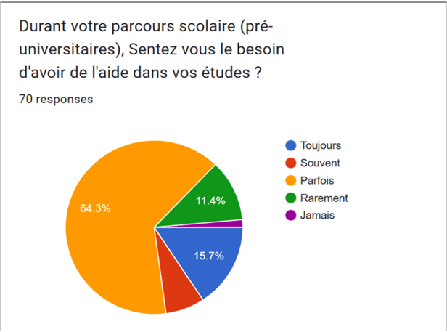
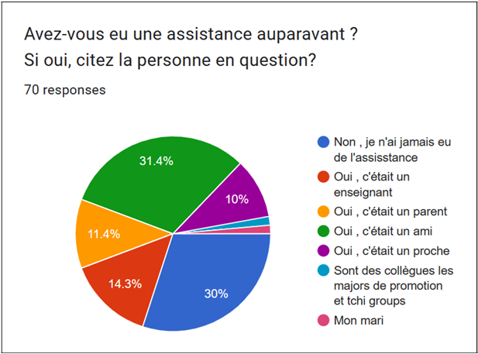
Intelligent e-tutoring system to help new-coming students
John Doe¹, Jane Smith² & Alex Brown¹,²
Department of Computer Science, Example University2. School of Engineering, Example University *john.doe@example.edu
1. Abstract
This template is specifically designed for the Second National Conference on New Educational Technologies and Informatics 2025, organized by the LabSTIC Laboratory at the University of 8 May 1945 Guelma.
▷ It serves as a starting point for creating professional conference posters.
▷ This poster showcases the use of the baposter LaTeX template for designing effective and visually appealing conference presentations. The template provides a flexible grid layout, customizable colors, and easy integration of graphics and tables.
▷ You can quickly modify sections, add images, and include references using standard LaTeX commands [1]. The intelligent e-tutoring system aims to support new-coming students by providing personalized guidance and resources.
▷ Survey results indicate improved engagement and satisfaction among users of the system. The modular design allows for easy adaptation to different academic disciplines and institutional requirements .
2. Introduction
4. Methodology
6. Discussion
▷ The baposter class is designed for large format posters, supporting multiple columns and rows.
▷ Each section is defined using the posterbox environment, which allows you to organize content visually [2].
▷ You can adjust the layout, colors, and fonts to match your conference or institution’s style.
▷ Thetemplate makes it easy to include images, tables, and mathematical equations for a com prehensive presentation.
▷ Customization options enable you to highlight important information and improve readability.
▷Themodularstructure facilitates quick updates and reorganization of sections as your content evolves.
▷ Using the provided color schemes and font settings ensures a professional and cohesive appearance.
▷ You can add graphics to your poster using the \includegraphics command.
▷ The example below shows how to include im ages in a section:
▷ Figure. 1 demonstrates image placement in the template
Fig. 1: Example Graphics in baposter
▷ Discussion: The template allows you to easily update and rearrange sections as needed.
▷ You can comment out or duplicate sections to experiment with different layouts.
▷ For advanced customization, refer to the baposter documentation and class file.
7. Conclusion
▷ In conclusion, the baposter template is a powerful tool for creating professional conference posters.
▷ Edit the content, add your graphics, and up date the bibliography to fit your needs.
▷ For more examples and options, see the offIcial documentation or explore the class file.
3. Problematic
▷ To use the template, edit the section titles and replace the example text with your own con tent.
▷ You can include bullet points, numbered lists, equations, and tables as needed [3].
▷ The template supports custom colors and backgrounds for visual appeal.
▷ For mathematical content, use environments like equation or align for clear presentation.
▷ Tables can be created using the tabular environment and enhanced with the booktabs package.
▷ Images and results2s can be inserted with \includegraphics for better illustration of concepts.
▷ Adjust spacing and font sizes to ensure read ability on large-format posters.
▷ Refer to the documentation for advanced fea tures such as custom box shapes and header styles.
8. References
[1] L. Lamport. Latex: A document preparation system. 1994.
[2] F. Mittelbach and M. Goossens. The latex companion. 2004.
[3] T. Oetiker et al. The not so short introduction to latex2e. 2022.
5. Results
▷ Key features of baposter:
▷ Easy placement of images and logos in header and sections.
▷ Flexible grid system for organizing content.
▷ Simple integration of tables, figures, and mathematical formulas.
▷ Bibliography support for references.

