Slide 1
Noisy MNIST
A Machine Learning Test-Case
By Nightvid Cole

Slide 2
MNIST introduction
MNIST is a machine learning classic – it is a database of 70,000 handwritten samples of the digits 0-9
Used to train and test machine learning – can the computer learn to recognize the digits?
Standard uses 60,000 samples for training the model, 10,000 for testing
Each image is 28 by 28 pixels, values from 0-255

Slide 3
Setup
Using XGBoost in Python, train on a subset of MNIST samples
Random forest, works faster than TensorFlow, does not require one-hot encoding
Then test on a subset of MNIST testing data
Around 95% accuracy after using 12,000 training samples, 300 estimators and max depth of 9 levels (Random chance would be 10% accuracy)

Slide 4
From MNIST to Noisy-MNIST
Reduce value range to small number by multiplying all pixel values by a small constant
Replace a rectangular region in each sample with a “patch of noise” – the noise will have the full range of values 0-255 while the useful data will only have small values!
Randomize both the location of the rectangle and the pixel values within it
Can the model still recognize the digits?

Slide 5
Two types of noisy-MNIST
#1 - Noise-free training data, noisy test data
#2 - Noisy training data, noisy test data
Can the machine learn to “see past” the noise, despite the much higher noise values than signal values?

Slide 6
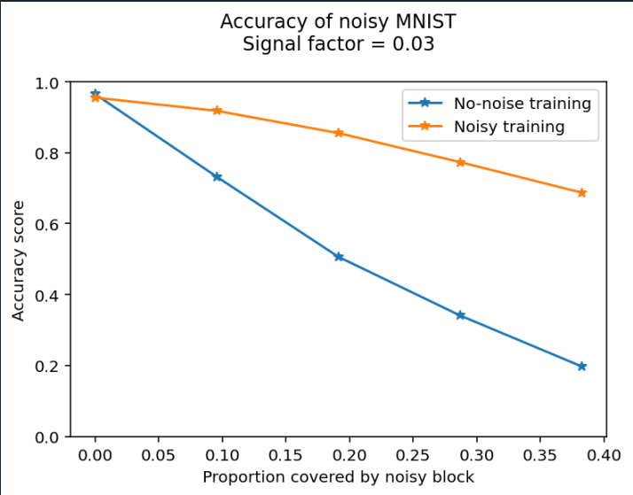
Result

Slide 7
Conclusion
Adding a “noisy region” to the test data results in progressive degradation of XGBoost-based digit identification in MNIST test data, with larger noise areas resulting in increasingly poor performance
However, the performance degradation is greatly reduced when the model is trained on data with statistically similar noise
Demonstrates the value of training models on data with similar noise profile as the data it is used on

