Slide 1


Use Case Discovery Framework [Use case] A customer interacts with a product or service to fulfill a need or a want

Slide 2

Work together to solve your most critical business pain points Show this slide to your customer to help them understand the goal of the session.
IBM offers a complimentary half-day session to help you identify your greatest pain points and business challenges.
In this session, IBM experts will:
Share the latest technology related to your industry and business pain points
Facilitate an interactive design-thinking exercise to identify the most critical pain points and challenges that IBM technology can solve
Outcome – A prioritized use case
Next steps – Technology discovery and architecture of the solution

Slide 3
Use Case Discovery Agenda- Half Day
Customize this agenda for what works best for your team.
Topics | Objectives | Duration
Technology innovations and industry trends (Senior decision makers) | IBM technology and how it can help in your industry Use cases and best practices | 30 Minutes
Collaborate to understand your biggest challenges (IT Architects, Security, Lines of Business Stakeholders ) | Work through a collaborative exercise to gain insight into your key business pain points and biggest challenges | 90 Minutes
BREAK – 15-30 min
Explore how IBM technology can solve your biggest challenges (IT Architects, Security, Lines of Business Stakeholders) | Dive into applicable use cases based on the identified pain points from collaborative session Demo to show how (optional) | 60 Minutes
Recommended next steps (Senior decision makers) | Recap key focus areas Establish how IBM can help bring value to your business Deliver prioritized use case for solving your identified challenges | 60 Minutes

Slide 4

Use Case Discovery is adaptable to satisfy your needs and availability
Modify this as needed
1 Hour provides …
2 Hours provides …
3 hours provides …
4 hours provides …
1 INFORM
Duration: 15 min
Brief introduction of IBM technology and fit
Align on your vision
Duration: 15 min
Brief introduction of IBM technology and fit
Analysts' Forecasts and Trends
Industry uses cases and
best practices
Align on your vision
Duration: 30 min
Brief introduction of IBM technology and fit
Analysts' Forecasts and Trends
Industry uses cases and
best practices
Align on your vision
Duration: 30 min
Brief introduction of IBM technology and fit
Analysts' Forecasts and Trends
Industry uses cases and
best practices
Align on your vision
Senior Decision Makers
2 COLLABORATE, EXPLORE
Duration: 20 min
- Collaborate/Explore
Discussion to identify challenges and pain points, areas and roles impacted
Duration 15 min.
-Prioritize
Duration: 90 min
Discussion to identify challenges and pain points, areas and roles impacted
Duration: 135 min
Design Thinking session to identify challenges and pain points, areas and roles impacted
Duration: 145 min
Design Thinking session to identify challenges and pain points, areas and roles impacted
IT Architects, Security, Lines of Business Stakeholders
3 ALIGN
IT Architects, Security, Lines of Business Stakeholders
Align business outcome to goals
Prioritize
Align business outcome to goals
Prioritize
Duration: 45 - 60 min
Align business outcome to goals
Prioritize
(Opt) Demo use cases based on the challenges identified
4 PRIORITIZE
Duration 10 min.
- Recap/Plan
IT Architects, Security, Lines of Business Stakeholders
Duration: 15 min.
Recap key focus areas
Plan for next steps
Duration: 15 min
Recap key focus areas
Plan for next steps
Duration: 15 min
Recap key focus areas
Plan for next steps
5 DESCRIBE
IT Architects, Security, Lines of Business Stakeholders
Results of whiteboard exercise, prioritized use case and technology identified
Results of whiteboard exercise, prioritized use case and technology identified
Results of whiteboard exercise, prioritized use case and technology identified
Results of whiteboard exercise, prioritized use case and technology identified
6 RECAP & SUMMARIZE
Senior Decision Makers
Can split into 2 sessions

Slide 5
1 Inform
Brief introduction of IBM technology and fit
Align on your vision
Share possible use cases that might fit client pain points

Slide 6

2 Collaborate + Explore
15 – 30 minutes
Directions
Discuss and capture the business landscape.
Review the input of the team and discuss and clarify so that everyone understands everyone's input.
Describe your challenges and then delineate them into specific use cases that you can tackle with IBM.
We want to develop or understand a strategy and a starting point for a journey to achieve the customer’s long-term goals.
Before we align, categorize or prioritize, we want to understand the big picture so we can begin to capture your goals and understand them in context.

Slide 7
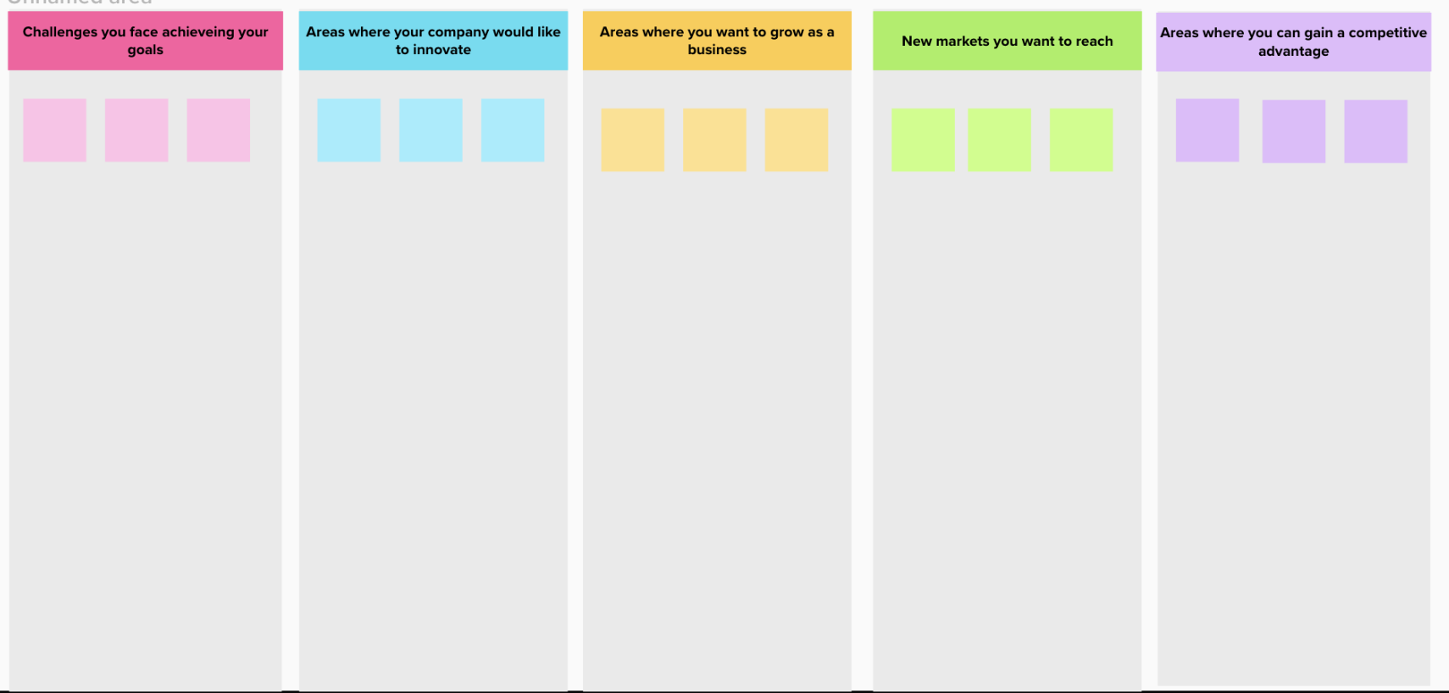
2 Collaborate + Explore
What drives your company? | Where do you want your company to be in 2 years?
What are the strategic initiatives that are driving your organization? What are some of the challenges you face in achieving your goals? | Benefits this will bring to your business: areas where your company wants to innovate areas where you want to grow as a business new markets you want to reach areas where you can gain a competitive advantage
Mural Board/Whiteboard

Slide 8
3 Align
15 – 30 minutes
Directions
1. Populate the columns on the chart with the results from the Collaborate discussion.
2. Align the difficulties and challenges with the team’s goals and the desired business outcome that would be delivered by achieving the goals.
3. Determine the roles directly impacted by the effort. Who will work with the solution? Who will benefit when it is completed?
4. Name the process you aim to improve for each use case so you can prioritize.
Explore pain points, challenges, or problems your team wants to address with the outcome your use case should deliver for your business.
Scope each use case by aligning the desired business outcome to the people who will adopt or reject your solution and the experience you want to create or improve.

Slide 9
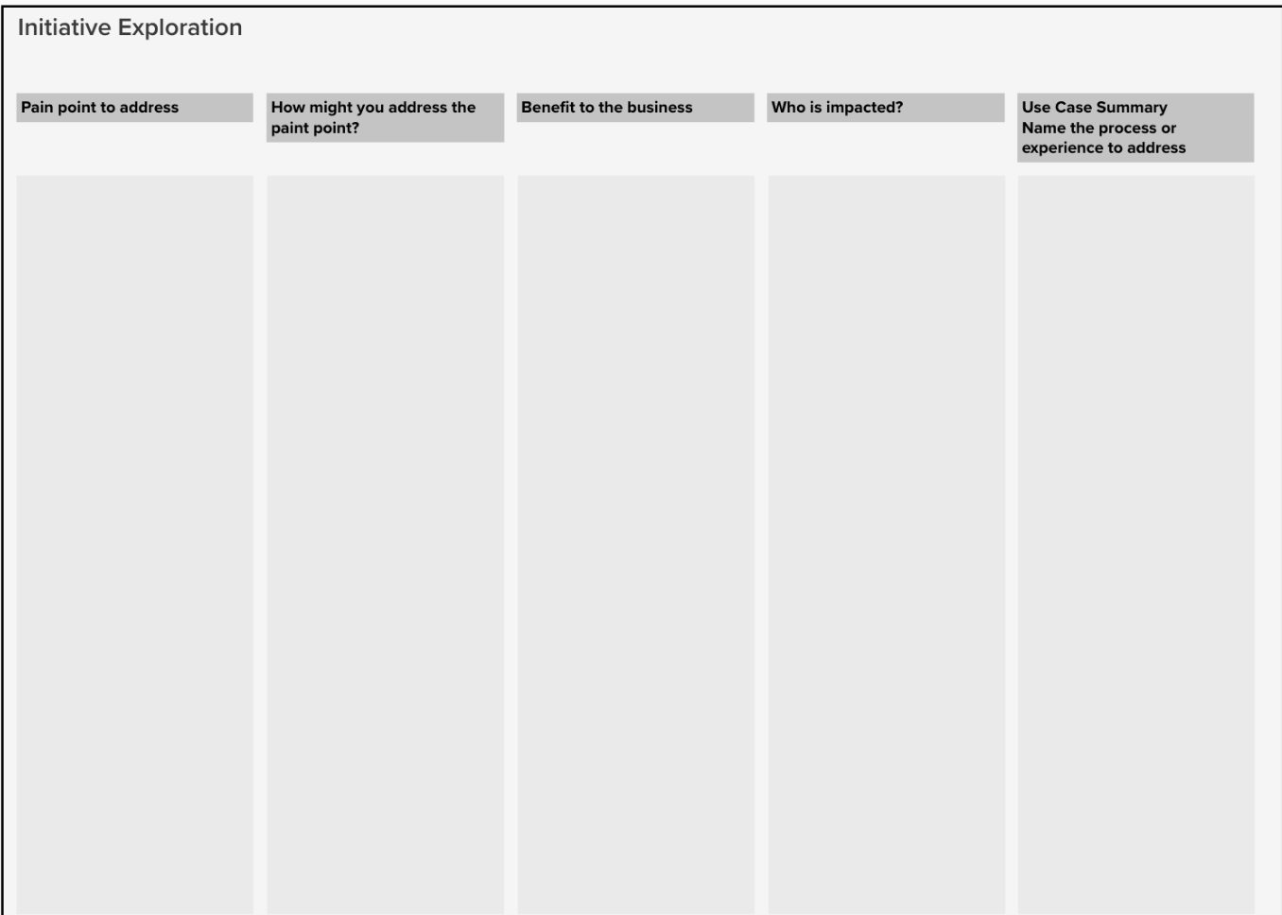
3 Align
COLLABORATE + EXPLORE
ALIGN
1. Move the results from the Collaborate exercise to the columns in Align
2. Think about:
• Opportunities your company should pursue
• What have you never been able to solve?
• Threats to your company
• Other pain points
• Existing workflows/processes that need improving
• Areas where you can be disruptive or innovative
• Areas of the business that are important or growing
• Areas where the business could offer a competitive advantage?

Slide 10
4 Prioritize
15 – 20 minutes
Directions
Vote on the use cases (3 votes for each client team member)
First: Vote on the use case that will deliver the most business value based on the information collected in previous activities.
Second: Vote on how easy it is for your team to the solution. Think about other teams or parties who might block your way, your ability to access to data, external regulations or controls, lack of executive support, deliver
Third: Vote on the use cases would you most like access to IBM's expertise and offerings. Mark those with a star.
Tips
Review the list to see if you have initiatives that are very similar to one another and might "split the vote." If you have no clear winners, review your list and see if some use cases should be grouped.
What you choose to progress depends on what you value and how much. Sometimes a "no-brainer" is the clear winner, or you might decide a "big bet" is worth the effort, because of the value it will bring.
Be sure to ask: Why solve this problem? Is it worth solving? What is the motivation?
Prioritize use cases that will deliver value aligned to your goals.
Highlight how IBM can help the team achieve each goal with IBM technology or service offerings.

Slide 11
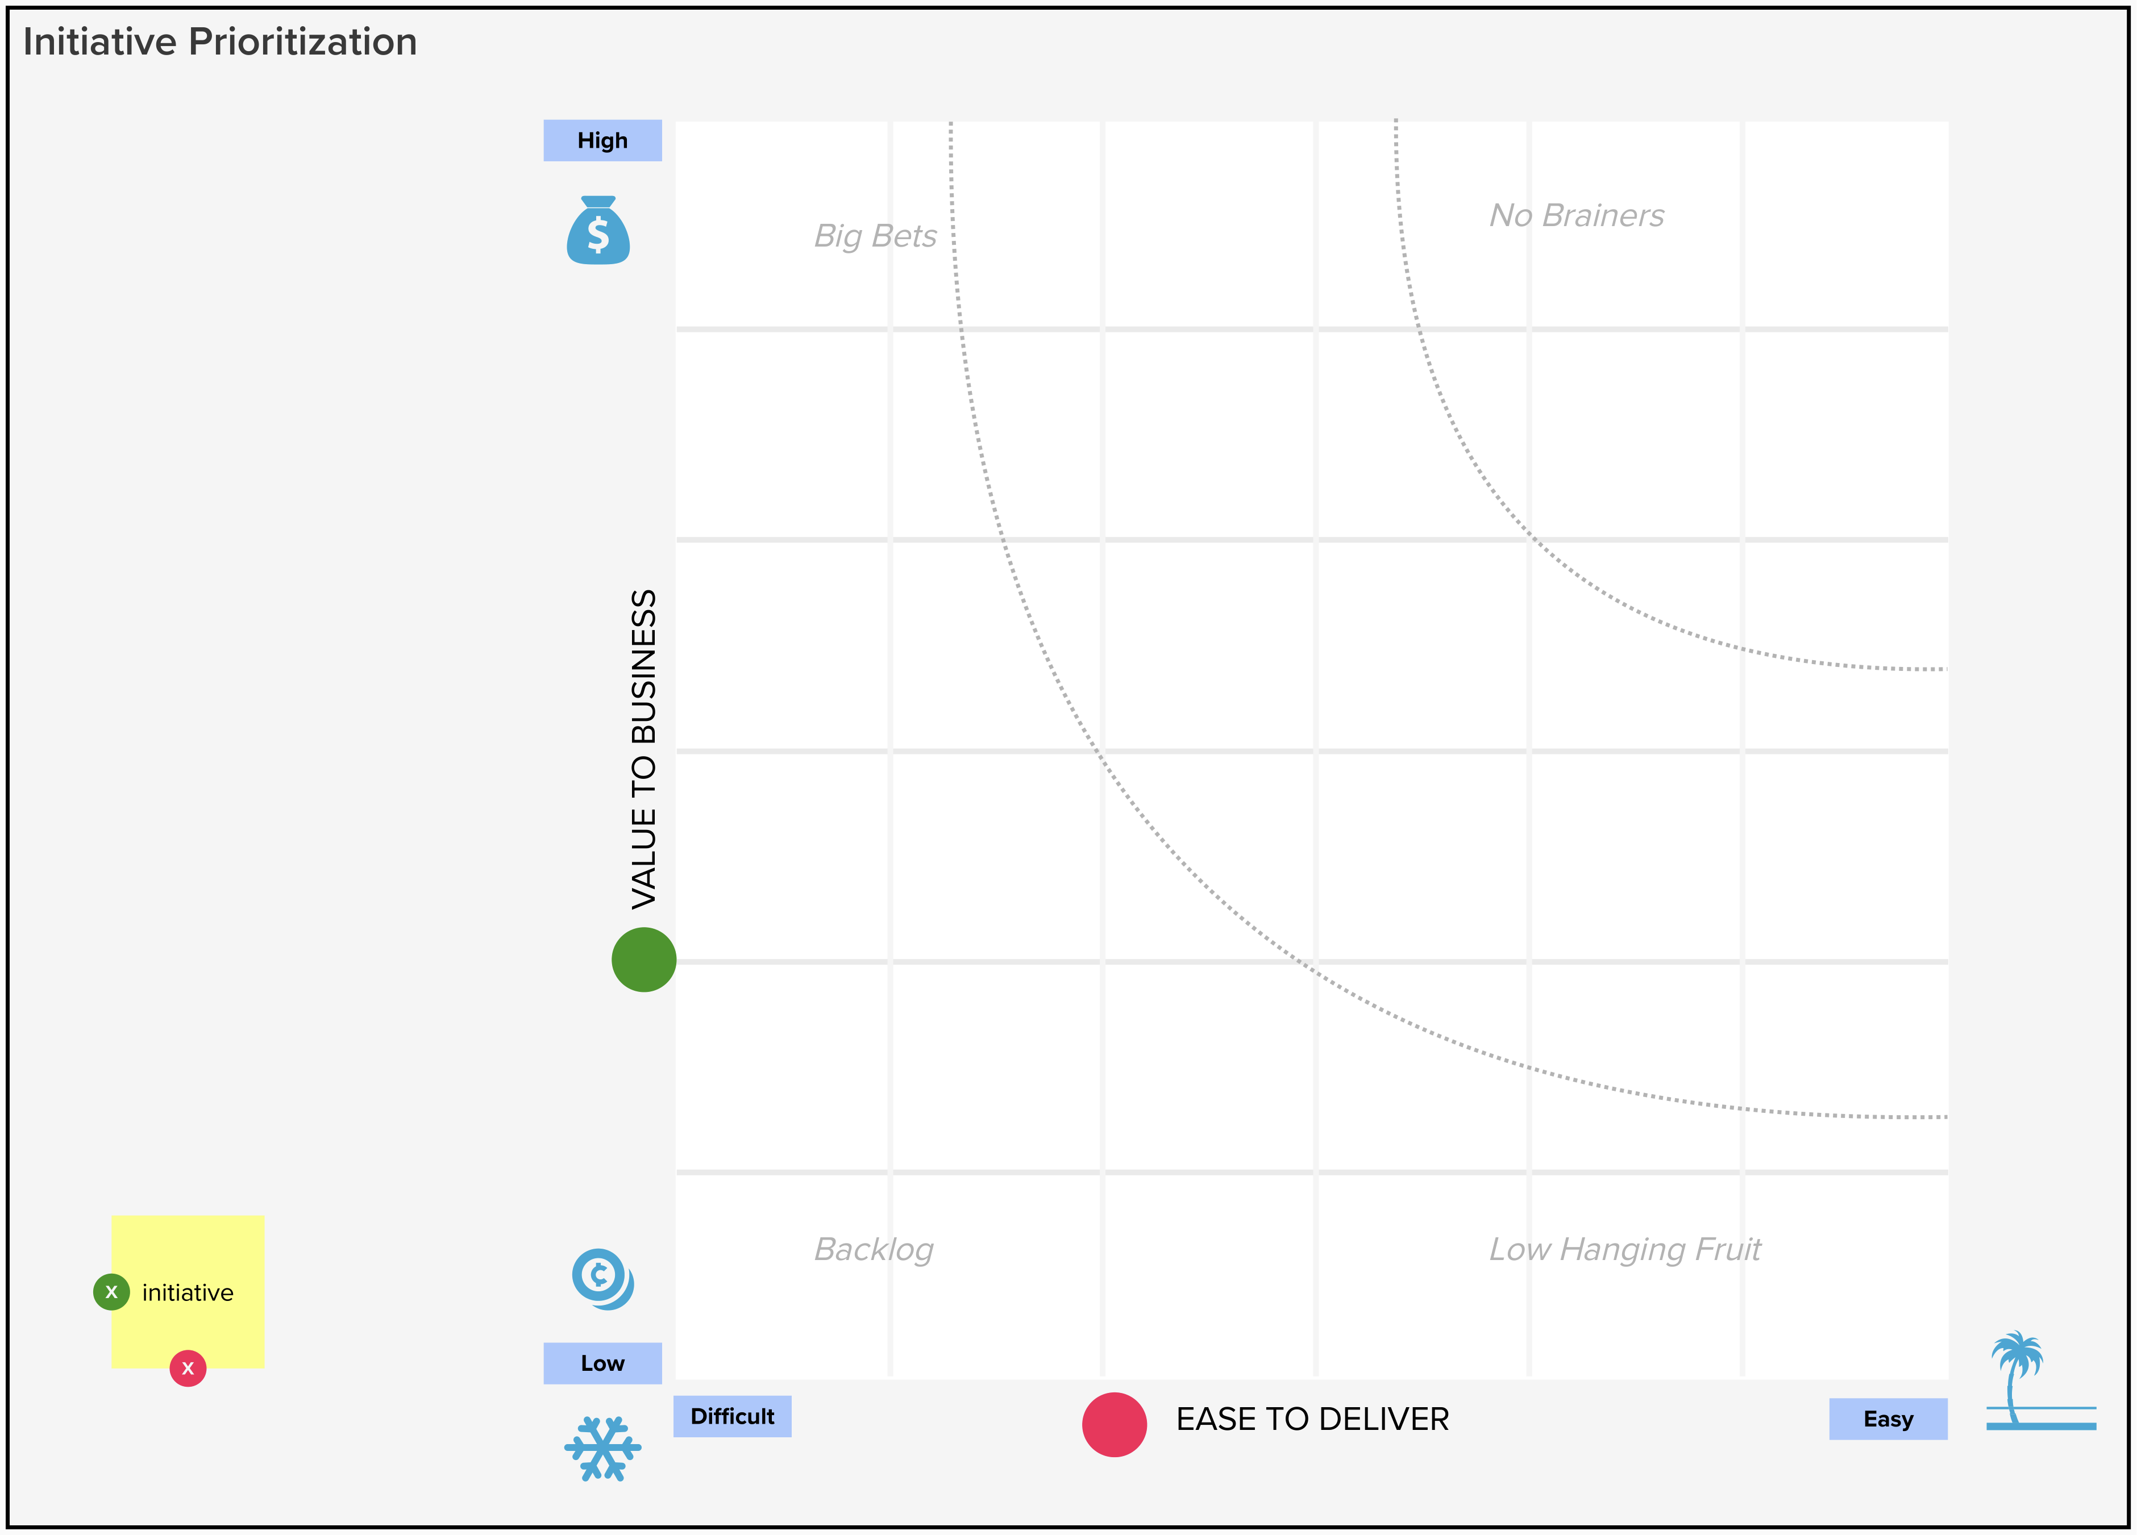
4 Prioritize
VALUE TO BUSINESS
Consider the following areas for your company across all use cases:
• user impact
• enable business innovation
• improve
• agility
• profit, cut costs
• competitive advantage
• company survival
EASE TO DELIVER
Consider the following areas for your company across all use cases:
• business feasibility
• organizational capability
• ability to go to market
• legal / regulatory implications
• urgency of the business challenge
• team availability

Slide 12
5 Describe the Use Case
10 - 15 minutes
Use case statement
We want to address these pain points, challenges, or opportunities.
Pain point
Capture your intention and define your use case on one card to keep the team focused as you move forward.
We want to achieve.
Goal
Which results in these benefits to
the business.
Directions
Create a definition for each use case the team selects to pursue. Grab the results from the Prioritization board. Clarify and add detail as needed.
Benefit
Doing this will impact people in these roles.
Role
We are interested in exploring tech
Opportunities provided by:
Technology

Slide 13
6 Recap/Plan
15 minutes
Are there there any roadblocks or risks we need to address?
Do we have stakeholder buy-in? Funding?
Our next steps are:
Present the IBM POV related to the use cases identified and prioritized
Demo solutions
Present case studies
Architecture workshop
Expert Labs Assessment
Present roadmap (including forecast deployment date)
Progress the prioritized use case

Slide 14
(Optional) Demonstrate
Present a demo that best fits the customer’s pain point

