Slide 1

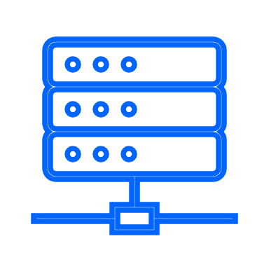



Application Modernization
Do you see any of these?
Do your developers have challenges to develop new features at the pace that your business requires?
Is the architecture of your application hindering you from being able to add functionality?
Is your application expensive to maintain and extend?
Are you spending a lot of time for migration projects just to stay on a supported software stack?
Do you want to benefit from containerization, but your application server does not really fit?
Slow dev-test and deployment cycles
Application and Runtime Technical Debt
Complex, custom or manual operation processes
Cloud-Native and platform Skills
Security Patch Backlog
Key Benefits
Are you looking for
Why Now?
Gartner expects that technical debt will consume more than 40% of the current IT budget by 2025. It is time to address and eliminate technical debt in Java applications
Increase efficiency and reduce costs: Modern application runtimes (Liberty) and DevOps principals can be used to automate many of the manual processes involved running traditional WebSphere in Production today.
Tooling and automation: IBM Cloud Transformation Advisor and IBM Mono2Micro reduce the effort required to move to Liberty
Operations
Developer
50% improvement in developer productivity
40% improvement in administrator productivity
Decouple middleware and application updates to eliminate enterprise-wide major version upgrades | Rapid development with modern build and deployment tools
Monthly build and certified images with latest security patches | Lightweight, fast, flexible and composable application runtime
Zero migration for seamless upgrades | Integration with modern CI/CD processes
Modern, cloud-native runtime with flexible and scalable operational model | Latest Jakarta and MicroProfile industry standard APIs
195% three-year ROI
40% improvement in infrastructure utilization in first year
Achieve Transformational Results
Monolithic Java applications have slow development, test, and deployment cycles due to their size and complexity. They are difficult to scale and have a lack of flexibility. Making a change to these applications requires updating and testing the entire stack which is restrictive and time-consuming.
In contrast, modern, microservices based applications are decoupled, with each service being able to be developed, updated, deployed, and scaled without affecting other services.
Modernizing WebSphere applications brings many of the benefits of modern applications without the need to rewrite the entire application estate

Slide 2
Cloud Pak for Apps (Application Modernization) Conversation:
IBM Internal
1.
What is the conversation?
2.
Why Now?
3.
Common Customer Pain Points
Monolithic Java applications have slow development, test, and deployment cycles due to their size and complexity. They are difficult to scale and have a lack of flexibility. Making a change to these applications requires updating and testing the entire stack which is restrictive and time-consuming.
In contrast, modern, microservices based applications are decoupled, with each service being able to be developed, updated, deployed, and scaled without affecting other services.
Modernizing WebSphere applications brings many of the benefits of modern applications without the need to rewrite the entire application estate
Gartner expects that technical debt will consume more than 40% of the current IT budget by 2025. It is time to address and eliminate technical debt in Java applications
Increase efficiency and reduce costs: Modern application runtimes (Liberty) and DevOps principals can be used to automate many of the manual processes involved running traditional WebSphere in Production today.
Tooling and automation: IBM Cloud Transformation Advisor and IBM Mono2Micro reduce the effort required to move to Liberty
Slow dev-test and deployment cycles
Application and Runtime Technical Debt
Complex, custom or manual operation processes
Cloud-Native and platform Skills
Security Patch Backlog
4.
Approach to Achieving Value
1. Understand Client Industry and KPIs
2. Develop a one Page Point of View (POV)
3. Brief stakeholders on IBM’s approach to WebSphere Modernization
4. Schedule and run Modernization Briefing and gather information
5. (Optional) Client Engineering runs PoX
6. Technology Expert Labs provides WebSphere Modernization Job Assessment
7. Propose the Modernization effort required
8. Client Modernizes to Liberty
Achieve Transformational Results
5.
The Value to the CUSTOMER
6.
Key Benefits
7.
Tactics
8.
Key Contacts & Resources
9.
Customer Stories
Entry Point: WebSphere ND customers looking to adopt cloud native principals and reduce TCO for existing applications
Executive Sponsorship:
Jason Gartner, General Manager, Application Platform
John Greene, Director, Product Management, App Runtimes
Customer Success
Dave Mulley, WW Customer Success
Product Management:
David Sallinas, WebSphere , CP4Apps Product Manager
John Buckley, Application Modernization Product Manager
Sales:
Gary Juvinall, WW Sales
Kevin Postrich, WW Tech Sales
Expert Labs:
Shruthi Savla, WW Technology Expert Labs
Hendrik van Run, WW Technology Expert Labs
CSM Playbook: Link
Seismic C\loud Pak for Applications: Link
Discover
Performed two successful PoCs to demonstrate that migration to Liberty on OpenShift in a Cloud can be done in just days. Build and deployment times reduced from a few days to less than 10 minutes.
https://www.ibm.com/cloud/blog/proving-the-websphere-modernization-path-to-liberty-on-openshift-at-discover
FlowFactor
Modernized from traditional WebSphere to Liberty and reduced deployment cycle time by 99%.
https://www.ibm.com/case-studies/flowfactor/
Svenska Handelsbanken
Received a 17500x improvement in upgrade time by modernizing from traditional WebSphere to Liberty, demonstrating that a rollout of a new JavaEE version went from 15-24 months to 30 minutes for an entire test environment
https://ibm.seismic.com/Link/Content/DC7X2JC4mm2P382MbggWqXDdp2bP
50% improvement in developer productivity
40% improvement in administrator productivity
Operations
Developer
Entry Point: WebSphere ND customers needing to reduce technical debt, complexity and costs while increasing innovation and delivery speed
Decouple middleware and application updates to eliminate enterprise-wide major version upgrades | Rapid development with modern build and deployment tools
Monthly build and certified images with latest security patches | Lightweight, fast, flexible and composable application runtime
Zero migration for seamless upgrades | Integration with modern CI/CD processes
Modern, cloud-native runtime with flexible and scalable operational model | Latest Jakarta and MicroProfile industry standard APIs
195% three-year ROI
40% improvement in infrastructure utilization in first year
Entry Point: Managing WebSphere ND deployments has become increasingly complicated
Source: https://ibm.seismic.com/Link/Content/DC4Gcc3W2f3Gb8FHRgBTTcXbF4RV
Entry Point: Velocity of Java application security risks is increasing

Slide 3
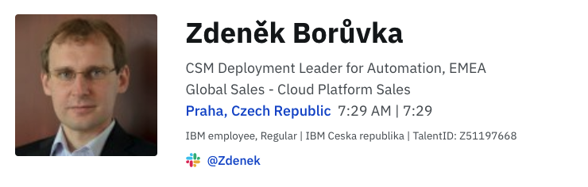
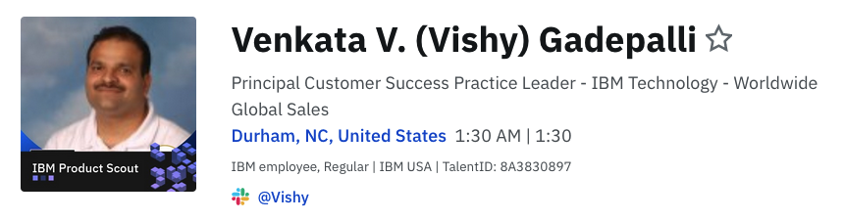
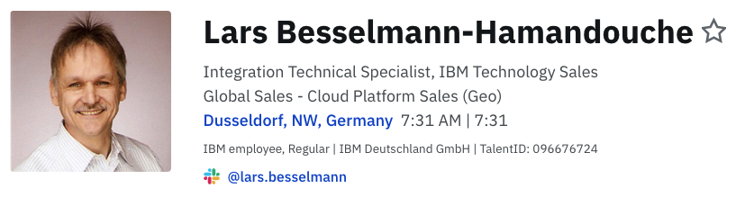
IBM Internal
Application Modernization – call to action
Familiarize with the play
Select clients to contact (typically WAS ND and WAS clients)
Prepare for the initial demand generation conversation using the prospecting one pager, the full deck and CSM Playbook page or Seismic CP4Apps sales kit / WHE (and/or get help from the play contact points)
As a next step consider planning remote or on site WebSphere update /roadmap Workshop (90 mins.) or Transformation Advisor (free of charge application assessment of which applications can be modernized to Liberety and/or containers and which really need WAS ND)
For clients showing interest create a GS Success Plan and get in touch with contact points for wider plan or more help (if needed)
Reflect progress in Gainsight
Contacts for help (to be contacted in the order below):
Market CSM Automation Leader
EMEA CSM
WW CSM
Technical Sales

