Slide 1

Executive Business Review for <Customer name>
<Insert Logo from
CADET External Customer View>
Presenter Name & Title
Presenter Name & Title
Presenter Name & Title

Slide 2
Leveraging this Template (page to be deleted prior to sharing)
Leveraging this Template
All yellow text/ yellow highlighted text is considered placeholder and must be replaced or removed
Notes for additional context can be found in the speaker notes. Be sure to remove them before sharing slides.
This template can be replaced with the customer’s template if available.

Slide 3
Considerations for EBR (page to be deleted prior to sharing)
Why do an EBR
An Executive Business Review is a periodic review with the executive sponsors from the client and the IBM team (and partners) to ensure alignment at a strategic level. This is a time to reinforce progress the client is making in their adoption, align on strategic objectives of the client, uncover additional opportunities, and review the customer’s entitlement and deployment.
Find more information on the EBR in the CSM Playbook here.
Responsibilities
CSM Account Specialist is responsible and accountable for the EBR for Diamond accounts.
The CSM Architect is responsible and accountable for the EBR for direct and BP-engaged accounts.
The CSM Architect can work with the account team to ensure the right content is included in the EBR such as deployment data, product roadmaps, and strategy alignment.
Considerations
EBR should not exceed more than 1 hour.
EBR should be face-to-face whenever possible.
EBR should occur quarterly.
Co-create final agenda with the customer with proposed topics

Slide 4
Considerations for EBR cont…. (page to be deleted prior to sharing)
Potential Goals for EBR
Document outcomes achieved since last EBR
Track software consumption and utilization
Identify issues (business, technical, engagement) early so they can be addressed promptly
Identify new projects or areas for expansion
Engagement – demonstrate and seek new access/entry points
After the EBR
Track completion in Gainsight
Add timeline
Add task for follow-up items
Gathering Content for EBR
CADET External Customer View (Diamond only)
Client Value Acceleration (Diamond only)
Use case workshops
Business Outcomes Framework (agreed upon metrics)
Notes:
TSL/MD

Slide 5

Considerations for Partner participation (page to be deleted prior to sharing)
Your customers choose to work with partners because they trust them and rely on them to help them achieve their objectives. Partner involvement in the EBR reflects that we are one team are working together for the customer’s success.
Be to understand the partner landscape for this customer:
Is there one dominant technology advisor partner that the customer depends on for their strategic planning?
Is there a services implementation partner that is working on a specific migration project?
Are there multiple partners engaged in projects related to multiple entitlements you plan to cover in this EBR?
Is the partner solely a fulfillment partner with no involvement in the strategic direction or value realization of the customer’s investment?
Once you understand these dynamics consider how the partners should participate.
A strategic partner may co-host with you or play a key role in delivering some of the content.
An implementation partner may wish to give an update on their progress and share a point of view on what’s working or could be improved as the project continues.
When multiple partners are involved, you want to avoid any competitive concerns with information being shared.
IMPORTANT: Always confirm your plan for partner involvement with your customer.
Partner attendee roles to consider:
Partner account rep
Partner technical pre-sales rep
Partner delivery leader
Partner technology consultant
Remember, the EBR is a chance to have a positive impact on the partner’s view of IBM and IBM technology. This impact goes beyond this single customer and drives growth for IBM through our Ecosystem.

Slide 6
update
Sample Workshop agenda
Introductions | Introduce <CLIENT NAME> and IBM teams
Reflection | Review outcomes from last quarter(s)
Adoption Progress
Strategic Alignment
Offering Update/ Product Roadmap
Events & Assets
<CLIENT NAME>
&
IBM
6

Slide 7
Workshop Participants
IBM | Role
 | TSL/MD
 | ATL
 | Dealmaker
 | CSM Account Specialist
Customer | Role
 | CIO
 | Business Leader
 | IT Operations
 | IT Finance
 | Optional: Procurement…
Notes:
TSL/MD (MD is primarily on Signature accounts
ATL (on Signature and Strategic accounts)

Slide 8

IBM Technology Team for <CLIENT NAME>
Technology Sales
Brand Sales
Brand Technical Sales
Customer Lifecycle
NAME
Technology Sales Leader
email
Customize to fit customer’s team
NAME
Account Technical Leader
email
NAME
Dealmaker
email
8
Notes:
IBM Roles to consider
Technology Sales Leader (TSL)
Dealmaker (DM)
Account Technical Leader (ATL)
Customer Success Manager (CSM) Account Specialist
Brand Seller
Brand Technical Specialist
Client Engineering
Subscription & Annuity

Slide 9
Strategic Alignment
Short Term Goals (1-3 months)
Working with the client, what are the near-term goals, KPIs or initiatives that they are tracking?
Long Term Goals (6-12 months)
Working with the client, what are the longer term goals, KPIs or initiatives that they are tracking
Notes:
Purpose: All about the client’s goals. Work with your project teams to pre-populate, but this is key for aligning on outcomes, and potentially understanding new pain points that will expose expansion paths.

Slide 10
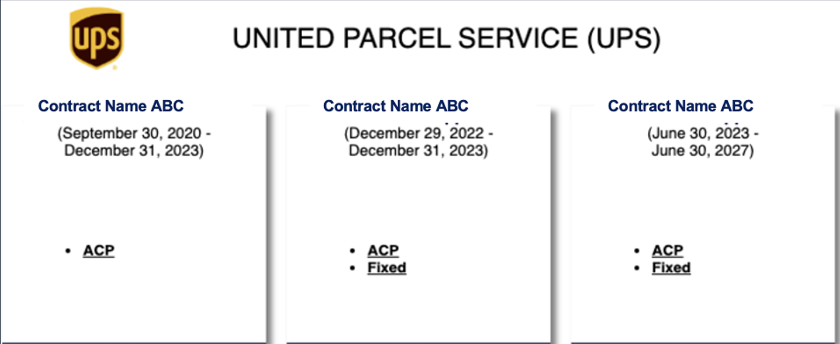
Insert CADET ECV slide to show all Contracts/Sections
Notes:
Insert from Cadet External Customer View

Slide 11
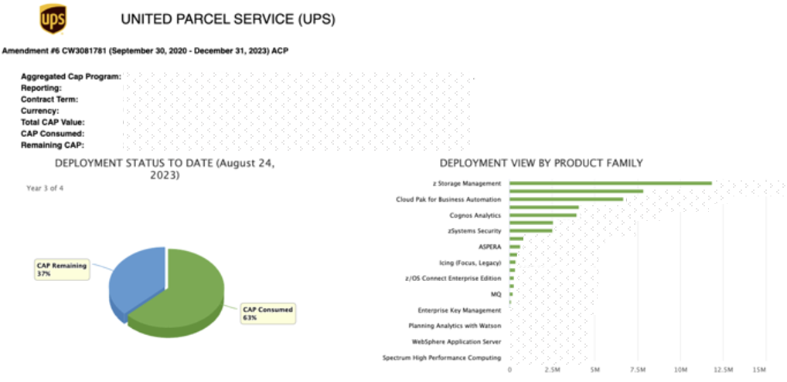
Insert CADET ECV slide for each Contract Section to show Contract Consumption (ACP Sample)
Notes:
Insert from Cadet External Customer View

Slide 12
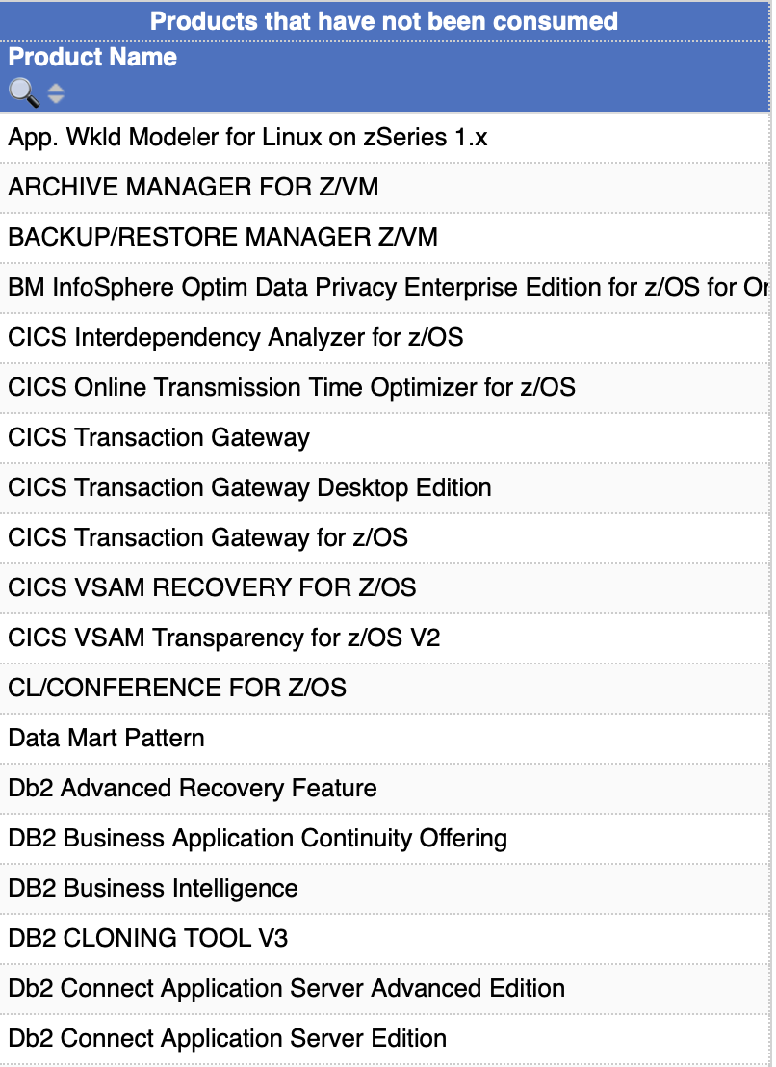
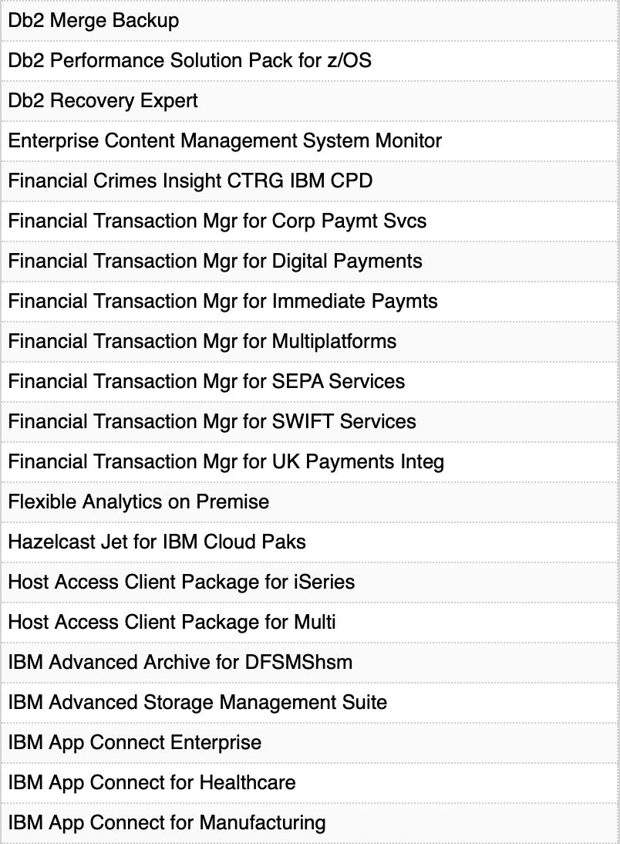
Insert CADET ECV Products Not Yet Consumed View for each Section (ACP Sample, pg 2)
Contract ABC (December 31, 2021 – June 30, 2023) ACP
Notes:
Insert from Cadet External Customer View

Slide 13
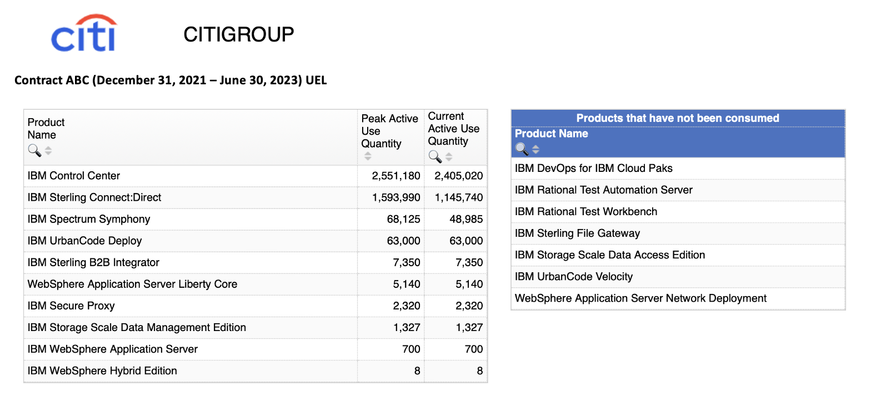
Insert CADET ECV slide for each Contract Section to show Contract Consumption (UEL Sample)
Notes:
Insert from Cadet External Customer View

Slide 14
Insert CADET ECV Upcoming Projects View
*This view of customer projects will be available soon in CADET if it isn’t already*
Notes:
Coming Soon from Cadet External Customer View

Slide 15
Reflection
Concrete and meaningful outcomes the business sponsor would recognize.
Where applicable, use the output from the the Business Outcomes framework on targeted outcomes and ROI considered successful.
Concrete and meaningful outcomes the business sponsor would recognize.
Where applicable, use the output from the the Business Outcomes framework on targeted outcomes and ROI considered successful.
Use Case 1 or Key Project 1
What progress has been made since the last EBR?
Use Business Opportunity Statement, customer challenge and what the customer wanted to achieve
IBM Technology or Services
Quantifiable or qualifiable evidence of progress toward the goal
Concrete and meaningful outcomes the business sponsor would recognize.
Where applicable, use the output from the the Business Outcomes framework on targeted outcomes and ROI considered successful.
Use Case 2 or Key Project 2
What progress has been made since the last EBR?
Use Business Opportunity Statement, customer challenge and what the customer wanted to achieve
IBM Technology or Services
Quantifiable or qualifiable evidence of progress toward the goal
Notes:
Purpose: Convey the progress that has been made since the last review with this executive. While some updates will be activity-based, it is important to ensure we have quantitative progress that is shared. If we don’t yet have ROI, consider other metrics that can convey progress. The number of new users onboarded? The number of workflows that have been moved to the tool?

Slide 16
Customize this slide – Deployment Value
Deploying
Complete: Include KPIs
In progress: Include what is working, what needs improvement, and timeframe for next key milestones
In future: What are the KPIs or questions that the exec should be thinking about? Use the Business Impact Workshop content
Recognize Value
Complete: Include KPIs from Value Realization Health check
In progress: Include what is working, what needs improvement, and timeframe for next key milestones
In future: What are the KPIs or questions that the exec should be thinking about? Use the Business Impact Workshop content
Notes:
Purpose: Showing visually how a client is doing along their path is powerful.

Slide 17
Events and Assets
Events
<Event>
Communities:
<Link to communities they should follow>
Studies:
<Link to any external studies or documentation>
References
<Link to external references or content for clients like them that you think would be valuable given their situation>
Make ask here on external story
Notes:
Purpose: Share key links or upcoming events that would be of benefit to the client. For example, is there a new case study released that would be applicable to what you know about the client? Or is there an upcoming event that might be a candidate for them to attend or speak at? Ask any participating partners to contribute relevant items here.

Slide 18
Thank you
<Name>
Customer Success Manager
—
firstlastname@us.ibm.com
+1-555-555-5555
<Name>
Additional Speakers
—
firstlastname@us.ibm.com
+1-555-555-5555
© Copyright IBM Corporation 2020. All rights reserved. The information contained in these materials is provided for informational purposes only, and is provided AS IS without warranty of any kind, express or implied. Any statement of direction represents IBM’s current intent, is subject to change or withdrawal, and represent only goals and objectives. IBM, the IBM logo, and ibm.com are trademarks of IBM Corp., registered in many jurisdictions worldwide. Other product and service names might be trademarks of IBM or other companies. A current list of IBM trademarks is available at Copyright and trademark information.

