Slide 1


Use Case Discovery Framework [Use case] A customer interacts with a product or service to fulfill a need or a want

Slide 2

Work together to solve your most critical business pain points Show this slide to your customer to help them understand the goal of the session.
IBM offers a complimentary half-day session to help you identify your greatest pain points and business challenges.
In this session, IBM experts will:
Share the latest technology related to your industry and business pain points
Facilitate an interactive design-thinking exercise to identify the most critical pain points and challenges that IBM technology can solve
Outcome – A prioritized use case
Next steps – Technology discovery and architecture of the solution

Slide 3
Use Case Discovery Agenda- Half Day
Customize this agenda for what works best for your team.
Topics | Objectives | Duration
Technology innovations and industry trends (Senior decision makers) | IBM technology and how it can help in your industry Use cases and best practices | 30 Minutes
Collaborate to understand your biggest challenges (IT Architects, Security, Lines of Business Stakeholders ) | Work through a collaborative exercise to gain insight into your key business pain points and biggest challenges | 90 Minutes
BREAK – 15-30 min
Explore how IBM technology can solve your biggest challenges (IT Architects, Security, Lines of Business Stakeholders) | Dive into applicable use cases based on the identified pain points from collaborative session Demo to show how (optional) | 60 Minutes
Recommended next steps (Senior decision makers) | Recap key focus areas Establish how IBM can help bring value to your business Deliver prioritized use case for solving your identified challenges | 60 Minutes
Notes:
Whiteboard and face-to-face is best, but there are mural templates you can use if you are remote.
Add Bus Opp mural template as an optional tool

Slide 4

Use Case Discovery is adaptable to satisfy your needs and availability
Modify this as needed
1 Hour provides …
2 Hours provides …
3 hours provides …
4 hours provides …
1 INFORM
Duration: 5 min
Brief introduction of IBM technology and fit
Align on your vision
Duration: 30 min
Brief introduction of IBM technology and fit
Analysts' Forecasts and Trends
Industry uses cases and
best practices
Align on your vision
Duration: 30-45 min
Brief introduction of IBM technology and fit
Analysts' Forecasts and Trends
Industry uses cases and
best practices
Align on your vision
Duration: 30-45 min
Brief introduction of IBM technology and fit
Analysts' Forecasts and Trends
Industry uses cases and
best practices
Align on your vision
Senior Decision Makers
2 COLLABORATE, EXPLORE, ALIGN, PRIORITIZE
Duration: 55 min
Discussion to identify challenges and pain points, areas and roles impacted
Duration: 60 min
Discussion to identify challenges and pain points, areas and roles impacted
Prioritize pain points
Duration: 90 min
Design Thinking session to identify challenges and pain points, areas and roles impacted
Duration: 90 min
Design Thinking session to identify challenges and pain points, areas and roles impacted
IT Architects, Security, Lines of Business Stakeholders
3 SHOW ME DEMO
Duration: 30 min
Demo use cases based on the challenges identified
Duration: 60 min
Demo use cases based on the challenges identified
IT Architects, Security, Lines of Business Stakeholders
4 RECAP & SUMMARIZE
Duration: 30 min
Recap key focus areas
Deliver prioritized use case based on established priorities and IBM technology
Duration: 30 min
Recap key focus areas
Deliver prioritized use case based on established priorities and IBM technology
Duration: 60 min
Recap key focus areas
Deliver prioritized use case based on established priorities and IBM technology
Senior Decision Makers
Results of whiteboard exercise, prioritized use case and technology identified
Results of whiteboard exercise, prioritized use case and technology identified
Results of whiteboard exercise, prioritized use case and technology identified
Results of whiteboard exercise, prioritized use case and technology identified
Can split into 2 sessions

Slide 5
1 Inform
Explore possible use cases that might fit client pain points
Review the CSM Use case repo for clients with similar pain points
Playbook pages – (in backup) these pages all contain the most common use cases per technology.

Slide 6

2 Collaborate
15 – 20 minutes
Directions
Discuss and capture the business landscape.
Review the input of the team and discuss and clarify so that everyone understands each individual’s input.
Describe your challenges and then delineate them into specific use cases that you can tackle with IBM. We want to develop or understand a strategy and a starting point for a journey to achieve your long-term goals. Before we align, categorize or prioritize, we want to understand the big picture so we can begin to capture your goals and understand them in context.
Notes:
Facilitator notes:
Success
You understand and have captured: the motivation to work with IBM, what you want to achieve, context related to what is driving the client
Tips
Be specific and clear with what you capture. Be brief but write enough that you will be able to remember the intent later. There should be enough detail that you can explain the team's work to a new person or partner who might join the team later or someone you need to whom you need to present the team's work.
Tips
Populate the board before the session with what you know individually or as a team. Use that as a starting point for conversation and add clarity and details in the session.

Slide 7
2 Collaborate
What drives your company? | Where do you want your company to be in 2 years?
What are the strategic initiatives that are driving your organization? What are some of the challenges you face in achieving your goals? | Benefits this will bring to your business: areas where your company wants to innovate areas where you want to grow as a business new markets you want to reach areas where you can gain a competitive advantage
Notes:
Facilitator notes:
People / end users whose experience you’d like to improve:
customers
external partners
internal stakeholders
Problems your teams are facing and future opportunities:
customer satisfaction
churn or employee satisfaction
technical challenges
operational drag
You can use sticky notes on whiteboards or just have the group write these on the whiteboard
What holds company or users back? What are they struggling with?

Slide 8
2 Explore + Align
15 – 30 minutes
Directions
1. Populate the columns on the next chart with the results from the business landscape discussion.
2. Align the difficulties and challenges with the team’s goals and the desired business outcome that would be delivered by achieving the goals.
3. Determine the roles directly impacted by the effort. Who will work with the solution? Who will benefit when it is completed?
4. Name the process you aim to improve for each use case so you can prioritize.
Explore pain points, challenges, or problems your team wants to address with the outcome your use case should deliver for your business.
Scope each use case by aligning the desired business outcome to the people who will adopt or reject your solution and the experience you want to create or improve.
Notes:
Faciitator notes:
Success
You identified the effort required to deliver the goals, the value that will be derived by completing each one, so that you can prioritize the efforts based on benefits that are most valued by the team.
Tips
When you start to discuss the details, you might define distinct efforts required to achieve one goal, so you list each effort in a separate row. On the other hand, addressing one challenge may lead to multiple benefits, those can be listed in the same row.
If multiple roles are impacted by the goal, they might be listed in separate rows and separate processes.

Slide 9
2 Explore + Align
Pain points to address | How you might address the pain point | Benefit to the business | Who is impacted? | Use case summary – Name the process or experience to address
Move the results from the business landscape exercise to these columns.
Think about:
• Opportunities your company should pursue
• What have you never been able to solve?
• Threats to your company
• Other pain points
• Existing workflows/processes that need improving
• Areas where you can be disruptive or innovative
• Areas of the business that are important or growing
• Areas where the business could offer a competitive advantage?
Notes:
Facilitator Notes:
What is the problem that needs to be solved? What situation needs to be improved? For what role?
Do you need a value stream mapping exercise to identify the
bottlenecks in the process?
https://www.ibm.com/garage/method/practices/discover/practice_value_stream_mapping/

Slide 10
2 Prioritize
15 – 30 minutes
Directions
Vote on the use cases (3 votes for each client team member)
First: Vote on the use case that will deliver the most business value based on the information collected in previous activities.
Second: Vote on how easy it is for your team to the solution. Think about other teams or parties who might block your way, your ability to access to data, external regulations or controls, lack of executive support, deliver
Third: Vote on the use cases would you most like access to IBM's expertise and offerings. Mark those with a star.
Tips
Review the list to see if you have initiatives that are very similar to one another and might "split the vote." If you have no clear winners, review your list and see if some use cases should be grouped.
What you choose to progress depends on what you value and how much. Sometimes a "no-brainer" is the clear winner, or you might decide a "big bet" is worth the effort, because of the value it will bring.
Be sure to ask: Why solve this problem? Is it worth solving? What is the motivation?
Prioritize use cases that will deliver value aligned to your goals.
Highlight how IBM can help the team achieve each goal with IBM technology or service offerings.
Notes:
Facilitator notes:
Tips
Sometimes use cases fall to the backlog because they are more similar to another initiative than the team realized and you have accidentally "split the vote." If you have no clear winners, review your list and see if some use cases should be grouped.

Slide 11
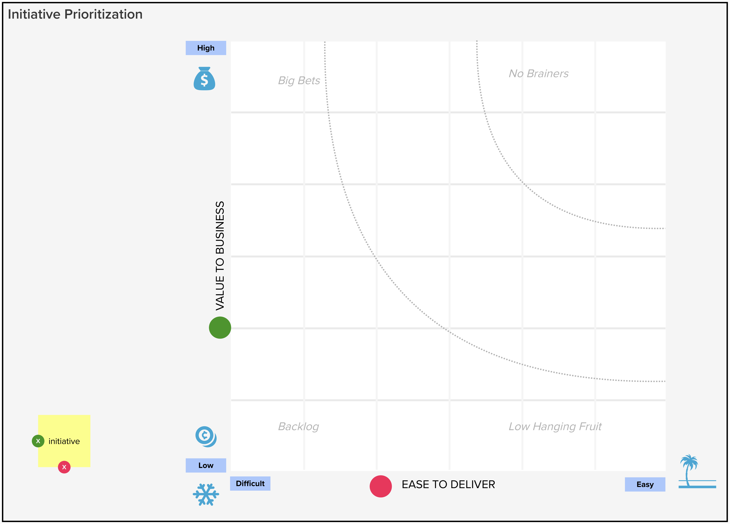
2 Prioritize
VALUE TO BUSINESS
Consider the following areas for your company across all use cases:
• user impact
• enable business innovation
• improve
• agility
• profit, cut costs
• competitive advantage
• company survival
EASE TO DELIVER
Consider the following areas for your company across all use cases:
• business feasibility
• organizational capability
• ability to go to market
• legal / regulatory implications
• urgency of the business challenge
• team availability

Slide 12
3 Demonstrate
Present a demo that best fits the customer’s pain point

Slide 13
4 Describe the Use Case
10 minutes
Directions
Create a definition for each use case the team selects to pursue. Grab the results from the Prioritization board. Clarify and add detail as needed.
Use case statement
We want to address these pain points, challenges, or opportunities.
Pain point
Capture your intention and define your use case on one card to keep the team focused as you move forward.
We want to achieve.
Goal
Which results in these benefits to
the business.
Benefit
Doing this will impact people in these roles.
Role
We are interested in exploring tech
Opportunities provided by:
Technology
Notes:
Facilitator notes:
Who is affected by the issue or change (impact to people in specific roles)
What goal does the client want to achieve? What pain point is addressed and then what is the goal of addressing the pain point?
What process of product will get you there? (tech opps provided by…)
What is the business impact if the goal is achieved?

Slide 14
4 Recap
45 minutes
Are there there any roadblocks or risks we need to address?
Do we have stakeholder buy-in? Funding?
Our next steps are:
Present the IBM POV related to the use cases identified and prioritized
Demo solutions
Present case studies
Architecture workshop
Expert Labs Assessment
Present roadmap (including forecast deployment date)
Progress the prioritized use case

Slide 15
Backup
Use the following slides to explore common use cases for each of the technology areas

Slide 16
Sustainability pain points / use cases
Maximo pain points - Michael Holton
TRIRIGA pain points - Mike Singleton
Supply Chain pain points - CK Rao
EIS use cases - Scott Nogueira
Aviation Weather use cases – Scott Nogueira

Slide 17
Data & AI, Automation
Cloud Pak for Data Data Fabric - Campbell Robertson
Data Management - Campbell Robertson
Business Analytics & Customer Care - Christian Peterman
Watson AIOps – Dave Mulley
Observability/Instana - Dave Mulley / Hollis Chui
Turbonomic – Dave Mulley
Integration - Vishy Gadepalli
Business Automation - Di Lang

Slide 18
Security pain points / use cases
QRadar & QRoC - Greg Sabatini (@gsabatini), Hemankita Perabathini (@hemankita)
Guardium - Greg Sabatini (@gsabatini), Cathrine Bjørndal (@Cathrine Bjorndal), Hemankita Perabathini (@hemankita )
Verify - Greg Sabatini (@gsabatini), Cathrine Bjørndal (@Cathrine Bjorndal), Hemankita Perabathini (@hemankita )
Cloud Pak for Security - Greg Sabatini (@gsabatini), Cathrine Bjørndal (@Cathrine Bjorndal), Hemankita Perabathini (@hemankita )
MaaS360 - Greg Sabatini (@gsabatini), Cathrine Bjørndal (@Cathrine Bjorndal), Hemankita Perabathini (@hemankita )
Trusteer - Greg Sabatini (@gsabatini), Cathrine Bjørndal (@Cathrine Bjorndal), Hemankita Perabathini (@hemankita )

Slide 19
Mural template link: https://app.mural.co/invitation/mural/presalesgarageamericas9984/1623262775737?sender=slafera&key=17d31100-9109-4add-a2b8-494ecc9f1bc9 This links to the original Business Framing template from Garage. You can still use this template if you have time and expertise to perform the exercise. Use this only if you are holding a remote or hybrid session.

Slide 20


<Customer Industry> <Customer name> <use case name> <Describe the use case here>
Customer Background
<Provide a brief background on customer here>
CSM / Use Case Author
<Provide CSM name, picture & Bluepages link here>
<IBM Geo Location>
Customer Company
Logo here
(optional)
Business Challenge(s) addressed by Use Case
<Describe the business challenges here>
Target Users
<Who are the targets for this Use Case>
Benefits
<Describe the benefits here>
IBM’s Unique Value
<Describe why IBM here>
Growth Offerings Involved
<List IBM products here>
Forecast Deployment Date
<List forecasted date of deployment here>
Partner Involved?
<Yes | No>
If ”Yes”, who is the Partner?
<IBM Partner Name and Key Contact>
This is not an approved external reference.
For IBM internal use only.
Notes:
Store this in Box or in Gainsight – using Timeline

