Slide 1
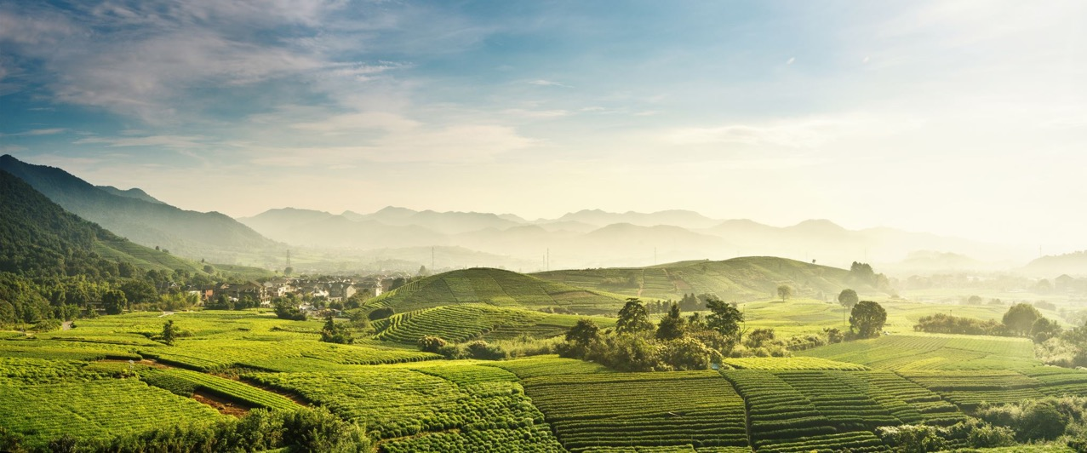
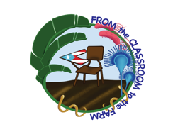
Control Practices
Nicole Colon Carrion and Sofia Macchiavelli Giron

Slide 2


From the Classroom to the Farm
Learning Goals
1. Discuss approaches for the control of plant diseases
2. Develop strategies to manage plant diseases
3. Network with Extension agents

Slide 3
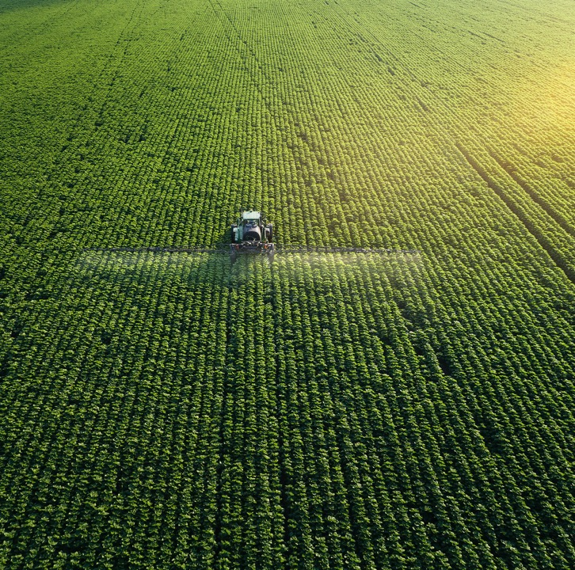
From the Classroom to the Farm
Control Practices
Control practices are practices that increase the quantity and improve the quality of plants and their products
They are aimed at protecting populations of plants from getting diseased rather than curing them
Methods vary depending on:
Type of disease
Pathogen
Host
Environmental conditions

Slide 4
From the Classroom to the Farm
Integrated Control of Plant Diseases
ICD is the control of plant diseases involving coordinated use of multiple practices
Main goals:
Eliminate or reduce initial inoculum
Reduce the effectiveness of initial inoculum
Increase resistance of the host
Delay onset of disease
Slow secondary cycle

Slide 5
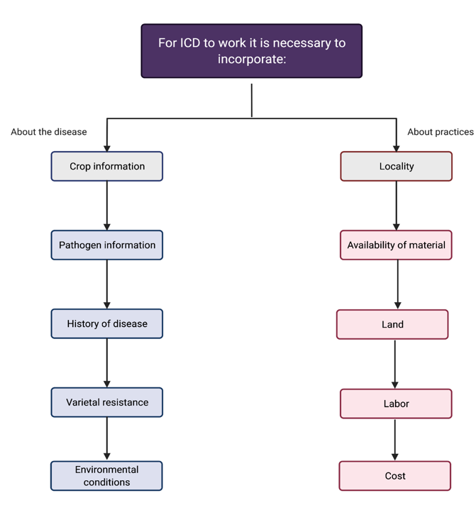
From the Classroom to the Farm
Integrated Control of Plant Diseases

Slide 6
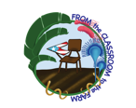
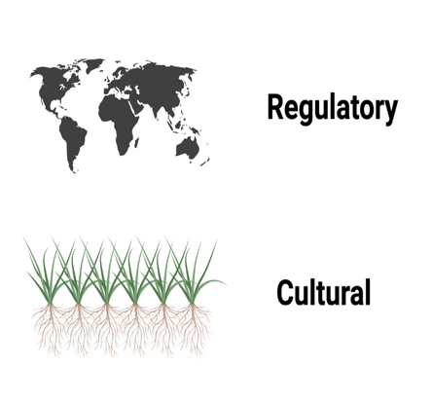
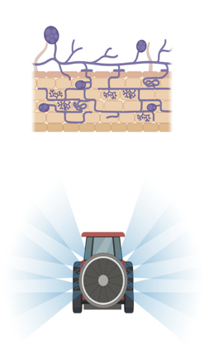
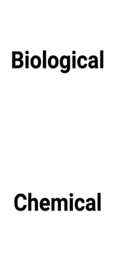
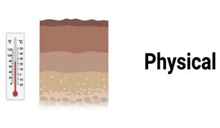
From the Classroom to the Farm
Types of Control Practices

Slide 7
From the Classroom to the Farm
Control Practices
Each of these methods is based on one of these traditional principles:
Avoidance
Exclusion
Eradication
Protection
Resistance
Therapy

Slide 8
From the Classroom to the Farm
Avoidance
Protection
Creates or selects unfavorable conditions for the pathogen
Creates a barrier that protects the plant from infection
Exclusion
Resistance
Prevents the introduction of inoculum
Selects plants that are tolerant or resistant to the pathogen
Eradication
Therapy
Kills or inactivate the pathogen's inoculum
Cures infected plants

Slide 9
From the Classroom to the Farm
Types of Control Practices

Slide 10
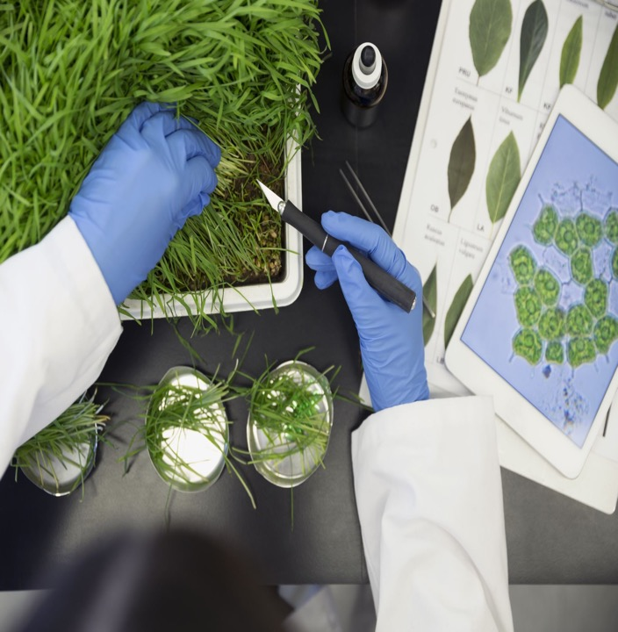
From the Classroom to the Farm
Regulatory Control
Regulatory control are practices that exclude a pathogen from a host or a geographical area
Prevent import or spread of pathogens into absent areas
The logistic behind this practice is based on the disease triangle (no pathogen = no disease)

Slide 11
From the Classroom to the Farm
Quarantine & Inspection
Plant Quarantine Act 1912
Restricts the entry or passage of plants, plant products, soil, or other agricultural material to the US from foreign countries
Plant material is grown and tested to ensure disease-free plants

Slide 12
From the Classroom to the Farm
Crop Certification
Voluntary or compulsory inspections to ensure disease-free plants
Grower or seller submits material to the state's regulatory agency
Material is subjected to a series of tests. If no pathogen is detected, a certificate is provided

Slide 13
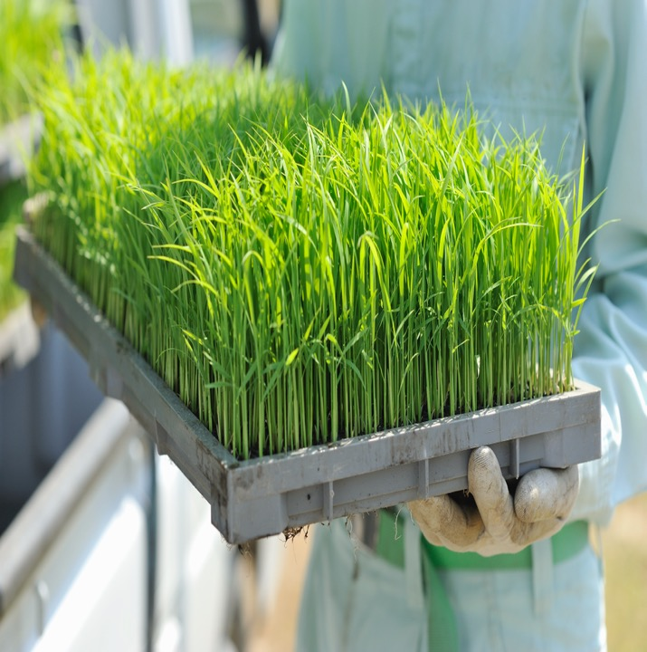
From the Classroom to the Farm
Cultural Control
Cultural control are practices that help the plant avoid contact with a pathogen
Some of them creates unfavorable environmental conditions for the pathogen or vectors
The logistic behind this practice is based on the disease triangle

Slide 14
From the Classroom to the Farm
Cultural Control
Many of these control practices depends on the grower
Some of them include:
Crop rotation
Tillage farming
Selecting proper plant dates and sites
Maintaining distance between the fields
Growing material tested for diseases
Removal of infected plants
Use of traps

Slide 15
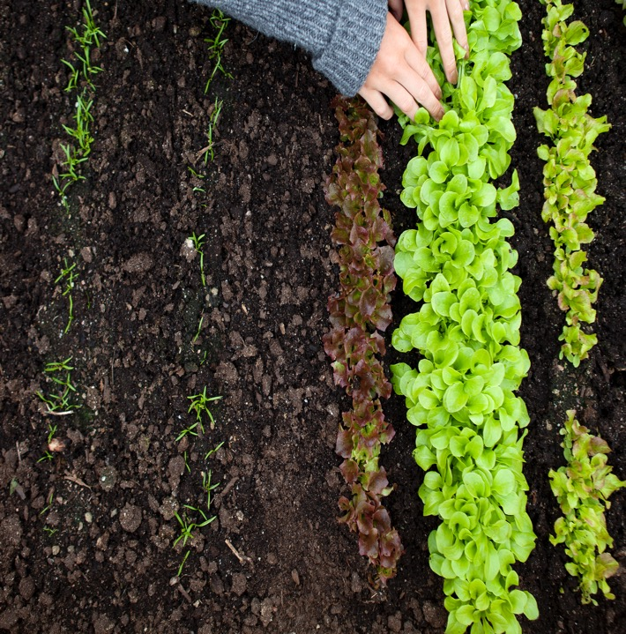
From the Classroom to the Farm
Crop Rotation
Crop rotation is a process of growing plant species that are not susceptible to the pathogen across a sequence of growing seasons
Benefits:
Improves soil quality
Prevent nutrient depletion
Prevents built up of disease
Improves production

Slide 16
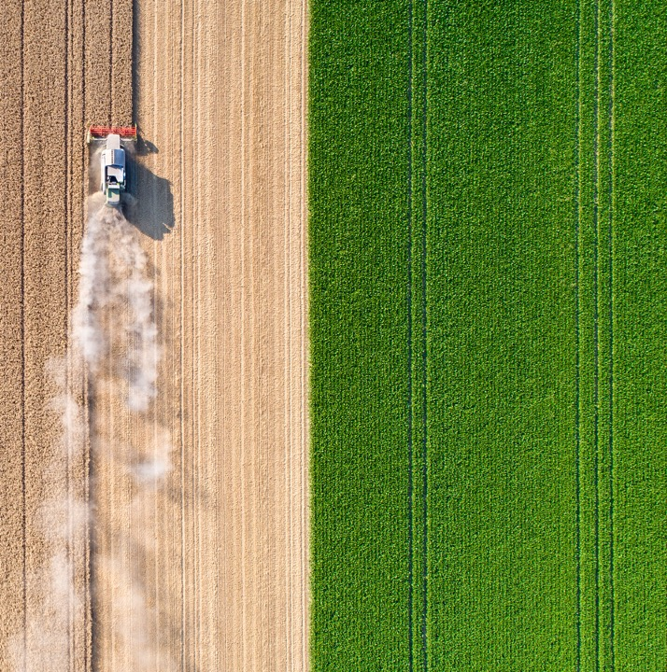
From the Classroom to the Farm
Tillage
Tillage is a process where the soil structure and properties are manipulated
Main goal: prepare the soil for seed planting and germination
Benefits:
Kills weeds
Manage crop residue
Destroy pathogen debris or inoculum
Reduce soil erosion
Improves soil health

Slide 17
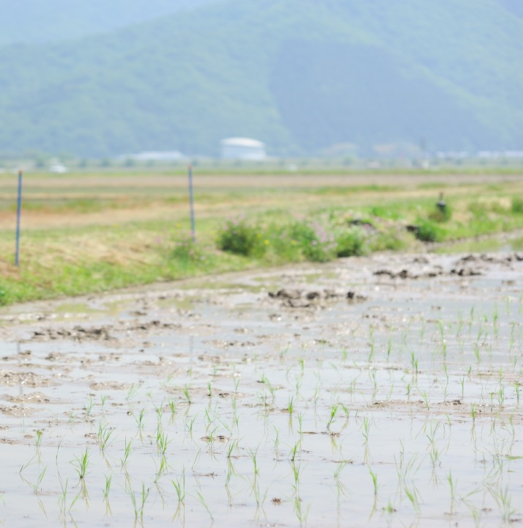
From the Classroom to the Farm
Physical Control
Physical control are practices that protect plants from inoculum
Physical practices depend on physical factors (heat/cold)
Some of them include:
Soil solarization
Radiation treatments
Hot-water treatments
Hot-air treatments
Refrigeration

Slide 18
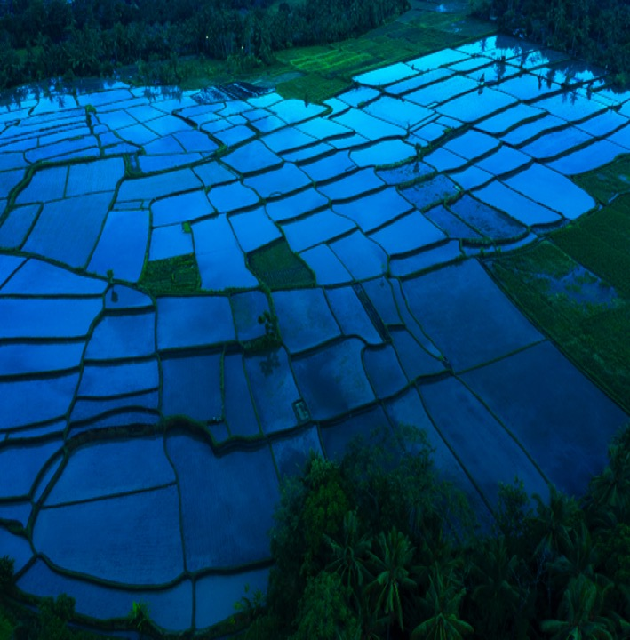
From the Classroom to the Farm
Soil Solarization
Soil solarization is a process that uses energy from the sun to eradicate the inoculum
Soil is covered with plastic traps that increase soil temperature and inactivate soil pathogens

Slide 19
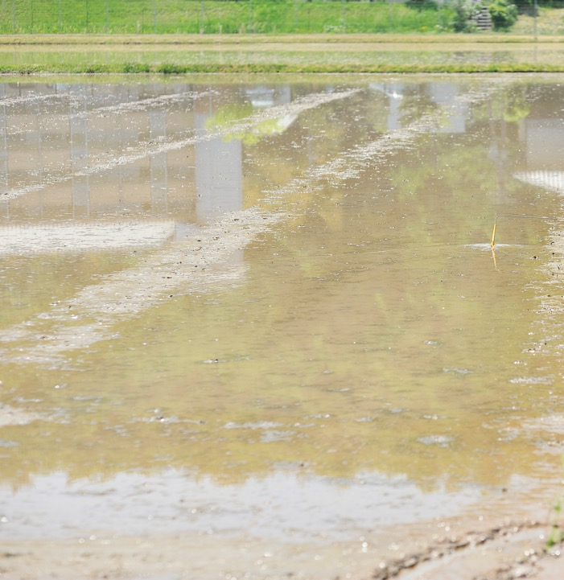
From the Classroom to the Farm
Hot-water Treatments
Hot-water treatment is a process where dormant plant organs are treated in hot water to kill pathogens
Dormant plant organs are known to withstand higher temperatures
Commonly used for seeds
Selection of temperatures must be based on the pathogens capacity to withstand those conditions

Slide 20
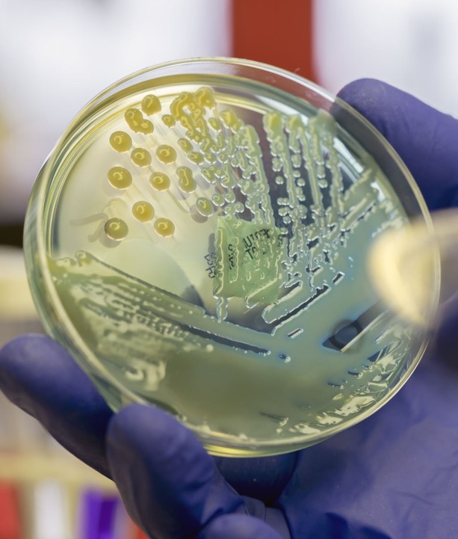
From the Classroom to the Farm
Biological Control
Biological control are practices that improve the resistance of the host or favor the activity of antagonistic microorganisms to the pathogen
Total or partial destruction of the pathogen by other organisms
Some of them include:
Antagonistic plants
Suppressive soils
Use of amendments that favors antagonistic microflora
Antagonistic microorganisms or their secondary products

Slide 21
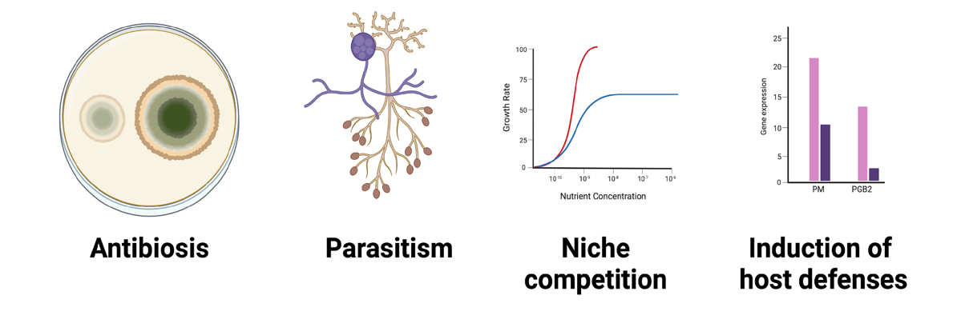
From the Classroom to the Farm
Mechanisms of Biological Controls

Slide 22
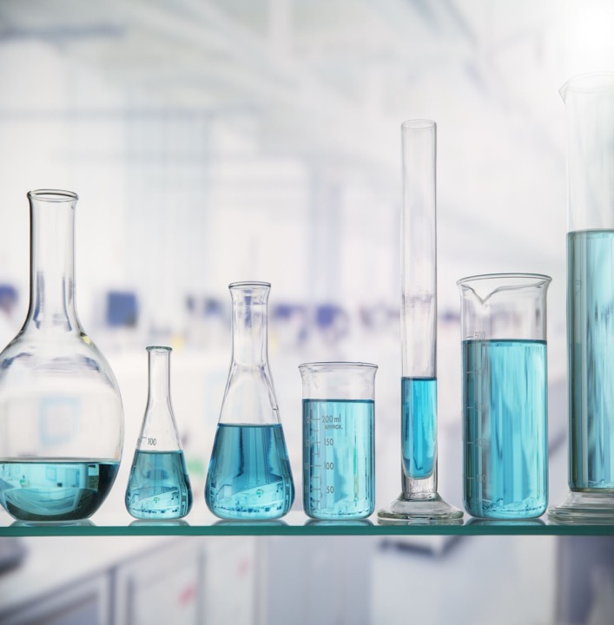
From the Classroom to the Farm
Chemical Control
Chemical control are practices that protect or cures infections in progress
Depends on the use and action of a chemical substance
Most of them work by activating the defenses of the plant against the pathogen
Some of them include:
Fumigation
Field Sanitation

Slide 23

From the Classroom to the Farm
Soil Fumigation
Soil fumigation is a process aimed at protecting the plants from the pathogen
Benefit: Controls a wide range of pathogens
Effects on soil microbial communities must be taken into consideration

Slide 24
References
From the Classroom to the Farm
Agrios, G. (2005). Plant Pathology. 5th edition. Editorial Elsevier Academic Press.
Burchett & Burchett (2018). Plant Pathology. 1st edition. Garland Science.
Schumann & D’Arcy (2009). Essential Plant Pathology. 2nd edition. American Phytopathological Society.
Singh (2017). Introduction to Principles of Plant Pathology. 5th edition. Medtech.

Slide 25
Glossary
From the Classroom to the Farm
Vector: living organism that carries and transmit a pathogen
Susceptible: at a risk of getting infected
Dormancy: state of reduced metabolic activity adopted by many organisms under conditions of environmental stress
Antagonism: in ecology, an association between organisms in which one benefits at the expense of the other
Antibiosis: production of chemical products by one organism to inhibit the other
Parasitism: when an organism lives on or within another organism and gains its sustenance from it
Niche: in ecology, all of the interactions of a species with the other members of its community, including competition, predation, parasitism, and mutualism
References: https://www.britannica.com/ & https://www.wikipedia.org/

