Slide 1
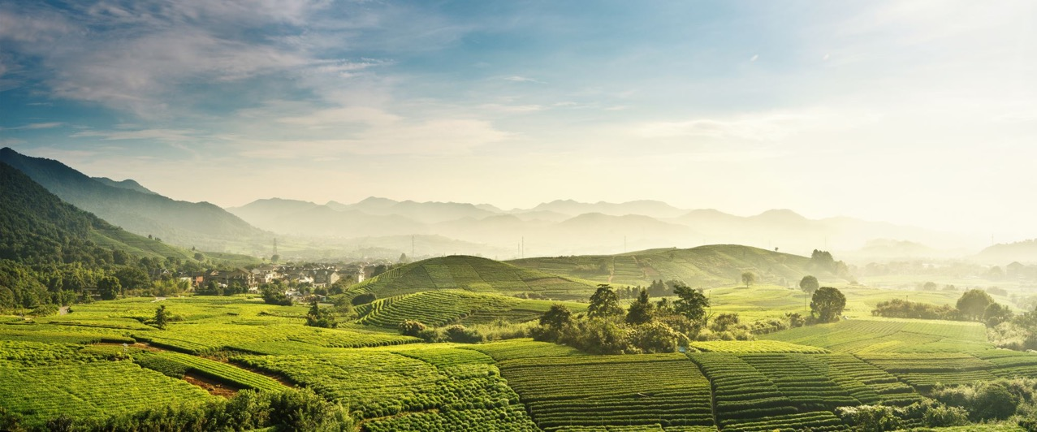

Diseases in Tropical Crops
Created by: Nicole Colón-Carrión
Revised by: Sofía Macchiavelli-Girón

Slide 2
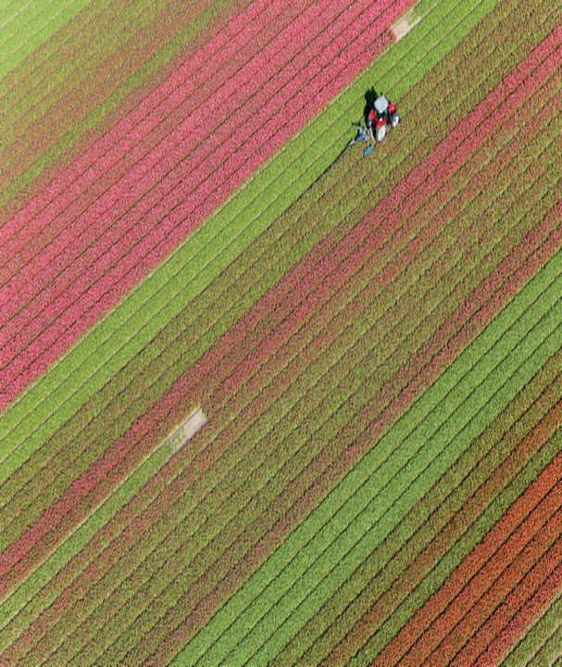

From the Classroom to the Farm
Session 1. Vegetables
Time: 40 minutes
Session 2. Fruits
Time: 1 hour & 10 minutes

Slide 3

From the Classroom to the Farm
Learning Goals
1. Describe disease in tropical crops
2. Learn about pathogen characteristics
3. Discuss detection methods

Slide 4
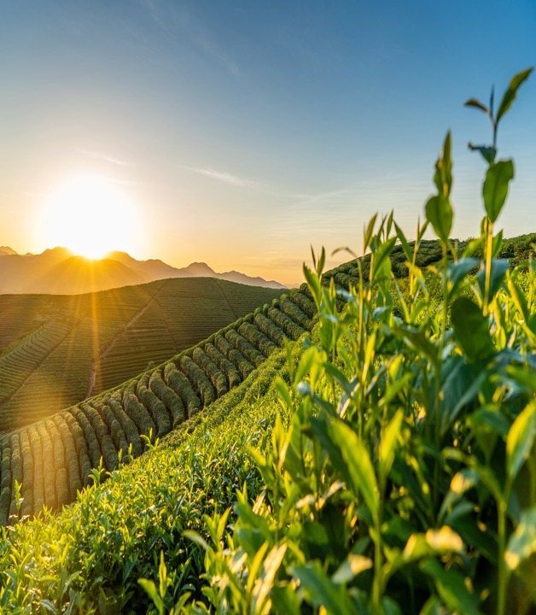
From the Classroom to the Farm
Tropical Agriculture
Tropical crops are crop plants grown in the tropics
This includes countries like Colombia, Costa Rica, Bahamas, Brazil, Ecuador, Puerto Rico, Thailand, and more
The environmental conditions in the tropics support diverse ecosystems and rich biodiversity, making it an excellent place for agricultural productivity

Slide 5
From the Classroom to the Farm
Tropical Agriculture
Tropical crops are diverse and are attacked by numerous pathogens and pests
Tropical crops focused on this presentation were selected based on a survey conducted among Puerto Rican farmers

Slide 6
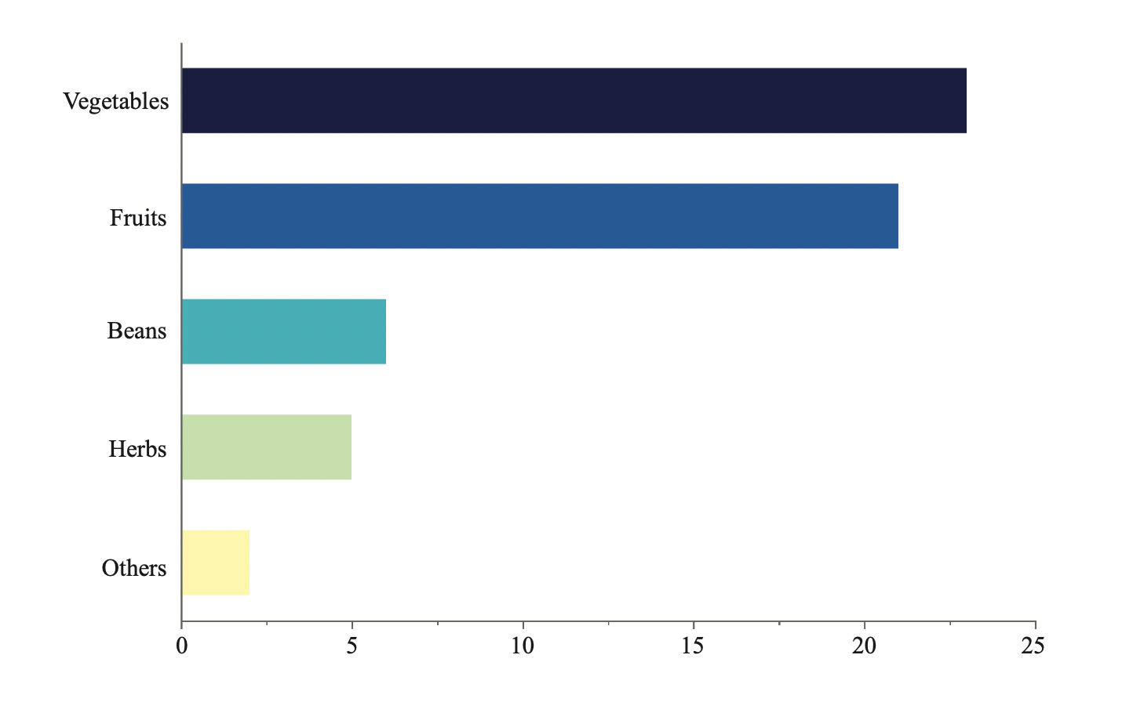
From the Classroom to the Farm
Main Crops Produce in Puerto Rico
As part of a study conducted by Colón-Carrión & Macchiavelli- Giron, 28 Puerto Rican farmers were asked to provide information regarding their agricultural practices and main problems faced, as well as main crops produced, in their farms

Slide 7

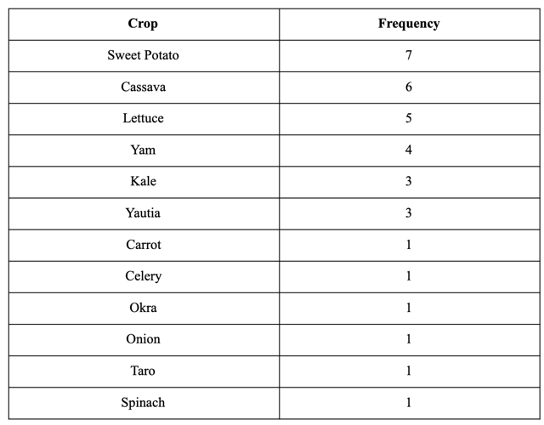
From the Classroom to the Farm
Main Crops Produce in Puerto Rico
Data: Colón-Carrión & Macchiavelli-Giron
This table represents the main crops produced by surveyed farmers in Puerto Rico. This data was used to select main crops and associated diseases to focus on the development of the lesson plan, and this presentation

Slide 8
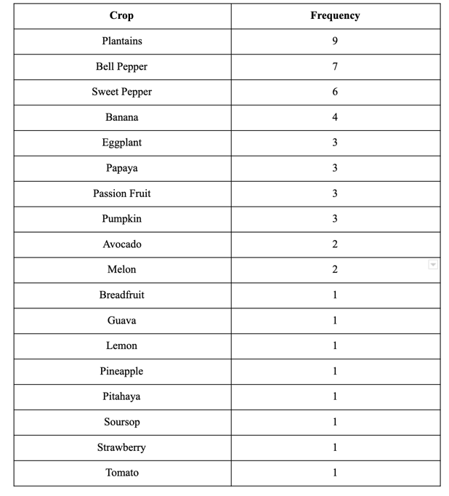
From the Classroom to the Farm
Main Crops Produce in Puerto Rico
Data: Colón-Carrión & Macchiavelli-Giron
This table represents the main crops produced by surveyed farmers in Puerto Rico. This data was used to select main crops and associated diseases to focus on the development of the lesson plan, and this presentation

Slide 9

Vegetables
Session 1

Slide 10
From the Classroom to the Farm
Sweet Potato
Scientific name: Ipomoea batatas
Perennial plant of the family Convolvulaceae
Cultivated for its edible tuberous root
Native to Tropical America
Numerous pathogens threaten its production

Slide 11
From the Classroom to the Farm
Black Rot
Caused by Ceratocystis fimbriata
Ceratocystis fimbriata have a wide host range and a large geographic distribution
Symptoms can be observed in the field and post-harvest
Field symptoms include wilting, stunting, leaf chlorosis, and leaf drop
Post-harvest causes a circular, brown/black spots on sweet potato root

Slide 12

From the Classroom to the Farm
Black Rot: Detection
Culture base isolation of the pathogen is necessary for morphological classification
Molecular identification can be accomplished by extracting DNA from a pure sample
Pathogenicity tests can also be used

Slide 13
From the Classroom to the Farm
Fusarium Wilt
Caused by Fusarium oxysporum f.sp. batatas
Soil-borne fungi
Can persist in the soil for long periods of time
Mostly present in subtropical regions of the world
The pathogen blocks the vascular system of the plant preventing the movement of water and nutrients
Causes symptoms such as wilting, leaf yellowing, and blackening of the vascular tissue

Slide 14
From the Classroom to the Farm
Fusarium Wilt: Detection
Initial symptoms can be perceived by a transverse section of the vascular tissue
Culture base isolation of the pathogen is necessary for morphological classification
Molecular identification can be accomplished by extracting DNA from a pure sample

Slide 15
From the Classroom to the Farm
Root Knot
Caused commonly by the root-knot nematode, Meloidogyne incognita
Can also be caused by other root-knot nematodes
Meloidogyne incognita has a broad host range
Commonly found in all sweet potato growing regions
Symptoms depend on the cultivar
Symptoms include the formation of galls, cracking of tubers, and blistering of the storage root. Can cause stunting, chlorosis, and death of the plants

Slide 16
From the Classroom to the Farm
Root Knot: Detection
Initial symptoms can be perceived through visual inspection of galls
Species detection requires a combination of morphological features and molecular identification
Biochemical methods are also used for the identification of a single young egg-laid

Slide 17
From the Classroom to the Farm
Leaf Curl
Caused by a virus belonging to the Begomovirus group
Scientific name: Sweetpotato leaf curl (SPLCV)
Worldwide distribution
Vector: whiteflies
Usual symptoms include vein swelling, yellowing, and upward curling of the leaves
Plants do not always show symptoms

Slide 18
From the Classroom to the Farm
Leaf Curl: Detection
Difficult to detect as plants do not always show symptoms
Detection through molecular identification

Slide 19
From the Classroom to the Farm
Cylas formicarius var. elegantulus
Weevil in the beetle family Brentidae
Also known as "piche de la batata"
Destructive pest of sweet potato
Present in most of the tropical and subtropical regions
Destruction can be caused by larvae and adult stage (both feed on the tubers)
Cause yellowing of the vines, cavities in the tuber, and a spongy and dark appearance of tubers
The taste of the tuber is affected (sour taste)

Slide 20
From the Classroom to the Farm
Cylas: Detection
Visual presence of the larvae
Species detection requires a combination of morphological features and molecular identification

Slide 21
From the Classroom to the Farm
Cassava
Scientific name: Manihot esculenta
Also referred to as Yuca
Woody shrub cultivated for its edible tuberous root
Originated from Latin America and propagated to Africa
Numerous pathogens threaten cassava production

Slide 22
From the Classroom to the Farm
Leaf-spot Disease
Caused by Cercospora caribaea
Also refer to as "mancha blanca" or white spot
Wide distribution
Causing numerous diseases of cultivated plants
Symptoms differ between cultivar
Symptoms include circular chlorotic areas and white lesions
Spores may become visible in the leaf

Slide 23
From the Classroom to the Farm
Leaf-spot Disease: Detection
Culture base isolation of the pathogen is necessary for morphological classification
Molecular identification can be accomplished by extracting DNA from a pure sample

Slide 24
Fruits
Session 2

Slide 25
From the Classroom to the Farm
Bell Peppers
Scientific name: Capsicum annuum
Produce fruits in different colors
Native to Mexico, Central America, and South America
Numerous pathogens threaten its production

Slide 26
From the Classroom to the Farm
Powdery Mildew
Caused by Leveillula taurica
Wide host range
Among the worst diseases for bell pepper
The disease takes around 21 days to develop symptoms
Infect only leaves
Symptoms include fluffy and white patches under the leaves

Slide 27
From the Classroom to the Farm
Powdery Mildew: Detection
Zip lock bag with a moist paper towel for two days
Culture based identification is needed
Detection through molecular identification

Slide 28
From the Classroom to the Farm
Bacterial Leaf Spot
Caused by Xanthomonas campestris pv. vesicatoria
Strains can be cultivar specific
Among the most destructive disease of peppers
Disease spread by water or farmer's activity
Symptoms differ based on cultivar
Symptoms include green to dark brown leaf and fruit spot, stem canker, and defoliation

Slide 29
From the Classroom to the Farm
Bacterial Leaf Spot: Detection
Culture base isolation of the pathogen is necessary for morphological classification
Molecular identification can be accomplished by extracting DNA from a pure sample

Slide 30
From the Classroom to the Farm
Mosaic Viruses
Multiple strains can lead to mosaic viruses
Around 35 viruses are known to affect pepper
Among the most destructive disease of peppers
Symptoms include stunting of the plant, clearing of leaf veins, wrinkling of the leaves, and malformation of the fruit
Severity of symptoms depends on the age of the plant

Slide 31
From the Classroom to the Farm
Mosaic Viruses: Detection
Detection is based on immunological test and pathogenicity tests
Visualization through electron microscopy

Slide 32
From the Classroom to the Farm
Plantains
Scientific name: Musa x paradisiaca
Major food staple in Africa, Central, and South America, and the Caribbean islands
They are boiled or fried when eaten and are an essential source of starch

Slide 33
From the Classroom to the Farm
Black Sigatoka
Caused by Mycosphaerella fijiensis
Present in all countries that grow Musa spp.
Reduce yield by 35-50%
Symptoms include chlorotic spots on the bottom leaf surface
It progresses to thin brown streaks and fusiform black streaking of the leaves

Slide 34
From the Classroom to the Farm
Black Sigatoka: Detection
Culture base isolation of the pathogen is necessary for morphological classification
Molecular identification can be accomplished by extracting DNA from a pure sample

Slide 35
From the Classroom to the Farm
Burrowing Nematode
Radopholus similis
Endoparasite of the roots
Cause loss in crop production between 20 and 100%
Symptoms include dark and necrotic lesions on the root system (roots and rhizome)
Above ground symptoms include stunted plant, reduction in the number and size of leaves, leaf yellowing, and premature defoliation

Slide 36
From the Classroom to the Farm
Burrowing Nematode: Detection
Species detection requires a combination of morphological features and molecular identification
Biochemical methods are also used for the identification of a single young egg-laid

Slide 37
References
From the Classroom to the Farm
Agrios, G. N. (2005). Introductory Plant Pathology. 5th ed. Academic Press, New York, NY.
Clark, C. A., Ferrin, D. M., & Holmes, G. J. (2105). Diseases of sweet potato (Ipomoea batatas [L.] Lam.). The American Phytopathological Society.https://www.apsnet.org/edcenter/resources/commonnames/Pages/Sweetpotato.aspx
Jones, D. R. (1997). Diseases of Banana and Plantain (Musa spp.). The American Phytopathological Society. https://www.apsnet.org/edcenter/resources/commonnames/Pages/BananaandPlantain.aspx
Lewis Ivey, M. L. (2015). Diseases of Pepper (Capsicum L.). The American Phytopathological Society. https://www.apsnet.org/edcenter/resources/commonnames/Pages/Pepper.aspx
Lozano, J. C., & Nolt, B. (1993). Diseases of Cassava (Manihot esculenta Crantz). The American Phytopathological Society. https://www.apsnet.org/edcenter/resources/commonnames/Pages/Cassava.aspx

Slide 38
Glossary
From the Classroom to the Farm
Perennial plant: plants that can live for three or more growing seasons
Chlorosis: is a yellowing of normally green leaves due to a lack of chlorophyll
Wilting: is the loss of rigidity of non-woody parts of plants
Vascular system: tissues that transport nutrients and fluids throughout the plant
Xylem: tissue that distributes water and dissolved minerals from the roots to the leaves
Phloem: tissue that carries food downward from the leaves to the roots
Tuber: specialized storage stem of certain seed plants
Spores: fungi reproductive cell
Strain: a genetic variant or subtype of a microorganism
Cultivar: is a type of plant that people have bred for desired traits
Necrosis: death of a circumscribed area of plant tissue as a result of disease or injury
Endoparasite: a parasite that lives inside its host
Transverse section: a section of a tissue made by cutting horizontally
References: https://www.britannica.com/ & https://www.wikipedia.org/

