Slide 1


Resources for Farmers
Created by: Nicole Colón-Carrión
Revised by: Sofía Macchiavelli-Girón

Slide 2


From the Classroom to the Farm
Goal
1. Explore resources available for the farmer’s local community in Puerto Rico

Slide 3
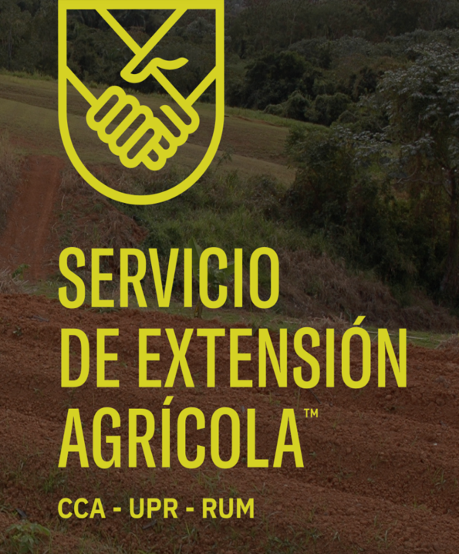
From the Classroom to the Farm
Extension Service – UPRM (SEA)
Organization that provided educational services to growers and stakeholders in Puerto Rico
Services are available throughout the whole island
Their team is composed of scientist, educators, and leader willing to assist farmers with their everyday needs
Site: uprm.edu/sea

Slide 4
From the Classroom to the Farm
Mision SEA
Improve the quality of life of people living in socio-economic vulnerability through participatory action through a process of non-formal education based on scientific research and focused on the aspirations and needs of families and communities

Slide 5
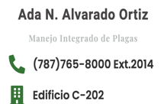
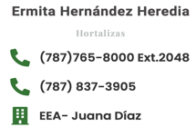
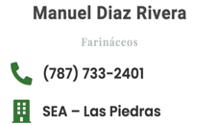
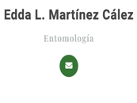
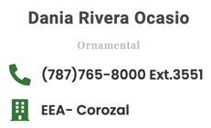
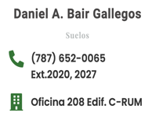
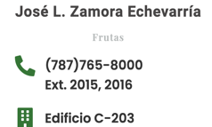
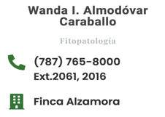
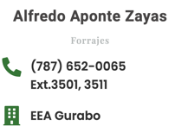
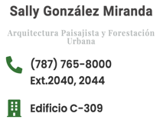
Agroenvironmental Sciences
From the Classroom to the Farm

Slide 6
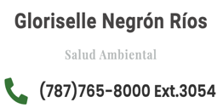
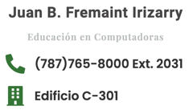
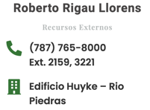
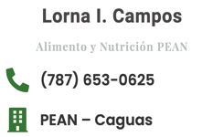
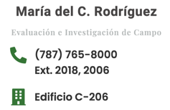
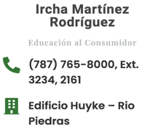
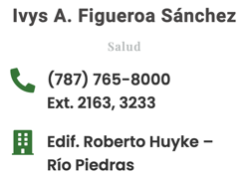
Agricultural Education
From the Classroom to the Farm

Slide 7
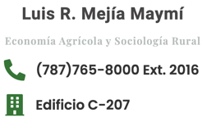
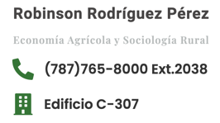
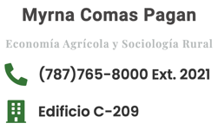
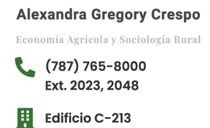
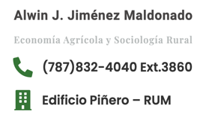
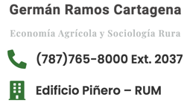
Agricultural Economics and Rural Sociology
From the Classroom to the Farm

Slide 8
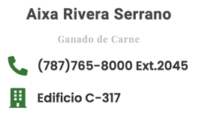
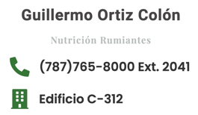
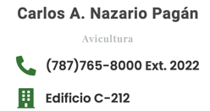
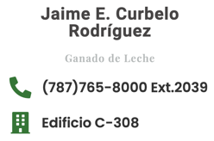
Animal Sciences
From the Classroom to the Farm

Slide 9
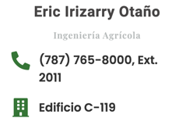
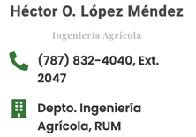
Agricultural Engineering
From the Classroom to the Farm

Slide 10
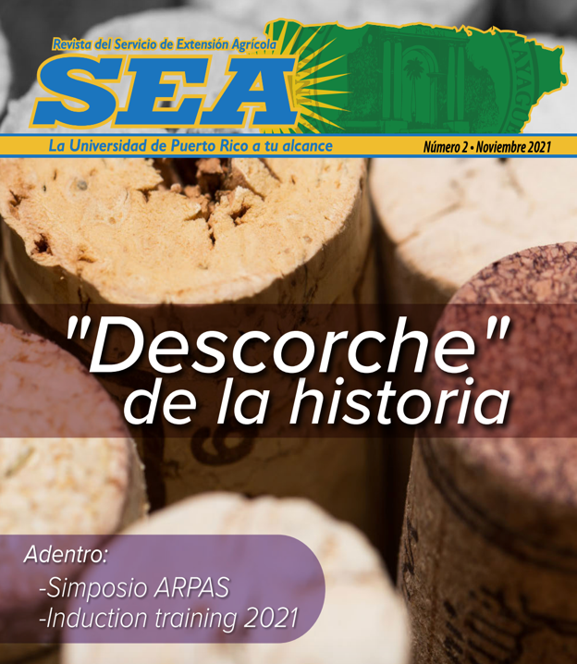
From the Classroom to the Farm
“Revista del Servicio de Extensión Agrícola”
Provides a newsletter with a wide variety of news and articles about the work carried out in the SEA and other relevant information for the general public
Each edition focuses on a particular topic

Slide 11
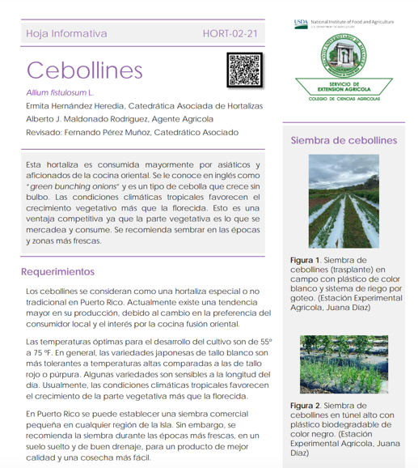
From the Classroom to the Farm
“Revista del Servicio de Extensión Agrícola”
SEA provides diverse educational material for farmers
Including Fact Sheets, Guides, and Manuals
Site: https://www.uprm.edu/sea/publicacion/a

Slide 12

From the Classroom to the Farm
American Phytopathological Society
International scientific organization devoted to the study of plant disease
The education section contains diverse educational material such as:
Case studies
Lab exercise
Information about pathogens
Information about diseases
Webinars

Slide 13
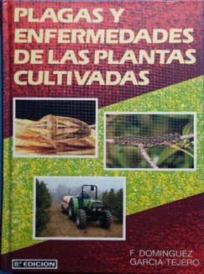
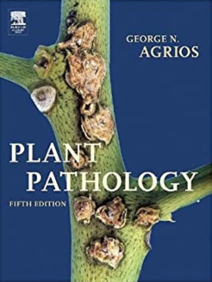
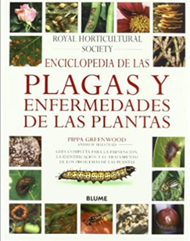
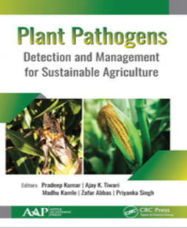
From the Classroom to the Farm
Books
Access to educational books may be restricted or may have a cost
Please check with the University of Puerto Rico Libraries for free access

Slide 14
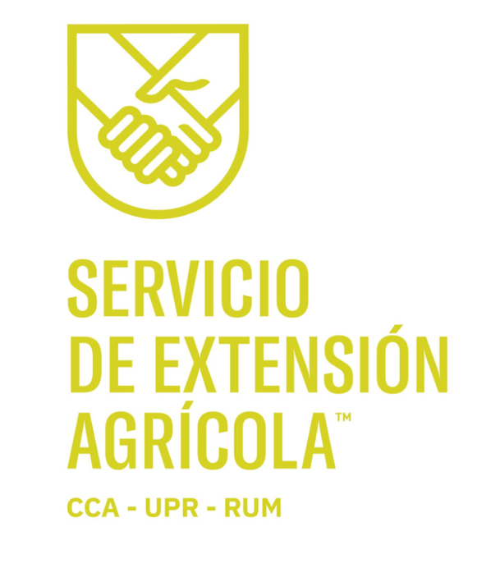
From the Classroom to the Farm
Plant Clinic
The University of Puerto Rico Mayaguez counts with a Plant Clinic that provides the community with information regarding plant diseases and management
FB Page: “Clinica de Enfermedades de Plantas UPRM”

Slide 15
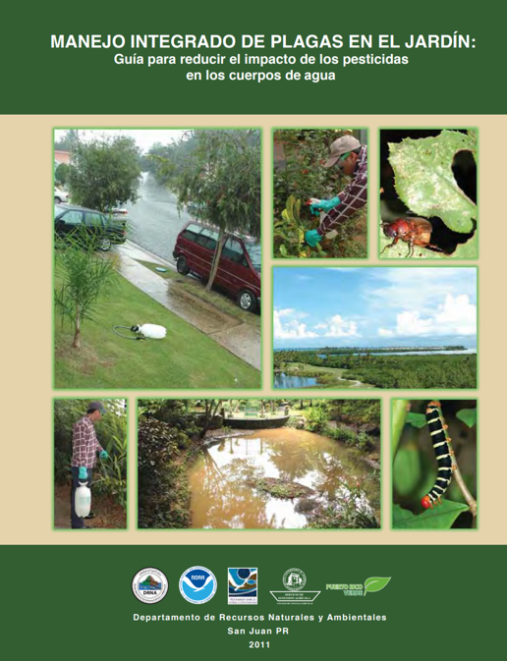
From the Classroom to the Farm
DRNA
The DRNA counts with useful information about sustainable agriculture, plant diseases, and management
Site: httpps://www.drna.pr.gov”

