Slide 1



Presented By:
Dr. Sofía Macchiavelli Girón
Dr. Nicole Colón Carrión
LIBCA
“Lideres Boicuas en Ciencias Agricolas” Introduction
August 2023

Slide 2


Table Of Content
01.
03.
05.
Who we are
Expectations & Rules
Investing in you
02.
04.
06.
What is “LIBCA”
2023-2024 Calendar
Q&A

Slide 3

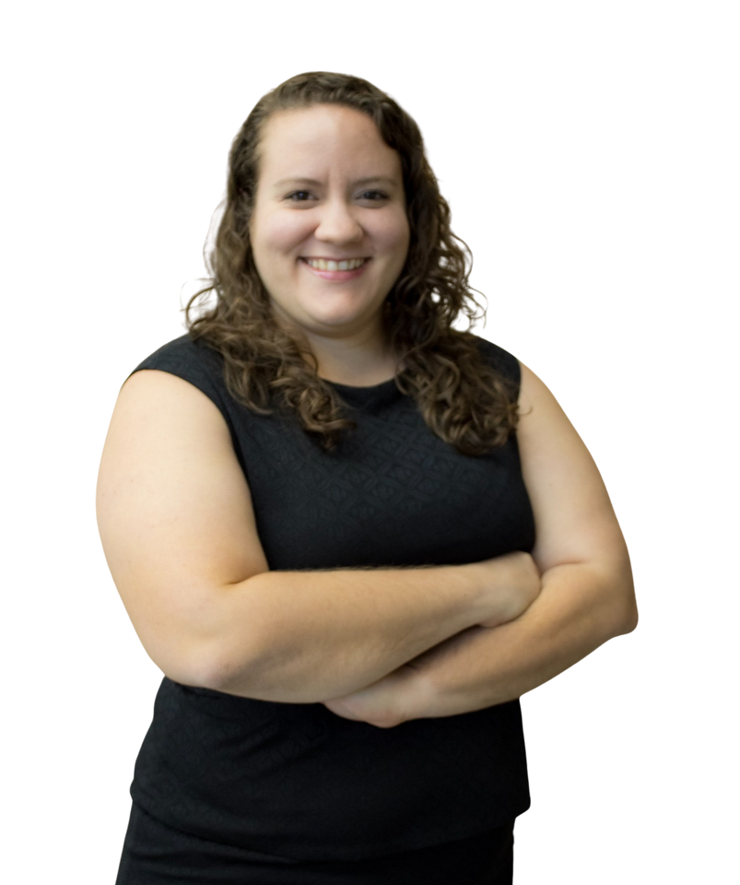

Sofía Macchiavelli Girón
Who We Are
I am from Mayagüez. I completed a bachelor's degree in Biology at the UPR-Mayagüez, where I did research with Dr. Dimuth Siritunga in the area of Plant Biotechnology. I then completed a PhD at the University of Wisconsin-Madison in Plant Pathology with Dr. Amanda Gevens, Potato and Vegetable Extension Specialist. I am an Agricultural Agent in the UPRM Agricultural Extension Service.

Slide 4
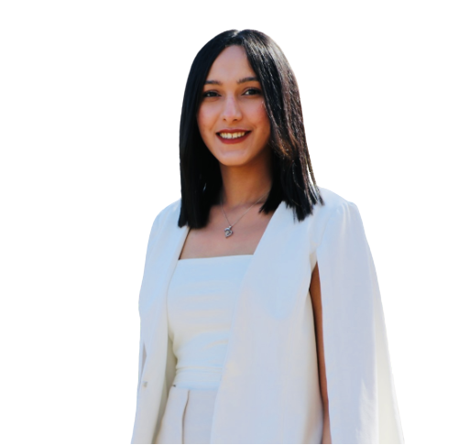
Nicole Colón Carrión
Who We Are
I was born and raised in Caguas, PR. I completed my bachelor's degree in Natural Sciences, with a concentration in Biology at the University of Puerto Rico in Cayey. I then joined the Post-baccalaureate Research Experience Program at Michigan State University where I worked in the area of Neurotoxicology. I earned my PhD from the University of Arizona in plant pathology with a certification in College education. In my thesis research I sought to understand how climate change affects the symbiotic relationships between endophytic fungi and plants, in tropical forests and agroecosystems. After my PhD, I worked as Researcher at Corteva Agrisciences identifying control products for soil-borne fungal pathogens. I am a Program Associate at Hispanic Access Foundation .

Slide 5


Let’s meet!
Ice Breaker Activity
Name
Degree/Specialization
Laboratory experience (if any)
What do you hope to learn in this program?
A hobby

Slide 6


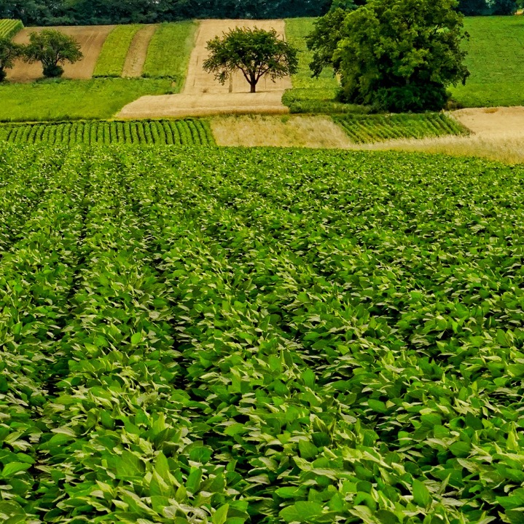


About LIBCA
“Lideres Boricuas en Ciencias Agricolas”
Why develop LIBCA?
About
a one-year leadership and professional development program for students pursing a bachelors in agricultural sciences at the University of Puerto Rico Mayagüez
“With the current challenges posed by climate change, now more than ever it is essential to develop leaders that can tackle these challenges and create innovative solutions towards sustainable agriculture. Through “LIBCA” we are providing students with leadership and professional development opportunities to succeed in the ag field and ensure food for future generations” - Nicole Colón Carrión
Vision
Cultivate a generation of resilient and innovative agricultural leaders equipped with the skills to tackle the challenges posed by climate change and drive sustainable growth in the agricultural sector.
Mission
Empower students with leadership and professional development skills through mentorship, networking, and experiential learning to become influential leaders in the agricultural field.

Slide 7

About LIBCA
“Lideres Boricuas en Ciencias Agricolas”
Why develop LIBCA?
What you are getting through “LIBCA”:
Workshop and mentorship surrounding:
Graduate School and Internship Applications
Development of Curriculum Vita and Resume
Introduction to Leadership Skills
Creation of an Individual Development Plan
LinkedIn Training
Agricultural Business
Fellowship Opportunities
Clifton Strengths
“LIBCA is important because it provides undergraduate students in ag sciences with vital skills, industry insights, and networking opportunities, cultivating a strong foundation for success and impactful careers in the field. Having gone through similar opportunities throughout my career, I firmly believe the exposure to the diverse array of possibilities awaiting students is vital for career success and overall satisfaction” - Sofía Macchiavelli Girón

Slide 8

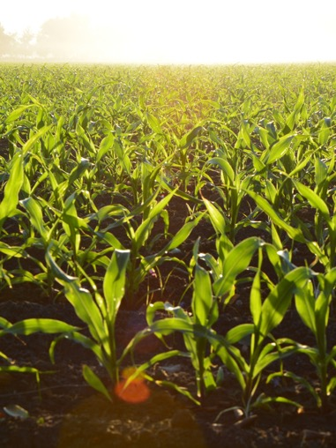
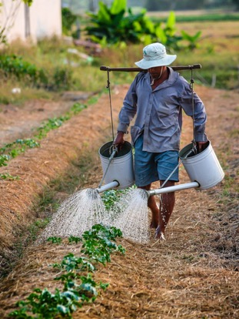

About LiBCA
What will it take from you?
1 workshop per month during the academic calendar
No workshops during the summer
All meetings will be at 10:30am
Duration of workshops: 1 hr
10 workshops total
No homework or assignments
Workshops will be held in a hybrid manner
For in-person workshops food will be provided
Workshops will be led by co-directors or invited speakers

Slide 9
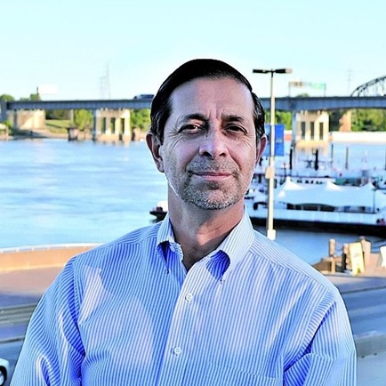
Founder
Dr. Emilio Oyarzabal
Dr. Emilio Oyarzabal, Argentinian scientist, provided the foundation for “LIBCA” with his mentoring program within the 2021 Plant Health Seismic Shifts in Disease Risk at the American Phytopathological Society annual meeting. This was a one-day workshop aimed at introducing underrepresented students to careers available in Plant Pathology and preparing them for networking events at the annual meeting. Three cohorts were organized to support 3 underrepresented communities and lead by diverse scientists: the Native American cohort, the Black/African American cohort, and the Hispanic cohort (led by Dr. Sofia Macchiaveli Girón and Dr. Nicole Colón Carrión). From this workshop a bigger vision was born. After 2 years of logistics and planning, the program was redesigned as a one-year leadership and professional development program targeting Puerto Rican students pursing a bachelors in agricultural sciences at Universidad de Puerto Rico (UPR) Mayagüez Campus. Emilio Oyarzábal has a degree in agricultural sciences from the University of Iowa and experience working at the Agricultural Experiment Station in Argentina and as Technical Development Manager for Monsanto. His motivation in university relations and student mentoring was born from the climate changes that we currently face and the need to find qualified people to solve them. Currently Dr. Oyarzabal is retired and sponsor of LiBCA.

Slide 10
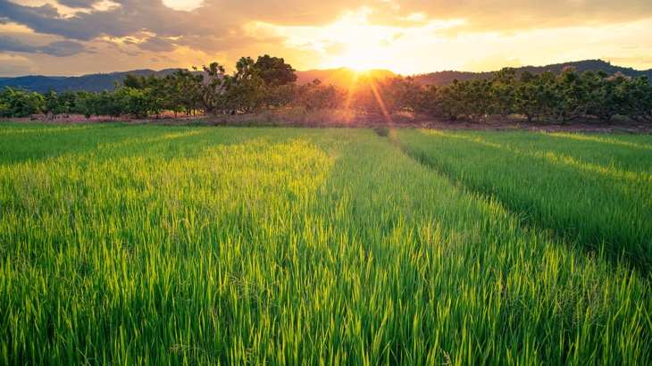
Attendance
01
Attendance to workshops throughout the year. If attendance can’t e met, please communicate with us and let us know.
Expectations & Rules
Participation
02
Active participation in workshops. This is design for you, get the most out of it!
Respect
03
Treat others with respect at all times.
Evaluations
04
Informal and formal evaluations will be held at the end of each semester. We expect students to provide us with feedback for improvement.

Slide 11
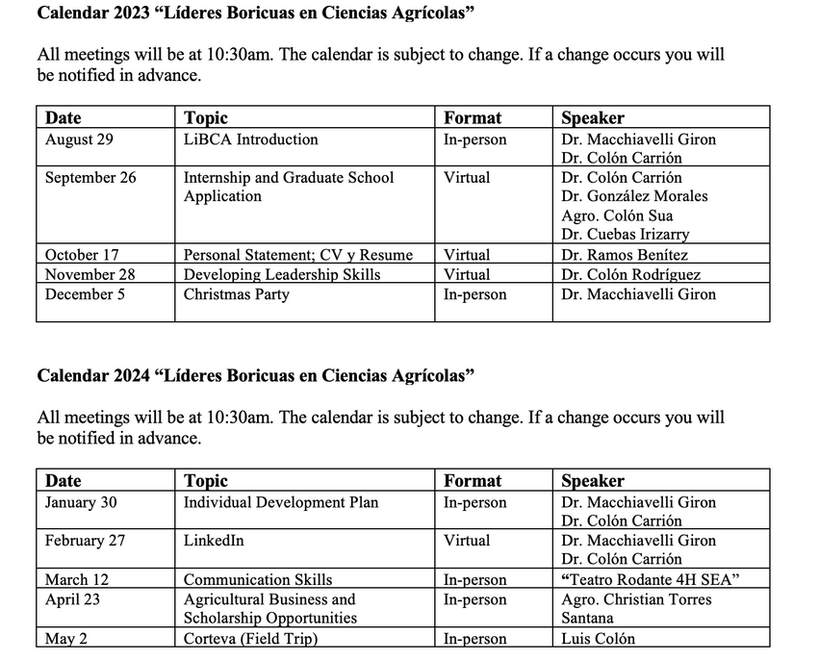
2023-2024
Calendar

Slide 12

Investing in you
Importance of professional development
Source: WebCE Online Education & Training

Slide 13
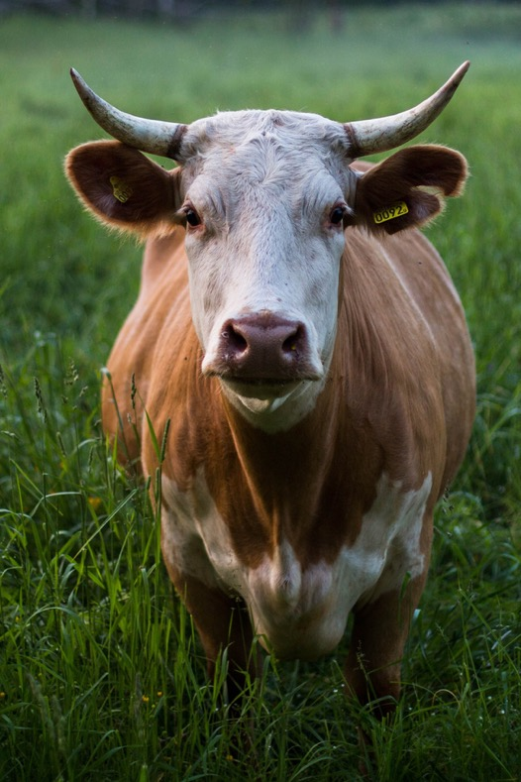
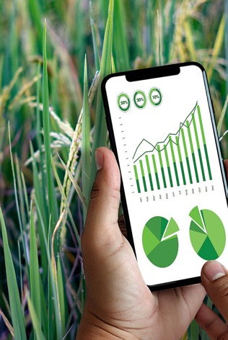

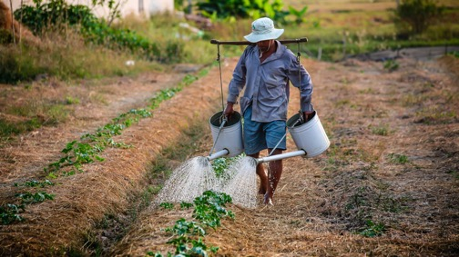
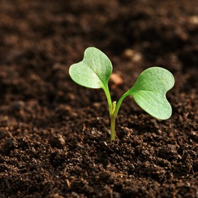
Q&A session

Slide 14
Presented By:
Dr. Sofía Macchiavelli Girón
Dr. Nicole Colón Carrión
LIBCA
“Lideres Boicuas en Ciencias Agricolas” Introduction

