Slide 1



Presented By:
Dr. Sofía Macchiavelli Girón
Dr. Nicole Colón Carrión
Guest Speakers:
Dr. González Morales
Agro. Colón Sua
Dr. Cuebas Irizarry
INTERNSHIP AND GRADUATE SCHOOL APPLICATION
September 2023

Slide 2

Table Of Content
Content List
01.
03.
About Internships
Graduate School Panel
02.
04.
How to Find Them
Guide Questions

Slide 3
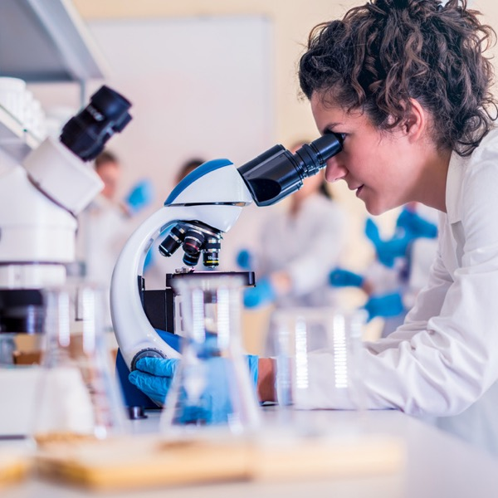


Research Internships
About
Summer Research Program (May-July)
Diverse programs
The program assigns you a laboratory and a mentor
The mentor develops an investigation on which you will work that summer
Benefits:
Hands-on research experience
Develop new research techniques
Expand your resume
1:1 mentoring

Slide 4

Research Internships
What the Program offers
Daily meals or money to cover them
Ticket to the institution
Transportation expenses
Stipend: $4,000-$5,000
Training opportunities

Slide 5

Research Internships
Application Materials Needed
Personal Statement
CV or Resume
Recommendation letters
Transcripts

Slide 6
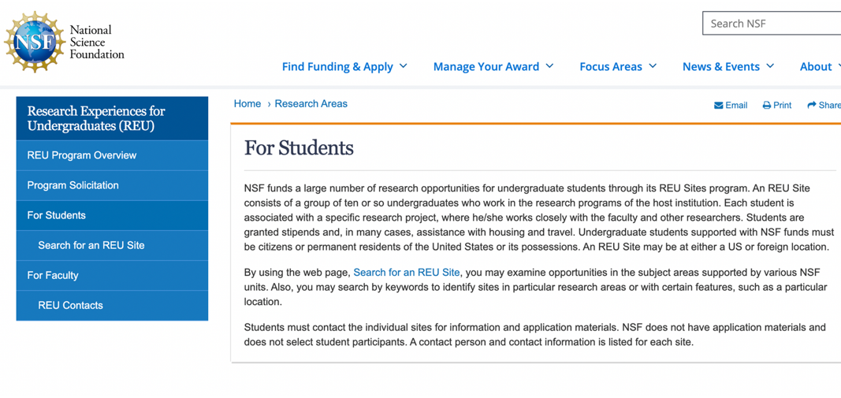
How to find them
1. Visit
https://www.nsf.gov/crssprgm/reu/

Slide 7
How to find them
2. Click at “Search for an REU Site”

Slide 8
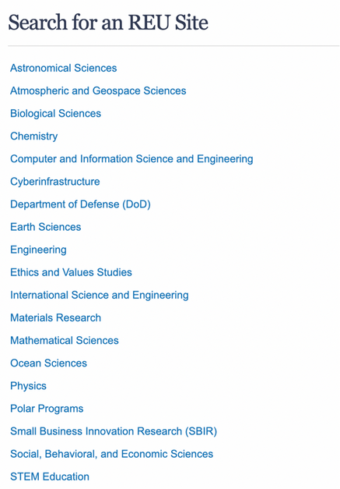
How to find them
3. Select Area of Interest

Slide 9
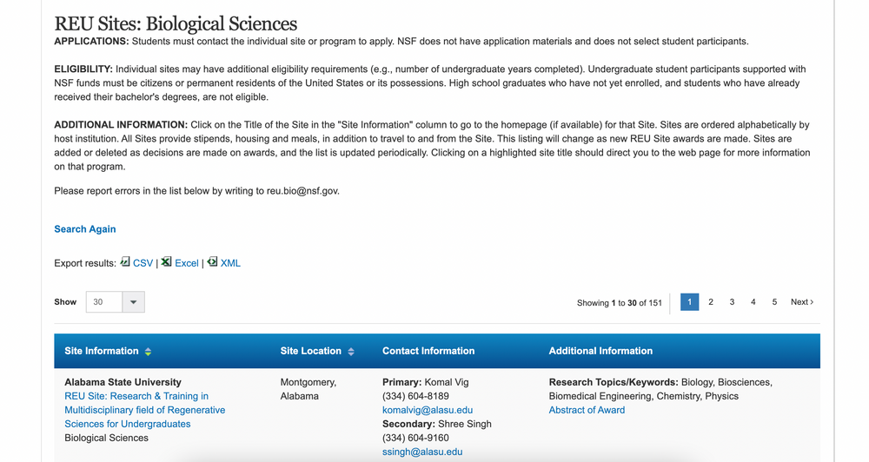
How to find them
4. Look for Program of Interest
A list of diverse programs within the field will appear. Information of university, location, contact, and program website will be provided.

Slide 10
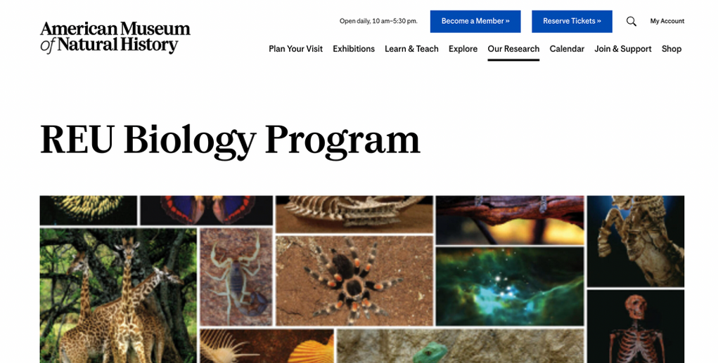
How to find them
5. Select Program of Interest and Visit Website
Look for information about program, application, and deadlines.

Slide 11
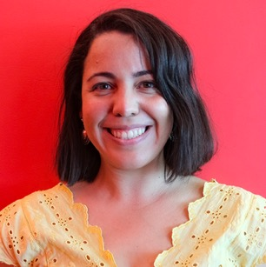
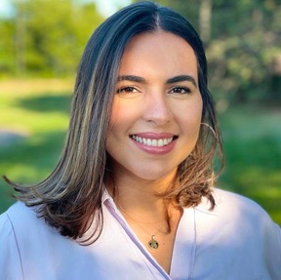
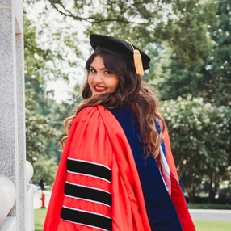
Graduate School Panel
Invited Speakers
DR. MARA CUEBAS IRRIZARY
GRETCHEN COLÓN SUAU
DR. MARIA GONZÁLEZ MORALES
ENVIRONMENTAL PROTECTION AGENCY
WESTERN KENTUCKY UNIVERSITY
DEFENSE CENTERS FOR PUBLIC HEALTH
PhD in Environmental Microbiology
MS in Animal Sciences
PhD in Urban Entomology

Slide 12

Guide Questions
Brief introduction of each speaker
What is graduated school?
Why choose to complete graduate studies?
What was your experience applying to graduate programs?
What documents did the programs require?
Once you applied, how was the selection process?
How did you choose the program and laboratory you wanted to work in?
What was your research project about?
What difficulties did you experience during your studies?
What advice can you give to students who are not sure about completing their graduate studies?
Is it necessary to complete graduate studies to be a professional in the agricultural field?

Slide 13
Presented By:
Dr. Sofía Macchiavelli Girón
Dr. Nicole Colón Carrión
Guest Speakers:
Dr. González Morales
Agro. Colón Sua
Dr. Cuebas Irizarry
INTERNSHIP AND GRADUATE SCHOOL APPLICATION
FEBRUARY 2023

