Slide 1
Adversarial Search

Slide 2
Toolbox so far
Uninformed search
BFS, DFS, uniform cost search
Heuristic search
A*
Common environmental factors: static, discrete, fully observable, deterministic actions.
Also: single agent, non-episodic.

Slide 3
There's More!
Add a second agent, but not controlled by us.
Assume this agent is our adversary.
Environment (for now)
Still static
Still discrete
Still fully observable (for now)
Still deterministic (for now)

Slide 4
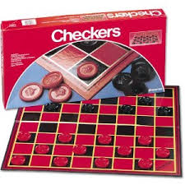
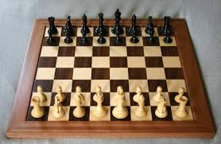
Games!
Deterministic, turn-taking, two-player, zero-sum games of perfect information.

Slide 5
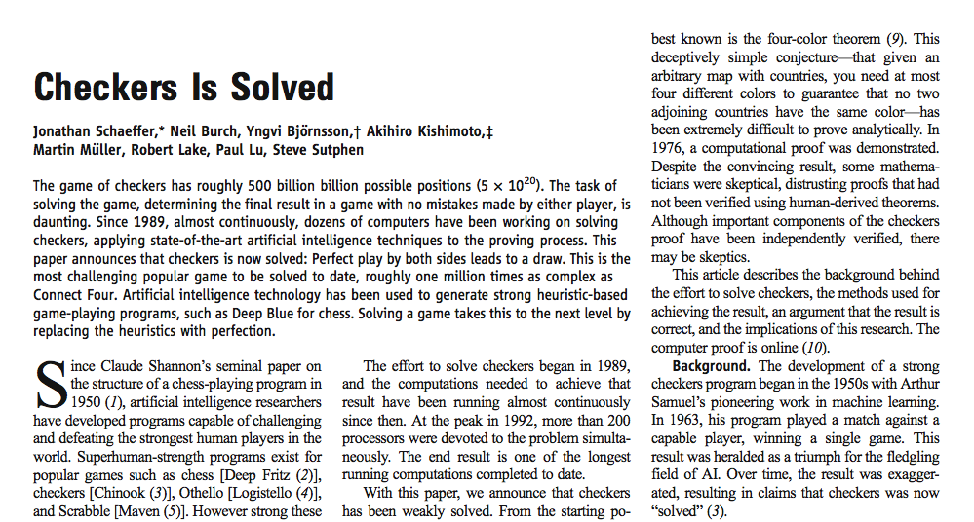
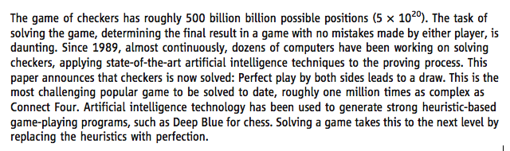
2007
Notes:
500 billion billion
2007

Slide 6
Adversarial search
Still search!
But another agent will alternate actions with us.
Main new concept:
Two players are called MAX and MIN.
Only works for zero-sum games.
Strictly competitive (no cooperation).
What is good for me is equally bad for my opponent (in regards to winning and losing).
Most “normal” 2-player games are zero-sum.

Slide 7
Most all of our concepts from state-space search transfer here.
S₀: initial state
TO-MOVE(s): Defines who makes the next move at a state.
ACTIONS(s): Returns the set of legal moves in a state.
RESULT(s, a): Returns what state you go into (transition model)
IS-TERMINAL(s): Returns true if s is a terminal state.
UTILITY(s, p): Numeric value of a terminal state s for player p.

Slide 8
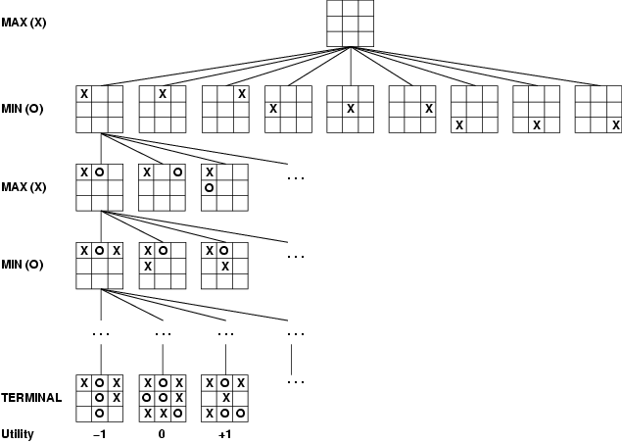
Game Tree

Slide 9
MAX
MIN
3 12 8 2 4 6 14 5 2
Notes:
best move is max should make the left-most move first. (gets you a 3).

Slide 10
Minimax algorithm
Select the best move for you, assuming your opponent is selecting the best move for themselves.
Works like DFS.

Slide 11
Minimax algorithm (assuming it is MAX's turn)
minimax(s) =
utility(s, MAX) if IS-TERMINAL(s)
max_{a in actions(s)} minimax(result(s, a)) if TO-MOVE(s)=MAX
min_{a in actions(s)} minimax(result(s, a)) if TO-MOVE(s)=MIN
result(s, a) means the new state generated by taking action a in state s.

Slide 12
MAX
MIN
3 12 8 2 4 6 14 5 2
minimax(s) =
utility(s, MAX) if IS-TERMINAL(s)
max_{a in actions(s)} minimax(result(s, a)) if TO-MOVE(s)=MAX
min_{a in actions(s)} minimax(result(s, a)) if TO-MOVE(s)=MIN

Slide 13
Properties of minimax
Complete?
Yes (assuming tree is finite)
Optimal?
Yes (assuming opponent is also optimal)
Time complexity: O(b^{m})
Space complexity: O(bm) (like DFS)
But for chess, b ≈ 35, m ≈ 100, so this time is completely infeasible!

Slide 14
Real-World Minimax
The minimax algorithm given here only stores the utility values; "real-world" minimax should store utility values and the move that gives you the value.
This is usually done by keeping an auxiliary data structure called a transposition table; this table also cuts down on search time.
Table stores, for every state, the minimax value and corresponding best move.

Slide 15
Nim

Slide 16
Nim
How to represent a state?
How to represent an action?

Slide 17
Problem: minimax takes too long.
Solution: improve algorithm to ignore parts of the tree that will definitely not be used (assuming both players play optimally).

Slide 18
MAX
MIN
3 12 8 2 4 6 14 5 2
Notes:
let's look at this example again...do "hand-wavy" steps of minimax, keeping track of back-up values with >= and <=. We know when we get to the middle node and see the "2" that we don't have to look at any other items at this MIN node, because it will never be selected.

Slide 19
MAX
>=3
MIN
3
<=2
3 12 8 2 4 6 14 5 2
Notes:
let's look at this example again...

Slide 20
Idea: for each node, keep track of the range of possible values that minimax could produce for that node.
If we ever find ourselves at a node that we know will never be selected during (optimal) game play, we can "prune" it (end the recursion on this part of the tree).
Enhanced version of minimax is called minimax with alpha-beta pruning.

Slide 21
Alpha-beta pruning
Recall that minimax is a variant of depth-first search. During the algorithm, we will only consider nodes along the path from the root node to the current node.
At each node in the search, we will maintain two variables:
alpha (α) = highest numeric value we’ve found so far on this path (best move for MAX)
beta (β) = lowest numeric value we’ve found so far on this path (best choice for MIN)

Slide 22
Alpha-beta pruning
Alpha and beta are inherited from parent nodes as we recursively descend the tree.
If at a MAX node, we see a child node that has a value >= than beta, short-circuit.
If at a MIN node, we see a child node that has a value <= than alpha, short-circuit.

Slide 23
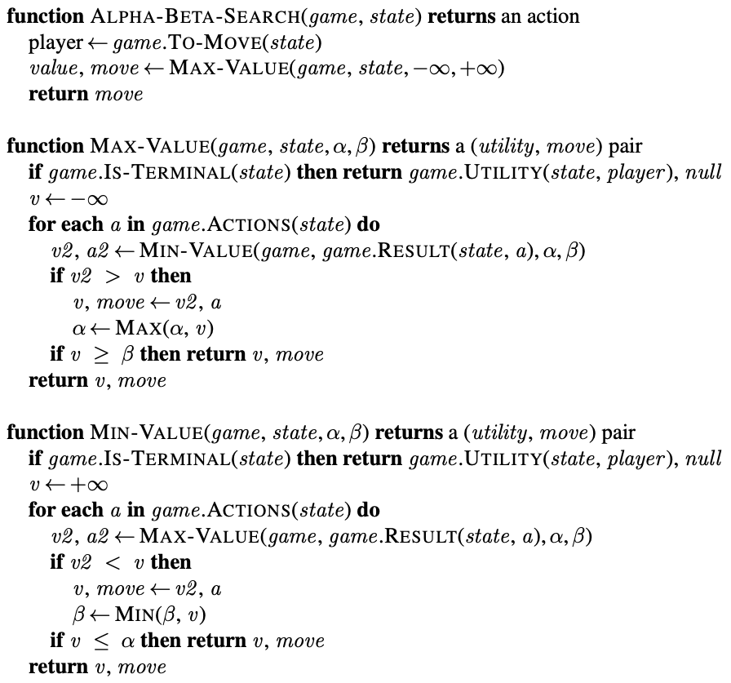

Slide 24
MAX
MIN
3 12 8 2 4 6 14 5 2
Notes:
let's look at this example again...do "hand-wavy" steps of minimax, keeping track of back-up values with >= and <=. We know when we get to the middle node and see the "2" that we don't have to look at any other items at this MIN node, because it will never be selected.

Slide 25
Alpha-beta code
For programming, use code in the book.
For offline use, use this idea:
alpha-beta(node):
inherit alpha & beta from parents
let v be each child value in turn:
if v >= beta, then short-circuit and return v else if v > alpha, then alpha = v (and continue) if v <= alpha, then short-circuit and return v else if v < beta, then beta = v (and continue)
if MAX, return alpha; if MIN, return beta (to parent)
Do either the red or the blue for each state (not both).
If at a MAX node:
If at a MIN node:

Slide 26
The results of alpha-beta depend on the order in which moves are considered among the children of a node.
If possible, consider better moves first!

Slide 28
Real-world use of alpha-beta
(Regular) minimax is normally run as a preprocessing step to find the optimal move from every possible situation.
Minimax with alpha-beta can be run as a preprocessing step, but might have to re-run during play if a non-optimal move is chosen.
Save states somewhere so if we re-encounter them, we don't have to recalculate everything.

Slide 29
Real-world use of alpha-beta
States get repeated in the game tree because of transpositions.
When you discover a best move in minimax or alpha-beta, save it in a lookup table (probably a hash table).
Called a transposition table.

Slide 30


Slide 31
Real-world use of alpha-beta
In the real-world, alpha-beta does not "pre-generate" the game tree.
The whole point of alpha-beta is to not have to generate all the nodes.
The DFS part of minimax/alpha-beta is what generates the tree.

Slide 32
Summary so far
Minimax: Find the best move for each player, assuming the other player plays perfectly.
Based on DFS; searches the whole game tree.
Usually used as a preprocessing step (too slow for real time).
Alpha-beta: Always gives same result as minimax, but prunes sub-optimal branches.
Can be used to preprocess game tree, but sub-optimal moves will necessitate rerunning.
Can be used in real time, but often still too slow.

Slide 33
Improving on alpha-beta
Alpha-beta still must search down to terminal nodes sometimes.
(and minimax has to search to terminal nodes all the time!)
Improvement idea: can we get away with only looking a few moves ahead?

Slide 34
Heuristic minimax algorithm
minimax(s) =
utility(s, MAX) if is-terminal(s)
max_{a in actions(s)} minimax(result(s, a)) if to-move(s)=MAX
min_{a in actions(s)} minimax(result(s, a)) if to-move(s)=MIN
REGULAR MINIMAX
h-minimax(s, d) =
eval(s, MAX) if is-cutoff(s, d)
max_{a in actions(s)} h-minimax(result(s, a), d+1) if to-move(s)=MAX
min_{a in actions(s)} h-minimax(result(s, a), d+1) if to-move(s)=MIN
HEURISTIC MINIMAX
result(s, a) means the new state generated by taking action a in state s.
is-cutoff(s, d) is a boolean test that determines whether we should stop the search and evaluate our position.

Slide 35
How to create a good evaluation function?
Trying to judge the probability of winning from a given state.
Typically use features: simple characteristics of the game that correlate well with the probability of winning.

Slide 36
One last point
O | O | O
X | X | X
MAX
O | O | O
X | X | X | X
O | O | O
X | X | X |  | X
MIN
utility=1
MAX
O | O | O
X | X | X | O | X
O | O | O |  | O
X | X | X |  | X
etc…
O | O | O |  | O
X | X | X | X | X
utility=1

Slide 37
What if a game has a “chance element”?

Slide 38
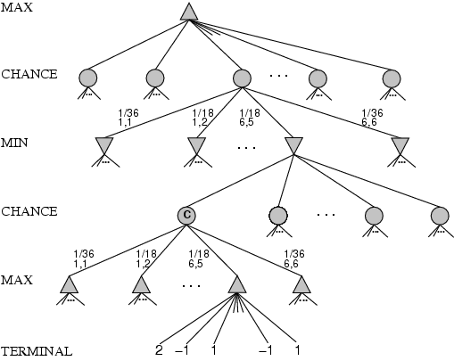
What if a game has a “chance element”?
We know how to value the other nodes. How do we value chance nodes?

Slide 39
Expected value
The sum of the probability of each possible outcome multiplied by its value:
x_{i} is a possible value of (random variable) X.
p_{i} is the probability of x_{i} happening.

Slide 40
Expected minimax value
Now three different cases to evaluate, rather than just two.
MAX
MIN
CHANCE
EXPECTED-MINIMAX-VALUE(n) =
UTILITY(n), If terminal node
max_{s ∈ successors(n)} MINIMAX-VALUE(s), If MAX node
min_{s ∈ successors(n)} MINIMAX-VALUE(s), If MIN node
∑_{s ∈ successors(n)} P(s) • EXPECTEDMINIMAX(s), If CHANCE node

Slide 41
3 17 2 12 15 25 0 2 5 3 2 14

