Slide 1
Markov Chains

Slide 2
Toolbox
Search: uninformed/heuristic
Adversarial search
Probability
Bayes nets
Naive Bayes classifiers
Statistical inference

Slide 3
Reasoning over time
In a Bayes net, each random variable (node) takes on one specific value.
Good for modeling static situations.
What if we need to model a situation that is changing over time?

Slide 4
Example: Comcast
In 2004 and 2007, Comcast had the worst customer satisfaction rating of any company or gov't agency, including the IRS.
I have cable internet service from Comcast, and sometimes my router goes down. If the router is online, it will be online the next day with prob=0.8. If it's offline, it will be offline the next day with prob=0.4.
How do we model the probability that my router will be online/offline tomorrow? In 2 days?

Slide 5
Example: Waiting in line
You go to the Apple Store to buy the latest iPhone. Every minute, the first person in line is served with prob=0.5.
Every minute, a new person joins the line with probability
1 if the line length=0
2/3 if the line length=1
1/3 if the line length=2
0 if the line length=3
How do we model what the line will look like in 1 minute? In 5 minutes?

Slide 6
Markov Chains
A Markov chain is a type of Bayes net with a potentially infinite number of variables (nodes).
Each variable describes the state of the system at a given point in time (t).
X₀
X₁
X₂
X₃

Slide 7
Markov Chains
Markov property: P(X_{t} | X_{t-1}, X_{t-2}, X_{t-3}, …) = P(X_{t} | X_{t-1})
Probabilities for each transition are identical: P(X_{t} | X_{t-1}) = P(X₁ | X₀)
X₀
X₁
X₂
X₃

Slide 8
Markov Chains
Since these are just Bayes nets, we can use standard Bayes net ideas.
Shortcut notation: X_{i:j} will refer to all variables X_{i} through X_{j}, inclusive.
Common questions:
What is the probability of a specific event happening in the future?
What is the probability of a specific sequence of events happening in the future?

Slide 9
An alternate formulation
We have a set of states, S.
The Markov chain is always in exactly one state at any given time t.
The chain transitions to a new state at each time t+1 based only on the current state at time t.
p_{ij} = P(X_{t+1} = j | X_{t} = i)
Chain must specify p_{ij} for all i and j, and starting probabilities for P(X₀ = j) for all j.

Slide 10
Two different representations
As a Bayes net:
As a state transition diagram (similar to a DFA/NFA):
X₀
X₁
X₂
X₃
S2
S1
S3

Slide 11
Formulate Comcast in both ways
I have cable internet service from Comcast, and sometimes my router goes down. If the router is online, it will be online the next day with prob=0.8. If it's offline, it will be offline the next day with prob=0.4.
Let’s draw this situation in both ways.
Assume on day 0, probability of router being down is 0.5.

Slide 12
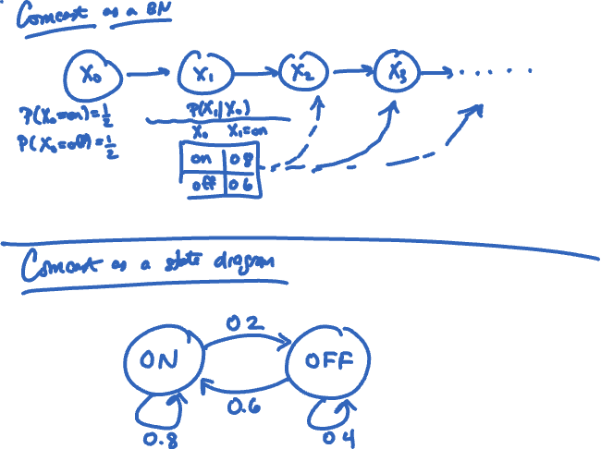

Slide 13
Comcast
What is the probability my router is offline for 3 days in a row (days 0, 1, and 2)?
P(X₂=off, X₁=off, X₀=off)?
P(X₂=off|X₀=off, X₁=off)*P(X₀=off, X₁=off) [mult rule]
P(X₂=off|X₀=off, X₁=off)*P(X₁=off|X₀=off)*P(X₀=off)
P(X₂=off|X₁=off)*P(X₁=off|X₀=off)*P(X₀=off)
p_{off,off} * p_{off,off} * P(X₀=off)
Notes:
P(x_{0:t}) = P(x_0)\prod_{i=1}^tP(x_i \mid x_{i-1})
0.5 * 0.4 * 0.4

Slide 14
More Comcast
Suppose I don’t know if my router is online right now (day 0). What is the prob it is offline tomorrow?
P(X₁=off)
P(X₁=off) = P(X₁=off, X₀=on) + P(X₁=off, X₀=off)
P(X₁=off) = P(X₁=off|X₀=on) * P(X₀=on)
+ P(X₁=off|X₀=off) * P(X₀=off)

Slide 15
More Comcast
Suppose I don’t know if my router is online right now (day 0). What is the prob it is offline the day after tomorrow?
P(X₂=off)
P(X₂=off) = P(X₂=off, X₁=on) + P(X₂=off, X₁=off)
P(X₂=off) = P(X₂=off|X₁=on) * P(X₁=on)
+ P(X₂=off|X₁=off) * P(X₁=off)

Slide 16
Markov chains with matrices
Define a transition matrix for the chain:
Each row of the matrix represents the transition probabilities leaving a state; each column represents the next state.
Let v_{t} = a row vector representing the probability that the chain is in each state at time t.
v_{t} = v_{t-1} * T
Notes:
For example, here the probability that state 1 goes to state 1 is .8
Do stock market example.
P(up|up)=.7
P(up|down)=.4

Slide 17
Formulate this matrix
If the stock market is up one day, then it will be up the next day with prob=0.7.
If it's down one day, it will be down the next day with prob=0.4.
Notes:
Do stock market example.
P(up|up)=.7
P(up|down)=.4

Slide 18
Mini-forward algorithm
Suppose we are given the value of X_{t} or a probability distribution over X_{t} and we want to predict X_{t+1}, X_{t+2}, X_{t+3}...
Make row vector v_{t} = P(X_{t})
Note that v_{t} can be something like [1, 0] if you know the true value of X_{t}, or it can be a distribution over values.
v_{t+1} = v_{t} * T
v_{t+2} = v_{t+1} * T = v_{t} * T * T = v_{t} * T²
v_{t+3} = v_{t} * T³
v_{t+n} = v_{t} * T ^{n}

Slide 19
Back to the Apple Store...
You go to the Apple Store to buy the latest iPhone.
Every minute, a new person joins the line with probability
1 if the line length=0
2/3 if the line length=1
1/3 if the line length=2
0 if the line length=3
Immediately after (in the same minute), the first person is helped with prob = 0.5
Model this as a Markov chain, assuming the line starts empty. Draw the state transition diagram.
What is T? What is v₀?

Slide 20
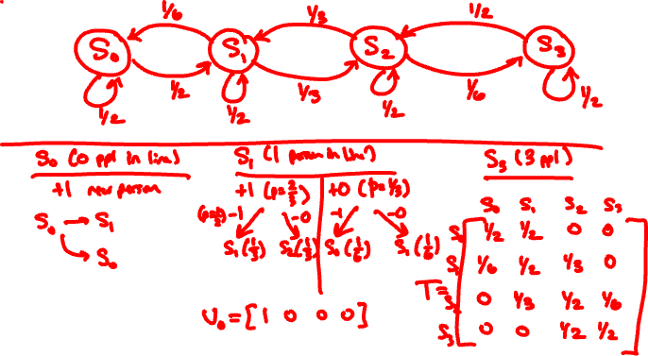
Every minute, a new person joins the line with probability
1 if the line length=0
2/3 if the line length=1
1/3 if the line length=2
0 if the line length=3
Immediately after (in the same minute), the first person is helped with prob = 0.5.

Slide 21
Every minute, a new person joins the line with probability
1 if the line length=0
2/3 if the line length=1
1/3 if the line length=2
0 if the line length=3
Immediately after (in the same minute), the first person is helped with prob = 0.5.

Slide 22
Markov chains are pretty easy!
But sometimes they aren't realistic…
What if we can't directly know the states of the model, but we can see some indirect evidence resulting from the states?

Slide 23
Weather
Regular Markov chain
Each day the weather is rainy or sunny.
P(X_{t} = rain | X_{t-1} = rain) = 0.7
P(X_{t} = sunny| X_{t-1} = sunny) = 0.9
Twist:
Suppose you work in an office with no windows. All you can observe is weather your colleague brings their umbrella to work.

Slide 24
Hidden Markov Models
X₀
X₁
X₂
X₃
E₁
E₂
E₃
The X's are the state variables (never directly observed).
The E's are evidence variables.

Slide 25
Common real-world uses
Speech processing:
Observations are sounds, states are words or phonemes.
Localization:
Observations are inputs from video cameras or microphones, state is the actual location.
Video processing (example):
Extracting a human walking from each video frame. Observations are the frames, states are the positions of the legs.

Slide 26
Hidden Markov Models
X₀
X₁
X₂
X₃
E₁
E₂
E₃
P(X_{t} | X_{t-1}, X_{t-2}, X_{t-3}, …) = P(X_{t} | X_{t-1})
P(X_{t} | X_{t-1}) = P(X₁ | X₀)
P(E_{t} | X_{0:t}, E_{0:t-1}) = P(E_{t} | X_{t})
P(E_{t} | X_{t}) = P(E₁ | X₁)

Slide 27
Hidden Markov Models
X₀
X₁
X₂
X₃
E₁
E₂
E₃
What is P(X_{0:t}, E_{1:t})?
Notes:
USE BAYES NET def'n of probability.
P(X_0) \prod_{i=1}^t P(X_i \mid X_{i-1})P(E_i \mid X_i)

Slide 28
Common questions
Filtering: Given a sequence of observations, what is the most probable current state?
Compute P(X_{t} | e_{1:t})
Prediction: Given a sequence of observations, what is the most probable future state?
Compute P(X_{t+k} | e_{1:t}) for some k > 0
Smoothing: Given a sequence of observations, what is the most probable past state?
Compute P(X_{k} | e_{1:t}) for some k < t

Slide 29
Common questions
Most likely explanation: Given a sequence of observations, what is the most probable sequence of states?
Compute
Learning: How can we estimate the transition and sensor models from real-world data? (Future machine learning class?)
Notes:
\argmax_{x_{1:t}} P(x_{1:t} \mid e_{1:t})

Slide 30
Hidden Markov Models
R₀
R₁
R₂
R₃
U₁
U₂
U₃
P(R_{t} = yes | R_{t-1} = yes) = 0.7 P(R_{t} = yes | R_{t-1} = no) = 0.1
P(U_{t} = yes | R_{t} = yes) = 0.9 P(U_{t} = yes | R_{t} = no) = 0.2

Slide 31
Filtering
Filtering is concerned with finding the most probable "current" state from a sequence of evidence.
Let's compute this.

Slide 32
Recall the "mini-forward algorithm"
For Markov chains:
with matrices: v_{t+1} = v_{t} * T, with v₀ = P(X₀)
For HMM's:

Slide 33
Forward algorithm
Recursive computation of the probability distribution over current states.
Say we have P(X_{t} | e_{1:t})
Notes:
P(X_{t+1} \mid e_{1:t+1}) =
\alpha P(e_{t+1} \mid X_{t+1})\sum_{x_t} P(X_{t+1} \mid x_t)P(x_t \mid e_{1:t})

Slide 34
Forward algorithm
Markov chain version:
Hidden Markov model version:
Notes:
P(X_{t+1} \mid e_{1:t+1}) =
\alpha P(e_{t+1} \mid X_{t+1})\sum_{x_t} P(X_{t+1} \mid x_t)P(x_t \mid e_{1:t})

Slide 35
Forward algorithm
Today is Day 2, and I've been pulling all-nighters for two days!
My colleague brought their umbrella on days 1 and 2.
What is the probability it is raining today?
that is, find P(X_{t} | e_{1:t}) [filtering]
Assume initial distribution of rain/not-rain for Day 0 is 50-50.

Slide 36
Matrices to the rescue!
Define a transition matrix T as normal.
Define a sequence of observation matrices O₁ through O_{t}.
Each O matrix is a diagonal matrix with the entries corresponding to observation at time t given each state.
where each f is a row vector containing the probability distribution at timestep t.

Slide 37
f1:0=[0.5, 0.5]
f1:1=[0.75, 0.25]
f1:2=[0.846, 0.154]
T = [0.7, 0.3] [0.1, 0.9]
O1 = [0.9, 0.0] [0.0, 0.2]
O2 = [0.9, 0.0] [0.0, 0.2]
f1:0 = P(R0) = [0.5, 0.5]
f1:1 = P(R1 | u1) = 𝛂 * f1:0 * T * O1 = 𝛂[0.36, 0.12] = [0.75, 0.25]
f1:2 = P(R2 | u1, u2) = 𝛂 * f1:1 * T * O2 = 𝛂[0.495, 0.09] = [.846, .154]

Slide 38
Forward algorithm
Note that the forward algorithm only gives you the probability of X_{t} taking into account evidence at times 1 through t.
In other words, say you calculate P(X₁ | e₁) using the forward algorithm, then you calculate P(X₂ | e₁, e₂).
Knowing e2 changes your calculation of X1.
That is, P(X₁ | e₁) != P(X₁ | e₁, e₂)

Slide 39
Backward algorithm
Updates previous probabilities to take into account new evidence.
Calculates P(X_{k} | e_{1:t}) for k < t
aka smoothing. (not the same kind of smoothing as in Naïve bayes)

Slide 40
Backward algorithm
Algorithm generates a backward vector b for every timestep t.
This vector is based on the observation at time k and the next day's backward vector.
The initial backwards vector is for day t+1 and is a column vector of all 1's.

Slide 41
Backwards algorithm
Each backward vector is used to scale the previous day's forward vector.
After normalization, this is the updated probability for day k.
(Remember, that multiplication above is an item by item multiplication, not a matrix multiplication.)

Slide 42
Backward matrices
Main equations:
(column vector of 1s)
Notes:
b_{k:t} = T \cdot O_k \cdot b_{k+1:t}
b_{t+1:t} = [1; \cdots; 1]
P(X_k \mid e_{1:t}) = \alpha f_{1:k} \times b_{k+1:t}

Slide 43
f1:0=[0.5, 0.5]
f1:1=[0.75, 0.25]
f1:2=[0.846, 0.154]
b1:2=[0.4509, 0.1107]
b2:2=[0.69, 0.27]
b3:2=[1; 1]
mult=[0.803, 0.197]
mult=[0.885, 0.115]
T = [0.7, 0.3] [0.1, 0.9]
O1 = [0.9, 0.0] [0.0, 0.2]
O2 = [0.9, 0.0] [0.0, 0.2]
b3:2 = [1; 1]
b2:2 = T * O2 * b3:2 = [0.69, 0.27]
P(R1 | u1, u2) = 𝛂 f1:1 x b2:2 = 𝛂[0.5175, 0.0675] = [0.885, 0.115]
b1:2 = T * O1 * b2:2 = [0.4509, 0.1107]
P(R0 | u1, u2) = 𝛂 f1:0 x b1:2 = 𝛂[0.2255, 0.0554] = [0.803, 0.197]

Slide 44
Forward-backward algorithm
Compute these forward from X₀ to wherever you want to stop (X_{t})
Compute these backwards from X_{t+1} to X₀.
Notes:
f_t = \alpha \cdot f_0 \cdot T \cdot O

Slide 45
Viterbi algorithm
Computes most likely sequence of states (not a single state).
Just like forward algorithm, but compute max instead of sum in algorithm.

