Slide 1
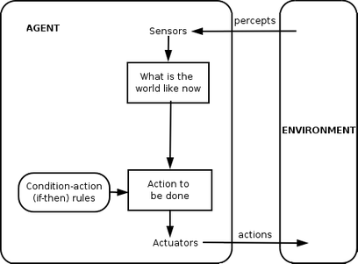

Agents
Agents interact with their environment through sensors and actuators.

Slide 2
Rational Agents
Rational agent:
For every possible percept sequence, a rational agent should
select an action that is expected to maximize its performance measure,
given evidence provided by the percept sequence and whatever built-in knowledge the agent has.

Slide 3
Rational Agents
Rational agent:
For every possible percept sequence, a rational agent should
select an action that is expected to maximize its performance measure,
given evidence provided by the percept sequence and whatever built-in knowledge the agent has.

Slide 4
Rational Agents
Rational agent:
For every possible percept sequence, a rational agent should
select an action that is expected to maximize its performance measure,
given evidence provided by the percept sequence and whatever built-in knowledge the agent has.

Slide 5
Rational Agents
Rational agent:
For every possible percept sequence, a rational agent should
select an action that is expected to maximize its performance measure,
given evidence provided by the percept sequence and whatever built-in knowledge the agent has.

Slide 6
Environments
Fully-observable vs partially-observable
Single agent vs multiple agents
Deterministic vs non-deterministic
Episodic vs sequential
Static or dynamic
Discrete or continuous

Slide 7
State Space Search

Slide 8
Environments
Fully-observable vs partially-observable
Single agent vs multiple agents
Deterministic vs stochastic
Episodic vs sequential
Static or dynamic
Discrete or continuous

Slide 9
Overview
Problem-solving as search
How to formulate an AI problem as search.
Uninformed search methods

Slide 10

What is search? (3.1)
Notes:
Search is a strategy you can use when you have some kind of problem with a definable goal, an environment in which the agent can take a sequence of actions to reach the goal. In general, search is finding the best sequence of actions that lead you to the goal.

Slide 11
What is search?
Notes:
Search is a strategy you can use when you have some kind of problem with a definable goal, an environment in which the agent can take a sequence of actions to reach the goal. In general, search is finding the best sequence of actions that lead you to the goal.

Slide 12
Environmental factors needed
Static — The world does not change on its own, and our actions don't change it.
Discrete — A finite number of individual states exist rather than a continuous space of options.
Observable — States can be determined by observations.
Deterministic — Action have certain outcomes.
Notes:
observable = you always know where you are.

Slide 13
The environment is all the information about the world that remains constant while we are solving the problem.
A state is the set of properties that define the current conditions of the world our agent is in.
Think of this as a snapshot of the world at a given point in time.
The entire set of possible states is called the state space.
The initial state is the state the agent begins in.
A goal state is a state where the agent may end the search.
Agents move from state to state by taking actions. Moving from state to state has an associated cost.
Notes:
state space = graph, sometimes a tree, depends on the problem.

Slide 14
How does an agent know what actions are possible in a state?
Imagine a function ACTIONS(s) that returns the set of actions possible in a state s.
How does an agent know what state they go to when they take an action?
Imagine a function RESULT(s, a) that returns the new state s' that you end up in when taking action a from state s.
How does an agent know when they have reached a goal state?
Imagine a function IS-GOAL(s) that returns true/false.
How does an agent know the cost of moving from one state to another?
Imagine a function ACTION-COST(s, a, s') which returns the cost of taking action a in state s and moving to state s'.
Notes:
state space = graph, sometimes a tree, depends on the problem.

Slide 15
Formulating problems as search (3.2)
Canonical problem: route-finding
Route-finding with traveling salesperson problem.
Sliding block puzzle (almost any kind of game or puzzle can be formulated this way).
Roomba problem.

Slide 16
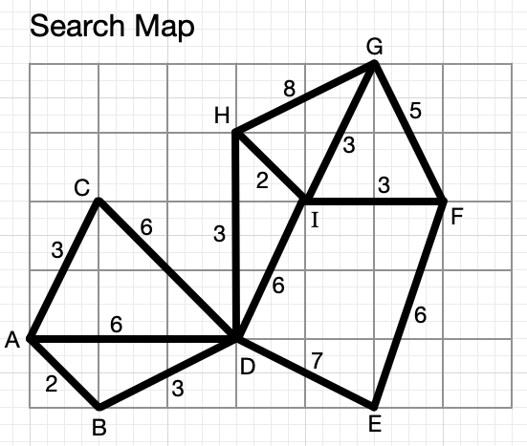
Formulate navigation problem

Slide 17
Formulate navigation problem

Slide 18
Formulate 8-puzzle problem

Slide 19
Formulate Roomba problem

Slide 20
Formulate Roomba problem

Slide 21
Formulating problems as search
You must determine the following:
What do my states look like?
What is my initial state? What are my goal state(s)? What does the state space "look like?" Is is a graph or a tree?
What is my cost function?
How do I know how "good" a state or action is?
Usually desirous to minimize, rather than maximize.
Usually phrased as a function of the path from the initial state to a goal state.

Slide 22
Formulating problems as search
A solution to a search problem is a path between the initial state and a goal state.
The quality of a solution is measured by path cost, which is the sum of all the individual costs along the way.
Optimal solutions have the lowest cost of any possible path.

Slide 23
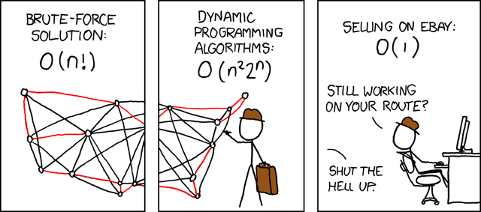
State space search gives us graph searching algorithms.
Are we searching a tree or a (true) graph?
Notes:
Handout tree/graph search. One needs explored list, one does not.

Slide 24
Side note:
Consider whether the search space forms a tree or a graph.
Often there are faster versions of these algorithms for searching trees.
Notes:
Handout tree/graph search. One needs explored list, one does not.

Slide 25
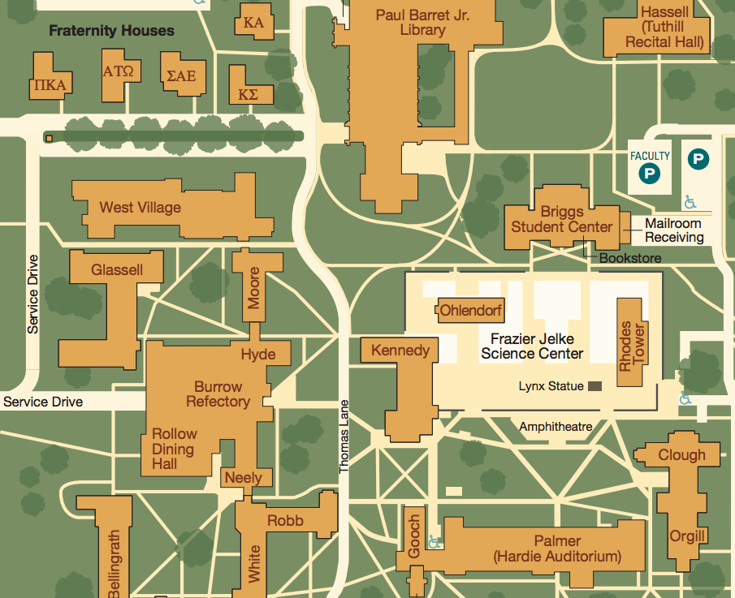

Slide 26
Recap
What things do we need to define in order to formulate a problem as a search problem?

Slide 27
Trees vs graphs
If your search space is a tree, that implies there is only one path from the start state to any goal state.
Equivalently: only one sequence of actions for each possible goal state.

Slide 28
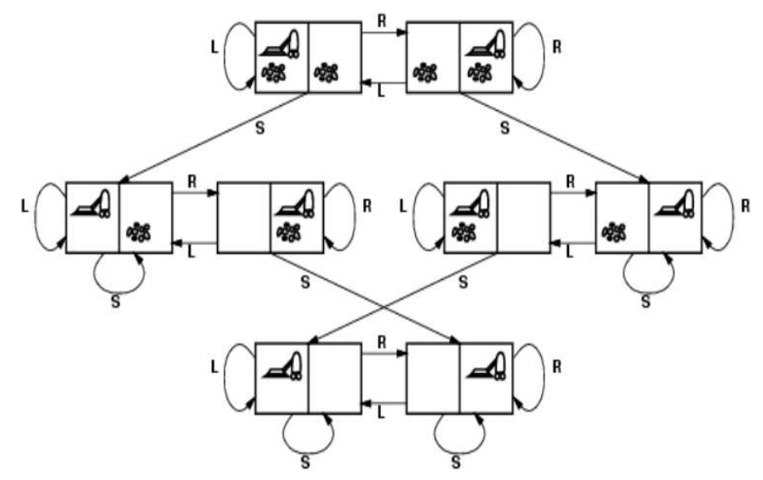
Always a good idea to try to visualize the graph of the search space.

Slide 29
Generic search algorithms (3.3)
All search algorithms work in essentially the same manner:
Start with initial state.
Generate all possible successor states (a.k.a. "expanding a node."
Pick a new node to expand.
Continue until we find a goal state.

Slide 30
There are two simultaneous graph-like structures used in search algorithms:
(1) Graph (or tree) of underlying state space.
(2) Tree maintaining the record of the current search in progress (the search tree).
(1) does not depend on the current search being run.
(1) is sometimes not even stored in memory (too big!)
(2) always depends on the current search, and is always stored in memory. It is created on the fly during the running of the search algorithm.
Notes:
does not depend on your current search. Usually not stored in memory.
Is always stored in memory, depends on current search.

Slide 31
Search tree
A node n of the search tree stores:
a state (of the state space)
a pointer to the state's parent node (usually)
the action that got you from the parent to n (sometimes)
the path cost g(n): cost of the path so far from the initial state to n.

Slide 32
Generic search algorithms' data structures
Frontier: a data structure storing the collection of nodes that are available to be examined next in the algorithm.
Often represented as a stack, queue, or priority queue.
Reached: a map from states to nodes.
Used to quickly access the priorities of states stored in the frontier to see if the algorithm has found a better priority.

Slide 33
How do you evaluate a search algorithm?
Completeness — Does the algorithm always find a solution if one exists?
Optimality — Does the algorithm find the best solution?
Time complexity
Space complexity

Slide 34
Uninformed search methods
These methods have no information about which nodes are on promising paths to a solution.
Also called: blind search

Slide 35
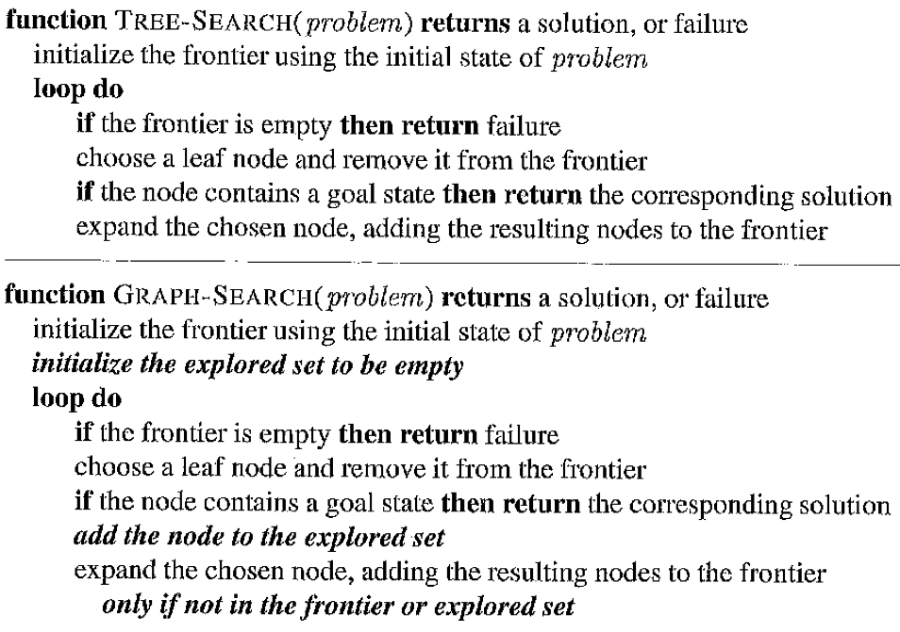
Frontier = stack, queue, or priority queue.
Explored set = hash table.

Slide 36
Uninformed search algorithms
Breadth-first search
Variant — Uniform-cost search
Depth-first search

Slide 37
Breadth-first search
Choose shallowest node for expansion.
Data structure for frontier?
Queue (regular, FIFO)
Complete? Optimal? Time? Space?
Notes:
complete = yes
optimal = maybe. yes if

Slide 39
Depth-first search
Choose deepest node to expand.
Data structure for frontier?
Stack (or just use recursion)
Complete? Optimal? Time? Space?

Slide 41
Uniform-cost search
Choose node with lowest path cost g(n) for expansion.
Data structure for frontier?
Priority queue
Suppose we come upon the same state twice. Do we re-add to the frontier?
Yes, if lower path cost.
Notes:
complete

Slide 43
Uniform-cost search
Choose node with lowest path cost g(n) for expansion.
Data structure for frontier?
Priority queue
Suppose we come upon the same state twice. Do we re-add to the frontier?
Yes, if lower path cost.
Complete? Optimal? Time? Space?
Notes:
complete

Slide 44
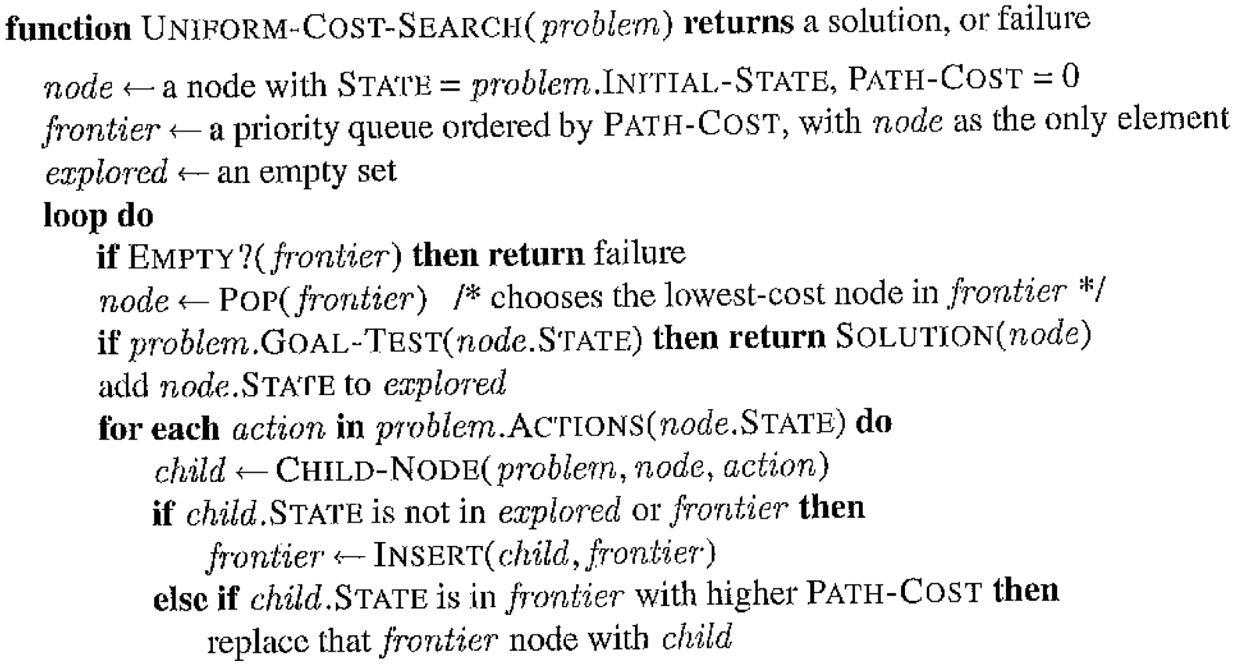

Slide 45
Iterative deepening DFS
Suppose we have a DFS algorithm that cuts off at some maximum depth.
Run this algorithm with max-depth=1.
Then 2, then 3, …
Complete? Optimal? Time? Space?

Slide 46
Review – State Space Search
Strategy – Discover the best (shortest, cheapest, quickest, etc) path from the initial state to a goal state.
State:
State space:

Slide 47
Review – State Space Search
Node:
Search tree:
Frontier:
Reached:

Slide 48
Review – Uniform Cost Search
aka Dijkstra's algorithm
Frontier = priority queue
Sorted by g(n):
Always expand lowest g(n) node on the frontier.
Time/Space:
Complete? Optimal?

Slide 49
A* and variations
Same algorithm as uniform-cost search.
Uses a different evaluation function to sort the priority queue.
Need a heuristic function, h(n).
h(n) = Estimate of lowest-cost path from node n to a goal state.
In other words = an estimate of the distance remaining.

Slide 50
Visualizing a heuristic function

Slide 51
A* Algorithm
Sort priority queue by a function f(n), which should be the estimated lowest-cost path through node n.
How do we define f(n)?
Remember: g(n) = sum of costs from start state to node n.
h(n) = Estimate of lowest-cost path from node n to a goal state.
f(n) = g(n) + h(n)

Slide 52
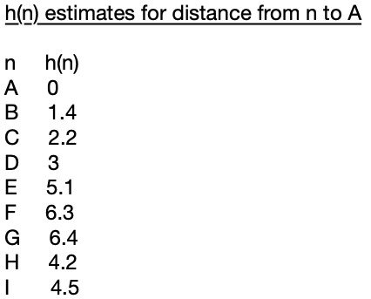

Slide 53
Properties of A*

Slide 54
Heuristics
A heuristic function h(n) is admissible if it never over-estimates the true lowest cost to a goal state from node n.
Equivalent: h(n) must always be less than or equal to the true cost from node n to a goal.
What happens if we just set h(n) = 0 for all n?
Notes:
h(n) = 0 → UCS/Dijkstra

Slide 55
Heuristics
A heuristic function h(n) is consistent if values of h(n) along any path in the search tree are non-decreasing.
Equivalent definition of consistency: given a node n, and an action which takes you from n to node n':
h(n) <= cost(n, a, n') + h(n')
h(n) – h(n') <= cost(n, a, n')
Consistency implies admissibility (but not the other way around).
Difficult to invent (natural) heuristics that are admissible but not consistent.

Slide 56
A* Algorithm
A* is optimal if h(n) is consistent (and therefore admissible).
If your search space is a tree, A* only needs an admissible heuristic to be optimal, but this is uncommon.

Slide 57
Where do heuristics come from?

Slide 58
Greedy best-first search
Use just h(n) to sort priority queue.
Optimal?
Complete?
Notes:
Not optimal – do example with x

Slide 59
Summary
Uniform cost search (Dijkstra) [sort by g(n)]
Complete and optimal.
A* [sort by f(n) = g(n) + h(n)]
Complete and optimal, assuming an admissible and consistent heuristic.
Greedy best first search [sort by h(n)]
Complete, but not optimal.

Slide 60
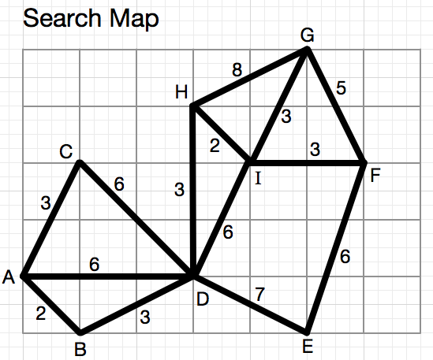
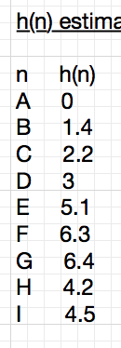

Slide 61
Stanley Milgram

Slide 62



Travers & Milgram (1969)
To: Joe Smith
Stockbroker
Boston, MA
Source
Target
296 letters
22% reached target
Median chain length = 6
Notes:
What’s interesting here?
Original finding
Mark Newman’s question

Slide 63
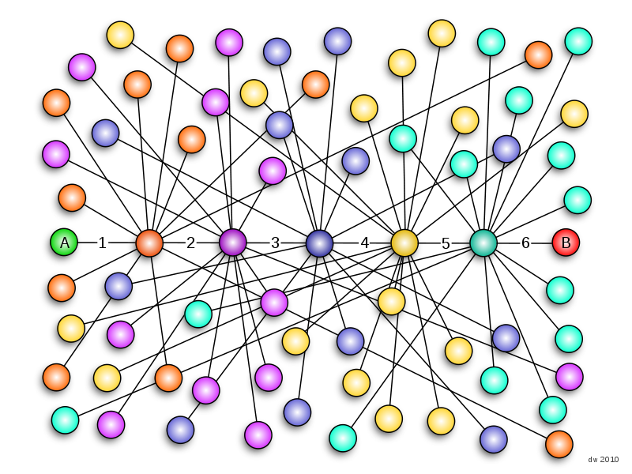
Notes:
296 letters
22% reached target
Median chain length = 6

