Slide 1
Reinforcement Learning

Slide 2
Environments
Fully-observable vs partially-observable
Single agent vs multiple agents
Deterministic vs stochastic
Episodic vs sequential
Static or dynamic
Discrete or continuous

Slide 3
What is reinforcement learning?
Three machine learning paradigms:
Supervised learning
Unsupervised learning (overlaps w/ data mining)
Reinforcement learning
In reinforcement learning, the agent receives incremental pieces of feedback, called rewards, that it uses to judge whether it is acting correctly or not.

Slide 4
Examples of real-life RL
Learning to play chess.
Animals (or toddlers) learning to walk.
Driving to school or work in the morning.
Key idea: Most RL tasks are episodic, meaning they repeat many times.
So unlike in other AI problems where you have one shot to get it right, in RL, it's OK to take time to try different things to see what's best.

Slide 5
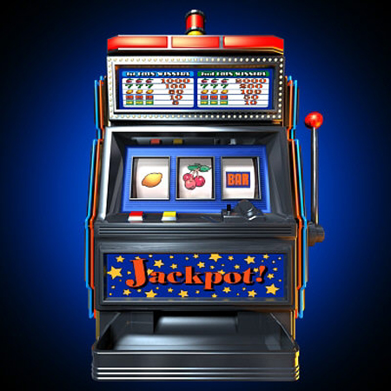
n-armed bandit problem
You have n slot machines.
When you play a slot machine, it provides you a reward (negative or positive) according to some fixed probability distribution.
Each machine may have a different probability distribution, and you don't know the distributions ahead of time.
You want to maximize the amount of reward (money) you get.
In what order and how many times do you play the machines?
Notes:
Present n-armed bandit problem.
Must balance exploitation and exploration.

Slide 6
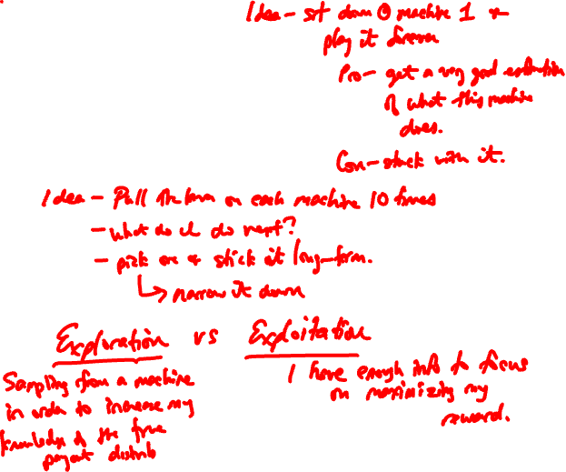
You have n slot machines.
When you play a slot machine, it provides you a reward (negative or positive) according to some fixed probability distribution.
Each machine may have a different probability distribution, and you don't know the distributions ahead of time.
You want to maximize the amount of reward (money) you get.
In what order and how many times do you play the machines?

Slide 7
RL problems
Every RL problem is structured similarly.
We have an environment, which consists of a set of states, and actions that can be taken in various states.
Environment is often stochastic (there is an element of chance).
Environment can be fully or partially observable (here, we will focus on fully observable).
Our RL agent wishes to learn a policy, π, a function that maps states to actions.
π(s) tells you what action to take in a state s.

Slide 8
What is the goal in RL?
In other AI problems, the "goal" is to get to a certain state. Not in RL!
A RL environment gives feedback every time the agent takes an action. This is called a reward.
Rewards are usually numbers.
Goal: Agent wants to maximize the amount of reward it gets over time.
Critical point: Rewards are given by the environment, not the agent.

Slide 9
Mathematics of rewards
Assume our rewards are r₀, r₁, r₂, …
What expression represents our total rewards?
How do we maximize this? Is this a good idea?
Use discounting: at each time step, the reward is discounted by a factor of γ (called the discount rate).
Future rewards from time t =
Notes:
r_{t} + \gamma r_{t+1} + \gamma^2 r_{t+2} + \cdots = \sum_{k=0}^\infty \gamma^k r_{t+k}

Slide 10
Markov Decision Processes
An MDP has a set of states, S, and a set of actions, A(s), for every state s in S.
An MDP encodes the probability of transitioning from state s to state s' on action a: P(s' | s, a)
RL also requires a reward function, usually denoted by R(s, a, s') = reward for being in state s, taking action a, and arriving in state s'.
An MDP is a Markov chain that allows for outside actions to influence the transitions.
Notes:
Why is this called Markov?
Very much like a Markov chain!

Slide 11
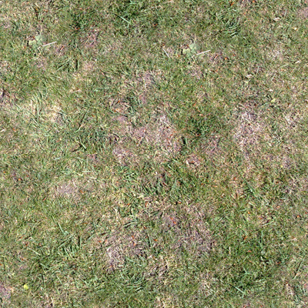

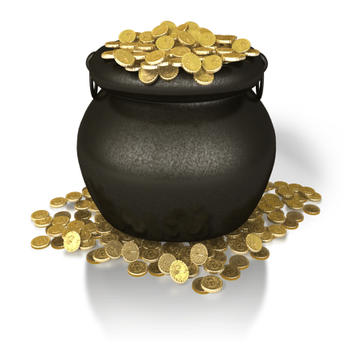
Grass gives a reward of 0.
Monster gives a reward of -5.
Pot of gold gives a reward of +10 (and ends game).
Two actions are always available:
Action A: 50% chance of moving right 1 square, 50% chance of staying where you are.
Action B: 50% chance of moving right 2 squares, 50% chance of moving left 1 square.
Any movement that would take you off the board moves you as far in that direction as possible or keeps you where you are.
Notes:
PASS OUT ANSWER KEY(excel sheet)
THEN PASS OUT RL LEARNING NOTES PDF

Slide 12
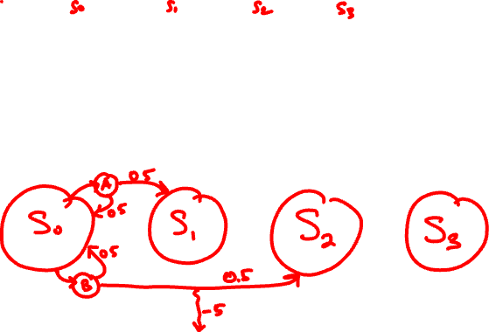
Grass gives a reward of 0.
Monster gives a reward of -5.
Pot of gold gives a reward of +10 (and ends game).
Two actions are always available:
Action A: 50% chance of moving right 1 square, 50% chance of staying where you are.
Action B: 50% chance of moving right 2 squares, 50% chance of moving left 1 square.
Any movement that would take you off the board moves you as far in that direction as possible or keeps you where you are.

Slide 13
Policies and value functions
Almost all RL algorithms are based around computing, estimating, or learning policies and value functions.
A policy (usually π) is a function from states to actions that tells you what action you should do in each state.
A value function represents the expected future reward from either a state, or a state-action pair.
V^{π} (s): If we are in state s, and follow policy π, what is the total future reward we will see, on average?
Q^{π} (s, a): If we are in state s, and take action a, then follow policy π, what is the total future reward we will see, on average?

Slide 14
Optimal policies
Given an MDP, there is always a "best" policy, called π*.
The point of RL is to discover this policy by employing various algorithms.
Some algorithms can use sub-optimal policies to discover π*.
We denote the value functions corresponding to the optimal policy by V*(s) and Q*(s, a).

Slide 15
Optimal policies
Suppose I am in state s, I take action a, and I find myself in state s'.
What is my current reward?
R(s, a, s')
Suppose V(s') to

Slide 16
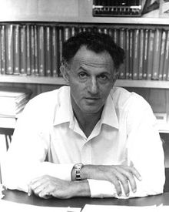
Bellman equations
The V*(s) and Q*(s, a) functions always satisfy certain recursive relationships for any MDP.
These relationships, in the form of equations, are called the Bellman equations.

Slide 17
Recursive relationship of V* and Q*:
The expected future rewards from a state s is equal to the expected future rewards obtained by choosing the best action from that state.
The expected future rewards obtained by taking an action from a state is the weighted average of the expected future rewards from the new state.
Notes:
V^*(s) = \max_a Q^*(s, a)

Slide 18
Bellman equations
No closed-form solution in general.
Instead, most RL algorithms use these equations in various ways to estimate V* or Q*. An optimal policy can be derived from either V* or Q*.

Slide 19
RL algorithms
Goal of RL algorithm: estimate V* or Q* (and then derive optimal policy π* from that.
One way of classifying RL algorithms by whether or not the algorithm requires a full model of the environment.
In other words, do we know P(s' | s, a) and R(s, a, s') for all combinations of s, a, s'?
If we have this information (uncommon in the real world), we can estimate V* or Q* directly with very good accuracy.
If we don't have this information, we can estimate V* or Q* from experience or simulations.

Slide 20
Value iteration
Value iteration is an algorithm that computes an optimal policy, given a full model of the environment.
Algorithm is derived directly from the Bellman equations (usually for V*, but can use Q* as well).

Slide 21
Value iteration
Two steps:
Estimate V(s) for every state.
For each state:
Simulate taking every possible action from that state and examine the probabilities for transitioning into every possible successor state. Weight the rewards you would receive by the probabilities that you receive them.
Find the action that gave you the most reward, and remember how much reward it was.
Compute the optimal policy by doing the first step again, but this time remember the actions that give you the most reward, not the reward itself.

Slide 22
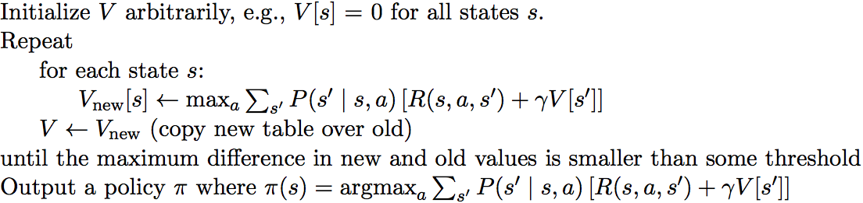
Value iteration
Value iteration maintains a table of V values, one for each state. Each value V[s] eventually converges to the true value V*(s).

Slide 23
Grass gives a reward of 0.
Monster gives a reward of -5.
Pot of gold gives a reward of +10 (and ends game).
Two actions are always available:
Action A: 50% chance of moving right 1 square, 50% chance of staying where you are.
Action B: 50% chance of moving right 2 squares, 50% chance of moving left 1 square.
Any movement that would take you off the board moves you as far in that direction as possible or keeps you where you are.
γ (gamma) = 0.9

Slide 24
Running value iteration:
initial: 0 0 0 0
after rd 1: 0 5 5 0
after rd 2: 2.25 5 7.25 0

Slide 25
V[s] values converge to:
6.47 7.91 8.56 0
How do we use these to compute π(s)?

Slide 26
Computing an optimal policy from V[s]
Last step of the value iteration algorithm:
In other words, run one last time through the value iteration equation for each state, and pick the action a for each state s that maximizes the expected reward.

Slide 27
V[s] values converge to:
6.47 7.91 8.56 0
Optimal policy:
A B B ---
Notes:
Experiment with different MDPs – change gold reward to +100.

Slide 28
You are a doctor performing a clinical trial for new medications (called A and B) to treat Ebola.
Patients can be healthy, sick, very sick, or dead.
Rewards: healthy=10, sick=-1, very sick=-2, dead=-100.
It turns out the medications interact with each other.
Giving A then B makes you sicker 90% of the time, but healthier 10% of the time.
Giving B then A makes you healthier 90% of the time, but sicker 10% of the time.
Giving A then A makes you healthier 50% of the time, but does nothing 50% of the time.
Giving B then B makes you sicker 50% of the time, but does nothing 50% of the time.
Notes:
A patient can be healthy, sick, very sick, or dead.

Slide 29
Review
Value iteration requires a perfect model of the environment.
You need to know P(s' | s, a) and R(s, a, s') ahead of time for all combinations of s, a, and s'.
Optimal V or Q values are computed directly from the environment using the Bellman equations.
Often impossible or impractical.

Slide 30
Simple Blackjack
Costs $5 to play.
Infinite deck of shuffled cards, labeled 1, 2, 3.
(so equal prob of drawing each number at any time)
You start with no cards. At every turn, you can either "hit" (take a card) or "stay" (end the game). Your goal is to get to a sum of 6 without going over, in which case you lose the game.
You make all your decisions first, then the dealer plays the same game.
If your sum is higher than the dealer's, you win $10 (your original $5 back, plus another $5). If lower, you lose (your original $5). If the same, draw (get your $5 back).

Slide 31
Simple Blackjack
To set this up as an MDP, we need to automate the 2nd player (the dealer) in the MDP.
Usually at casinos, dealers have simple rules they have to follow anyway about when to hit and when to stay.
Is it ever optimal to "stay" from S0-S3?
Assume that on average, if we "stay" from S4/S5/S6, and then the dealer plays, here's what happens:
Stay from S4, we win $3 (net $-2).
Stay from S5, we win $6 (net $1).
Stay from S6, we win $7 (net $2).
Do you even want to play this game? (Does it make financial sense?)
What should gamma be?

Slide 32
Simple Blackjack
What should gamma be?
Notes:
should be 1.

Slide 33
Learning from experience
What if we don't know the exact model of the environment, but we are allowed to sample from it?
That is, we are allowed to "practice" the MDP as much as we want.
This echoes real-life experience.
One way to do this is temporal difference learning (TD learning).
Notes:
after this slide, show derivation of temporal difference learning

Slide 34
Temporal difference learning
We want to compute V(s) or Q(s, a).
TD learning uses the idea of taking lots of samples of V or Q (from the MDP) and averaging them to get a good estimate.
Let's see how TD learning works.

Slide 35
Example: Time to drive home
Suppose for ten days I record how long it takes me to drive home after work.
On the eleventh day, what time should I predict my travel time home to be?

Slide 37
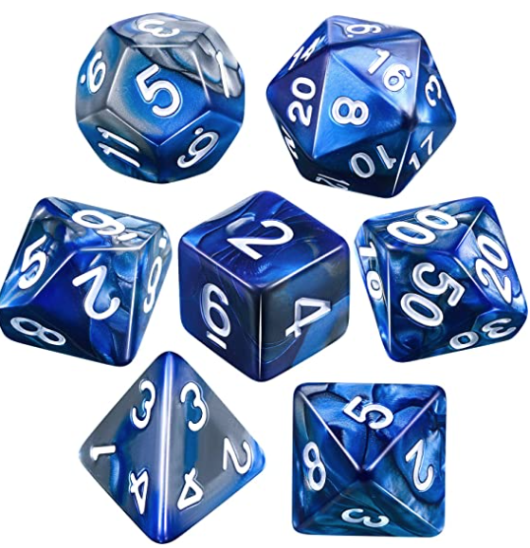
Example: Rolling a die
Basic TD equation:
V(s) = V(s) + 𝛼(reward – V(s))
But what if our reward comes in pieces, not all at once?
total reward = one step reward + rest of reward
total reward = r_{t} + 𝛾V(s')
V(s) = V(s) + 𝛼[r_{t} + 𝛾V(s') – V(s)]
Notes:
Suppose you have a friend who is rolling a die, but doesn't tell you how many sides the die has, nor what the numbers on each of the faces are. So it might be a 6-sided die, or have more/fewer sides, or have weird numbers.
Metaphor – walking towards a light you see in the distance. But it's foggy, and the light is playing tricks on you, and sometimes

Slide 38
Q-learning
Q-learning is a temporal difference learning algorithm that learns optimal values for Q (instead of V, as value iteration did).
The algorithm works in episodes, where the agent "practices" (aka samples) the MDP to learn which actions obtain the most rewards.
Like value iteration, table of Q values eventually converge to Q*.
(under certain conditions)
Notes:
Paper notes for coin flip example.

Slide 39
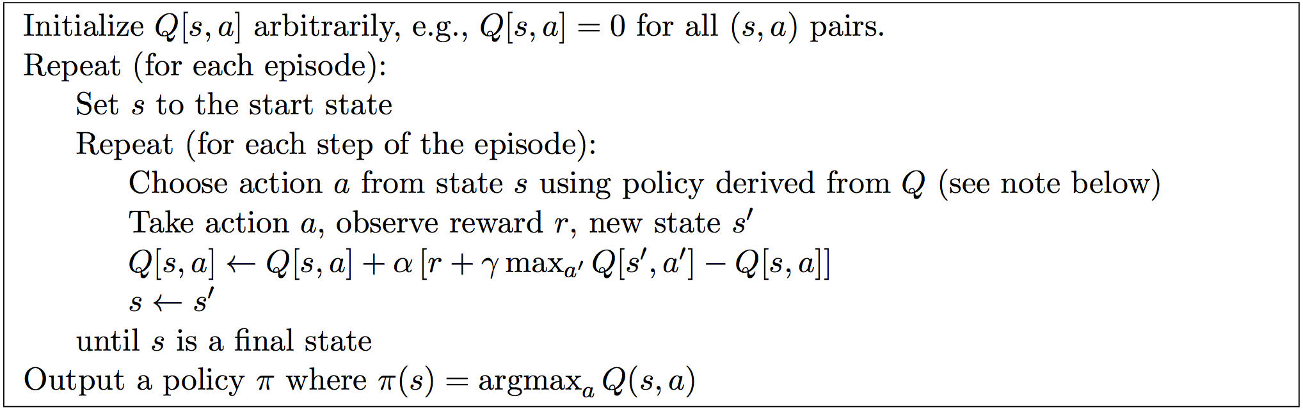
Notice the Q[s, a] update equation is very similar to the basic TD update equation.
(The extra γ max_{a'} Q[s', a'] piece is to handle future rewards.)
alpha (0 < α <= 1) is called the learning rate; it controls how fast the algorithm learns. In stochastic environments, alpha is usually small, such as 0.1.

Slide 40
Note: The "choose action" step does not mean you choose the best action according to your table of Q values.
You must balance exploration and exploitation; like in the real world, the algorithm learns best when you "practice" the best policy often, but sometimes explore other actions that may be better in the long run.

Slide 41
Often the "choose action" step uses policy that mostly exploits but sometimes explores.
One common idea: (epsilon-greedy policy)
With probability 1 - ε, pick the best action (the "a" that maximizes Q[s, a].
With probability ε, pick a random action.
Also common to start with large ε and decrease over time while learning.

Slide 42
What makes Q-learning so amazing is that the Q-values still converge to the optimal Q* values even though the algorithm itself is not following the optimal policy!

Slide 43
Simple Blackjack
Costs $5 to play.
Infinite deck of shuffled cards, labeled 1, 2, 3.
(so equal prob of drawing each number at any time)
You start with no cards. At every turn, you can either "hit" (take a card) or "stay" (end the game). Your goal is to get to a sum of 6 without going over, in which case you lose the game.
You make all your decisions first, then the dealer plays the same game.
If your sum is higher than the dealer's, you win $10 (your original $5 back, plus another $5). If lower, you lose (your original $5). If the same, draw (get your $5 back).

Slide 44
Simple Blackjack
To set this up as an MDP, we need to automate the 2nd player (the dealer) in the MDP.
Usually at casinos, dealers have simple rules they have to follow anyway about when to hit and when to stay.
Is it ever optimal to "stay" from S0-S3?
Assume that on average, if we "stay" from S4/S5/S6, and then the dealer plays, here's what happens:
Stay from S4, we win $3 (net $-2).
Stay from S5, we win $6 (net $1).
Stay from S6, we win $7 (net $2).
Do you even want to play this game? (Does it make financial sense?)
What should gamma be?

Slide 45
Q-learning with Blackjack
Update formula:
Sample episodes (states and actions):
S0 ➔ Hit ➔ S3 ➔ Stay ➔ End
S0 ➔ Hit ➔ S3 ➔ Hit ➔ S6 ➔ Stay ➔ End
S0 ➔ Hit ➔ S3 ➔ Hit ➔ S5 ➔ Stay ➔ End

Slide 46
Q-learning with Ebola!
Update formula:
Sample episodes (states and actions):
Sick-X ➔ A ➔ Sick-A ➔ A ➔ Healthy
Sick-X ➔ A ➔ Sick-A ➔ B ➔ Healthy
Sick-X ➔ A ➔ Sick-A ➔ A ➔ Sick-A ➔ B ➔ Healthy

Slide 47
2-Player Q-learning
Normal update equation:
Normally we always maximize our rewards. Consider 2-player Q-learning with player A maximizing and player B minimizing (as in minimax).
Why does this break the update equation?

Slide 48
2-Player Q-learning
Player A's update equation:
Player B's update equation:
Player A's optimal policy output:
Player B's optimal policy output:

