Slide 1
Naïve Bayes Classifiers

Slide 2
Review
Let event D = data we have observed.
Let events H₁, …, H_{n} be events representing the n hypotheses we want to choose between.
Use D to pick the "best" H.
There are two "standard" ways to do this, depending on what information we have available.

Slide 3
Maximum likelihood hypothesis
The maximum likelihood hypothesis (H^{ML}) is the hypothesis that maximizes the probability of the data given that hypothesis.
How to use it: compute P(D | H_{i}) for each hypothesis (1 through n) and select the one with the greatest value.

Slide 4
Maximum a posteriori (MAP) hypothesis
The MAP hypothesis is the hypothesis that maximizes the posterior probability:
The P(D | H_{i}) terms are now weighted by the hypothesis prior probabilities.

Slide 5
Posterior probability
If you need the actual posterior probability for some hypothesis H_{i}:
Notes:
P(H_i \mid D) = \frac{P(D \mid H_i) P(H_i)}{P(D)}
= \frac{P(D \mid H_i) P(H_0)}{\sum_j P(D, H_j)}
= \frac{P(D \mid H_i) P(H_i)}{\sum_j P(D \mid H_j)P(H_j)}

Slide 6
Combining evidence
If we have multiple pieces of data/evidence (say two pieces), then we need to compute or estimate
which is often hard.
Instead, we assume all pieces of evidence are conditionally independent given a hypothesis:
This assumption is most likely not true, but we do it to make our lives easier.
Notes:
P(D_1, D_2 \mid H_i)
P(D_1, D_2 \mid H_i) = P(D_1 \mid H_i) P(D_2 \mid H_i)

Slide 7
Combining evidence (m pieces)
where
Notes:
P(H_i \mid D_1, \ldots, D_m) = \frac{P(D_1, \ldots, D_m\mid H_i)P(H_i)}{P(D_1, \ldots, D_m)}
= \frac{\Big[ P(D_1 \mid H_i) \cdots P(D_m \mid H_i) \Big] P(H_i)}{P(D_1, \ldots, D_m)}
= \frac{\Big[ \prod_{j=1}^m P(D_j \mid H_i) \Big] P(H_i)}{P(D_1, \ldots, D_m)}
P(D_1\ldots, D_m) = \sum_{k=1}^n \Bigg( \Big[ \prod_{j=1}^m P(D_j\mid H_k) \Big] P(H_k) \Bigg)

Slide 8
Classification
Classification is the problem of identifying which of a set categories (called classes) a particular item belongs in.
Lots of real-world problems are classification problems:
spam filtering (classes: spam/not-spam)
handwriting recognition & OCR (classes: one for each letter, number, or symbol)
text classification, image classification, music classification, etc.
Almost any problem where you are assigning a label to items can be set up as a classification task.

Slide 9
Classification
An algorithm that does classification is called a classifier. Classifiers take an item as input and output the class it thinks that item belongs to. That is, the classifier predicts a class for each item.
Lots of classifiers are based on probabilities and statistical inference:
The classes become the hypotheses being tested.
The item being classified is turned into a collection of data called features. Useful features are attributes of the item that are strongly correlated with certain classes.
The classification algorithm is usually ML or MAP, depending on what data we have available.

Slide 10
Example: Spam classification
New email arrives: is it spam or not spam?
A useful set of features might be the presence or absence of various words in the email:
F1, ~F1: the word "luxury" appears/does not appear
F2, ~F2: the word "save" appears/does not appear
F3, ~F3: the word "brands" appears/does not appear
Let's say our new email contains "luxury" and "brands," but not "save."
The features for this email are F1, ~F2, and F3.
Let's use MAP for classification.

Slide 11
Example: Spam classification
Features = Data = D = F1, ~F2, F3.
Notes:
H^\text{MAP} = \argmax_i P(D \mid H_i)P(H_i)
H^\text{MAP} = \argmax_{i \in \{ \text{spam}, \text{not-spam} \} } P(F_1, \lnot F_2, F_3 \mid H_i)P(H_i)

Slide 12
Example: Spam classification
Features = Data = D = F1, ~F2, F3.
Let’s assume all the features are conditionally independent given the hypothesis.
Notes:
H^\text{MAP} = \argmax_i P(D \mid H_i)P(H_i)
H^\text{MAP} = \argmax_{i \in \{ \text{spam}, \text{not-spam} \} } P(F_1, \lnot F_2, F_3 \mid H_i)P(H_i)

Slide 13
Naïve Bayes
This is called a Naïve Bayes classifier.
Assumes the data is a collection of features, and each feature is conditionally independent of all other features given the hypothesis.
Classifies using MAP hypothesis.

Slide 14
Naïve Bayes
Hypotheses: H1 through Hn.
Features (data): F1 through Fm.

Slide 15
Probabilities needed
P(H_{i}) for i = 1 to n.
P(F_{j} | H_{i}) for j = 1 to m and i = 1 to n.

Slide 16
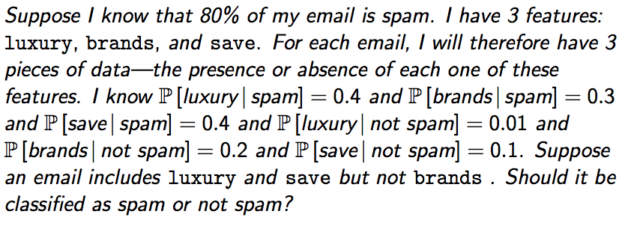
Example

Slide 17
Example
Suppose I know 80% of my email is spam.
I have three features, "luxury," "brands," and "save."
I know:
P(luxury | spam) = 0.4 P(luxury | ~spam) = 0.01
P(brands | spam) = 0.3 P(brands | ~spam) = 0.2
P(save | spam) = 0.4 P(save | ~spam) = 0.1
Suppose a new, incoming email contains "luxury" and "save" but not "brands." Should it be classified as spam or ~spam?

Slide 18
Learning probabilities from data
To use MAP, we need to calculate or estimate P(Hi) and P(F1, ~F2, F3 | Hi) for each i.
In other words, we need to know:
P(spam)
P(not-spam)
P(F1, ~F2, F3 | spam)
P(F1, ~F2, F3 | not-spam)
In the previous example, these were given to us, but what if they weren't?

Slide 19
Learning probabilities from data
Let's assume we have access to a large number of old emails that are correctly labeled as spam/not-spam.
How can we estimate P(spam)?
Notes:
P(\text{spam}) = \frac{\text{\# of emails labeled as spam}}{\text{total \# of emails}}

Slide 20
Learning probabilities from data
Let's assume we have access to a large number of old emails that are correctly labeled as spam/not-spam.
How can we estimate P(F1, ~F2, F3 | spam)?
Why is this probably going to be a very rough estimate?
Notes:
P(F_1, \lnot F_2, F3 \mid \text{spam}) = \frac{\text{\# of spam emails with those exact features}}{\text{total \# of spam emails}}
Reason: the # of spam emails with those exact features is probably very small.

Slide 21
Conditional independence to the rescue!
It is unlikely that our set of old emails contains many messages with that exact set of features.
Let's assume that all of our features are conditionally independent of each other, given the hypothesis (spam/not-spam).
These probabilities are easier to get good estimates for!
A classifier that makes this assumption is called a Naïve Bayes classifier.

Slide 22
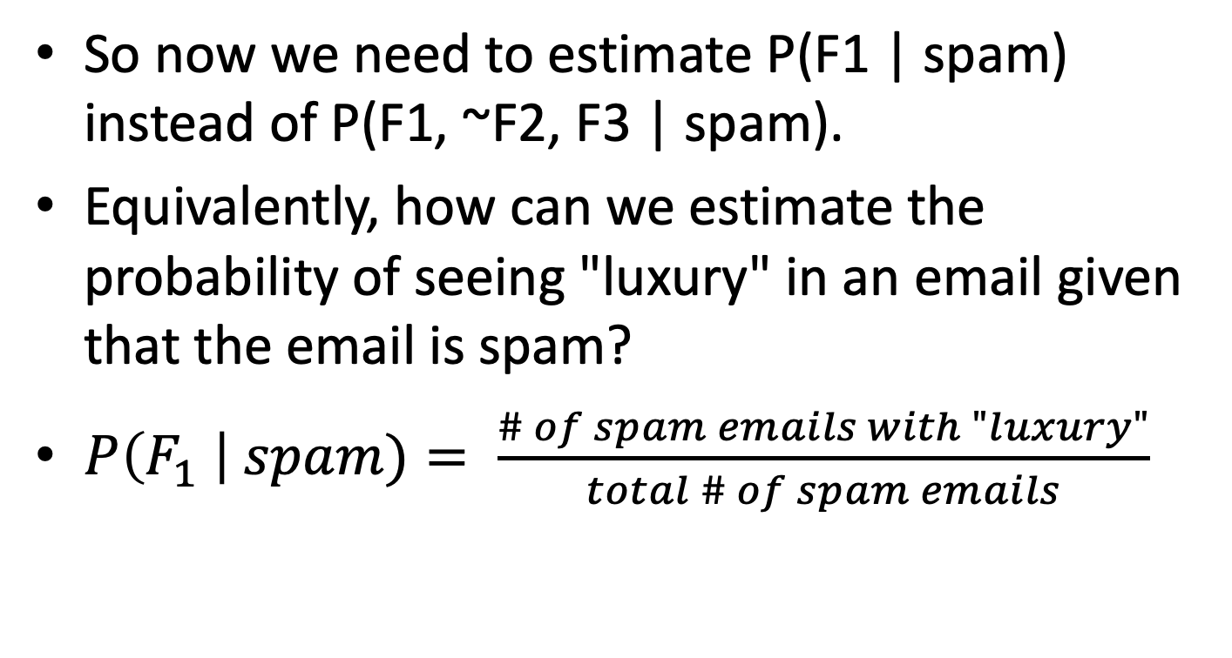
Learning probabilities from data
So now we need to estimate P(F1 | spam) instead of P(F1, ~F2, F3 | spam).
Equivalently, how can we estimate the probability of seeing "luxury" in an email given that the email is spam?
$P\left(F_{1} \right| spam)= \frac{\# of spam emails with "luxury"}{total \# of spam emails}$

Slide 23
Example
Suppose I have 20 emails that have been already classified into spam (15 emails) and non-spam (5 emails). Suppose I only care about the presence or absence of the words luxury, brands, and save. Suppose 6 of the spam emails contain "luxury," 3 of the spam emails contain "brands," and 7 of the spam emails contain "save." Suppose 1 of the non-spam emails contains "luxury," 2 of the non-spam emails contain "brands," and 2 of the non-spam emails contain "save." Suppose a new email arrives that contains the words "luxury" and "save" but not "brands." Should this be classified as spam or not spam?

Slide 24
Another problem to handle…
What if we a word never appears in any spam emails? What happens to its probability estimate? (and why is this bad?)
Probability of zero destroys the entire calculation!
Notes:
P(F_j \mid \text{spam}) = \frac{\text{\# of spam emails with word $F_j$}}{\text{total \# of spam emails}}
P(\text{spam} \mid F1, \ldots, F_m) = \frac{\Big[ \prod_{j=1}^m P(F_j \mid \text{spam}) \Big] P(\text{spam})}{P(F_1, \ldots, F_m)}

Slide 25
Another problem to handle…
Fix the estimates:
This is called smoothing. Removes the possibility of a zero probability wiping out the entire calculation.
Simulates adding two additional spam emails, one containing every word, and containing no words.
We would also smooth for non-spam: adding two non-spam emails, one with all words, one with no words.
Notes:
P(F_j \mid \text{spam}) = \frac{\text{\# of spam emails with word $F_j$ + 1}}{\text{total \# of spam emails + 2}}

Slide 26
Summary of Naïve Bayes
Assumes the data is a collection of features, and each feature is conditionally independent of all other features given the hypothesis.
Classifies using MAP hypothesis.

Slide 27
Example
Suppose I have 20 emails that have been already classified into spam (15 emails) and non-spam (5 emails). Suppose I only care about the presence or absence of the words luxury, brands, and save. Suppose 6 of the spam emails contain "luxury," 3 of the spam emails contain "brands," and 7 of the spam emails contain "save." Suppose 1 of the non-spam emails contains "luxury," 2 of the non-spam emails contain "brands," and 2 of the non-spam emails contain "save." Suppose a new email arrives that contains the words "luxury" and "save" but not "brands." Should this be classified as spam or not spam?
Notes:
smoothed numbers?

Slide 28
Summary of Naïve Bayes
Hypotheses: H₁ through H_{n}.
Features (data): F₁ through F_{m}.

Slide 29
Summary of Naïve Bayes
Probabilities needed to be determined (either given to you or estimated from data):
P(H_{i}) for i = 1 to n.
P(F_{j} | H_{i}) for j = 1 to m and i = 1 to n.

Slide 30
Summary of Naïve Bayes (for email)
Naïve Bayes classifies using MAP:
Compute this for spam and for not-spam; see which is bigger.
Notes:
H^\text{MAP} = \argmax_i P(D \mid H_i)P(H_i)
= \argmax_{i \in \{ \text{spam}, \text{not-spam} \} } P(F_1, \ldots, F_m \mid H_i)P(H_i)
= \argmax_{i \in \{ \text{spam}, \text{not-spam} \} } \Big[ P(F_1 \mid H_i) \cdots P(F_m \mid H_i) \Big] P(H_i)
= \argmax_{i \in \{ \text{spam}, \text{not-spam} \} } \Big[ \prod_{j=1}^m P(F_j \mid H_i) \Big] P(H_i)

Slide 31
Summary of Naïve Bayes (for email)
Estimating the prior for each hypothesis:
Estimating the probability of a feature given a class (aka likelihood) with smoothing:
Notes:
P(\text{spam}) = \frac{\text{\# of emails labeled as spam}}{\text{total \# of emails}}
P(F_j \mid H_i) = \frac{\text{\# of $H_i$ emails with word $F_j$ + 1}}{\text{total \# of $H_i$ emails + 2}}

