Slide 1
Gyrocopter Cage Match
Nate Phillips

Slide 2
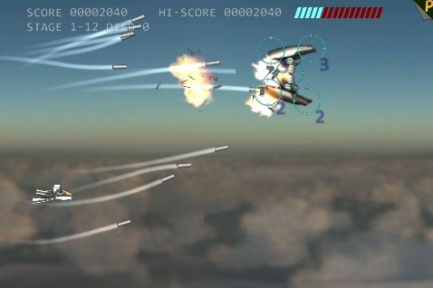
Original Design
Side scroller
High scores page
An options menu
Dynamic difficulty
Notes:
Link from: https://www.google.com/url?sa=i&rct=j&q=&esrc=s&source=images&cd=&cad=rja&docid=2soKk7o04tOJvM&tbnid=LEkRKLFuVuLb7M:&ved=0CAUQjRw&url=http%3A%2F%2Fosxreality.com%2F2008%2F12%2F10%2Fside-scrolling-shooter-space-deadbeef-awesome-and-free%2F&ei=ByIDUtSIEveq4AOfx4Bg&bvm=bv.50500085,d.dmg&psig=AFQjCNGHMdwtSZvS3ZDJcqz2eh-ym9Ma5Q&ust=1376023393965562

Slide 3
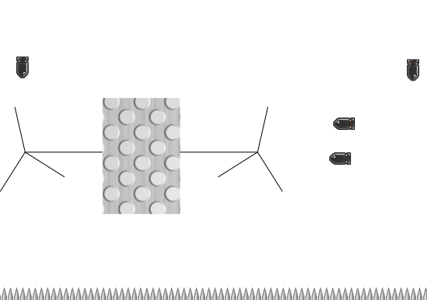
Design Evolution
Developed into a cage-based survival game.
Points based on how long a player has survived.

Slide 4
Additional Features
Contains:
High score page
Pause menu
Options menu
Rules section

Slide 5
Interesting Problems
How to keep the options menu and scores from resetting every time a user started a new game.
How to pause the game

Slide 6
Questions?

Slide 7
Overall Approach
Create a vehicle and a slew of bullets and keep track of their position (since this is canvas we are dealing with).
During each animation frame, test to see if the bullets or spikes have collided with the vehicle.
Every time a bullet reaches the spikes, it disappears (and another bullet spawns), and the player gains a point.
Notes:
Supplement slide

