Slide 1
Plagiarism Detection Visualization
Nate Phillips
Josh Crowson

Slide 2
Purpose
The purpose of this project was to design a system that could detect plagiarism and display the results in an intuitive human-friendly fashion.

Slide 3
Two Parts
A system to programmatically detect any instances of plagiarism and export the plagiarized words to an output file.
A system to take the words from the output file, as well as the two text files, and visualize the plagiarism level of the document.

Slide 4
Plagiarism Detection Software
The plagiarism detection program takes in two input text files and individually breaks the the texts into word groups of size 3-7.
When it breaks up the text, it strips out all punctuation.

Slide 5
Plagiarism Detection Software
The program then compares the word groupings from one text to the word groupings of the other text and stores them in another list.
Then the program reduces the list to remove redundant word groupings.

Slide 6
Plagiarism Detection Software
Primary text: 8 pages
Secondary text: 5 pages
Word groupings of in the primary text: 11040
Word groupings in the secondary text: 5345
80 word groupings in common between the two sets
The 80 word groupings is reduced to 12 unique word groupings

Slide 7
Plagiarism Detection Software
80 word groupings: [[the, c, programming], [c, programming, language], [one, of, the], [one, of, the], [the, c, programming], [c, programming, language], [the, b, language], [ritchie, modified, b], [ritchie, modified, b], [modified, b, which], [b, which, eventually], [which, eventually, became], [the, c, programming], [c, programming, language], [as, well, as], [ken, thompson, developed], [thompson, developed, the], [developed, the, c], [the, c, programming], [c, programming, language], [with, dennis, ritchie], [with, dennis, ritchie], [when, it, was], [dennis, ritchie, dennis], [ritchie, dennis, ritchie], [developed, the, c], [the, c, programming], [c, programming, language], [the, c, programming], [c, programming, language], [the, c, programming], [c, programming, language], [with, dennis, ritchie], [with, dennis, ritchie], [the, c, language], [the, c, language], [the, b, language], [of, the, c], [the, c, programming], [c, programming, language], [as, well, as], [part, of, the], [of, the, software], [the, computer, science], [the, computer, science], [is, based, on], [the, c, programming, language], [the, c, programming, language], [ritchie, modified, b, which], [ritchie, modified, b, which], [modified, b, which, eventually], [b, which, eventually, became], [the, c, programming, language], [thompson, ken, thompson, developed], [ken, thompson, developed, the], [thompson, developed, the, c], [developed, the, c, programming], [the, c, programming, language], [dennis, ritchie, dennis, ritchie], [developed, the, c, programming], [the, c, programming, language], [the, c, programming, language], [the, c, programming, language], [the, c, programming, language], [the, c, programming, language, developed], [ritchie, modified, b, which, eventually], [ritchie, modified, b, which, eventually], [modified, b, which, eventually, became], [thompson, ken, thompson, developed, the], [ken, thompson, developed, the, c], [thompson, developed, the, c, programming], [developed, the, c, programming, language], [developed, the, c, programming, language], [ritchie, modified, b, which, eventually, became], [ritchie, modified, b, which, eventually, became], [thompson, ken, thompson, developed, the, c], [ken, thompson, developed, the, c, programming], [thompson, developed, the, c, programming, language], [thompson, ken, thompson, developed, the, c, programming], [ken, thompson, developed, the, c, programming, language]]

Slide 8
Plagiarism Detection Software
Reduced to 12 word groupings:
[[one, of, the], [the, b, language], [as, well, as], [with, dennis, ritchie], [when, it, was], [of, the, c], [part, of, the], [of, the, software], [the, computer, science], [is, based, on], [ritchie, modified, b, which, eventually, became], [ken, thompson, developed, the, c, programming, language]]

Slide 9
Plagiarism Detection Software
Example of the reduction:
[ritchie, modified, b]
[modified, b, which]
[b, which, eventually]
[which, eventually, became]
[ritchie, modified, b, which]
[modified, b, which, eventually]
[b, which, eventually, became]
[ritchie, modified, b, which, eventually, became]
Becomes:
[ritchie, modified, b, which, eventually, became]

Slide 10
Improvements
A dictionary of synonyms
Take into consideration the lengths of the words
Handle punctuation better

Slide 11
Plagiarism Visualization
Plagiarism detection is an important field with definite practical significance. However, while some work has been done, by and large we have made no major advances in displaying plagiarism in the past five or six years.

Slide 12
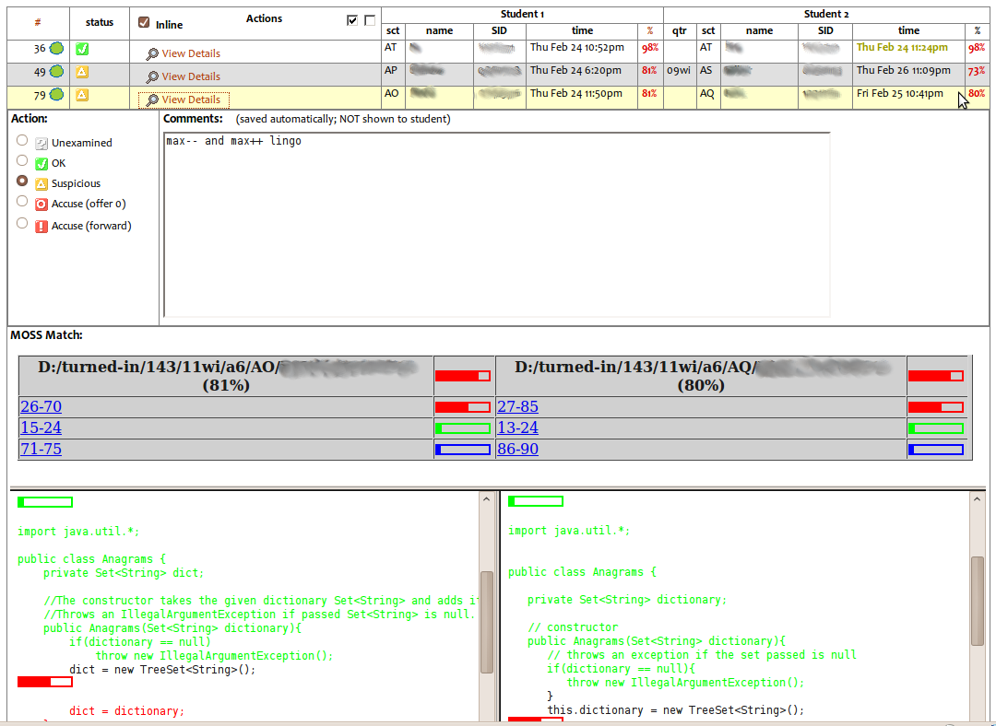
Moss Example

Slide 13
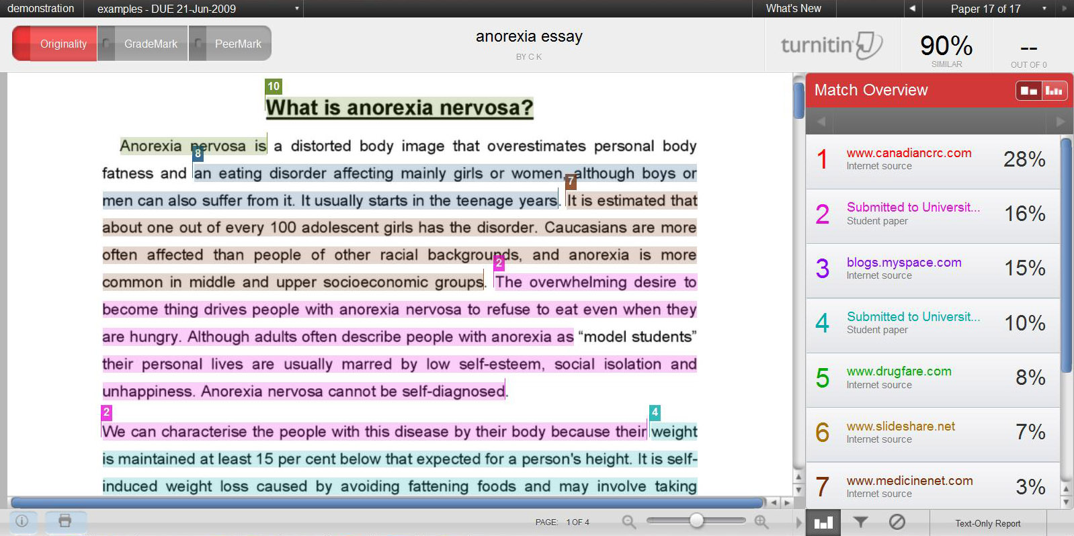
Turnitin.com Example
Notes:
https://www.google.com/url?sa=i&rct=j&q=&esrc=s&source=images&cd=&cad=rja&uact=8&docid=mxaBJqub061jBM&tbnid=U2TnTBtvZdjLnM:&ved=0CAUQjRw&url=https%3A%2F%2Fwww.wlv.ac.uk%2Fdefault.aspx%3Fpage%3D32434&ei=ChdpU9WLNaPuyAGZo4C4Dw&bvm=bv.65788261,d.aWc&psig=AFQjCNEqa_3NBYzyCT-uVRSkAI3XkWpVqw&ust=1399482500059273

Slide 14
Our visualization
For our visualization, we did something similar, though less in-depth, than the examples listed previously. We went through and highlighted any plagiarized words in both documents.
Notes:
Like Moss, we used different levels of plagiarism to compare one text file to a single primary source.

Slide 15
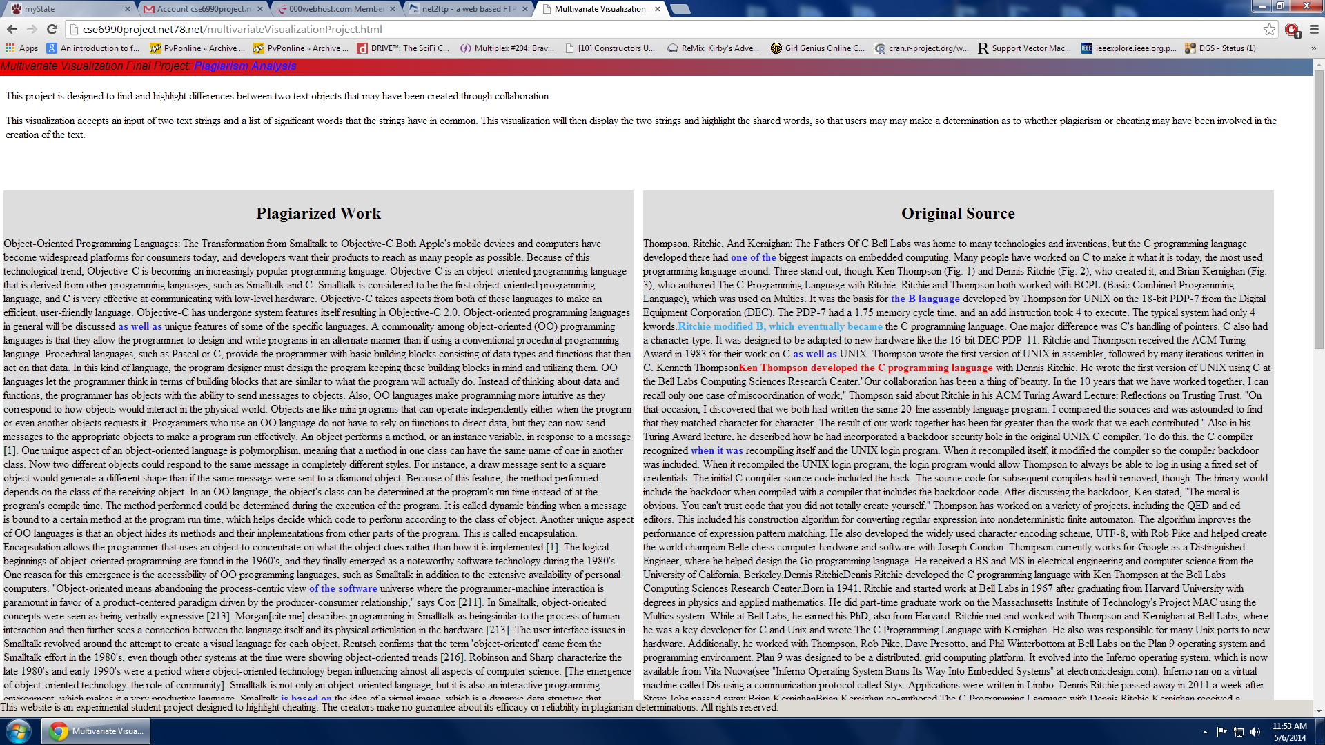

Slide 16
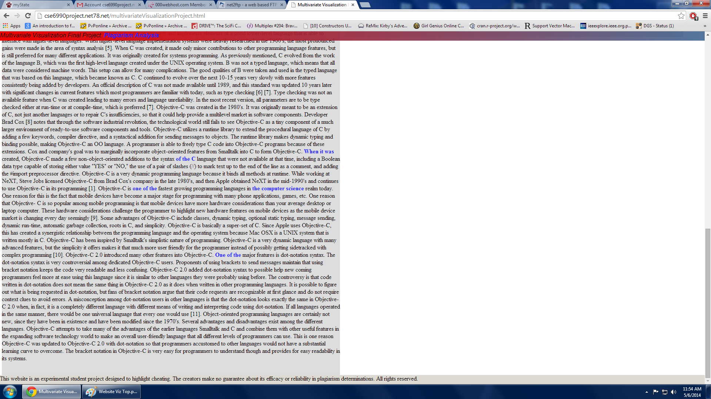

Slide 17
Possible Improvements
We considered a couple of alternate approaches/additional features as well.
Arc Graphs
Highlighting
Some sort of analytical analysis
Notes:
We eventually decided that arc graphs, for the purposes of text visualization, would result in a highly cluttered display, from which it would be difficult to extract information. Highlighting – Basically, we considered allowing the user to hover over plagiarized text and have all other text fade, except for the corresponding plagiarized text in the other document. However, given the size of the documents (and, thus, the knowledge that the text youre looking for might not be on screen) and the possibility of accidentally hovering over plagiarized text, we scrapped this plan. We also considered doing analytical analysis; in other words, something along the lines of estimating how much of the document is plagiarized or how many characters worth of plagiarism exists and whether that is significant, relative to the size of the paper. Of all the possible additions, this is the most appealing, and we would have likely implemented it, given enough time and expertise.

Slide 18
Questions?

Slide 19
Sources
Turnitin.com example: https://www.google.com/url?sa=i&rct=j&q=&esrc=s&source=images&cd=&cad=rja&uact=8&docid=mxaBJqub061jBM&tbnid=U2TnTBtvZdjLnM:&ved=0CAUQjRw&url=https%3A%2F%2Fwww.wlv.ac.uk%2Fdefault.aspx%3Fpage%3D32434&ei=ChdpU9WLNaPuyAGZo4C4Dw&bvm=bv.65788261,d.aWc&psig=AFQjCNEqa_3NBYzyCT-uVRSkAI3XkWpVqw&ust=1399482500059273

