Slide 1
Autonomous Emergency Response Robot
IEEE SoutheastCon Hardware Competition
Nate Phillips
Lindsey Hodges
Wani Hakim
ECE 410
January 29, 2011

Slide 2

SoutheastCon Hardware Competition
Theme:
Natural disasters can devastate whole countries.
Fast emergency response is critical for preventing further crisis and saving lives.
Notes:
Such as the recent mudslides in Brazil.

Slide 3
Design Specifications
Purpose:
Build an autonomous emergency response robot that can safely evaluate the situation and relay vital information to emergency response teams.
Goals:
Navigate through specified floor plan
Identify and avoid obstacles
Sense hazards
Find and determine status of victims
Report vital information to emergency responders
Restrictions:
Size: 20 x 20 x 20 cm
Time Limit: 4 minutes
Robot can not jump, fly, hover, or climb over walls.
Wireless communication is not allowed.

Slide 4
Scoring
Category | Points | Total Possible
Audio Output | 150 | 150
Digital Display | 50 | 50
Victim Position* | 60 | 720
Victim Status | 40 | 480
Hazard Location | 200 | 200
Total |  | 1,600
Notes:
15 points
will be deducted per grid square away from the correct position, with a minimum position
score of 0, using Manhattan Distance = |X2-X1| + |Y2-Y1|. Any “extra” reported victims receive a penalty of -30 points.

Slide 5
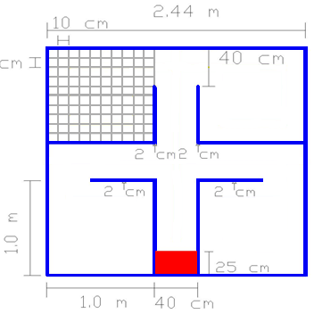
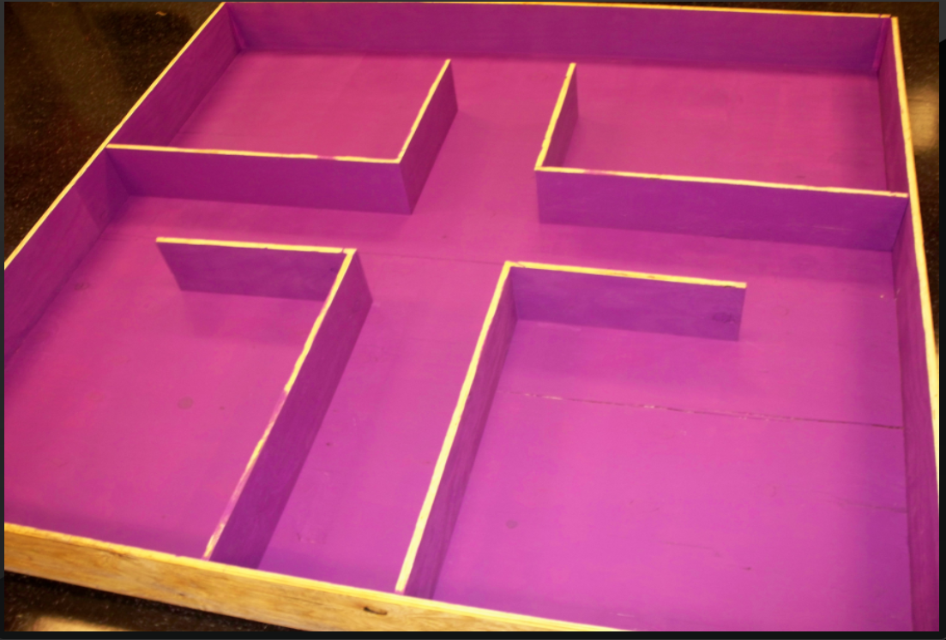
Course Layout
RED: designated starting area
10 x 10 grid for victims and hazards
obstacles can be placed at any angle in hallways and rooms
2
3
1
4
START

Slide 6

Navigation Platform
Platform has the same orientation even when body rotates.
B = North
A = West
C = East
D = South
Distance measurements used in calibration:
DB = constant 2 cm
DA + DB + DC = hallway width or distance between room walls

Slide 7
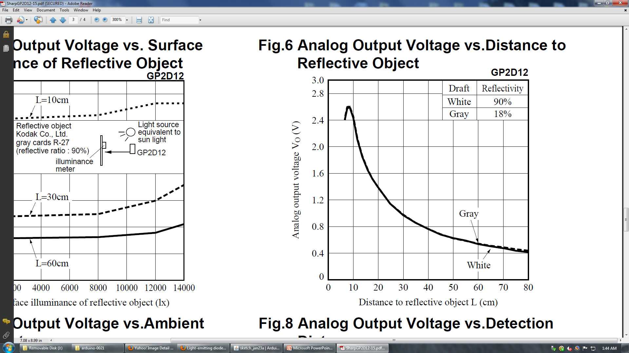
Calibrating Sensors
The IR sensors sit further inward to prevent the spike in error between 0 cm and 8 cm.
Voltage rating of 5V divided by 1024 points to give a value per step
5V/1024 = 0.0048828125
Exponential
Slope: 1/Volts * 28
Distance = (Volts x)*28
Arduino code:
float volts = analogRead(IRpin)*0.0048828125;
float distance = 28*pow(volts, -1.0);

Slide 8
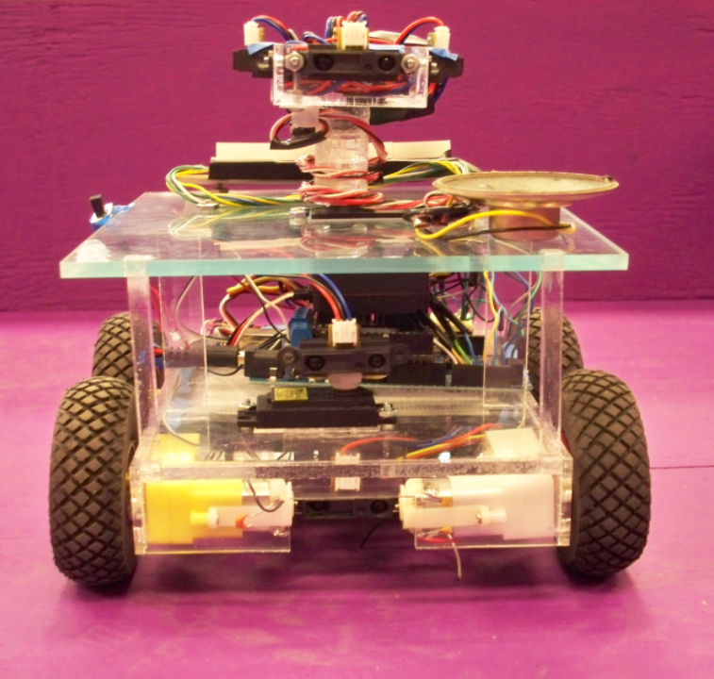
Obstacle Detection
Navigation Platform
360° Servo Motor
Obstacle Detector
180° Servo Motor
Victim Detector

Slide 9
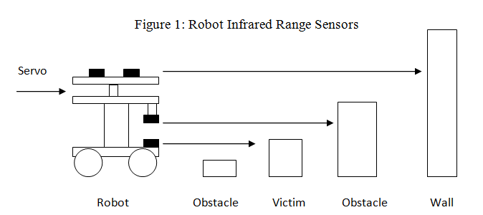
Obstacle Avoidance
Objects to Avoid:
Walls
3 cm x 2 cm victims
4 cm x 9 cm obstacles
2 cm x 4 cm obstacles

Slide 10
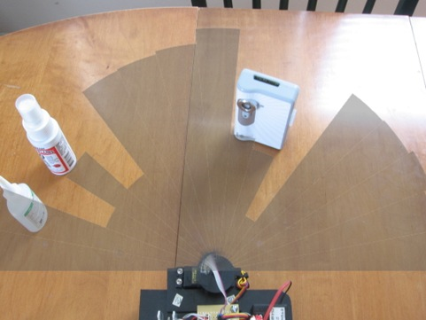
Obstacle Avoidance
The robot must know where the obstacles and the walls are to navigate through the course.
The servo motor pans from 30° to 150° so the infrared sensor can take measurements.
Values returned are distance measurements
( ex. [121, 83, 2, 2, 2, 2, 54, 85, 141] )
where the value indicates how close the object is to the robot.
Program analyzes the values returned and the angle of the servo motor to decide whether the robot can fit around the obstacle or if it needs to try a different route.
The image shows how the infrared sensor input to the microcontroller when mounted on a servo motor matches the actual placement of the obstacles.

Slide 11
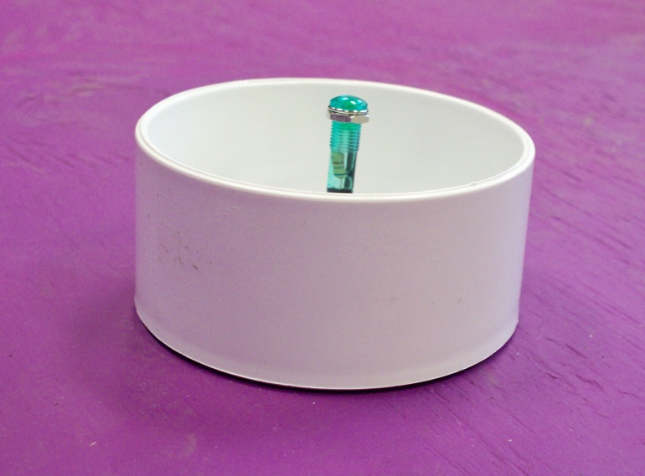
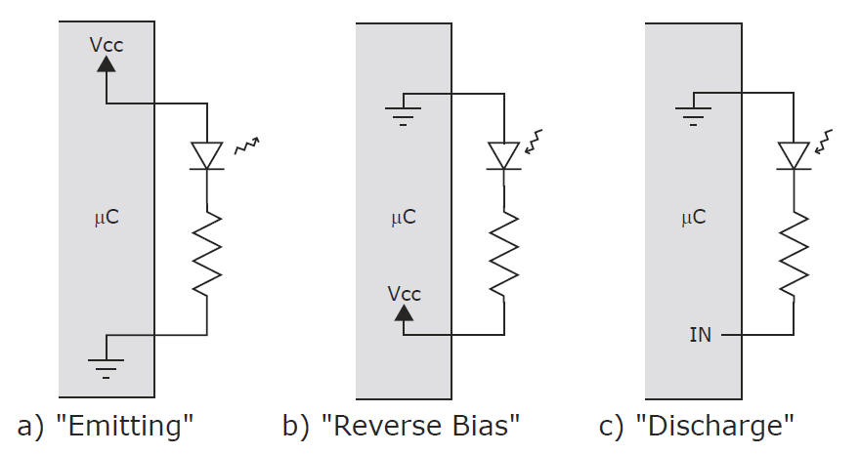
Detecting Victims
Victims: Green LED in PVC cap
ON = Conscious
OFF = Dead
No battery connections
Blinking = Unconscious
2 Hz with 50% duty cycle
Blinks twice every second
Detection: Green LED used to detect the victim green LED
a) Connect to two bidirectional I/O pins and drive LED with current in forward direction
b) Drive LED in the reverse-bias direction
c) Current discharges and is measured
Time to discharge is inversely proportional to amount of incident light measured

Slide 12
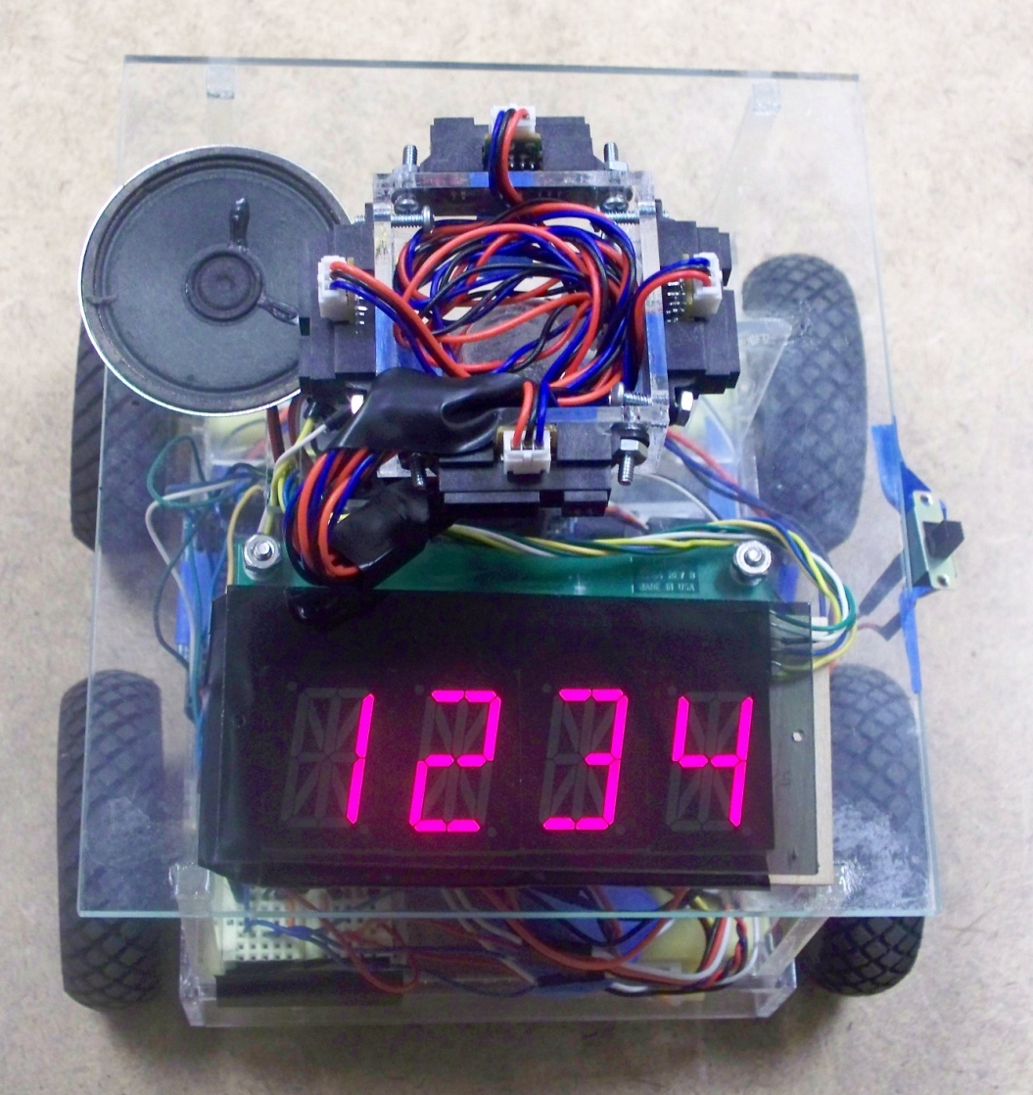
Robot Output
Audio Controller
Voice synthesizer
Developed by RC Systems
Model: V8600A
4 digit LED display
1” Alphanumeric numbers
Controlled by stackable serial drivers
Bright segments
Covered with antiglare material to increase readability
Speaker
8 ohm
Display

Slide 13
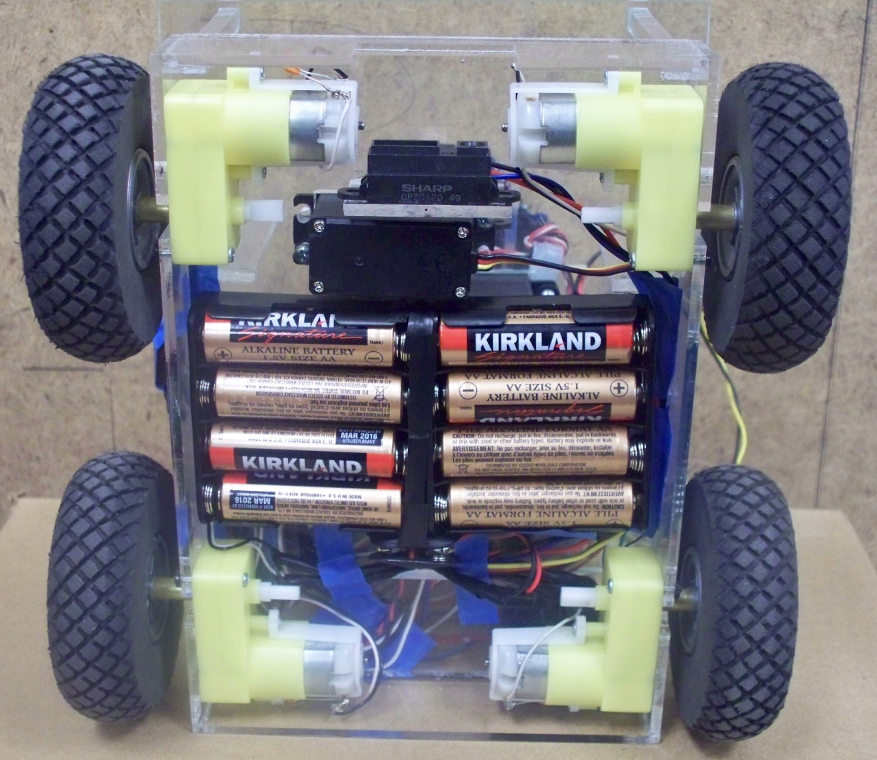
Robot Body
Wheels
8 cm. diameter diamond-tread wheels
Battery Pack
8 AA batteries
Nominal voltage = 12V
Micro DC Geared Motors
Gear ratio: 1:120
No-load speed (6V): 180RPM
Stall current(6V):470mA
Torque (6V): 1.92Kgcm

Slide 14
Overall Program Design
move forward
move forward
avoid obstacle
avoid obstacle
YES
YES
detect obstacle
detect obstacle
NO
NO
YES
detect hazard
report info
center of course
NO
move forward
move forward
avoid obstacle
avoid obstacle
YES
YES
detect obstacle
detect obstacle
NO
YES
NO
detect victim
report info
enter room
NO
program complete

Slide 15
Cost
Part | Cost
Wiring | $10.00
SHARP Infrared Sensors (6) | $24.00
Electromagnetic Field Detector | $10.00
Green LEDs | $2.00
V8600A Audio Synthesizer | $100.00
LED Digital Display | $30.00
Batteries | $35.00
360 full rotation servo motor | $13.50
180 servo motor | $15.60
Robot Body and Motors | $49.20
Arduino Mega Microcontroller | $55.00
DFRobot 2A Motor Controller | $17.00
4 x 8 sheets of plywood | $120.00
1 gallon of purple matte paint | $30.00
TOTAL | $511.30
Cost to reproduce
Minus course materials
prototype cost = $361.30
Relatively low
Salvaged components
from previous projects

