Slide 1
PR283 Assignment 1
Sudoku Model

Slide 2
Documentation

Slide 3
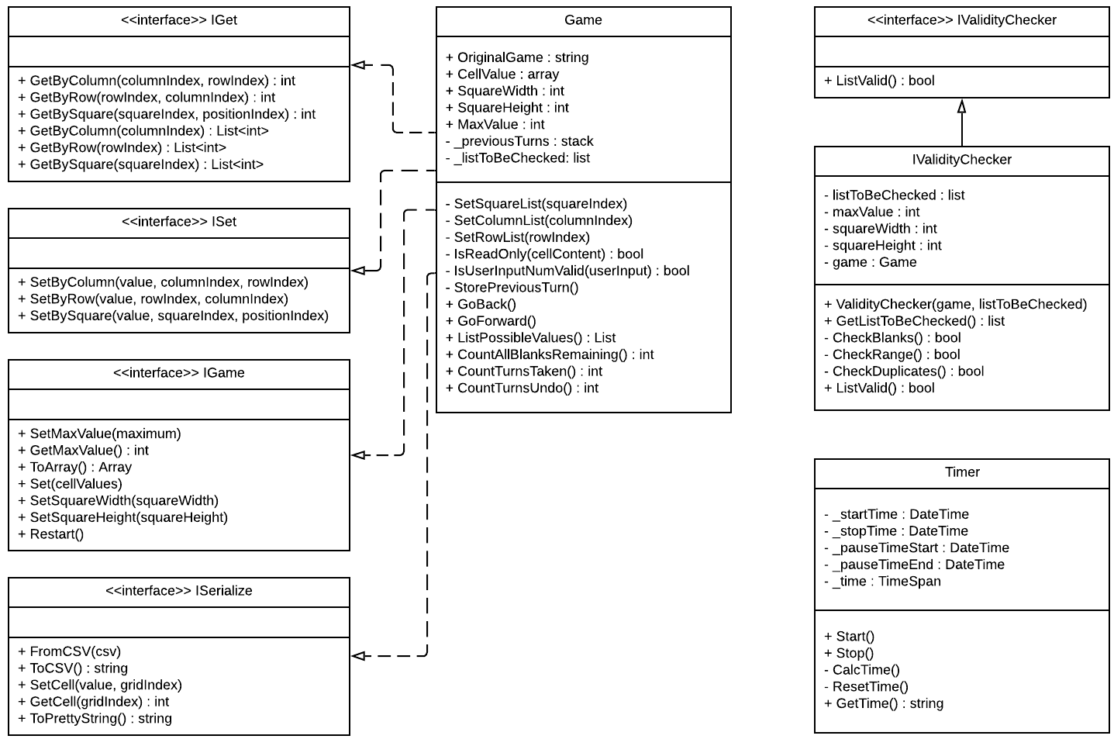
UML Class Diagram

Slide 4
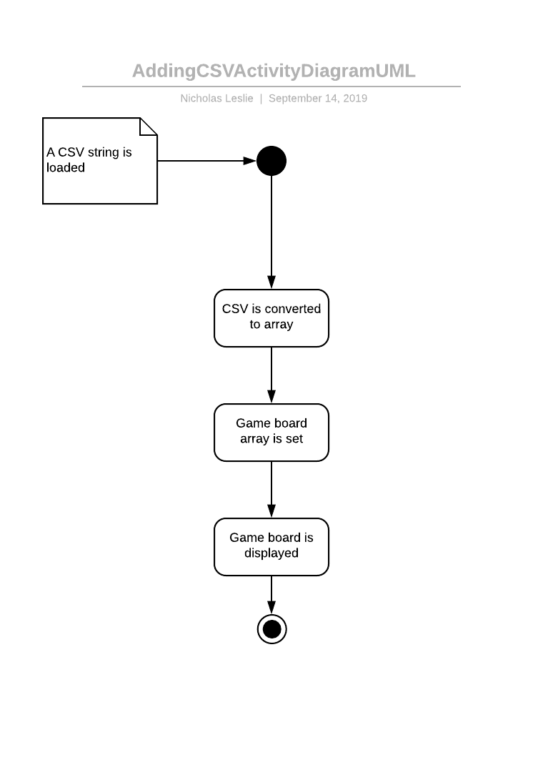
UML Activity Diagram #1

Slide 5
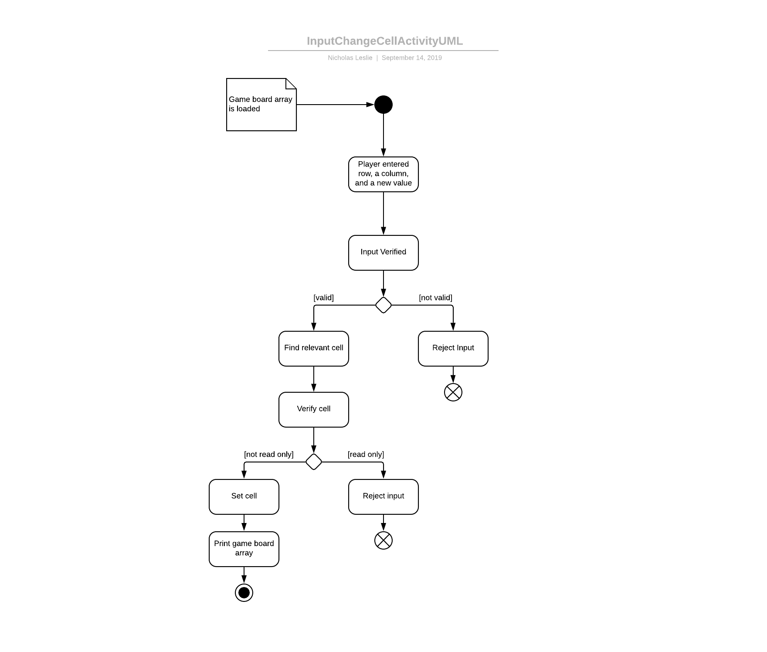
UML Activity Diagram #2

Slide 6
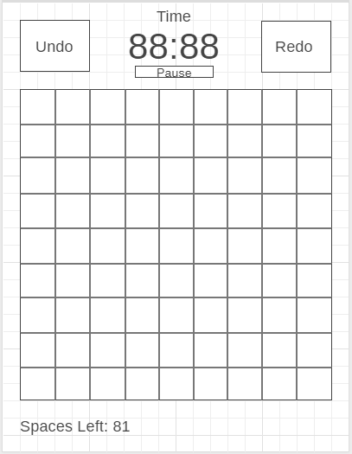
Wireframe of future UI

Slide 7
UML

Slide 8
Extra Features List

Slide 9
Extra Features List
Extra Features
1. Return a list of a selected column
2. Return a list of a selected row
3. Return a list of a selected square
4. Check if a row is valid
5. Check is a column is valid
6. Check is a square is valid
7. Return possible values in empty space in row
8. Return possible values in empty space in column
9. Return possible values in empty space in square
10. Reset Game
11. Cells containing data are Read-Only
12. Ensure users in is within a valid range
13. Check if row/column/square contains blank values
14. Check if row/column/square contains numbers within a valid range
15. Check if row/column/square contains duplicate numbers
16. Number of blank spaces remaining
17. Store each turn
18. Ability to go back a turn (undo)
19. Ability to go forward (redo)
20. Start timer
21. Stop timer
22. Pause timer
23. Return timed played
24. Count how many turns the player makes

Slide 10
MoSCoW

Slide 11
MoSCoW
Must Have (Part of the requirements)
Set the max value
Get max value
Return gameboard array
Set the gameboard array
Set the square width
Set the square height
Set a cell by column
Set a cell by a row
Set a cell by a square
Return a value at a cell by column
Return a value at a cell by row
Return a value at a cell by square
Convert a CSV string to array
Convert an array to a CSV string
Set a cell based on index
Get a cell based on index
Display a 1-D array as a pretty string
Must Have (Extra Features)
Return a list of a selected column
Return a list of a selected row
Return a list of a selected square
Check if a row is valid
Check is a column is valid
Check is a square is valid
Return possible values in empty space in row
Return possible values in empty space in column
Return possible values in empty space in square
Reset Game
Cells containing data are Read-Only
Ensure users in is within a valid range
Check if row/column/square contains blank values
Check if row/column/square contains numbers within a valid range
Check if row/column/square contains duplicate numbers

Slide 12
MoSCoW
Should Have (Extra Features)
Store each turn
Ability to go back a turn (undo)
Count how many turns the play has made
Wont Have (Extra Features)
Solve the puzzle
Create puzzles with any input
Check if a puzzle can be solved
Read from file
Save to file
Could Have (Extra Features)
Ability to go forward (redo)
Start timer
Stop timer
Pause timer
Return timer played
Count number of blank spaces remaining

Slide 13
The Code
This shows the code excluding the provided Interfaces

Slide 14
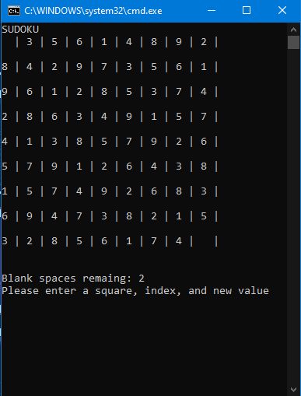
Compiled and running program

Slide 15
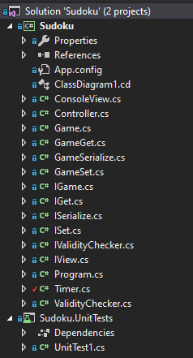
Folder Structure

Slide 16
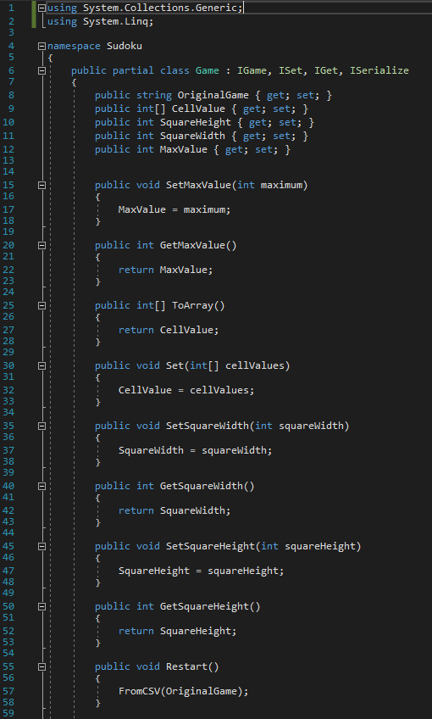
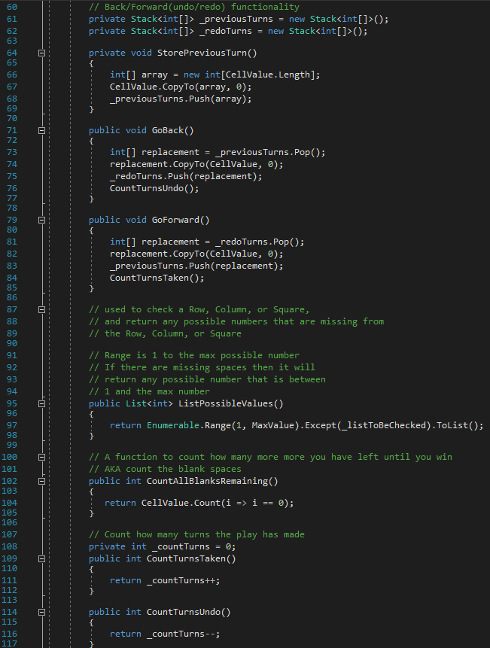
Game.cs

Slide 17
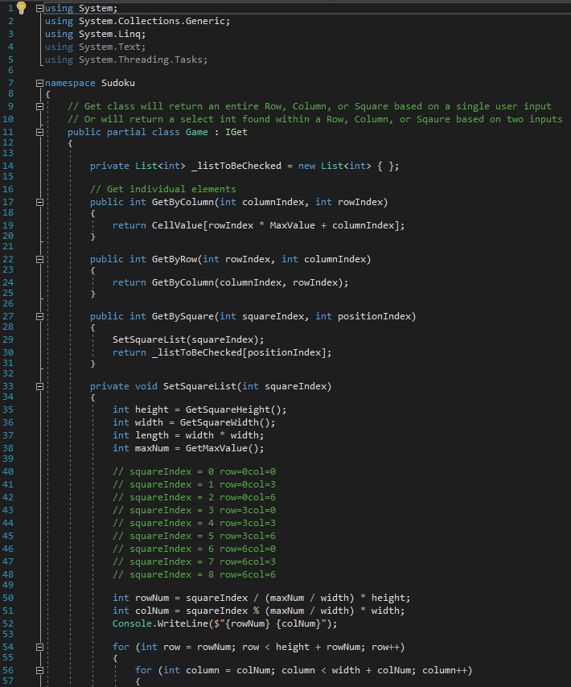
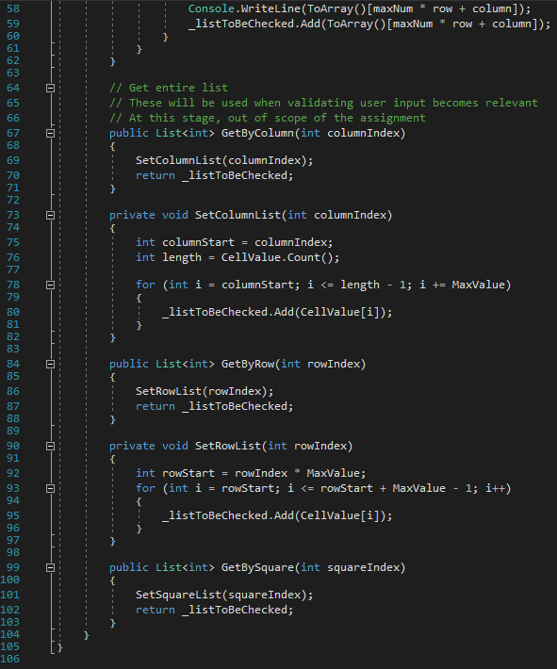
GameGet.cs

Slide 18
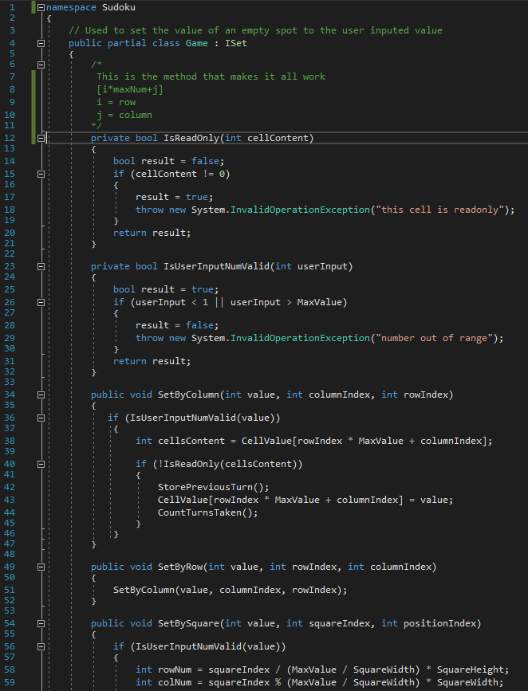
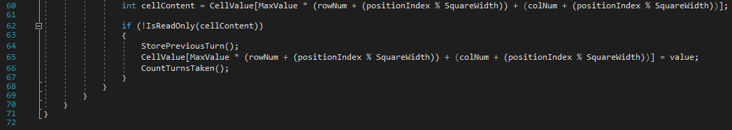
GameSet.cs

Slide 19
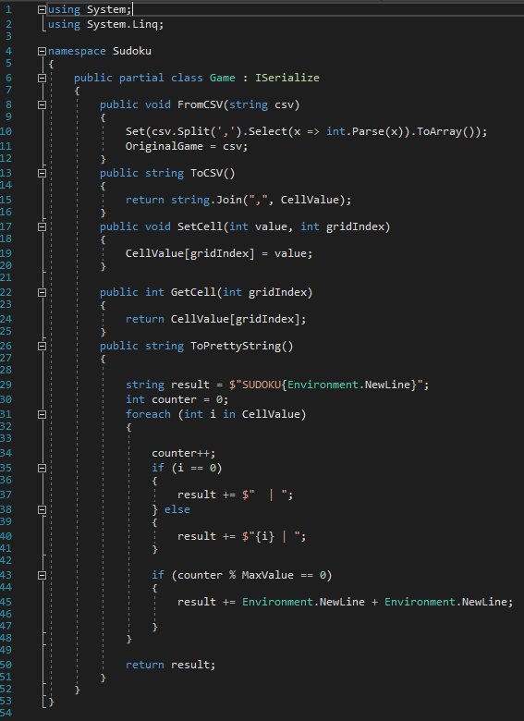
GameSerialize.cs

Slide 20
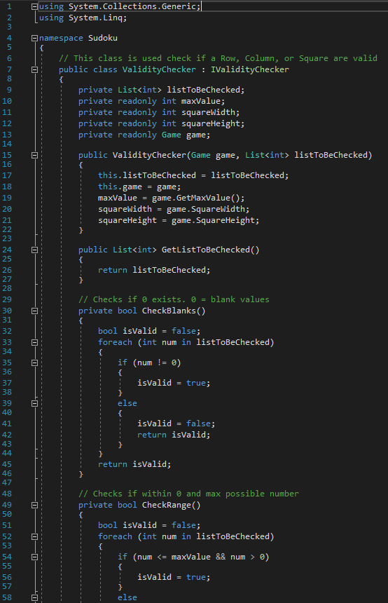
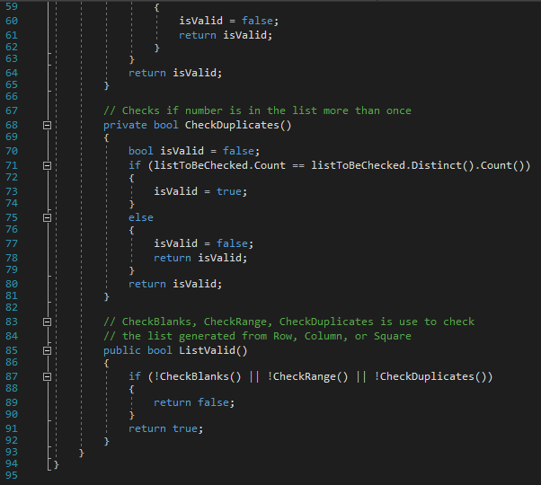
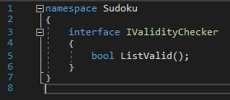
ValidityChecker.cs and IValidityChecker

Slide 21
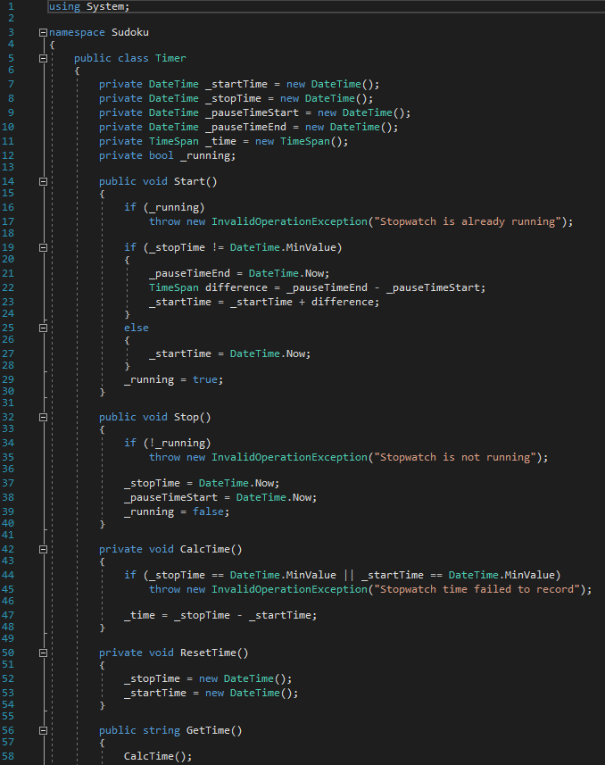

Timer.cs

Slide 22
Unit Tests
Unit tests cover all functions of the model along with Boundary testing on validation functions

Slide 23
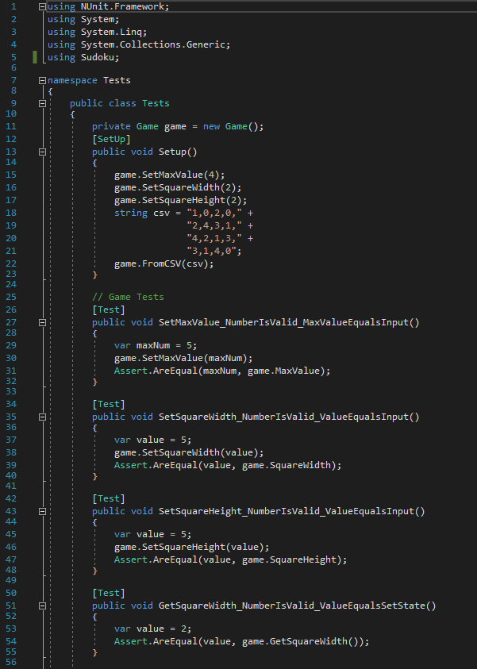
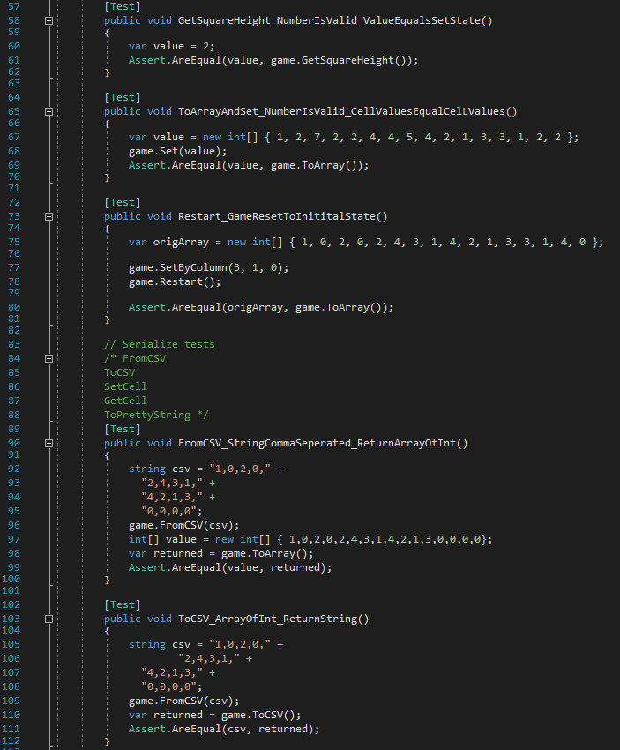
Unit Tests – Setup and 1 to 9

Slide 24
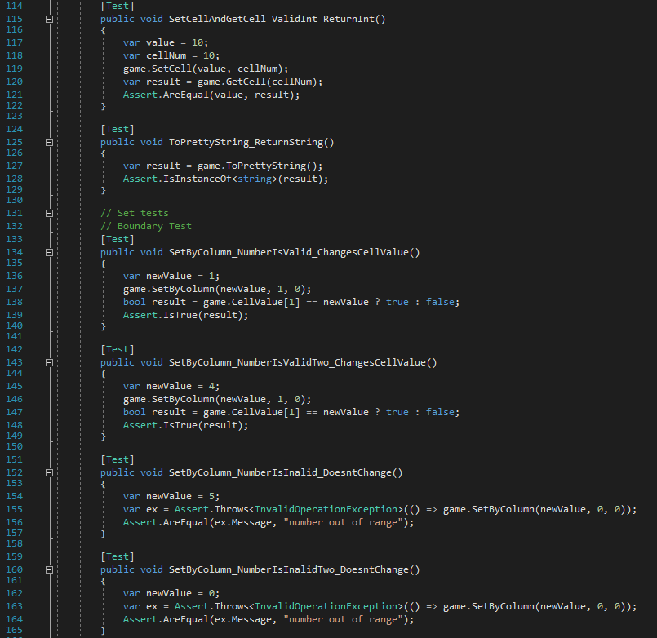
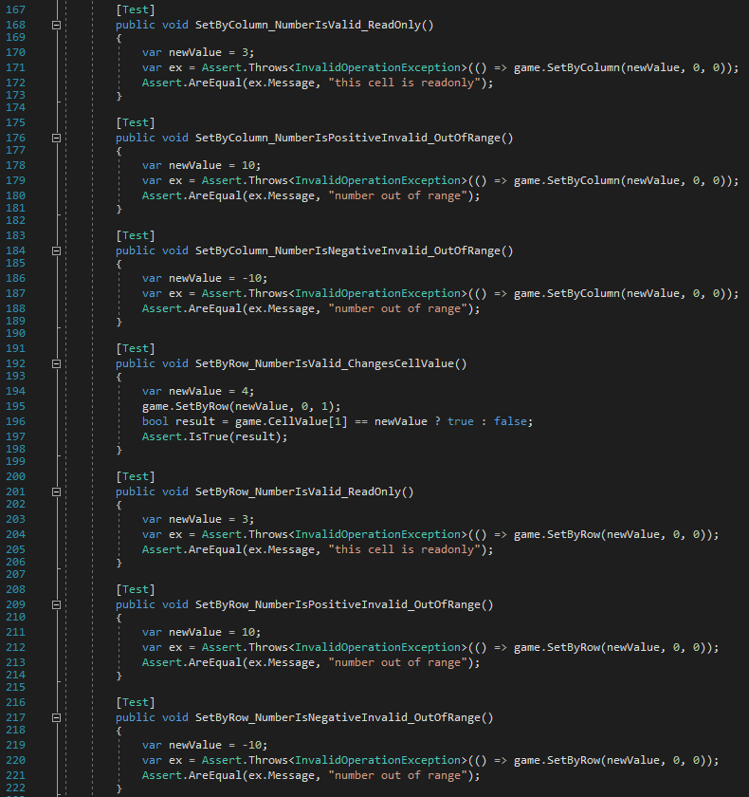
Unit Tests – 10 to 22

Slide 25
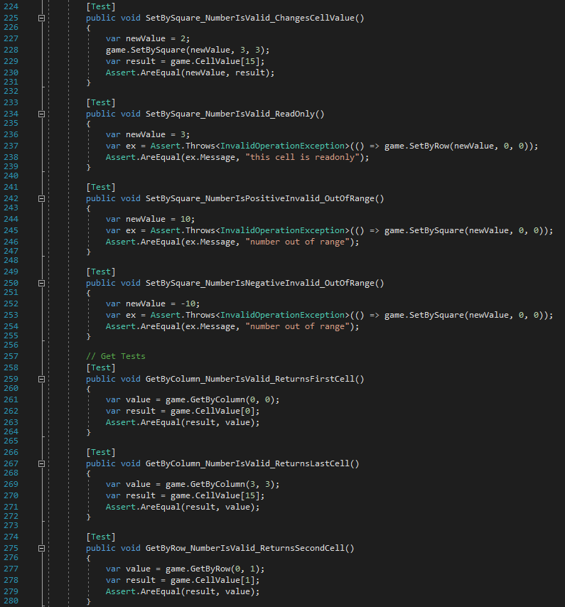
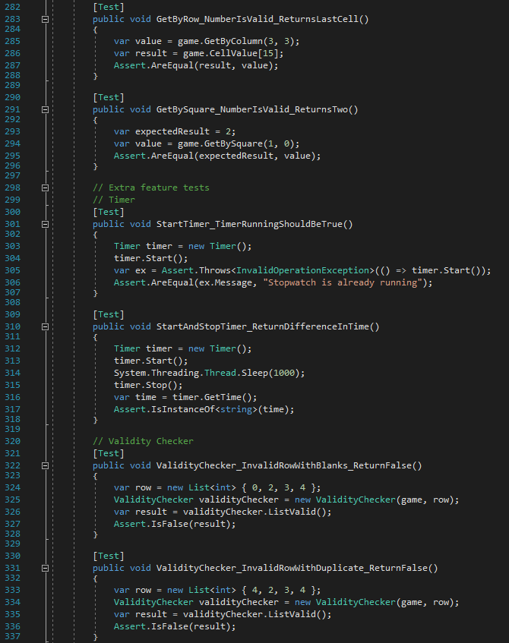
Unit Tests – 23 to 35

Slide 26
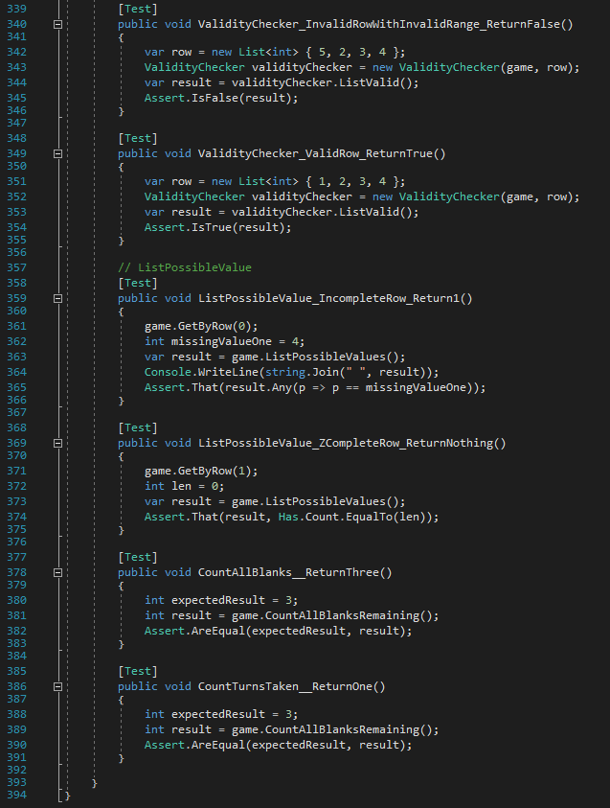
Unit Tests – 36 to 41

Slide 27
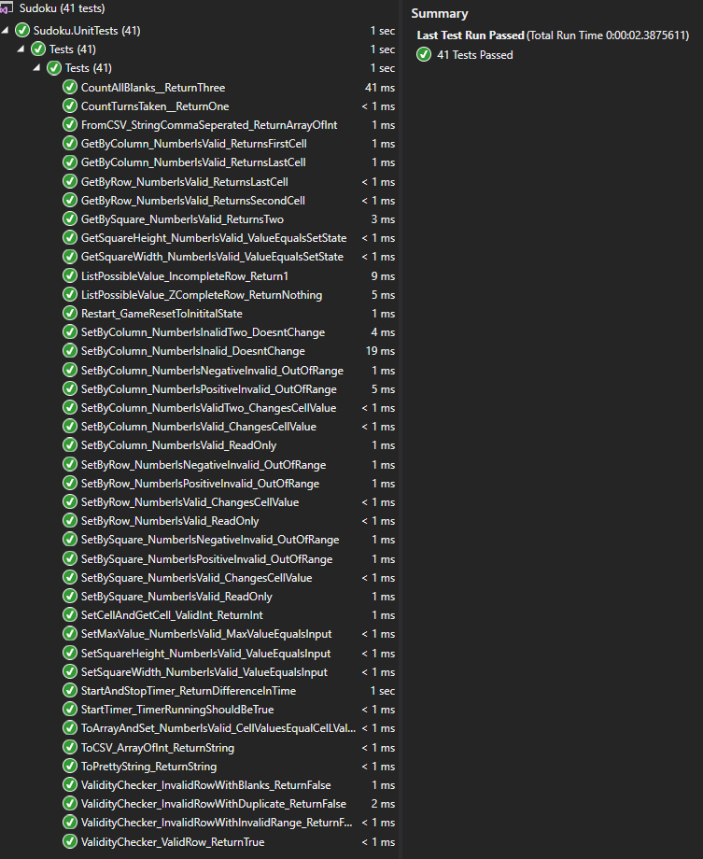
Unit Tests – Results

