Slide 1
Intro

Slide 2
AI explained in 3-minutes
Car Analogy | AI Term
Gasoline | Humanity’s data (Internet)
Engine | GPU’/s (NVIDIA) Neural nets
Steering System | Transfomer
Steering Wheel | APIs Prompts
Bicycle | Machine Learning
Car | Generative AI Model
Car Factory | Training
Driving | Inferencing
Distracted Driving | Overfitting

Slide 3
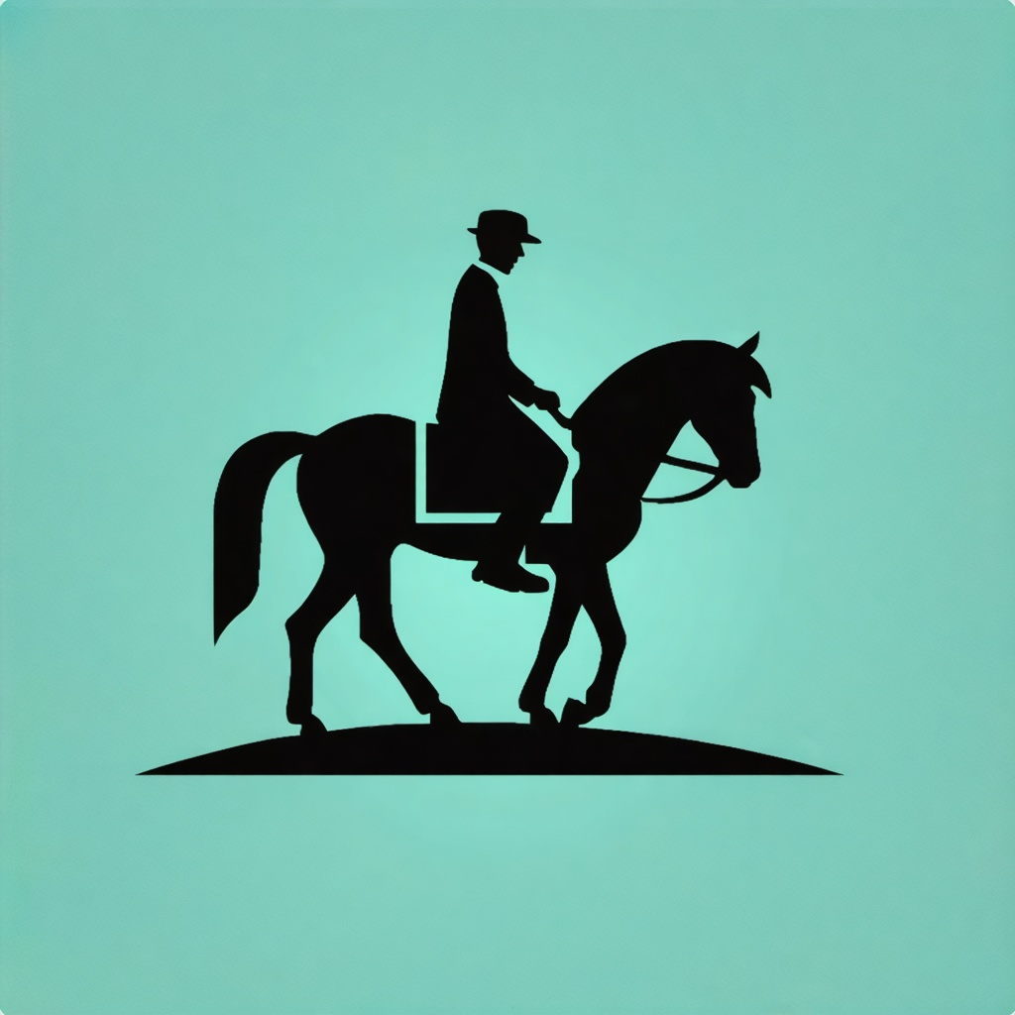

Before Cars:
Before AI:
People rode horses
People had computers
Takes forever to get places
Information overload

Slide 4
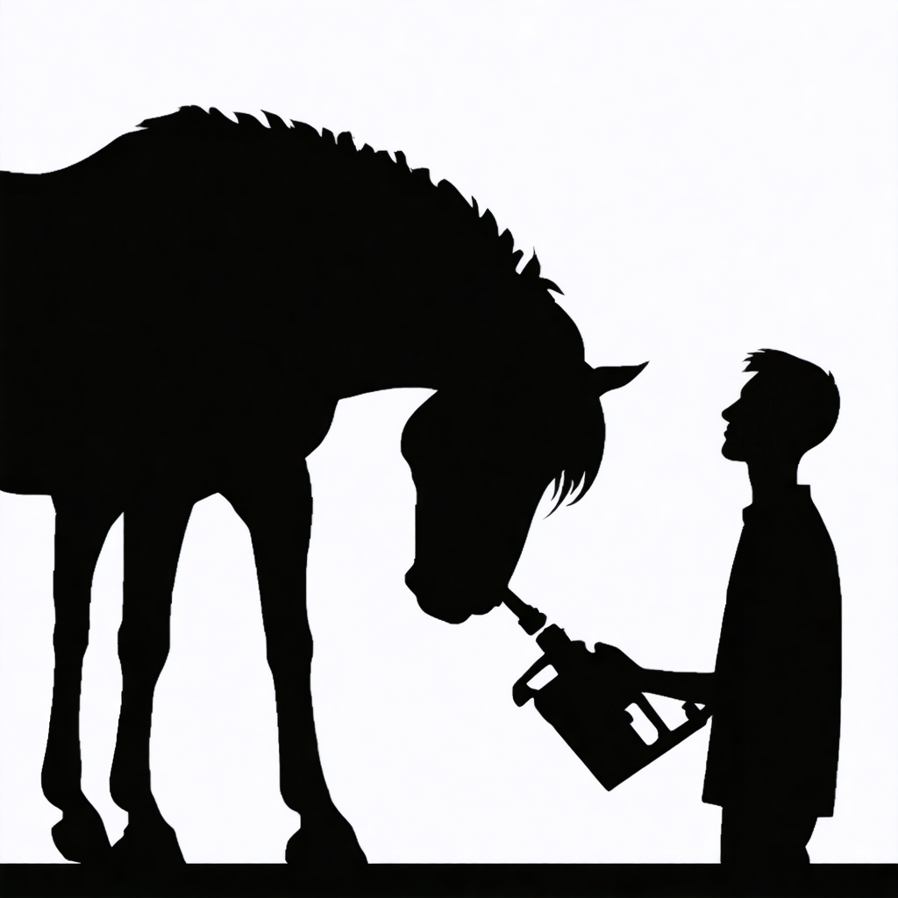

Before Cars:
Before AI:
Feeding it new power sources
Processing the entire internet’s data
Would kill it
Would freeze it

Slide 5
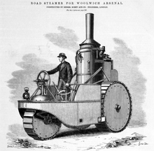
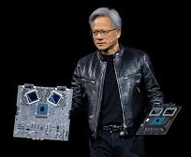

Early Cars
Early AI
Engines get invented
GPU’s/Neural Nets invented
Can only go forward
Cant pay attention (overfitting)
Gets stuck!
Distracted Driving = Bad

Slide 6
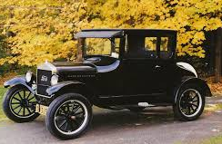

Mainstream
Cars
Mainstream AI
Transmissions and Steering let people control cars
Transformer let computers pay attention
Ford’s first car factory makes:
Training on the internet makes:
Model T
chatGPT

Slide 7

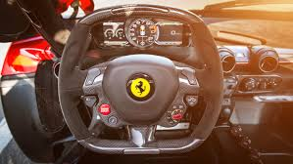
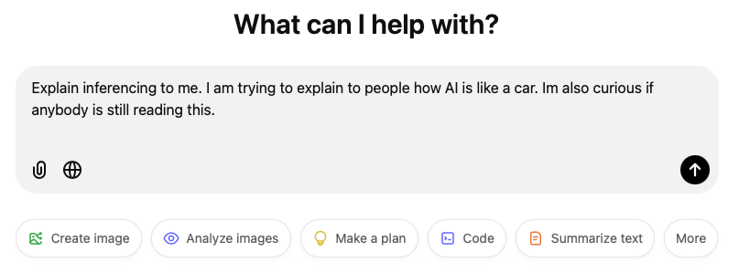
Driving a car
Using AI
Steering wheels and gas pedals let you drive a car
APIs and Prompts let you use an AI
When you use a car its called
When you use AI its called
Driving
Inferencing

Slide 8
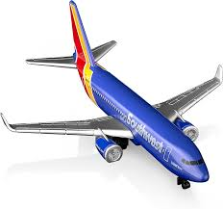
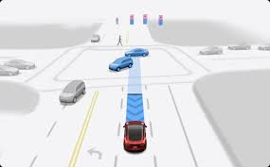
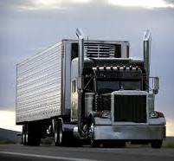
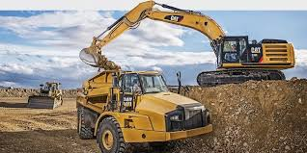
Beyond Cars:
Beyond chatGPT:
People used engines to make other valuable things
People will use transformers to make other valuable things
Cars led to
AI will lead to
The modern world
Autonomous Cars

Slide 9


Beyond Cars:
Beyond chatGPT:
People used engines to make other valuable things
People will use transformers to make other valuable things
Cars led to
AI will lead to
The modern world
Recommendation Engines

Slide 10
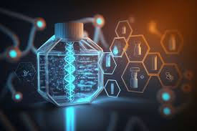
Beyond Cars:
Beyond chatGPT:
People used engines to make other valuable things
People will use transformers to make other valuable things
Cars led to
AI will lead to
The modern world
The future world

Slide 11
How YOU could use AI
AI = entire knowledge of humanity at your fingertips
Qualifications required:
You can read
You have grit
Build AI with AI

